Slide 1
Sustaining the Healthcare Workforce in the COVID Era
What Can We Learn from Combat and Operational Stress Control?
James C. West, M.D.
Center for the Study of Traumatic Stress
Department of Psychiatry
School of Medicine, Uniformed Services University
American Psychiatric Association Committee on the Psychiatric Dimensions of Disaster
Notes:
JOSH
I’m Joshua Morganstein and I’m an Associate Professor and Assistant Chair in the Department of Psychiatry and Assistant Director at our Center for the Study of Traumatic Stress in the School of Medicine at the Uniformed Services University. I’ll let my colleagues, Dr. Mary Vance and Dr. James “Curt” West introduce themselves.
MARY THEN CURT INTRODUCE…
Dr. Patcho Santiago wasn’t able to join us today, but wanted to acknowledge his important contributions to this activity. Of note, Dr. Santiago recently served for 6 years as the Psychiatry Residency Program Director for the National Capital Consortium in Bethesda, Maryland.
It’s good to be with you today to talk about the challenging issues of disasters and how to prepare residents to respond to these events. We understand many of you are still dealing with COVID-19 and its impact on your healthcare systems, training programs, and communities. And, of course, beyond the pandemic, we’ve all been dealing with the collision of multiple crisis events, including wildfires and hurricanes, as well as civil unrest and an unfolding economic crisis, events that really challenge our values and pull at the fault lines of our communities.
So, we are looking forward to talking with you and thinking together about how we can best prepare our residents to effectively plan for and respond to the needs of their patients and their communities when disasters occur. During the workshop, we’ll have some interactive activities. We are really looking forward to your participation in these, so, please have your mobile device available that can scan a QR code and/or an internet window open on your computer so you can share your thoughts.

Slide 2
Disclaimer
The ideas, attitudes, and opinions expressed herein are our own and do not necessarily reflect those of the Uniformed Services University, the Department of Defense, or other branches of the U.S. government. We are not endorsing any of the entities or resources mentioned in this presentation and have no relevant disclosures or conflicts of interest to report.
Notes:
JOSH
These are our thoughts and ideas and we have no disclosures or conflicts of interest.

Slide 3
Objectives
Review basics of disasters and psychological responses to them
Translate concepts of combat and operational stress control into hospital wellness programs
Develop a tiered approach to workforce support
Apply support across all phases of COVID response
Notes:
JOSH
During our time together, we’ll define disasters and briefly highlight some of the important concept regarding their impact on individuals and communities. We’ll also define disaster and preventive psychiatry and talk about how a knowledge of this field can help residents and the systems in which they work. Finally, we’ll examine how we can go about teaching disaster and preventive psychiatry and share some resources that are readily available to facilitate education and training, to help really lower the burden on programs.

Slide 4
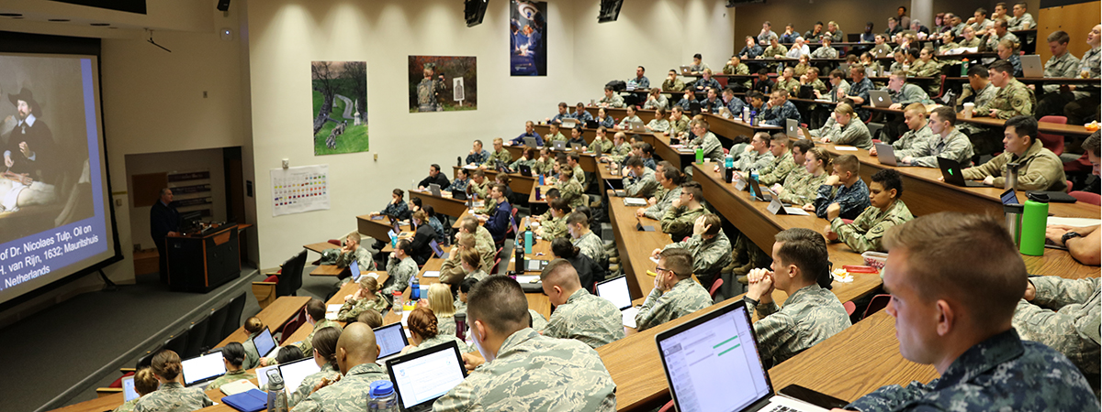
Uniformed Services University
Uniformed Services University
USUHS
Chartered by Congress in 1972 within the Dept of Defense
“Nation’s health professions academy”
Schools of Medicine, Nursing, Dentistry, Medical & Clinical Psychology, MPH, other graduate programs
School of Medicine
Dept of Psychiatry
CSTS
RESPECT
INTEGRITY
SAFETY
EXCELLENCE
Notes:
JOSH
For some context, the Uniformed Services University is the federal training facility for uniformed health professionals. Our Center studies trauma in the context of disasters, including natural and climate-related, as well as human generated disasters. Over the past 34 years, the Center has been involved in nearly every major disaster the United States has faced as well as many international disasters. An important part of our work involves education and training of healthcare personnel on the psychological and behavioral effects of disasters and interventions to enhance well-being and functioning for affected communities.

Slide 5
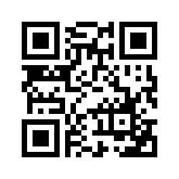
What one word would you use to describe your experiences of the COVID era? Multiple responses are welcome!
https://PollEv.com/jameswest797
Text APSCOVID and your response to 37607
Notes:
JOSH
To help get us thinking together, let’s consider that you and your residents have likely had a wide variety of experiences, and responses to those experiences, during this pandemic… So, what one word would you use to describe your residents' experiences in the COVID era? Feel free to put in more than one single-word answer.
We’re going to keep this slide up while you scan the QR code and we’ll put the URL in the chat window for those who’d prefer to copy and paste that into a web browser to access the poll. We’ll stay on this slide for another 5 seconds or so and then transition to the next slide so we can begin reviewing our responses…
https://www.polleverywhere.com/free_text_polls/kYzaN5g6h79fAfyKPiTlb

Slide 6
Notes:
Poll Title: COVID Reactions https://www.polleverywhere.com/free_text_polls/permO3h518aj27ZtlmQnf

Slide 7
Psychological & Behavioral Responses to Pandemics/Disaster
Sleep difficulties
Decreased Sense of Safety
Physical (Somatic) Symptoms
Irritability, Anger
Distraction, Isolation
Distress Reactions
Psychiatric Disorders
Depression
PTSD
Anxiety
Complex Grief
Resilience
Health
Risk
Behaviors
Alcohol, Tobacco, Rx meds
Family Distress
Interpersonal Conflict/Violence
Disrupted Work/Life Balance
Restricted Activities/Travel
Ursano, R., Fullerton, C., Weisaeth, L., & Raphael, B. (2017). Individual and Community Responses to Disasters. In R. Ursano, C. Fullerton, L. Weisaeth, & B. Raphael (Eds.), Textbook of Disaster Psychiatry (pp. 1-26). Cambridge: Cambridge University Press.
Notes:
CURT
The core of disaster and preventive psychiatry is understanding the reactions of individuals and communities to extreme events. In the aftermath major storms, wildfires, mass shootings, or infectious outbreaks, there are a collection of consistently observable reactions.
CLICK
Following disaster, disorders such as PTSD, Major Depressive Disorder, and anxiety disorders are of concern.
CLICK, CLICK
But with far greater prevalence, the public experiences distress reactions and engages in health risk behaviors. Insomnia, decreased sense of safety, substance use and family conflict are common reactions to extreme events. They create significant mental health burden and adversely impact community well-being and functioning.
Consider alcohol use. Transient increased use of alcohol as a health risk behavior after disaster is associated with work errors, accidents, presenteeism in the workplace, as well as family conflict and violence. Decreased perception of safety may be the driver of increased use of alcohol. This illustrates how the intervention for increased alcohol use in the context of disaster may be different.
Distress and risk behaviors are normal and expectable reactions to disasters, like COVID-19. Intervention involves normalizing, rather than pathologizing, these often-transient reactions. It also involves encouraging the use of healthy outlets for coping, educating people on where and when to get additional help if needed, and creating a culture that encourages help-seeking. These are critical elements of supporting public mental health during this prolonged crisis, with a goal of promoting recovery and avoiding over-medicalizing experiences.
CLICK
It’s also good to remember that the vast majority of people, including those who experience difficulties during this pandemic, will ultimately do well, even without specific intervention. Many will even develop new confidence in their ability to manage future stressors. Right now, these are particularly important messages for us to share with our families and friends, our coworkers, our patients, and even ourselves.

Slide 8
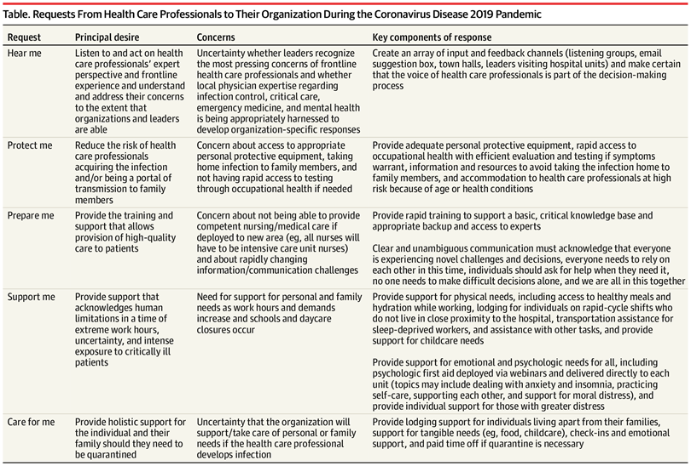
Concerns of Healthcare Workers
PPE
Exposure
Testing
Uncertainty about organizational support
Childcare
Family needs
Redeployment
Information
Shanafelt T, Ripp J, Trockel M. (2020) Understanding and Addressing Sources of Anxiety Among Health Care Professionals During the COVID-19 Pandemic. JAMA. 323(21):2133-2134.

Slide 9
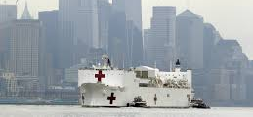
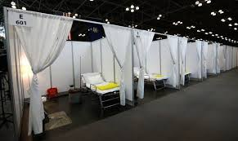
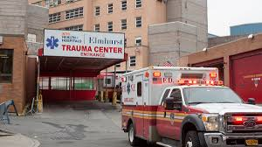
Two Worlds Come Together
Deployment of military medical teams to NYC
Interaction with local hospitals
Observation of embedded psychiatry
HERO-NY is born
Npr.org
Hbr.org
Nytimes.com
Notes:
JOSH
During our time together, we’ll define disasters and briefly highlight some of the important concept regarding their impact on individuals and communities. We’ll also define disaster and preventive psychiatry and talk about how a knowledge of this field can help residents and the systems in which they work. Finally, we’ll examine how we can go about teaching disaster and preventive psychiatry and share some resources that are readily available to facilitate education and training, to help really lower the burden on programs.

Slide 10
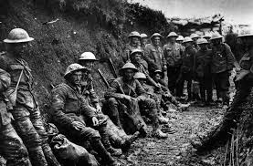
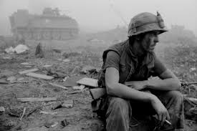
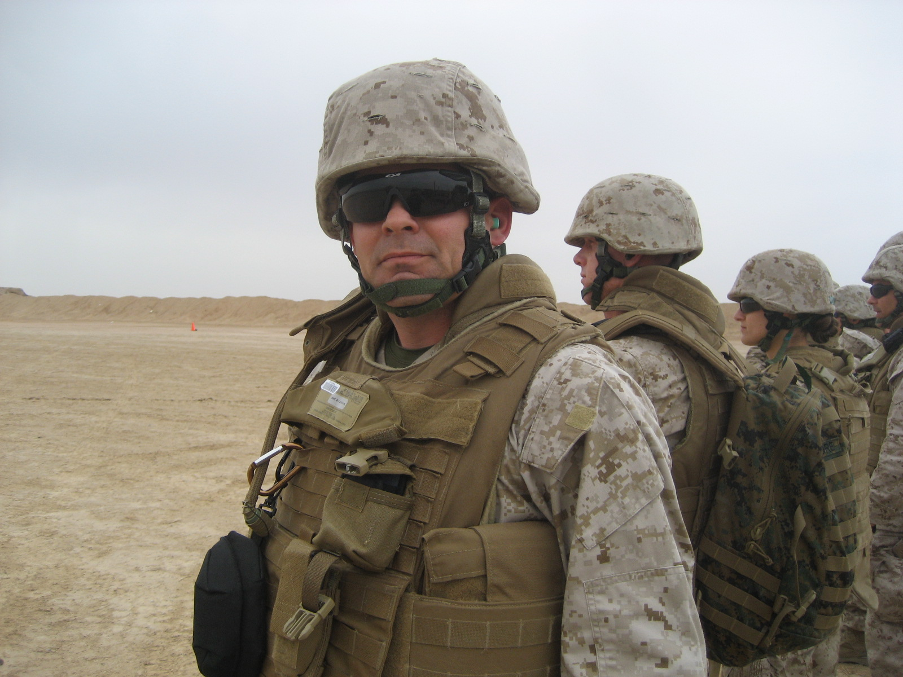
Military Combat and Operational Stress Control
WWI – PIES
Forward deployed psychiatrists
OIF/OEF
embedded psychiatrists
deployment-cycle preparation
Militaryhistorynow.com
Bloomberg.com
Me – Afghanistan, 2010
Notes:
JOSH
During our time together, we’ll define disasters and briefly highlight some of the important concept regarding their impact on individuals and communities. We’ll also define disaster and preventive psychiatry and talk about how a knowledge of this field can help residents and the systems in which they work. Finally, we’ll examine how we can go about teaching disaster and preventive psychiatry and share some resources that are readily available to facilitate education and training, to help really lower the burden on programs.

Slide 11
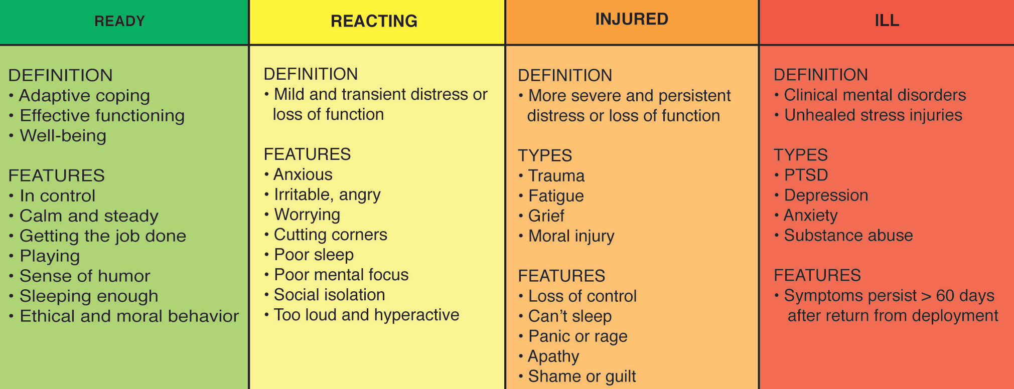
Stress Continuum
Adapted from: Nash WP. US Marine Corps and Navy combat and operational stress continuum model: a tool for leaders. In: Ritchie EC, ed. Combat and Operational Behavioral Health. Fort Detrick, MD: Borden Institute; 2011
Notes:
CURT
Psychiatry training focuses on the diagnosis and treatment of mental illness. In Disaster and Preventive Psychiatry, we emphasize a public mental health model that recognizes much of what people experience occurs along a continuum of expectable responses and is not always pathologic. Rather, individuals and the communities in which they live and work heavily influence well-being.
The goal of Disaster and Preventive Psychiatry is not to diagnose and treat illness, it is to help individuals and communities identify reactions, determine where along the continuum they are, and promote actions that move them back toward a state of wellness and ability to adapt to the crisis.

Slide 12
Stress Continuum – Healthcare Workers
READY (Green) | REACTING (Yellow) | HURTING (Orange) | ILL (Red)
Minimal stress Adaptive coping Optimal function Personal well-being | Moderate stress Mild or temporary distress Mild or temporary impairment Resolves with self-care, minimal or no intervention | Significant stress Moderate/ persistent distress Moderate Impairment, in multiple areas Requires leader & Support intervention | Severe/prolonged stress Severe distress Serious Impairment Mental health diagnosis Requires clinical intervention
 |  | Screening & Referral to Treatment
Notes:
CURT
Psychiatry training focuses on the diagnosis and treatment of mental illness. In Disaster and Preventive Psychiatry, we emphasize a public mental health model that recognizes much of what people experience occurs along a continuum of expectable responses and is not always pathologic. Rather, individuals and the communities in which they live and work heavily influence well-being.
The goal of Disaster and Preventive Psychiatry is not to diagnose and treat illness, it is to help individuals and communities identify reactions, determine where along the continuum they are, and promote actions that move them back toward a state of wellness and ability to adapt to the crisis.

Slide 13
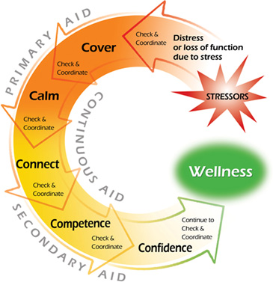
Intervention Models - COSC
Proximity
Immediacy
Expectancy
Simplicity
US Navy, NCCOSC, 2013

Slide 14
Psychological First Aid (PFA)
SAFETY
Training
Equipment
Information
Protect Family
”Buddy Up”
CALMING
Ensure Sleep & Meals
Use Media Wisely
Provide Information
Normalize Reactions
Breaks, Rest Cycles
Listen to People
EFFICACY
Community-derived Activities
Recognize Service
Helping Resources
Buddy Checks
CONNECTEDNESS
Team Huddles
Buddy Checks
Camaraderie Activities
Technology
Reintegrate after “Deployment”
HOPE
Restore Normal Activities
Encourage Problem-Solving
Focus on Strengths
Seek Opportunities to Grow
Make Meaning of Event
Look to the Future
Hobfoll, S. E., Watson, P., Bell, C. C., Bryant, R. A., Brymer, M. J., Friedman, M. J., et al. (2007). Five essential elements of immediate and mid-term mass trauma intervention: empirical evidence. Psychiatry, 70(4), 283–315– discussion 316–69.
Notes:
MARY
Disaster and preventive psychiatry offers a simple, actionable tool to promote resilience in the face of disasters: Psychological First Aid.
Following exposure to trauma, we can reduce distress and improve functioning by enhancing a sense of safety (CLICK), calming (CLICK), self and community efficacy (CLICK), social connectedness (CLICK), and hope (CLICK). These elements form the basis of PFA, which is an evidence-informed framework for supporting resilience after disasters.
PFA is different from clinical interventions. It does not require a diagnosis to administer. It can be administered by any responder, or even a trained bystander, as a “just in time” intervention after a traumatic event or disaster.
It encourages self- and community efficacy, rather than reliance of systems of care, during times when such systems may be overwhelmed or unavailable.
It can be useful for patients and family members, for organizations and communities, and indeed for healthcare workers. In fact, within OUR institution, staff support rounds have been designed with the principles of PFA in mind.

Slide 15
Intervention in Healthcare Systems
Self-help resources
Hotlines
EAP
Expanded access to clinical care
Notes:
JOSH
During our time together, we’ll define disasters and briefly highlight some of the important concept regarding their impact on individuals and communities. We’ll also define disaster and preventive psychiatry and talk about how a knowledge of this field can help residents and the systems in which they work. Finally, we’ll examine how we can go about teaching disaster and preventive psychiatry and share some resources that are readily available to facilitate education and training, to help really lower the burden on programs.

Slide 16
Tiers of Support
Self help
Peer support
Organizational support and leadership
Screening and referral
Clinical
Care
Leadership/
Organization
Peer Support
Self Help
Notes:
JOSH
During our time together, we’ll define disasters and briefly highlight some of the important concept regarding their impact on individuals and communities. We’ll also define disaster and preventive psychiatry and talk about how a knowledge of this field can help residents and the systems in which they work. Finally, we’ll examine how we can go about teaching disaster and preventive psychiatry and share some resources that are readily available to facilitate education and training, to help really lower the burden on programs.

Slide 17
Stress Continuum – Tiers of Support
READY (Green) | REACTING (Yellow) | HURTING (Orange) | ILL (Red)
Minimal stress Adaptive coping Optimal function Personal well-being | Moderate stress Mild or temporary distress Mild or temporary impairment Resolves with self-care, minimal or no intervention | Significant stress Moderate/ persistent distress Moderate Impairment, in multiple areas Requires leader & Support intervention | Severe/prolonged stress Severe distress Serious Impairment Mental health diagnosis Requires clinical intervention
 |  | Screening & Referral to Treatment
Self Help
Peer Support
Leadership/Organizational Support
Screening/Referral
Notes:
CURT
Psychiatry training focuses on the diagnosis and treatment of mental illness. In Disaster and Preventive Psychiatry, we emphasize a public mental health model that recognizes much of what people experience occurs along a continuum of expectable responses and is not always pathologic. Rather, individuals and the communities in which they live and work heavily influence well-being.
The goal of Disaster and Preventive Psychiatry is not to diagnose and treat illness, it is to help individuals and communities identify reactions, determine where along the continuum they are, and promote actions that move them back toward a state of wellness and ability to adapt to the crisis.

Slide 18
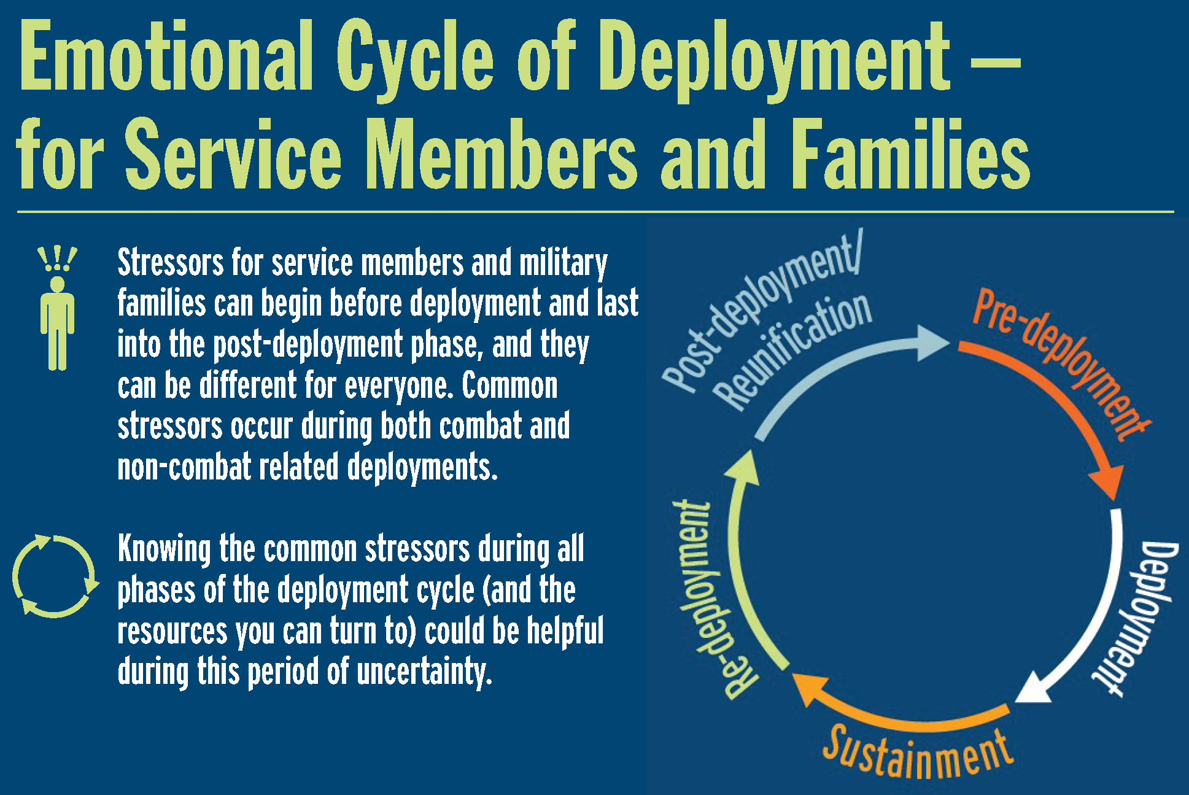
Phases of Support - COSC
Preparation
Sustainment
Recovery and reintegration
https://www.pdhealth.mil/sites/default/files/images/
Notes:
JOSH
During our time together, we’ll define disasters and briefly highlight some of the important concept regarding their impact on individuals and communities. We’ll also define disaster and preventive psychiatry and talk about how a knowledge of this field can help residents and the systems in which they work. Finally, we’ll examine how we can go about teaching disaster and preventive psychiatry and share some resources that are readily available to facilitate education and training, to help really lower the burden on programs.

Slide 19
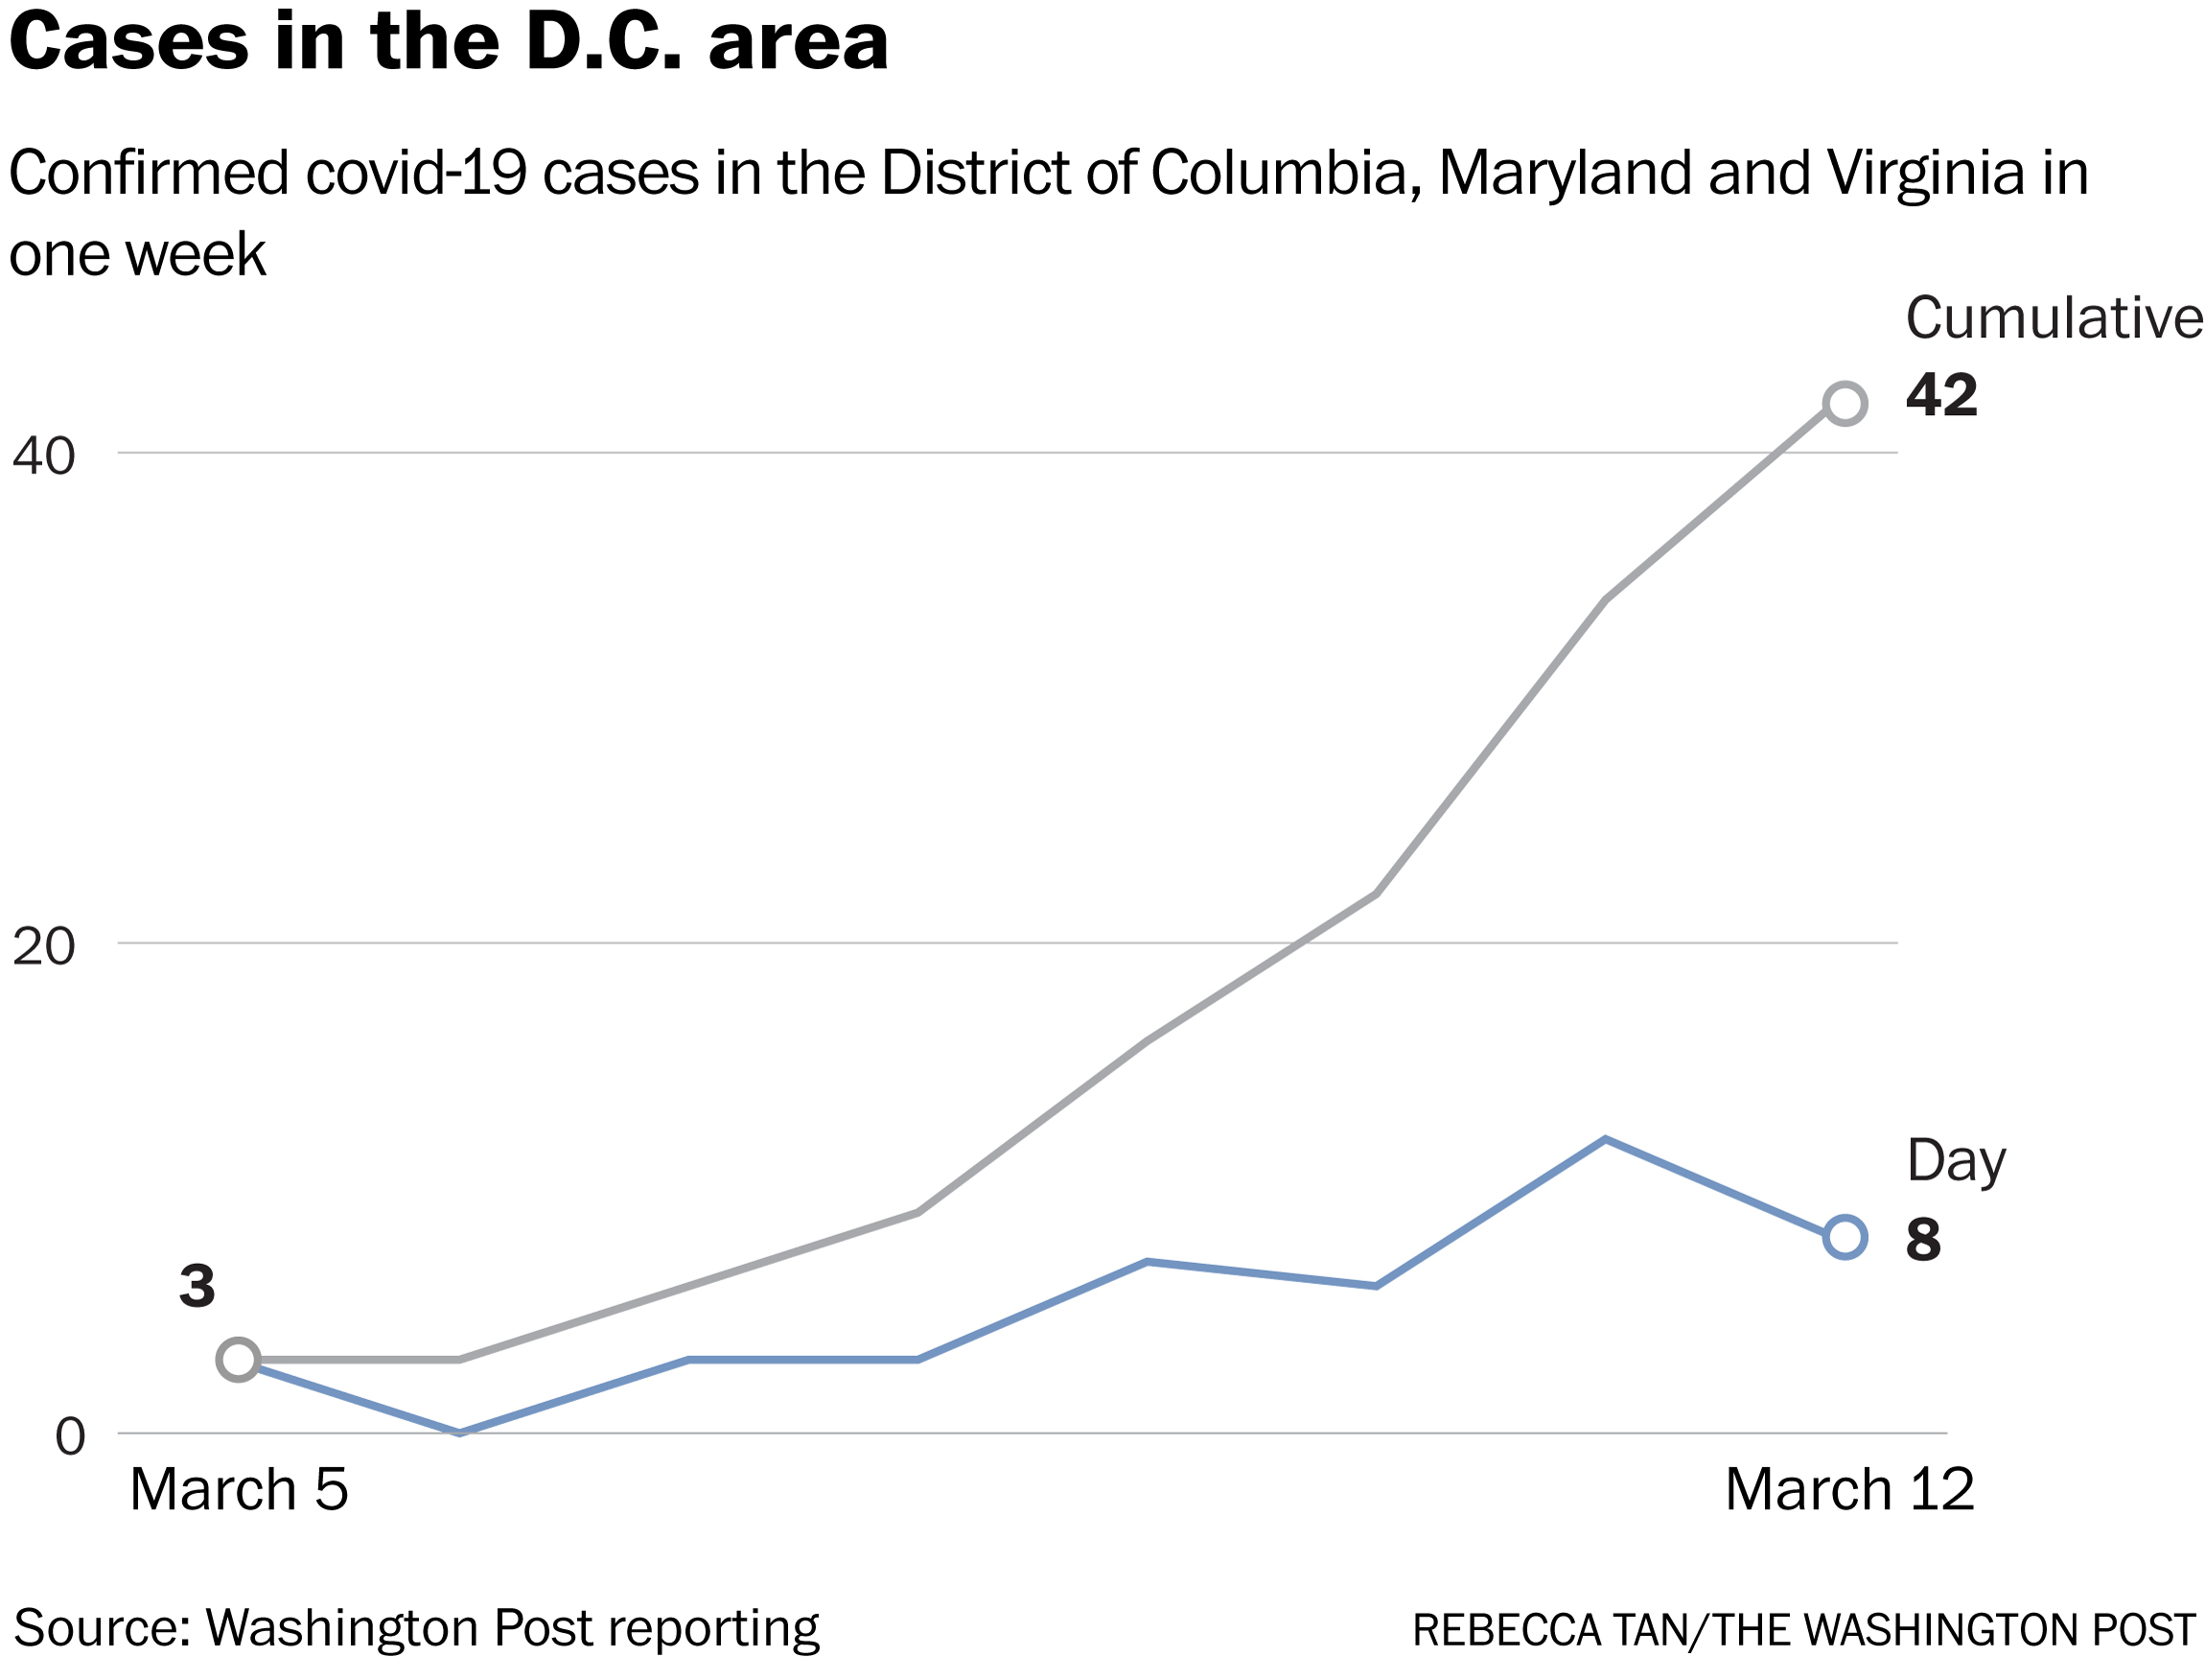
Phases of Support - Healthcare
Preparation
Sustainment
Recovery and reintegration
Morganstein, J., West, J.C., & Ursano, R.J. (2017). Work-Associated Trauma. In Brower, K., Riba, M., (Eds.) Physician Mental Health and Well-Being: Research and Practice. New York: Springer.
Notes:
JOSH
During our time together, we’ll define disasters and briefly highlight some of the important concept regarding their impact on individuals and communities. We’ll also define disaster and preventive psychiatry and talk about how a knowledge of this field can help residents and the systems in which they work. Finally, we’ll examine how we can go about teaching disaster and preventive psychiatry and share some resources that are readily available to facilitate education and training, to help really lower the burden on programs.

Slide 20
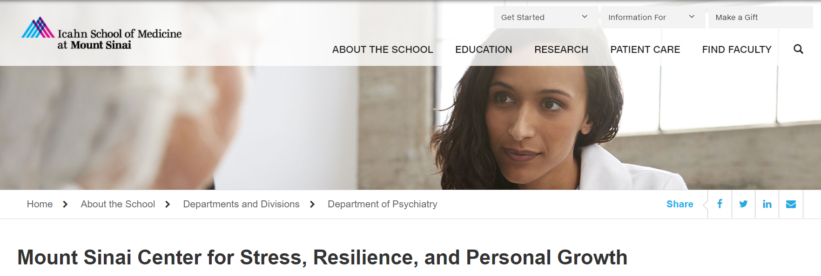
New Approaches in Healthcare Systems
https://www.gnyha.org/program/hero-ny/
https://med.umn.edu/covid-fatigue/minnrap
https://icahn.mssm.edu/about/departments/psychiatry/clinical/stress-resilience-personal-growth-center
Notes:
JOSH
During our time together, we’ll define disasters and briefly highlight some of the important concept regarding their impact on individuals and communities. We’ll also define disaster and preventive psychiatry and talk about how a knowledge of this field can help residents and the systems in which they work. Finally, we’ll examine how we can go about teaching disaster and preventive psychiatry and share some resources that are readily available to facilitate education and training, to help really lower the burden on programs.

Slide 21
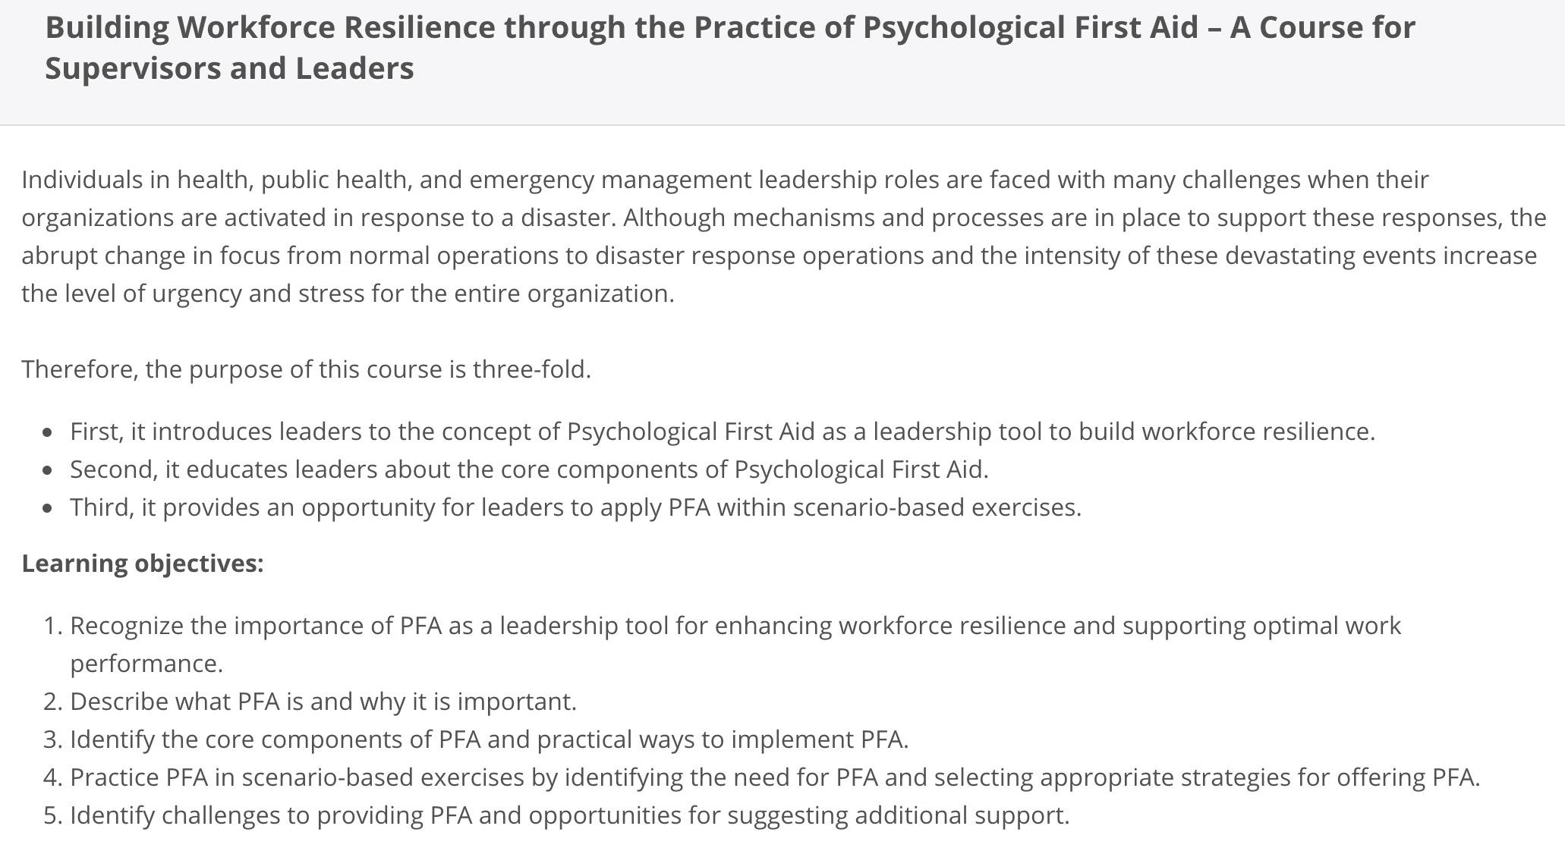
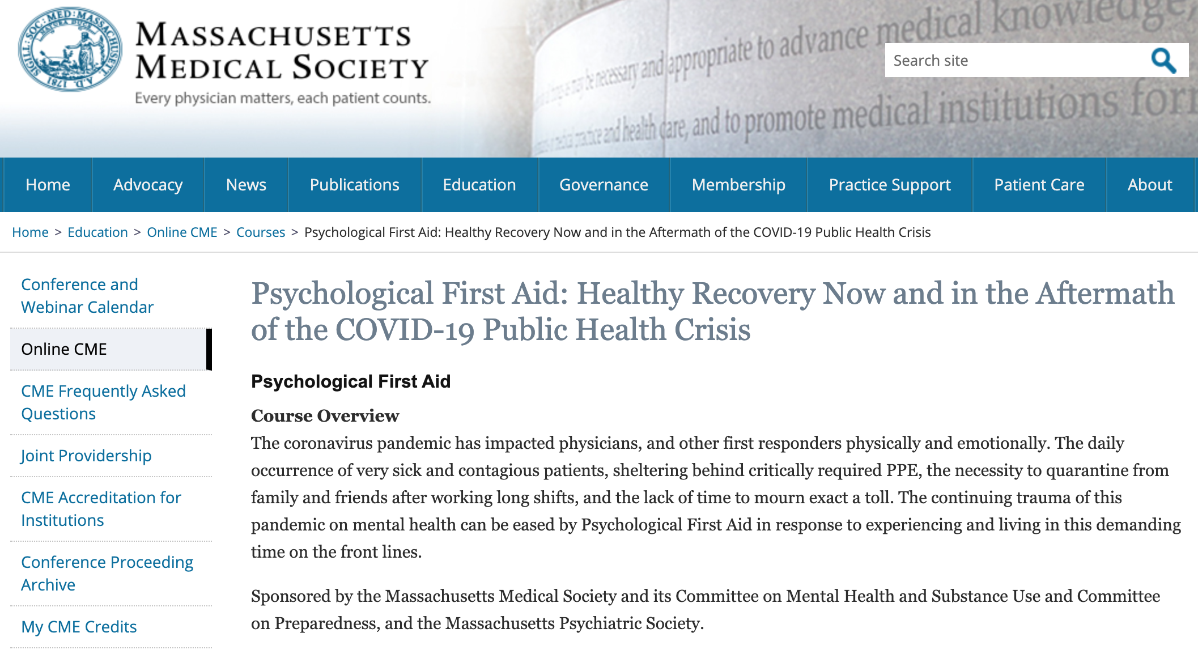
Resources
Notes:
JOSH
An important and obvious question is where would I get content to train residents? There are resources that already exist to facilitate training and education. We mentioned that Psychological First Aid is a critical aspect of knowledge and skills.
There are a variety of online trainings in the principles of Psychological First Aid, by very reputable organizations. The National Child Traumatic Stress Network has an online training in community-based Psychological First Aid to help with supporting the well-being of adults and children affected by disasters. The training module puts participants in the role of provider in a post-disaster scenario. It’s free to use and comes with continuing education included.
Another free online training in Psychological First Aid was developed by the National Association of City and County Healthcare Organizations and this is geared at people who are, or hope to be, supervisors or leaders. This was jointly developed by the Behavioral Health division at the federal Office of the Assistant Secretary for Preparedness and Response. These are the folks that play a vital role in coordinating national disaster behavioral health response efforts.
Also, the Massachusetts Medical Society recently adapted principles of Psychological First Aid to create a brief COVID-19 specific education module to promote psychological recovery from the global pandemic.

Slide 22
Rapid Response Resources “I’m Really Pressed for Time and Need it NOW”
Assistant Secretary for Preparedness & Response (ASPR)
Technical Resources Assistance Center & Information Exchange (TRACIE)
COVID Behavioral Health Resources
https://asprtracie.hhs.gov/technical-resources/115/covid-19-behavioral-health-resources/99
Center for the Study of Traumatic Stress COVID-19 Response page
https://www.cstsonline.org/resources/resource-master-list/coronavirus-and-emerging-infectious-disease-outbreaks-response
Notes:
JOSH
Knowledge products and education resources, particularly those that support rapid response, can be really helpful during a disaster. The ASPR TRACIE Behavioral Health COVID page has numerous resources that address a broad range of important areas. The resources at our Center for the Study of Traumatic Stress have been developed by a multi-disciplinary team of subject-matter experts. They are brief, easy to read, and have actionable guidance on steps to take and those to avoid. Both the ASPR and CSTS resources support healthcare workers, patients and families, as well as supervisors and leaders, in helping to address the unique and evolving challenges of COVID-19. All of these resources are in the public domain and free to use and share.

Slide 23
Thank you
James.west@usuhs.edu
Cstsonline.org

