Slide 1
Professional Solutions
for Primary Care
An Origin Story about Integrated Primary Care: 1985-2021
Patti Robinson, PhD
March 11, 2021 | 8:30am -12:45pm PST | Zoom
1

Slide 2
Objectives
Describe the context for design and implementation of the first randomized controlled trials of delivery of behavioral health services in primary care
Describe methods and materials used in two randomized controlled trials that set the stage for development of the Primary Care Behavioral Health (PCBH) model and the Collaborative Care (CC) model
Summarize the results of two randomized controlled trials
Describe an innovative approach to treating depression symptoms that focuses on increasing coping behavior
Provide an overview of an innovative approach to treating depression based on Focused Acceptance and Commitment Therapy (FACT)

Slide 3
1985-2021
. . . Letting go of traditions
. . . holding on to science
From MH to PC
Early Randomized Trials
Model development
Healthcare Transformation
Notes:
Student and then a clinician with a passion for the scientist practitioner model. Influenced by early behaviorists, Skinner, cognitive behavioral scientists, met Kirk Strosahl and Steve Hayes in the early 80’s. Entered into primary care research in the late 80’s and then focused my attention on model development for integrated services in the 90’s. Direction now: an evolved primary care or general practice service.

Slide 4
Mental Health to Primary Care Behavioral Health
From diagnosis and treat to target to care at the time of need for the problem of concern
From intervention with more severe to broad outreach including prevention, acute and chronic care
From treatment for the few to treatment for many
From psychotherapist to consultant

Slide 5
Early research 1980’s – 1990’s Population-based care, Functional outcomes, Brevity
Donald Patrick - University of Washington Public Health Dept
Pioneer in exploring impact of population-based care interventions
Interested in primary care
Focus on patient quality of life

Slide 6
What do PCPs identify as MH needs?
What is a priority for treatment of patients over 65?
Depression 95%
Satisfaction with Life 81%
Ability to deal with stress 72%
Less than half assessed themselves as very well prepared for counseling depressed patients over 65.

Slide 7
Interventions for PC: Life Satisfaction Class
What primary care service / class might “demoralized older adults” find helpful?
Dosing behavior change: 10 to 6 to 4 classes
Establishing BH value to PCPs
Patient experience
60% completed
Rated very positively

Slide 8
Interventions for PC: Life Satisfaction Class
Goals of Class
Increase pleasurable activities
Increase accomplishment activities
Use of problem solving
New ways of working with depressed thoughts and feelings
Med Chief: “Teach my staff . . . ”

Slide 9
Research: A context for forming new relationships
After the study,
”Don’t leave. All of our patients need better life satisfaction . . . In fact, our staff do, too.”
Early inconveniences: working in a closet
Big payoffs: 3 years later, the Group Care Clinic

Slide 10
A first step toward integration of clinical services
Kirk Strosahl
Greg Simon
Sue Snyder
Patti Robinson

Slide 11
Long term outcomes
Cost and outcomes of Medicare reimbursement for HMO Preventive Services (Patrick, D. L., et al., (1999).
Medicare beneficiaries enrolled in a health maintenance organization (HMO) were randomized to a preventive services benefit package for 2 years or to usual care.
At 24- and 48-month follow ups, the TX group had completed more advance directives, participated in more exercise, and consumed less dietary fat than the control group.
They also reported higher satisfaction with health, less decline in self-related health status, and fewer depressive symptoms than surviving control participants.

Slide 12
Curious about what PCPs do . . .
Phone surveys of 155 patients 1 and 4 months after a visit for depression where meds were prescribed
61% indicated that their PCP encouraged them to do things they were already doing that made them feel better
40% indicated that their PCP encouraged them to engage in pleasure activities
34% indicated that their PCP supported their efforts to solve problems of living
Patient-PCP interactions about use of CBT strategies at the 1-mo visit were correlated with reports of use of CBT strategies at the 4-mo visit
Robinson, P., et al., (1995). Primary Care physician use of Cognitive Behavioral Therapy techniques with Depressed Patients. J. Fam Practice, 40, 352-357.

Slide 13
Curious about patient experience. . .
Robinson, P., et al., (1995). Primary Care physician use of Cognitive Behavioral Therapy techniques with Depressed Patients. J. Fam Practice, 40, 352-357.
Stress in past year | Percent
Relationship problem | 60%
Occupational problem | 48%
Loss of a loved one | 25%
DX of health problem | 16%
Move to a new home | 10%
Other stress | 42%

Slide 14
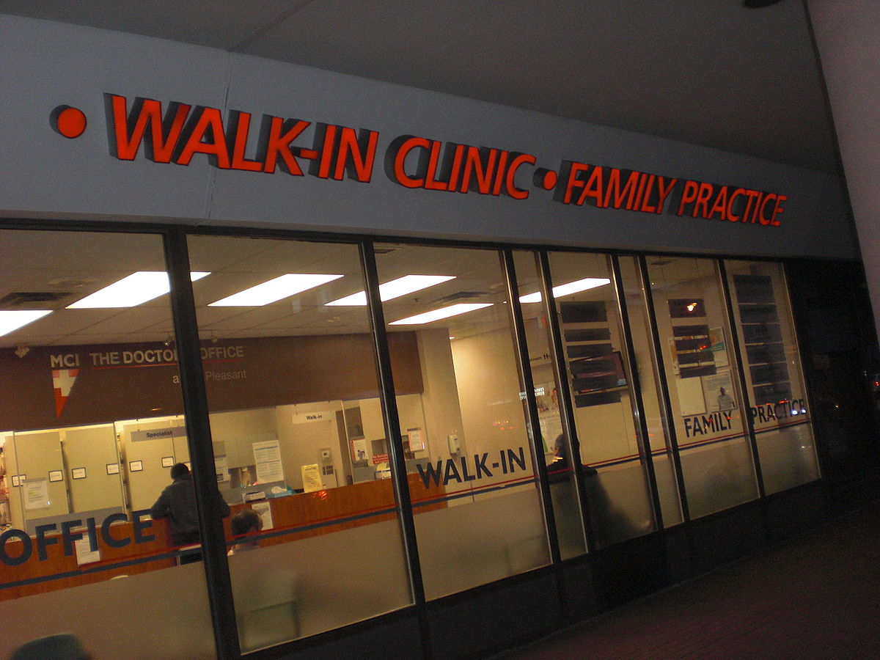
Randomized Trials
Northgate Clinic
Seattle Washington
Center for Health Studies
. . . An on-going tension between medication and behavioral health treatment
. . . Part of context: PCPs not able to Rx “new” anti-depressants without patient failing old

Slide 15
How depression looks in PC
Requested PCP referral of patients with probable major depression and willing to use medication
 | RCT 1 | RCT 2
Mild to Mod | 58% | 57%
More severe | 42% | 43%

Slide 16
Liaison Psychiatry Study Intervention
Medication – Selection, Dosing, Adherence
Video
LP
visits with patients: length variable, # sessions ranged 1-17
Monitoring pharmacy records
Behavioral health: development of patient education materials
Seven Ways to Cope Booklet
Using Medications Successfully Booklet
Both booklets available in event materials.

Slide 17
What do patients think . . . ?
Patients assigned to intervention received 2 booklets (meds, behavior change) and a video at the time of the baseline interview
Data collected in telephone interviews 1 week later
75% reported that they read or viewed all of the educational products.
The majority rated the products as somewhat to significantly helpful: medication 81%; behavioral health 82%, and video 59%
Robinson, P., et al., (1997). The education of depressed primary care patients: What do patients think of interactive booklets and a video? J. Fam Med, 44, 562-571

Slide 18
Helpfulness of Patient Education Materials

Slide 19
Example from “Planning to Feel Better”
Pleasant Activities
These are the things in your life that you do just for fun. They are simple and quite personal. They help your body recover from both large and small stresses. Examples include listening to music, going for a walk, watching a favorite show, or reading something you enjoy. If you’re interested in planning pleasant activities, follow these steps and use the work sheet below.
Identify what you did for pleasure when you were less depressed
Ask yourself, what might you enjoy doing tomorrow?
Identify and plan to do one pleasant activity each day this week. Start with something that is simple for you.
Identify what or who can help you do these activities.
Bring this worksheet to your next visit with your physician.

Slide 20
RCT: Liaison Psychiatry Findings What outcomes were significantly different from Usual Care (UC)?
Outcome | Mild to Mod 58% | More Severe 42%
50% reduction in Depression | No | Yes
Medication Adherence | Yes | Yes
Satisfaction with Depression TX | No | Yes

Slide 21
What were the concerns going into the 2nd RCT?
How to make depression care more acceptable to patients with mild to moderate symptoms (the larger of the two groups)?
Feasibility
LP not resource feasible
LP not cost feasible
Medication use with mild to moderate

Slide 22
RCT: Behavioral Health Consultant Intervention
Behavioral Health Consultant provided 2.5 to 3.5 hours direct consultation over 4 to 6-week period for all ICP patients
Fidelity ratings high; Retention high (94% of those attending visit 1 completed)
4-5 phone follow-ups over following 4.5 to 5 months (calls 5 minutes)
Detailed in 107 page ”Integrated Program” Intervention Manual

Slide 23
RCT: Behavioral Health Consultant Intervention
Visit | Topic
1. | Behavioral Experiments – to improve QOL in 7 areas
2. | Daily Pleasurable Activities
3. | Problem Solving
4. | Identifying thoughts and feelings and relating to them in new ways
Optional 2 visits: 88% attended one or more

Slide 24
RCT: Behavioral Health Consultant Intervention
The seven areas of living:
enjoying things alone
accomplishing things alone
talking with others
contentment with work
sensual experience
fun with others
images of a better future
Participants selected the following topics for optional visits:
cognitive / acceptance strategies 32%
personal assertion skills 17%
problem solving skills 11% relaxation 9%
couples consultation 6%
additional assistance with behavioral experiments 3%

Slide 25
RCT: Behavioral Health Consultant Intervention
At all IPC visits, the BHC and participant worked collaboratively to develop behavioral experiments to improve satisfaction in one or more life areas. The seven areas of living:
enjoying things alone, accomplishing things alone, talking with others, contentment with work, sensual experience, fun with others, and images of a better future.
For BHC visits, participants selected the following topics for optional visits: cognitive / acceptance strategies 32%
personal assertion skills 17%
problem solving skills 11% relaxation 9%
couples consultation 6%

Slide 26
RCT: Behavioral Health Consultant Intervention: A multi-faceted intervention (aka, team)
Shared chart
Feedback to PCPs on Integrated Program Care (ICP) visits
Suggestion of specific actions for PCPs to take in follow-ups with IP patients
IP Newsletters fortnightly
Encouragement of PCP to support patient’s “Progress Plan” (a relapse prevention plan)
Brief weekly calls with LP (10-20 minutes); direct with 6%
Communication with PCPs as needed regarding medications

Slide 27
RCT: Behavioral Health Consultant Results What outcomes were significantly different from Usual Care (UC)?
Outcome | Mild to Mod 57% | More Severe 43%
50% reduction in Depression | Yes (1/4) | Yes
Medication Adherence | Yes | Yes
Satisfaction with Depression TX | Yes | Yes

Slide 28
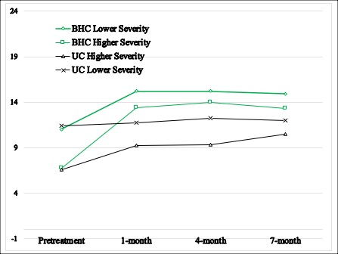
RCT: Behavioral Health Consultant Results What outcomes were significantly different from Usual Care (UC)? Use of evidence-based coping strategies
Robinson, et al., 2020. The Impact of Integrated Care on Patient Behavior: A Randomized Controlled Trial. Family Systems and Health Care.

Slide 29
Evidence-based Coping Strategies
1. Planning regular participation in pleasurable activities
2. Planning regular participation in activities that boost your confidence
3. Planning regular participation in activities that help you relax
4. Planning regular participation in activities with other people
5. Using problem solving techniques for problems you’re having in life such as problems with your job or relationships
6. Noticing negative thoughts and replacing them with more positive thoughts
*Robinson, et al., 2020.
J of Family Systems and Health

Slide 30
Coping Strategy Use Scale (CSUS)
Frequency of use is based on a on a Likert-type scale ranging from 0 (Not used/don’t know) to 4 (Daily).
Total score is the sum of item scores associated with responses to the following question: “Which of the following techniques have you used over the past X? Not used/don’t know = 0; less than once a week = 1; once a week = 2; several times a week = 3, daily = 4.”

Slide 31
RCT: Behavioral Health Consultant Results
What outcomes were significantly different from Usual Care (UC)?

Slide 32
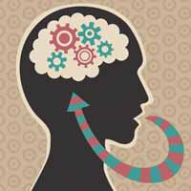
RCT: Behavioral Health Consultant Results
What outcomes were significantly different from Usual Care (UC)?

Slide 33
RCT: Behavioral Health Consultant Results
What outcomes were significantly different from Usual Care (UC)?

Slide 34
RCT: Behavioral Health Consultant Results What components of the Integrated Program did PCPs see as “definitely useful” and “essential”?

Slide 35
RCT: Behavioral Health Consultant Results Additional provider feedback . . .
Materials easy to use: 88%
Improved PCP satisfaction with depression care
100% of PCPs Preferred Integrated Care Program to Referral to MH

Slide 36
RCT: Behavioral Health Consultant Integrated Care Program Books

Slide 37
Next? For University of WA group and Katon – IMPACT For Me: Model Development Social Justice
Yakima Valley Farm Workers Clinic 2000-2006
United States Air Force 2006-2015
San Francisco Dept of Health 2013-2017
Multnomah County Public Health Dept 2015-2018
New Zealand 2017-present
Interprofessional Primary Care Institute

Slide 38
My true north
Population Health
Equity
Social Justice
Teamwork
Community-focused care
Culturally safe services
Behavioral science and a person’s ability to choose, learn, and re-create themselves

Slide 39
My Teachers: USAF

Slide 40
PCBH Effectiveness Studies in US Clinical Outcomes
>70% of patients treated in PCBH model improved, with faster rates of improvement observed among those in higher distress
Most patients receiving 2-4 visits show broad improvement in symptoms, functioning, well-being
Changes are robust and stable at 2 years

Slide 41
Reduction in functional distress observed across multiple studies High rates of patient (>95%) and primary care team member (>90%) satisfaction
Therapeutic alliance shown to be stronger in PCBH than outpatient settings, and unrelated to positive treatment outcome
Positive treatment outcomes seen across conditions, including significant conditions such as Post-Traumatic Stress Disorder (50% treatment completers no longer met criteria) and suicidal ideation

Slide 42
Effectiveness Studies in US System Outcomes
Large reductions in specialty mental health referral rate²Improved adherence to evidence-based guidelines²⁶
More appropriate antidepressant prescribing
Improved PCP willingness to engage with behavioral issues
Improved detection (and treatment) of suicidal ideation
High patient and PCP satisfaction
More appropriate utilization of PCP
Improved prevention (completion of anticipatory guidance in well-child checks)

Slide 43
USAF: PCBH Innovators
1. BHCs: Mandated world-wide; use of I and E to distinguish Internal BHC in PC and External Prescriber – in MH clinic
2. Integration of BHCs into FP residencies
3. “First Stop” – all MH starts in PC
Innovative use of Four Charlies
Reached more people in PC and in MH – many that would never have sought MH secondary care
Saving lots of money

Slide 44
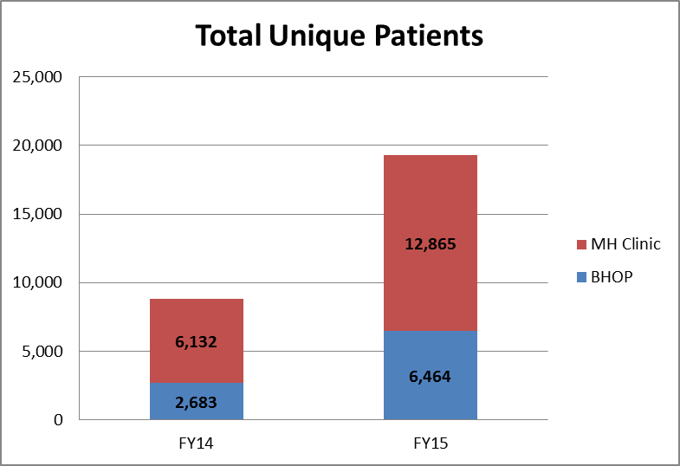
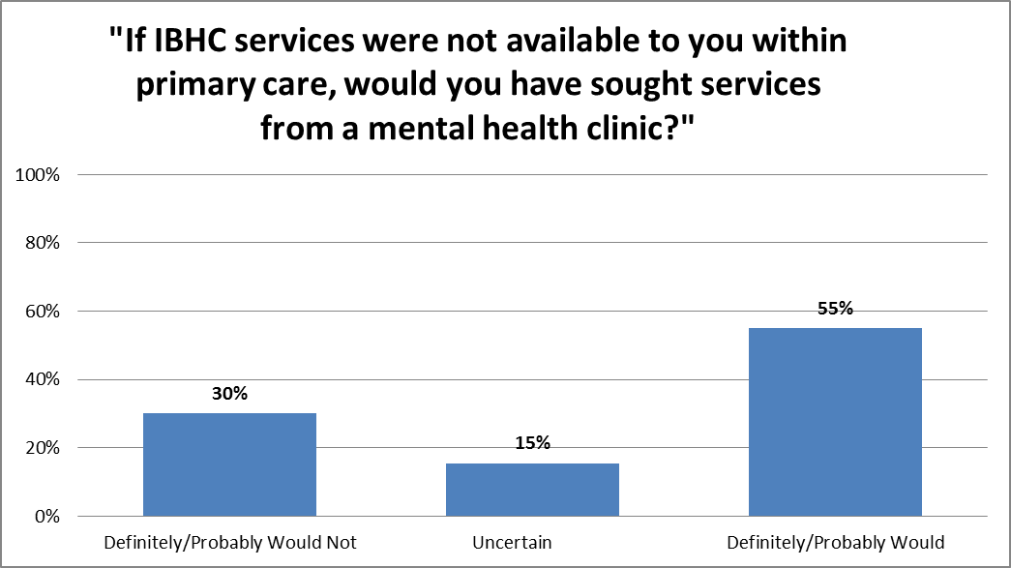
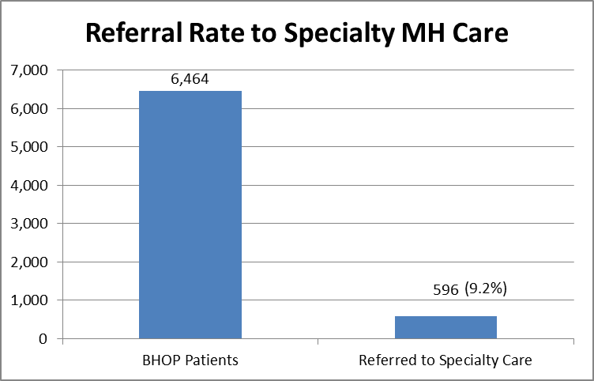
PC “FIRST STOP”

Slide 45
My Teachers: Yakima Valley Farm Workers Clinic

Slide 46
PCBH Impact: Children (Pediatric Symptom Checklist)
RURAL Practice
*62% Hispanic, 40% Spanish-speaking

Slide 47
PCBH Impact: Adults with Chronic Disease
RURAL Practice
*62% Hispanic, 40% Spanish-speaking

Slide 48
My Teachers: New Zealand

Slide 49
HIP Services and Health Care Equity
Significantly improved equity of access across Māori, Pacific, Asian and European populations with no significant difference between rates of conversion of referral to appointments across ethnicities
74% of Māori clients report improved wellbeing (compared to 72% European, 74% Asian, 71% overall)
95% satisfaction rating from over 3,000 client surveys
Reduction in prescribing of medication in favor of a ‘skills before pills’ approach
See http://www.tetumuwaiora.co.nz/#tetumuwaiora

Slide 50
HIP Services and Patient Access*
57 – 70% of patients are seen for therapy on the same day as disclosing distress to their GP (compared to 3 – 5% for conventional service)
75% seen for talking therapy within five days (less than 17% in conventional services)
See http://www.tetumuwaiora.co.nz/#tetumuwaiora

Slide 51
HIP Clients at Follow-Up: Better, Same, Worse
62%
24%

Slide 52
My Colleagues

Slide 53
A review of 29 studies on PCBH approach
found that it shows promise as an effective population health approach to behavioral health service delivery and that it is associated with positive patient and implementation outcomes (Hunter et al., 2017)

Slide 54
PCBH and IMPACT: Cut from the same cloth?
PCBH
Goal of full integration
Population focus – take all comers, do a little for a lot
Work as a consultant and generalist to improve individual and family functioning
IMPACT
Target diagnostic group
Focus on medications
Use of a protocol to reduce symptoms

Slide 55
PCBH and IMPACT: A Complementary Relationship Possible?
PCBH BHC Consultation Service provides a horizontal platform
PCBH Pathways are vertical integration strategies that address the needs of a population (e.g., depressed patients with diabetes)
Best Practices: USAF
Internal and External BHCs
Multnomah Public Health

Slide 56
PCBH and IMPACT: The Challenges and Opportunities
Challenges
Difficult for 1 person to do both programs
Difficult to staff; often IMPACT may be a part-time role while PCBH is a full-time role
Infra-structure for charting and billing
Dealing with inefficiencies
Opportunities
View IMPACT as a PCBH Pathway and gain efficiency
Use the CC codes for BHCs to teach coping strategies
See handout:
Coping Strategy Use Scale Pt Handout

Slide 58
*Robinson, et al., 2020.
J of Family Systems and Health

Slide 59
The Road Not Taken – Robert Frost
Two roads diverged in a yellow wood,
And sorry I could not travel both
And be one traveler, long I stood
And looked down one as far as I could
To where it bent in the undergrowth;
Then took the other, as just as fair,
And having perhaps the better claim,
Because it was grassy and wanted wear;
Though as for that the passing there
Had worn them really about the same,
And both that morning equally lay
In leaves no step had trodden black.
Oh, I kept the first for another day!
Yet knowing how way leads on to way,
I doubted if I should ever come back.
I shall be telling this with a sigh
Somewhere ages and ages hence:
Two roads diverged in a wood, and I—
I took the one less traveled by,
And that has made all the difference.

Slide 60
In Concluding
Follow your heart
Do what matters
Pay attention
Fail mindfully
Collect data
Look for opportunities
Start again

Slide 61
www.ipcinstitute.us

