Slide 1
January 12^{th, 2023} MEDICARE ANNUAL WELLNESS Visit ECHO
Presented by Julie O’Meara, DBH, MA

Slide 2
Please put the following in the chat box
WELCOME!
Name
Organization
Position
Credentials

Slide 3
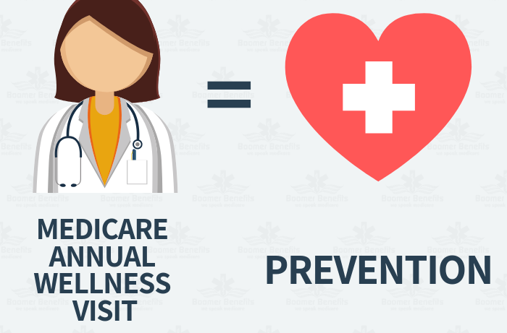
Why Preventive care?

Slide 4
Intervention
Education
Screenings
Awareness

Slide 5
The Affordable Care Act allowed CMS to create the AWV in 2011 with no co-pays or deductibles for all beneficiaries.
The purpose of the AWV is to prioritize preventive care and invest in the patient-provider relationship rather than
addressing acute complaints or chronic diseases.
For the patient/provider:
The main benefit of the AWV is the creation of a written
Personalized Prevention Plan.
For your organization:
This is the most efficient means to close care-gaps and enhance patient engagement, a key component of a patient centered medical home.

Slide 6
Annual Wellness Visit
Research shows that patients who complete these visits are
twice as likely to adhere to screening recommendations
Is recommended, not required
There is no co-pay for the AWV
Not a hands-on exam, a discussion/visit
It is an in-depth review of current health status and a conversation about their preventive health plan + health goals.
Traditional Medicare covers this visit once every
366 days.
Med Advantage plans cover this visit once
per calendar year.
Is the most effective way to close all payor care gap opportunities for bonus revenue.
Patients who receive an AWV report that they are more satisfied with their overall healthcare!!

Slide 7
CMS Required Measures for an AWV
HRA
Medical/family history
Current Medical Providers + Suppliers
Screening Schedule Review from the Personalized Prevention Plan of Services (PPPS) developed at the IPPE.
Breast Cancer, Colon Cancer, Immunizations
List of risk factors and conditions*
Screening for risk of depression
Assessing ADL’s
Advanced care directives discussion
Exercise regimen
Fall risk management
Screening for opioid use
Urinary incontinence management
Detection of cognitive impairment
Direct observation, patient self-report or
concerns expressed by family or caregivers
Assessments: Only physical touch in an AVW
BMI, BP, Heart Rate

Slide 8
Medicare AWV Types
Initial Preventive Physical Exam (IPPE)
Welcome to Medicare Visit
Review of medical and SOCIAL health history and preventive services.
Covered only ONCE during their first 12 months of enrollment in Part B.
No Copay
Initial Annual Wellness Visit (AWV)
Develop the Personalized Prevention Plan of Service (PPPS)
Covered only once at the first time they have an AWV past 12 months enrollment.
No Copay
Subsequent Annual Wellness Visit(s).
(AWV)
Review and Update the PPPS.
Every AWV’s after the Initial AWV.
No Copay
Annual Routine Physical Exam
Yearly physical exam without relationship to treatment of specific illness, symptom complaint or injury.
NOT covered by Traditional Medicare
Covered with No co-pay each calendar year by all Med Advantage Plans.

Slide 9
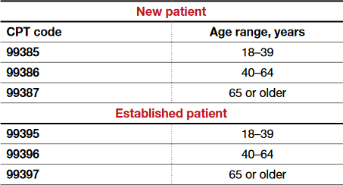
Medicare AWV Types
Initial Preventive Physical Exam (IPPE)
Welcome to Medicare Visit
Code to be used only once only during the first 12 months of enrollment.
G-0402
Initial Annual Wellness Visit (AWV)
Code to be used only once on their first visit after 12 months.
G-0438
Subsequent Annual Wellness Visit(s).
(AWV)
Code to be used on every AWV after the initial AWV.
G-0439
Annual Routine Physical Exam

Slide 10
Don’t be fooled by “visit” and “exam” because they are not used consistently
Other ways you may see these appointments:
The Initial Preventive Physical Exam (IPPE) is NOT a Physical Exam and is sometimes referred to as the Welcome to Medicare Visit
Some Medicare Advantage plans refer to the annual physical exam as the Preventive Routine Visit.
Sometimes the Annual Wellness Visit (AWV) is referred to as the (AVC) Annual Care Visit
You will see Medicare Advantage written as MedAdv or MA

Slide 11
Initial Preventive Physical Examination (IPPE): ​ HCPCS G0402​ - First 12 months Annual wellness visit (AWV): HCPCS G0438: Initial/First Annual Wellness- after 12 months of coverage (13-24 months)
G0439​: Subsequent AWV for the rest of the beneficiary's lifetime.
Helpful if these codes are built into your EHR
Note:
G0402 and G0438 can each only be billed once per beneficiary. If you are unsure if the patient has ever had one of these visits with a prior provider, you can check in the CMS database. If you don’t have enrollment specialist who can verify this upon scheduling, use G0439 as a default to be on the safe side.

Slide 12
Every role is vital to the success of these visits!
Pre-visit planning and care gap scrubbing are KEY for your AWV’s and patient care.
Personalized Health Plan is KEY for patient engagement
Customer Service as the first point of contact is KEY for patient engagement.
Scheduling is KEY for your clinical team.
Coding and documentation KEY for reimbursement.
Establishing a PPPS KEY for patient engagement.

Slide 13
What about Telehealth?
Consider a telehealth AWV for elderly who do not wish to come into the office due to Covid concerns or who have transportation or other SDoH barriers.
The IPPE/Welcome to MAWV can not be conducted via telehealth.
The rest of the AWV’s can. They are now reimbursed at the same rate as an in-person visit.
Everything can be conducted via telehealth except BP and BMI. Unless your patients have home monitoring devices.

Slide 14
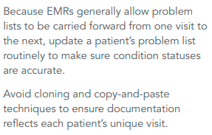
UPDATE PATIENTS' CONDITIONS

Slide 15
AWV DOCUMENTATION CRITERIA
ESTABLISH THE PATIENT’S MEDICAL AND FAMILY HISTORY
At a minimum, document the following:
Medical events of the patient’s parents, siblings, and children including conditions that may be hereditary or place the patient at increased risk
Past medical and surgical history including experiences with illnesses, hospital stays, operations, allergies, injuries, and treatments
Use of or exposure to medications and supplements, including calcium and vitamins
ESTABLISH A LIST OF CURRENT PROVIDERS AND SUPPLIERS
Include current patient providers and suppliers that regularly give medical care, including behavioral health care.

Slide 16
AWV DOCUMENTATION CRITERIA
Psychosocial risks including but not limited to depression/life satisfaction, stress, anger, loneliness/social isolation, pain, and fatigue.
Behavioral risks including but not limited to tobacco use, physical activity, nutrition and oral health, alcohol consumption, sexual health, motor vehicle (for example, seat belt use), and home safety.
Activities of Daily Living (ADLs) including dressing, feeding, toileting, grooming, physical ambulation including balance/risk of falls and bathing; and Instrumental ADLs (IADLs), including using the telephone, housekeeping, laundry, mode of transportation, shopping, housekeeping, managing medications, and handling finances.

Slide 17
Hierarchical Condition Categories (HCC)
Represent costly chronic health conditions and some severe acute conditions.
19 categories representing a patient’s health conditions(s) that map to specific ICD-10 codes which are used to determine a patient’s risk score.
86 HCC codes and approximately 9,500 ICD-10 codes to map to an HCC

Slide 18
Risk Adjustment and Hierarchical Condition Category (HCC) Coding
Mandated by the Centers for Medicare and Medicaid Services (CMS) in 1997.
Model assigns a patient risk adjustment factor (RAF) score to individuals with
serious or chronic illness based upon a combination of the individual’s health
conditions (ICD-10) and demographic details.
Documentation must support the presence of the condition and indicate the provider’s assessment and/or plan for management of the condition.
This must occur at least once each calendar year in order for CMS to recognize the individual continues to have the condition.

Slide 19
Risk Adjustment & HCC Documentation
Document on each condition the patient has that influences your ability to evaluate or treat the patient including:
Pertinent conditions
Chronic conditions
Active status
“History of” or “Past” conditions
Conditions that require two codes billed together

Slide 20
Risk Adjustment & HCC Documentation
Pertinent Conditions:
Document and code for any patient conditions that are
Present but stable
Managed on therapy
Require observation
Require referral to another provider for management
Influence your decision-making in care of the patient
Avoid documenting “history of” when the condition currently exists. In ICD 10 coding language, “history of” means that the patient no longer has the condition, in which case it cannot be coded as an active disease

Slide 21
Risk Adjustment & HCC Documentation
Chronic conditions:
Document chronic conditions annually, even when stable with treatment
Document that the condition is chronic
Document severity/stage of condition (i.e. stage IV chronic kidney disease/major depression)
Document associated conditions or complications and relationship to the
underlying chronic condition (i.e. diabetic retinopathy, cirrhosis secondary
to alcoholism)

Slide 22
Risk Adjustment & HCC Documentation
Active status: Conditions that are present and unresolved or unlikely to resolve need to be documented at least annually. CMS considers the condition resolved if not evaluated and coded at least once/calendar year.
Forever codes – conditions that do not go away and patients are expected to have forever, e.g., amputation, transplant, alcoholism in remission, CHF (compensated)
Might be forever codes include: ostomy, cirrhosis, diabetes, hepatitis, paraplegia/quadriplegia (be specific)
“History of” or “Past conditions”
History of cancer, if not in active treatment and does not have active disease. Cancer on long-term therapy is active cancer when the therapy is not prophylactic
History of stroke or CVA – document deficits and history of incident (e.g., hemiplegia secondary to CVA)
Conditions that require 2 codes billed together
Diabetes manifestations - nephropathy, neuropathy
Hypertensive renal disease – document both the hypertension and the renal disease
Infections, e.g., UTI and E. Coli

Slide 23
Risk Adjustment & HCC Documentation
Documentation of all conditions being:
Monitored/managed
Evaluated
Assessed/addressed
e.g., “Have you followed up with your oncologist?”
Treated
Considered in your care of the patient
e.g., patient has diabetes with kidney disease. I will prescribe something other than NSAID OR recommend NSAID with cautions

Slide 24
MEAT
One way to help ensure your documentation is up-to-par for HCC coding is to include MEAT (monitored, evaluated, assessed/addressed and treated) in the medical record for the patient encounter. To break it down, documentation must reflect:
M – Monitoring signs, symptoms, disease progression, disease regression
E – Evaluating test results, medication effectiveness, response to treatment
A – Assessing/Addressing ordered tests, discussion, review records, counseling
T – Treating medications, therapies, other modalities

Slide 25
TAMPER
T- Treatment Surgery, therapy, procedure, counseling, education, DME ordered/given, lab(s) ordered
A - Assessment Acknowledging/giving status/level of condition
M - Monitor/Medicare Ordering/referencing labs/other tests/ prescribing medication
P - Plan for management or follow-up of condition
E - Evaluate Examining (as in physical exam)
R - Referral to specialists for treatment or consultation of a confirmed condition

Slide 26
EXAMPLE
E11.9 (Diabetes w/o complications) currently on Metformin 500mg.
T – Treating medications
F33.1 (Major depressive disorder, recurrent, moderate) followed by Dr. XYZ
Referral

Slide 30
Quiz Questions
G0438 is a subsequent AWV.
Providers can copy and paste the history into the new note.
All diagnosis and conditions must be assessed and documented every year.
It is acceptable to document “history of” when the patient still has the condition.
Providers need to assess Fall Risk and document gait and balance as part of their chart note.
A great Patient Engagement strategy is to utilize a Patient Care Summary.

Slide 31
A Team Approach
Providers need to rely upon and utilize his/her entire care team
Care team huddles before each AWV patient arrives
Integrated workflows

Slide 32
Integrated care: A Team approach

Slide 33
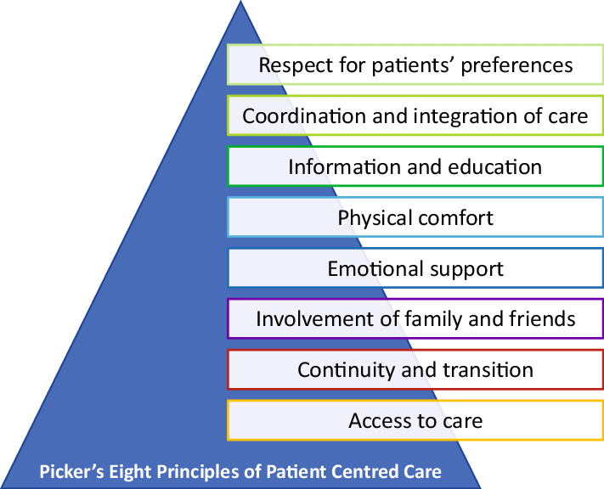
Patient engagement

Slide 34
Primary Care Provider
Behavioral Health Consultant
RN’s, LNP’s
Community Health Worker
Receptionist
Care Coordinator/Case Manager

Slide 35
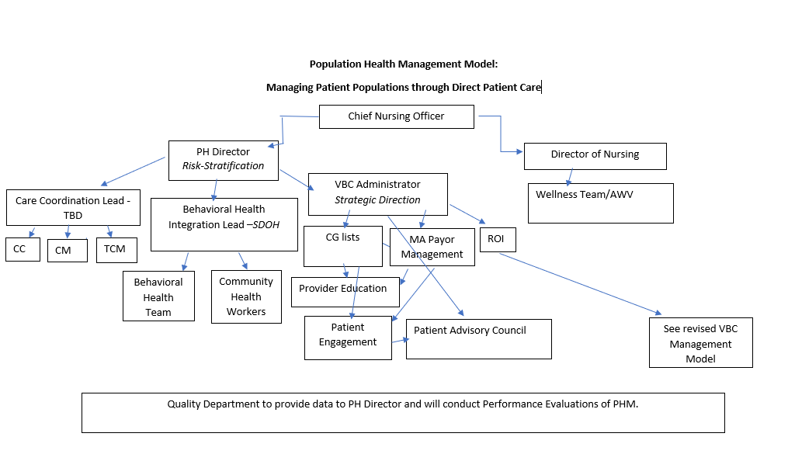
A population health model

Slide 36
Julie o’Meara integrated health solutions
Thank You!!!
208.805.8913
drjules45@gmail.com

Slide 37
THANK YOU FOR YOUR COMMITTMNET TO THESE IMPORTANT PREVENTIVE VISITS
Questions?

Slide 38
Resources
https://www.cms.gov/Outreach-and-Education/Medicare-Learning-Network-MLN/MLNProducts/preventive-services/medicare-wellness-visits.html
https://www.aafp.org/family-physician/practice-and-career/getting-paid/coding/annual-wellness-visits.html

