Slide 1
Psychiatric Collaborative care management
in
Arkansas
(CoCM)

Slide 2
Requesting AR Medicaid to provide coverage for Psychiatric Collaborative Care Management (CoCM) by adding the CPT codes to the Physician Fee Schedule (99492, 99493, 99494, 99484, G2214) [FQHC codes – G0511, G0512]
These are medical codes billed by the medical provider (ex. Family Practice, Internal Medicine, Pediatrics, OB-Gyn, or others)
Billed monthly for total care time provided to patient by the CoCM team
https://www.cms.gov/Outreach-and-Education/Medicare-Learning-Network-MLN/MLNProducts/Downloads/BehavioralHealthIntegration.pdf

Slide 3
WHY is CoCM needed?
Improve Access to Mental Health Care
Decrease Wait Times for MH care
Improves outcomes over “usual treatment in primary care”
Saves money - $6 saved for $1 spent
Savings are in the Medical Spend

Slide 4
CONTINUUM of MENTAL Health Care in Arkansas
AR PASSEs
Primary Care
MH Specialty Care
Continuum of Care
Outpatient therapy & medication
Inpatient MH /SUD treatment
988
Crisis lines
AR Childrens
Pediatric Mental Health Care Access
Grant
Co-located BHI therapists
CoCM
Outpatient Substance Abuse Treatment
Residential/long-term treatment

Slide 5
FROM a BHI Therapist in an Arkansas Healthcare system
“Without Medicaid coverage, the most vulnerable populations are not getting a treatment that others have available. It is difficult to sustain a psychiatric collaborative care program in a pediatric clinic due to Medicaid non-coverage. Currently, most private insurances seem to be covering psychiatric collaborative care”
“Our agency bills psychiatric collaborative care codes.
“I had a 14 year old Hispanic female that was scheduled for an intake after she asked her PCP for counseling. I failed to notice her insurance as Medicaid until she and her mother arrived. I had to explain co-payment/cost share/fees with a 14 year old as she translated to her mother. I did help her with the referral process and no-billed the encounter, but at the time, there was a long wait for community mental health services. Her parents were going through a divorce, and she was reaching out for help.”

Slide 6
CoCM services are being provided in Arkansas
ABCBS CoCM Claims Procedure Codes: 99492, 99493, 99484, and G2214
Year | 2020 | 2021 | 2022 YTD (Oct)
TOTAL Claimants Services | 290 1001 | 432 1682 | 2710 8783
Average services per claimant | 3.45 | 3.89 | 3.2

Slide 7
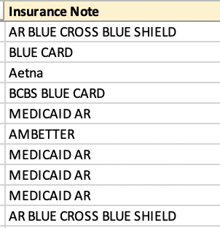
The last 10 patients referred to CoCM in an AR healthcare system

Slide 20
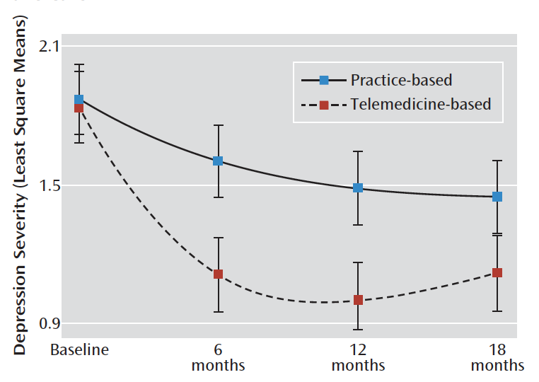
Off-site Telemedicine-based CoCM can yield better outcomes than practice-based care
2007-2009 at 6 FQHCs – in ARKANSAS –
Predominately rural, unemployed, uninsured
364 patients – screened positive for Depression – randomized
Followed for 18 mos
https://ajp.psychiatryonline.org/doi/full/10.1176/appi.ajp.2012.12050696

Slide 21
246 patients from Arkansas – 71% Medicaid
https://jamanetwork.com/journals/jamapsychiatry/fullarticle/2783602

Slide 23
CONTINUUM of MENTAL Health Care in Arkansas
AR PASSEs
Primary Care
MH Specialty Care
Continuum of Care
Outpatient therapy & medication
Inpatient MH /SUD treatment
988
Crisis lines
AR Childrens
Pediatric Mental Health Care Access
Grant
Co-located BHI therapists
CoCM
Outpatient Substance Abuse Treatment
Residential/long-term treatment

