Slide 1
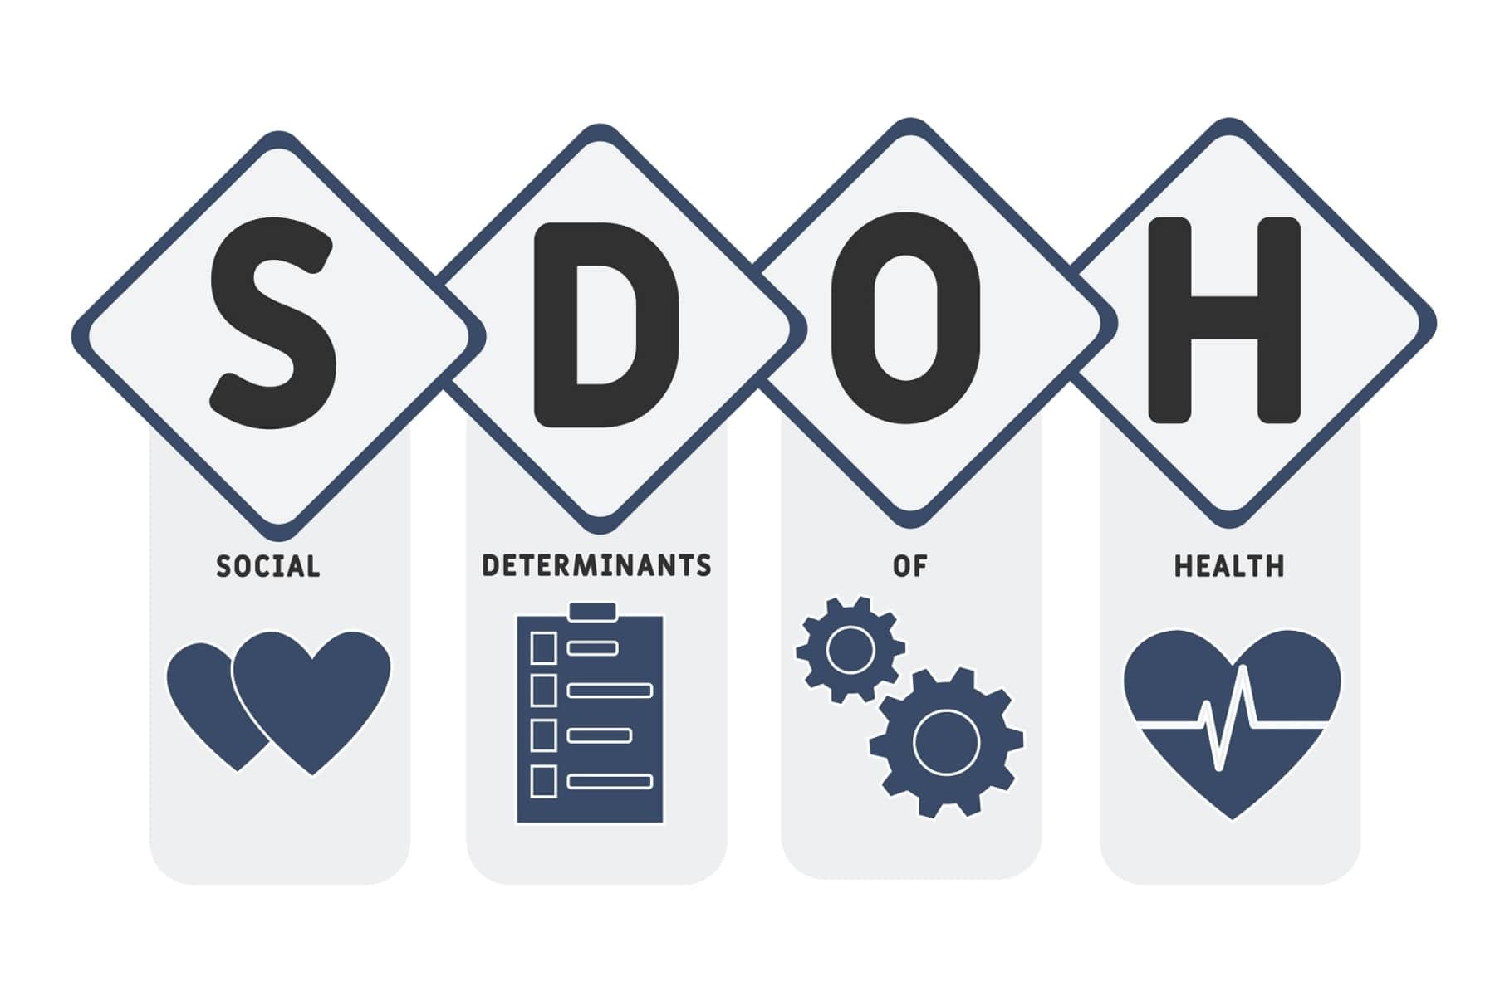
Social Determinants of Health

Slide 2
Population Health and SDOH Work Group
Justin Villines , ADH/OHIT/SHARE
Josh Heimburg, UAMS
Cheryl Arnold, Central Arkansas Ped Clinic
Jeff Oliver, Baptist Health
Kim Shuler, ABHIN
Dr. Patty Gibson, ABHIN
Jasmin Sumrall, Baptist Health
Christopher Meyer, ACCN ACH
Rhelinda McFadden, AFMC
Anne Santifer, ADH/OHIT/SHARE
Chad O’Kane, CHI St. Vincent
Kristen Fowler, Arkansas Ped Clinic
Anna Strong, ARAAP
Amanda Barber, AR BCBS

Slide 3
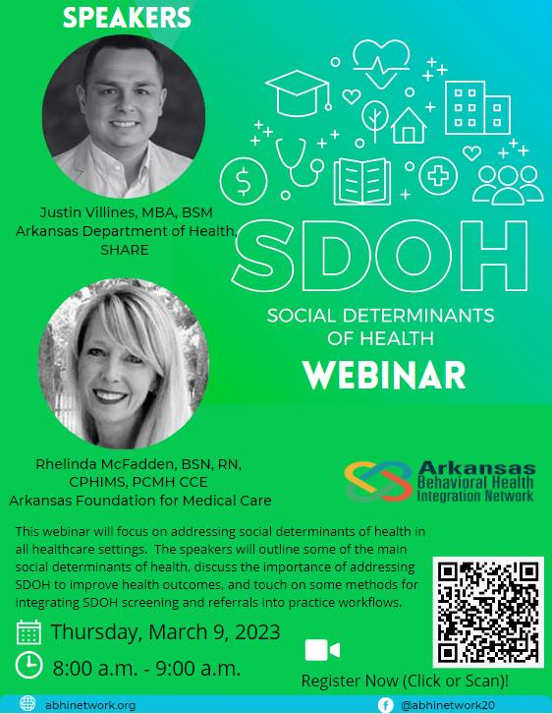

Slide 4
Today we will discuss how conditions in places where people live, work, learn, and play affect health outcomes.
Identify root causes of common health issues
Describe examples of interventions/programs addressing social determinants of health
Using social determinants of health to determine priorities for your community's work.
Notes:
Today we will discuss how conditions in places where people live, work, learn, and play affect health outcomes.
Content in this presentation will help you to:
Identify root causes of common health issues
Describe examples of interventions/programs addressing social determinants of health, and
Use social determinants of health to determine priorities.

Slide 5
Determinant:
A factor that decisively affects the nature or outcome of something
Social:
Relating to society or its organization
Notes:
Before we dive into social determinants, let’s first discuss the dictionary definition of a determinant. Determinant is defined as “a factor that decisively affects the nature or outcome of something.” In this module, we are looking at determinants, or factors, that affect health status or health outcomes. ​
​
It might also be helpful to define social. The dictionary definition of social is, “relating to society or it’s organization.” Synonyms for the word “social” are community, collective, group and public. ​
​
So, one way to describe a social determinant, at a very basic level, is a community or societal factor that that affects the nature or outcome of something. In this case, that “something” is health.​

Slide 6
“A state of complete physical, mental and social well-being and not merely the absence of disease or infirmary.”
- World Health Organization
Notes:
The World Health Organization defines health as “A state of complete physical, mental and social well-being and not merely the absence of disease or infirmary.”
What does that actually mean to them? Can they provide any concrete examples, like “not having the flu” or “being physically active”?

Slide 7
What is a Social Determinant of Health?
Notes:
Now that we have defined health, let’s define social determinants of health.

Slide 8
Circumstances in which people are:
Born
Grow up
Live
Work
Age, and
The systems put in place to deal with illness
-World Health Organization
Notes:
Social determinants of health are the circumstances where people are born, grow up, live, work, age, and the systems put in place to deal with illness, such as the healthcare delivery system. Circumstances are often beyond an individual’s control. Likewise, the social determinants of health listed here may be outside of an individual’s control as well.

Slide 9
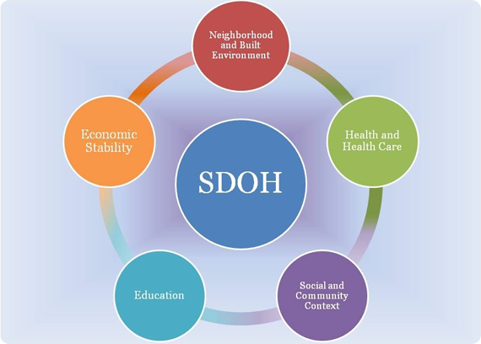
Notes:
Healthy People 2020 addresses social determinants of health (abbreviated here “SDOH”) in the goal to “Create social and physical environments that promote good health for all.” While several organizing frameworks exist for social determinants, Healthy People 2020 uses a “place-based” organizing framework which reflects five key areas of social determinants of health.
These five key areas, or determinants, include:
Economic Stability
Education
Social and Community Context
Health and Health Care
Neighborhood and Built Environment

Slide 10
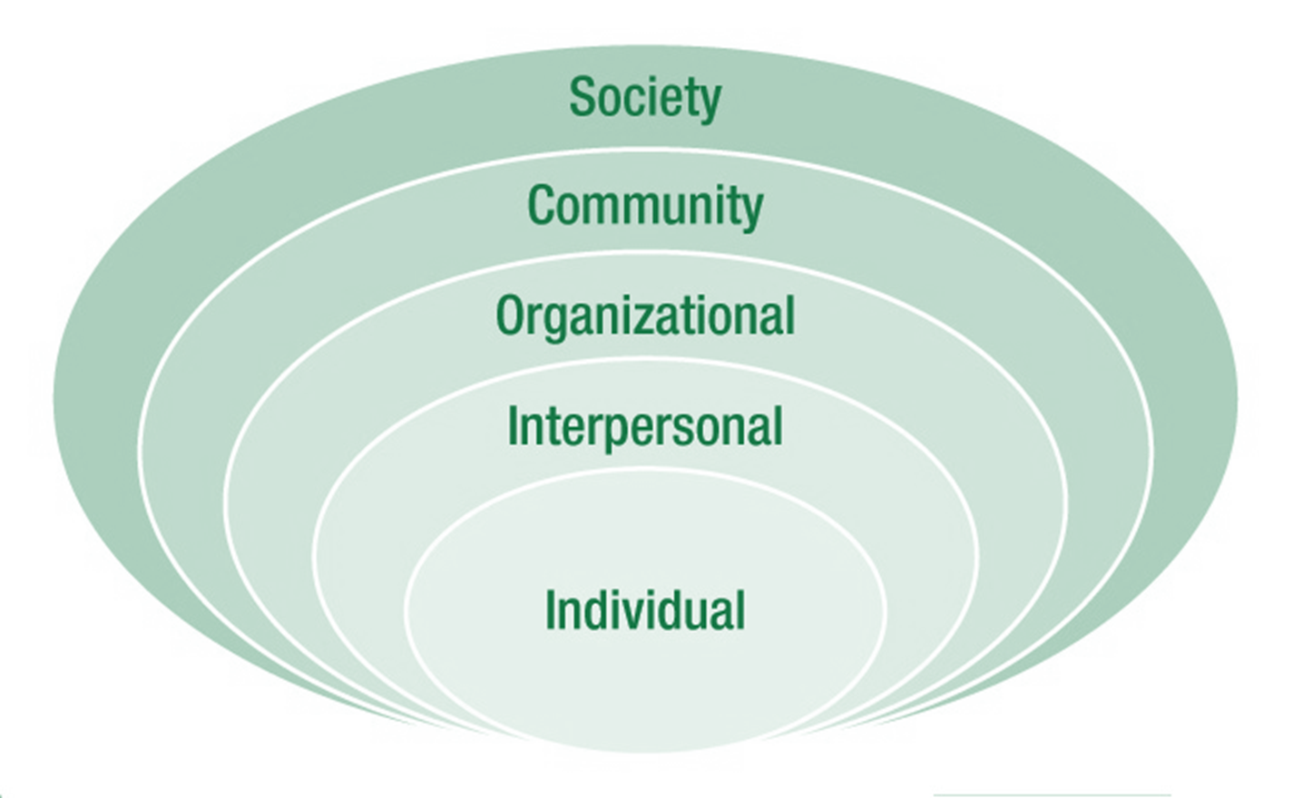
Notes:
Let’s look at how the social determinants of health relate to the social ecological model. As individuals, our health is impacted by our family and friends, the organizations of which we are a part, the community, and society. The social ecological model provides a framework for thinking about the many influences on health and behavior. Often these influences interact.
The social ecological model suggests that health is affected by the interaction between the individual, their friends and family (referred to as the interpersonal level), the organizations they are part of, such as worksites and faith-based groups, and the community. We are also affected by physical, social, and political environments. People are impacted by the context in which they live, and likewise, people influence others and the environments they live in. This can be very basic, like providing healthy food in your household. It can also be very complex and policy-oriented. It can be positive, and improve health, or negatively influence health.
The influence of social determinants of health can be seen within levels of the social ecological model. Most often, these influences work across multiple levels of the social ecological model.
The main idea with the Social Ecological Model is that programs should target individuals AND impact the interpersonal (relationship), community, organizational and environmental factors influencing health. Addressing multiple levels helps programs to be most effective. And the main idea with this module is that the social determinants of health should also be considered to help programs be most effective. We should look not only at the causes of health issues, but the causes of the causes.
The next few slides feature some health-related trivia questions. As you think about the questions and their answers, consider what community or societal factors might influence the health outcomes of interest.

Slide 11
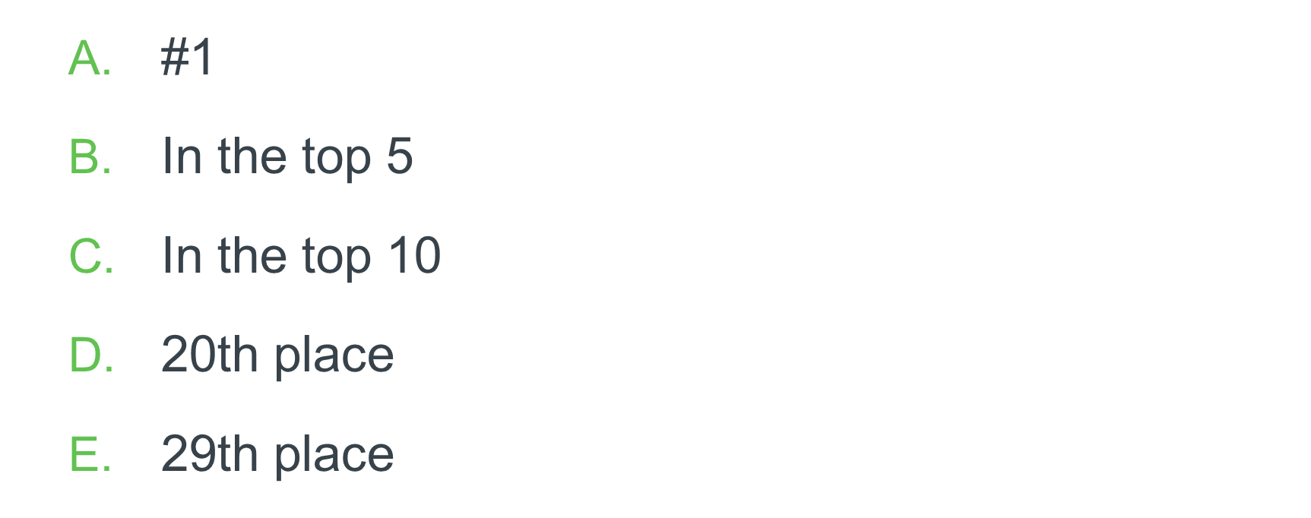
Notes:
One of the most fundamental ways we measure health and make comparisons between the US and other countries, or between states and counties in the United States, is with life expectancy. Life expectancy is the average period that a person may expect to live. It varies depending on where you are born and live. How do you think the US compares with other countries in the world in terms of life expectancy?
[read answer options]
The answer? E – the US ranks 29th place. With a life expectancy of 77.9 years, we are tied with South Korea and Denmark for 29th – 31st place, despite being the
second wealthiest country on the planet as measured by per capita gross domestic product, or GDP. Per capita means “for each person.” In this context, it relates to population size and GDP.
Japan has the highest life expectancy at 82.3 years. Based on the general correlation between GDP per capita and health, our average life expectancy in the US “should” be 3 years longer. Even citizens of countries considerably poorer than ours, including Costa Rica, Chile and Greece, live longer on average than we do.
Why do you think that is? What in our communities, what societal factors, could be driving these life expectancy rates?
Question Source: Unnatural Causes Health Equity Quiz.

Slide 12
Notes:
Next, lets consider where the US ranked in life expectancy around 50 years ago.
Do you think the US ranked…. [read answer options]?
The answer is B – in the top 5! In the 1950s, life expectancy in the US was at 68.2 years and longer than most other countries. Interestingly, we had less economic disparity back then compared with other countries, even Sweden. But especially starting in the 1980s, the gap in the U.S. between the rich and the rest of the population began to grow. Around this same time, other industrialized countries began to prosper and rapidly passed us on many health indicators.
Economic disparity is connected to income inequality, or the gap between what wealthy Americans earn compared with non-wealthy Americans – the middle and lower economic classes. In 2015, the top 1 percent of families in the United States made more than 25 times what families in the bottom 99 percent did.
How do you think this difference in wealth and income impacts how long people live? What in our communities, what societal factors impacting life expectancy, are connected to these large gaps in income?
Question Source: Unnatural Causes Health Equity Quiz.

Slide 13
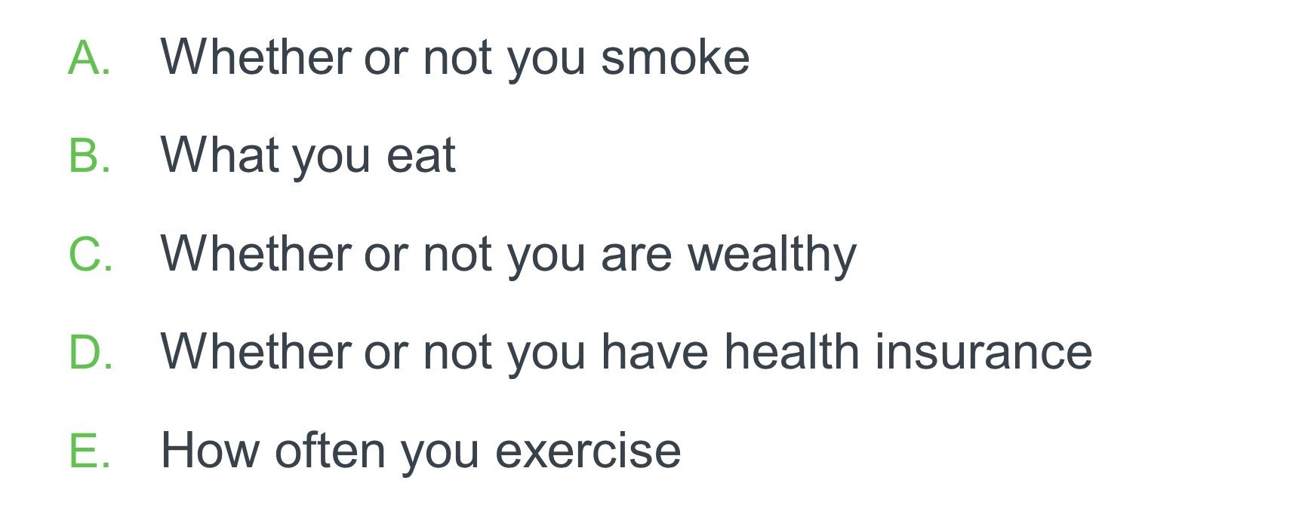
Notes:
Our next question relates to factors predicting individual health. Of the factors listed, which do you think best predicts one’s health?
[read answer options]
The answer is C – Whether or not you are wealthy.
The single strongest predictor of health is our position on the class pyramid. Those at the top – those with the most wealth - have the most power and resources, and on average live longer and healthier lives. Those on the bottom – those with the least wealth - are exposed to many health threats over which they have little or no control – low paying jobs with little job security, poor child care, poor quality housing, less access to healthy food, unreliable
transportation, and living conditions that are noisy and violent. These health threats increase the risk of chronic disease and early death.
Even among smokers, smokers who are poor have a higher mortality risk (risk of dying) than rich smokers.
Americans in the middle of the income spectrum fare better than those at lower incomes, but are still worse off than those at the top.
Thinking back to the term ‘social determinants,’ are there factors in our communities and organizations that affect health outcomes for those who are not wealthy? What are some of these factors?
Question Source: Unnatural Causes Health Equity Quiz.

Slide 14
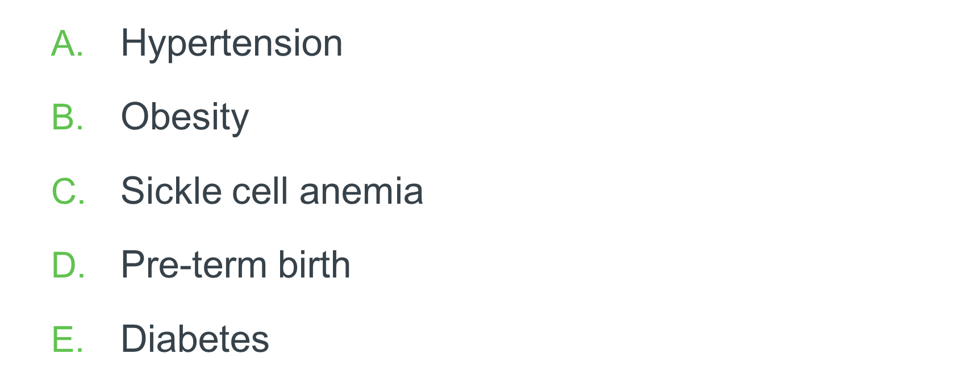
Notes:
This is our last question. Chronic stress increases risk for many health problems. Of the conditions listed on this slide, which is NOT impacted by chronic stress?
[read options from slide]
The answer is C – sickle cell anemia. Sickle cell anemia is a genetic disease that is inherited from biological family members. Chronic stress is a risk factor for all
the other conditions listed.
Our body’s reaction to stress when stress is constant can wear down our systems over time and increase our susceptibility to disease. These stressors can be exposure to violence; economic insecurity like not having enough food or not knowing whether we can pay the electric bill; and racism. Those who are lower in the class and racial hierarchy have more exposure to stressors that threaten health. They also have less access to resources that help cope with problems.
Chronic stress is constant and persists over an extended period of time. Chronic stress can result in serious health conditions including anxiety, insomnia, muscle pain, high blood pressure and a weakened immune system. It can contribute to the development of major illnesses, such as heart disease, depression and obesity.
Question Source: Unnatural Causes Health Equity Quiz.

Slide 15
Notes:
Many communities undertake initiatives aimed at improving the health of citizens. Often, these initiatives are intended to change individual behavior by offering opportunities and information that make it easier for people to quit smoking, get more exercise, eat healthier foods, or obtain health screenings for various diseases. While these programs can lead to good outcomes, they often don’t address the social determinants of health that are at least partially responsible for positive or negative health conditions in a community. Social determinants are complex. Sometimes focusing at the individual level is easier for communities, but it may not be the most effective way to improve health.

Slide 16
Notes:
Let’s look at an aspect related to social determinants of health and communities. Health starts in our schools, homes and communities. Think for a moment about that statement. Look at the two pictures. How might differences between communities' impact health for people who live there?

Slide 17
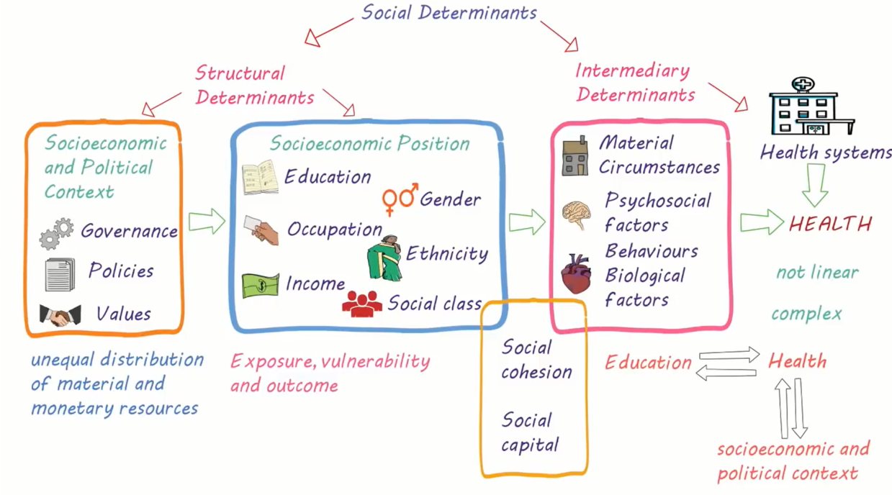
Image credit: Screenshot from Social Determinants of Health Video, Let’s Learn Public Health.
Notes:
As you can see, social determinants of health are complex. And you may be wondering how you, in a volunteer role, can influence change for such large issues.
To review, both structural and intermediary determinants impact health. Structural determinants include socioeconomic and political context, which influences an individual or group’s socioeconomic position. Socioeconomic status is influenced by a person’s education level and occupation, their income, gender, ethnicity, and social class.
Intermediary Determinants include one’s material circumstances and biological factors, like genetics. Psychosocial factors are factors involving both psychological and social aspects, or social conditions relating to mental health. Psychosocial health refers to one’s mental, emotional, social and spiritual health. Health systems also come into play to impact health.
Finally, this graphic shows a gold rectangle intersecting socioeconomic position (the blue box) and the intermediary or linking determinants listed in the light red box. The gold rectangle is intended to show how social cohesion and social capital can bridge gaps or deficits in some structural determinants. Social cohesion and social capital can be built. In fact, your involvement in this health volunteer program involves some social cohesion.
As you can see, the relationships are not direct. There is no single, straight line to get from poor to good health, or to influence a single social determinant. These factors do not exist in isolation.

Slide 18
Addressing Complex Needs
Notes:
It may seem daunting – even impossible - to address complex social determinants of health through your work. But we all have a role to play in improving health in our communities.
Social determinants of health can be addressed through developing community leaders, supporting social networks, and fostering a sense of community. The master volunteer program you are participating in is an approach to address social determinants. The hope is that you will become more engaged in your community – both through your structured volunteer work and within your personal networks. This engagement will contribute to improving health outcomes beyond the individual level. Your work will improve health for others.
Increasing access to community resources may be one of the clearest ways health teams can address social determinants. But as we work to do this, we must consider the barriers to accessing such resources. For example, imagine that you partner with an Extension professional to offer a series of healthy cooking classes in a low-income community. You are well-prepared for the first session, and really excited about the difference the program can make. But no one shows up. Disappointed, you might conclude that no one was interested in attending and cancel the remaining sessions. But the reasons for a low or no turnout may be more complex.
Considering social determinants means to look at the causes of the causes. To ask why. For our series of cooking classes, we might ask: “Why did no one show up?” There are a range of possible answers. What would your answer be?
For the sake of illustration, let’s say the response is “Because they did not know about the session.” To dig deeper, we would ask, “Why didn’t participants know about the session?” Think for a moment, why in this situation, might participants not know the session was occurring?
It may be that participants did not know about the session because they did not see the flyer placed on the community bulletin board. And to dig deeper still, we might ask, “Why didn’t potential participants see the flyer?” Think for a moment. What are some possible responses here?
Let’s assume that participants did not see the flyer because it was placed in an unlit area, and they get home from work after dark.
This is an oversimplified example, but you get the point. Asking a series of “whys” to tough questions can help to drill down to the root cause. In this overly simple example, there are other factors to consider. For example, perhaps the class was held during the day and participants would not have attended due to work conflicts. The point is that we can’t stop at the conclusion people simply are not interested. It is never that simple.

Slide 19
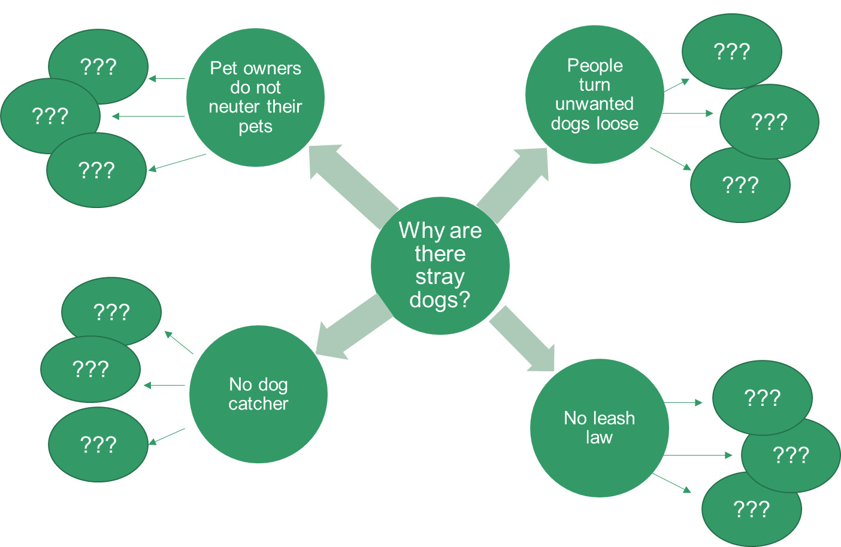
Notes:
For the sake of illustration, let’s look at a model for addressing complex issues. This is called the Stray Dog Model.
Let’s imagine your community has an issue with stray dogs. And this is what the community has identified as a key issue impairing their growth and development. We might start first by asking, “Why are there stray dogs?” Possible reasons are that there is no leash law in your town (a policy issue), or that there is no dog catcher (which might be an issue of local tax revenue, or of animal control being a low priority for your city). Other reasons might be that people turn their unwanted dogs loose or that they do not spay or neuter their pets, which leads to increased dog population.
As you can see, each of the four possible reasons why there are stray dogs has additional underlying reasons or causes, root causes of the issue. It is complex. But the more we ask “why” the closer we get to identifying the real issue.

Slide 20
Notes:
Let’s take the stray dog example one step further and examine how this is a social determinant of health. Recall that social determinants are the circumstances where people are born, grow up, live, work, and age that influence health.
This is a real-world example. One rural community was heavily impacted by diabetes. They also had high obesity rates and physical activity levels were low. A group in the community decided they wanted to do something to address the diabetes issue. Knowing that regular exercise can help prevent diabetes, especially among those who are pre-diabetic, they decided to look at how to get folks to exercise more. They did some focus groups to find out what types of exercise people were likely to engage in and identify the barriers to being active. It turns out that the biggest barrier to people getting out to walk in their community was…you guessed it…stray dogs. This community had an animal control issue. People did not feel safe going out to walk in their neighborhoods, or on a rural road, because they were afraid of all the stray dogs out. This made addressing the stray dog issue the most important first step to address diabetes.
In this example, stray dogs were a circumstance or condition where people lived that negatively impacted their health because it limited the physical activity – walking – that they were most likely to engage in.

Slide 21
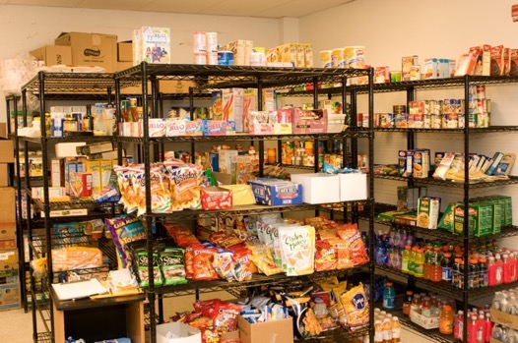
Situation:
Rural community, high poverty, 15 miles to nearest grocery store
Solution:
Food pantry, healthy food focus
Assistance applying for SNAP benefits
Transportation to grocery store in town
Notes:
Let’s look at one volunteer group’s project. This group lived in a rural community with a high poverty rate. The community was food insecure because of low income levels AND because the nearest grocery store was 15 miles away. This posed a barrier for those with no transportation, or those with limited resources to pay for fuel to get into town. The volunteer group decided they would establish a food pantry to address this need. The food pantry would operate through a local church and be supported by donations, both monetary and donations of food items. And they partnered with an Extension nutrition educator to make sure they had nutrition information and healthy recipes on hand to distribute to food pantry patrons.
You can already see the influence of social determinants of health on people living in this community. They may have relied on shelf-stable foods – perhaps highly processed, as these tend to be lower cost – and purchased fewer fresh foods because trips to the grocery store were infrequent.
The volunteers organizing the food pantry recognized the important role they could play to increase food access overall, and also access to healthy foods. They wanted to be a source of healthy food items for the community. So instead of merely asking for donations of canned goods to the food pantry, they put together a set a donation guidelines. This included recommending donations of canned goods labeled as ‘no salt added’ with an aim to lower sodium consumption and asking that donors avoid contributing sugary beverages, such as fruit-flavored drinks and sodas.
They also helped patrons apply for SNAP benefits to extend their food dollars when they traveled to the grocery store. SNAP stands for Supplemental Nutrition Assistance Program. Benefits under this program were formerly referred to as food stamps. In addition, they provided transportation by organizing trips to the grocery store using the church van.

Slide 22
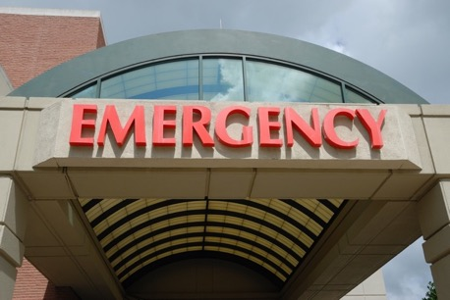
Situation:
Service providers in rural communities often saw clients with needs they could not meet
No list of resources or referral sources existed
Underutilized resources, unmet needs
Solution:
Engaged local hospital as sponsor
Community scan
Created resource guide; on hospital web site
Notes:
The next project example comes from another rural county. The group of health volunteers in this county determined that while many needs existed in their community, there were also many resources. The problem was that service providers often saw clients with complex needs – needs their agency or organization was not equipped to meet. They would rely on their local network to send out referrals. Limited connections meant some service providers were overwhelmed with referrals while others received none. People were not aware they existed, or did not realize the range of services provided.
You can see the issue here – a high need community where folks really wanted to help their neighbors. They just lacked the network to meet existing needs with existing resources. This volunteer group investigated the issue. They found a resource list developed in the past – it was very outdated. They partnered with the local hospital and collaboratively conducted a community scan to vet the services available, starting with the outdated resource list. They reached out – either by phone or in-person visit – to each resource on this list. They found that some of the organizations listed no longer existed. They found others that were new to the community, and some on the old list had expanded their services. This volunteer group worked together to vet and compiled an updated, comprehensive resource guide which is housed on the local hospital’s web site, available for both service providers and community members.

Slide 23
Situation:
High opioid prescribing rates
No non-drug treatment options for chronic pain available locally
Healthcare providers had limited treatment options; chronic pain sufferers had no alternatives to manage pain
Solution:
Identify evidence-based chronic pain self-management program
Arrange leader training
Offer in rural communities in partnership with healthcare providers
Notes:
Here’s another example of a master volunteer project addressing social determinants of health.
A Healthcare Team in one community were shocked when they learned their county had among the highest opioid prescribing rates in the state. They dug deeper to find out what conditions opioids are prescribed for. They discovered that they were commonly prescribed for chronic pain. Wanting to know more, the group worked with their county Extension educator to determine a course of action. They learned that treatment guidelines for chronic pain recommend that non-drug treatment options be tried first. They looked into these non-drug treatment options – exercise, cognitive-behavioral therapy, self-management programs, and physical therapy – and their availability locally.
They found very limited access. Repeated visits to physical therapists, most located an hour away, were cost prohibitive for many. Fitness facilities for exercise classes were expensive. And no self-management programs for chronic pain were available anywhere nearby. So the group worked with their county extension educator to identify how they could meet this need. They found several program options that included lay leaders in teaching. Group members got certified as program lay leaders and began offering chronic pain self-management programs at sites throughout their community. Programs were offered in partnership with local healthcare providers at sites convenient for participants, like churches, community centers, and clinics.
This locally-tailored approach helped overcome several barriers – transportation and limited access, to be certain. Additionally, volunteer lay leaders are effective at fostering social support and generating social cohesion. Because volunteers were involved in program delivery, social determinants relating to social cohesion as a support were present.

Slide 24
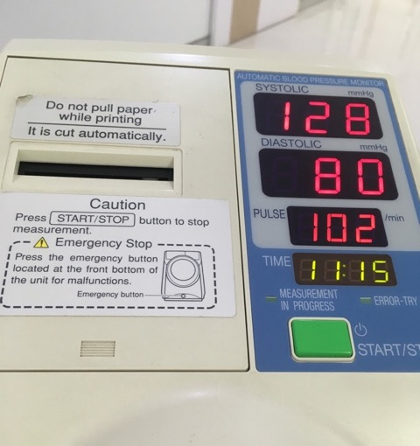
Situation:
High rates of stroke
Undiagnosed hypertension
People with diagnosed hypertension were not monitoring their blood pressure
Low-income, lacked transportation to places with blood pressure monitoring
Solution:
Raise funds to install blood pressure monitoring stations in libraries
Provide education and referral
Evaluate results
Notes:
Here’s our final example of a master health group addressing social determinants with their community work.
In this community, like so many across the United States, there were high rates of hypertension, both undiagnosed and diagnosed. High blood pressure is sometimes called the “silent killer” because it usually has no warning signs or symptoms. Many people do not know that they have high blood pressure, and that’s why it’s important to get your blood pressure checked regularly. High blood pressure is a leading cause of stroke, so it is important to keep levels within the recommended range.
People who have low incomes may not be able to afford a blood pressure cuff to keep at home. And while many retailers have blood pressure stations where people can check their blood pressure for free, those without transportation, and those residing in rural areas, may not have access.
Recognizing this as an issue, one master group brainstormed how they could help people monitor their blood pressure and teach the importance of stroke prevention and how to keep blood pressure at healthy levels. They decided that local libraries would be a good partner. They were located on the city’s public transportation route and were a site where many community members visited regularly. After obtaining permission from the local library system, they raised funds to purchase and install stationary blood pressure monitors in libraries. They worked with library staff to let people know about the monitors and raise awareness of the need to monitor blood pressure. Their county Extension educator supported the effort by training persons to present educational programs. And the library staff helped make sure that patrons measuring their blood pressure documented their levels. They even provided referral information for those with elevated blood pressure levels.

Slide 25
Notes:
The examples discussed here are just a few ideas of how social determinants of health can be addressed through your work. The main idea is to consider the health effects of issues – even those involving stray dogs – and figure out the root causes of community problems. Sometimes, there is a simple solution. But often the solution is more complex and may require partnering with others to influence community-level change. It may be that community organizations ask you to partner with them because you can meet needs they can’t. So be ready to answer the call, and look for the causes of the causes!

Slide 26
Thank You.

