Slide 1
Randy D. Walker, M.D., P.L.L.C.
1553 West Collin Raye Drive
P.O. Box 740
De Queen, Arkansas 71832
Phone: (870) 584-3000
Facsimile: (870) 584-3003
WWW.drrandywalker.com
Notes:
Good Morning
Thank you for having me. My name is Angie Walker and I am the office manager for Dr. Randy Walker.

Slide 2
CLINIC DEMOGRAPHICS
2 MEDICAL DOCTOR
8 ADVANCED NURSE PRACTITIONERS
1 PSYCHIATRIC NURSE PRACTITIONER
1 DIETICIAN
CLINIC HOURS
MON. – SUN. 7AM-7PM
AFTER HOURS PROVIDER ON CALL
ACTIVE PATIENT BASE: 11,000
3 LONGITUDINCAL CARE MANAGERS
HIGH RISK BENEFICIARIES: 535
1 EPISODIC CARE MANAGER
50-75 HIGH RISK BENEFICIARIES
“Quality Team Based Healthcare must be delivered to the right person, by the right person, at the right place, and at the right time every time.”
Notes:
Our clinic has been in operation since 07/2003. We are comprised of
2 Medical Doctors (Just added in 08/2021)
8 Advanced Nurse Practitioners
1 Psychiatric Nurse Practitioner
1 Dietician
We have 3 locations
Main Clinic open Monday – Sunday 7am-7pm
Leopard Care Clinic – School Based Clinic Monday – Friday 7am-4pm (During School Year)
Satellite clinic in Dierks, Arkansas Monday – Friday 8am-5pm
WE have an active patient base of over 11, 000 based on a 2 year look back and offer an after hours triage service after 7pm as well as a Home Visit Schedule for Home and Facility Bound Patients

Slide 3
Multi-Specialty Clinic
Adult & Pediatric Allergy
Adult & Pediatric Immunizations
X-Ray
Ultrasound
Spirometry
EKG
Fracture Care & Casting
Joint Injections
Minor Skin Lacerations
Wound Care
DOT Physicals
Drug Screens
Bone Density
Consortium Testing
Employment & Pre-Employment Physicals
Workers’ Compensation
Laboratory Testing
EPSDT
Wellness Exams
Nerve Conduction Testing
IV Fluids & Antibiotics
Notes:
We are a multi specialty clinic. Our goal is to do it all. Take care of our patients in their own community. We all know that as you start to move outside of your office it increases the time and bureaucracy that you deal with as well as what the patient deals with.

Slide 4
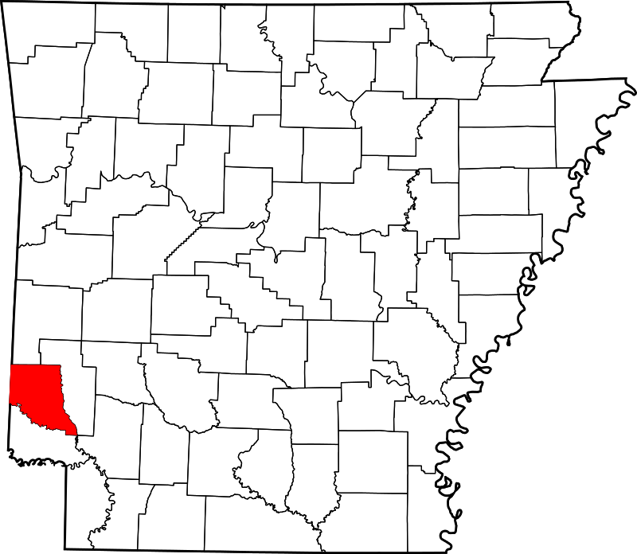
Sevier County Demographics
De Queen, Arkansas
Population 15,686
White 55%
Black 4%
Hispanic 34%
Economic Factors
Med. Hshld Inc. $49,470
Poverty Rate 18%
Food Insec. 15%
Uninsured 17%
No Trans. 5%
Notes:
Hispanic Population of >52%
We do have an undocumented population and about 300 Marshallese in our community.

Slide 5
TEAM BASED CARE
Notes:
There is no way that one provider can care for the patient in totality. It takes a team. We would not be where we are today without our team. People like to say it takes a village to raise a child, I can tell you that it takes everyone in the practice from the front office to the back office to provide care for a patient.

Slide 6
Driving Innovation
MCMP - Data Deadlines and Compliance
ACIC - Diabetes Reporting/Management
ACIC - HTN Reporting/Management
ACT - Prevention Reporting/Management
CPCI - Project Lead/Reporting/Management
CPC+- Project Lead/Reporting/Management
PCF – Project Lead/Reporting/Management
Confirmed – Project Lead/Management
People Don’t Care How Much Your Know Until They Know How Much You Care!
Notes:
Increase knowledge way to care for rural populations in Arkansas.
Increase understanding and identify ways to drive innovation in rural America
And how can we improve processes in the health community and identify resources to assist with preparedness
How do you Drive Innovation to Rural Areas? SIGN UP FOR PROGRAMS AND PILOT PROJECTS & Study your Numbers

Slide 7
Access & Continuity
1. Open Access
2. Expanded Hours Monday – Sunday 7am-7pm
3. Alternatives to Office Visits
Home Visits
Telehealth
Remote Patient Monitoring
E-Visits & Structured Phone Calls
4. 24/7 Access to EHR
5. After Hours Triage
6. Telehealth/Specialties
7. Specialty Space
Notes:
Access & Continuity: Access – Services when and at the time that the patient needs them. Continuity: Long Terms Trusting Relationship to Enable Effective Provisions of Care
Open Access:
Expanded Hours: Better for Patients, Better for Staff
Alternatives to Office Visits: Home Visits, Telehealth
24/7 Access to Care: Patient Portal
After Hours Triage:
Telehealth Specialties: Nothing has been more of a game changer for rural health than Telehealth
Specialty Space: We pull a list of those places we refer the most to and request that they use specialty space that we have available for specialty clinics.
Projects in the Works/Testing: Mental Health Moments, Chronic Care Management, Remote Patient Monitoring

Slide 8
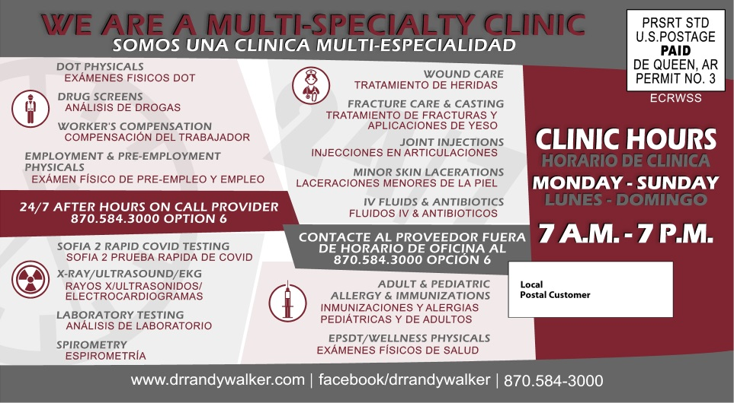
Access & Continuity Ideas
Notes:
All outreach materials should be language appropriate. Get with your local employers / plant HR person and identify the languages that represent the community / the plant.

Slide 9
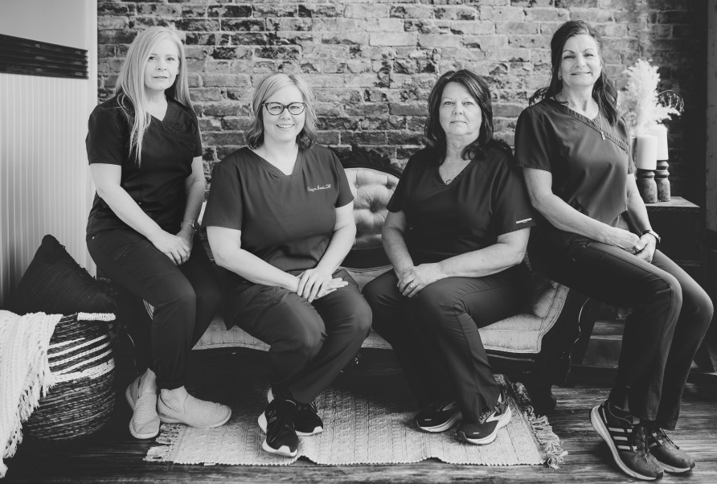
Care Management
1. Episodic Care Management
Follow Up Phone Calls within 24 Hours
2. Longitudinal Care Management
Monthly Phone Calls to Keep Patients Stable
3. 2-Step Risk Stratification Process
4. Follow Up Phone Calls within 24 Hours of Hospitalization/ER Visits
5. Chronic Care Management
Notes:
How Many Care Managers do we have in the room? Do you know the rule of thumb on the number of patients you should be able to manage? (suggest they add answer to the chat… give a minute for them to respond)
The answer is 75
Another question so stay near that chat and drop in your answers!!!
How many of you risk stratify your patients? (They should be able to drop in the chat or give you a thumbs up emoji)
How many of you screen for SDOH in your patients and documenting the results of the screening in your EHR? (
We break that up into two buckets
Episodic – I am 45 years old and I break my Hip – Short, quick relationship. Our interactions will be short term and goal oriented.
Longitudinal – I am 85 years old and I break my hip – this will be a long term relationship with a goal of stabilization.
I don’t want you to get hung up on age because for Team members that are dealing with co-morbidities that will last their lifetime. Diabetes, COPD, CHF, Hypertension they are longterm care management.
We do a follow up 24 hour phone call for all ER/Hospitalizations. We have to get our arms around those patients quick as we know they have a tendency to return to ER/Hospital with confusion of medications or worsening of conditions.
Chronic Care Management – Pull your patients with co-morbidities into this platform for management. They have elevated risk which equals cost.

Slide 10
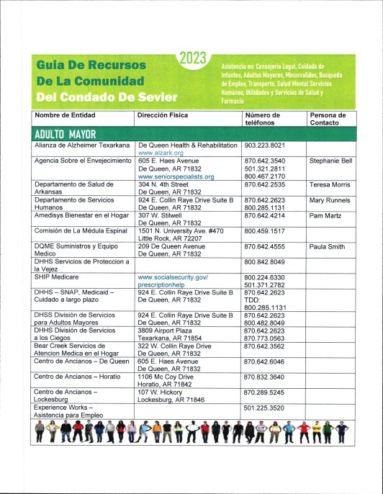
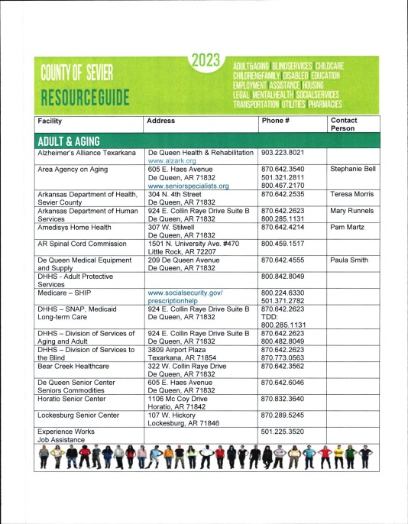
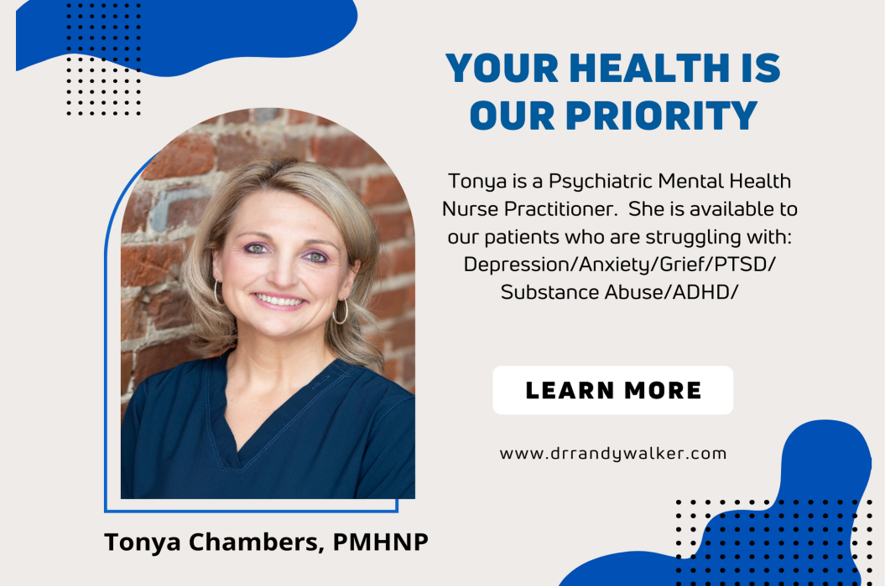
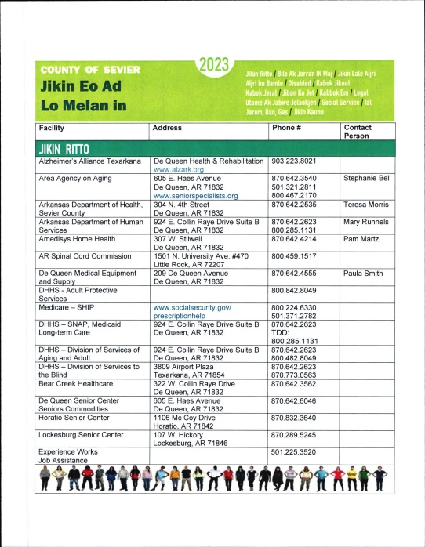
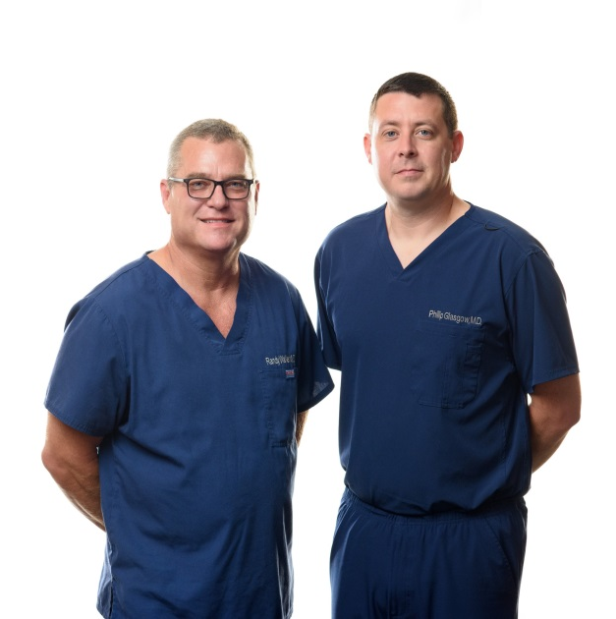
Care Management Ideas!
Notes:
Identify your top 10 patients with expenditures outside of your office. ER/Hospitaizations
Do you offer a COPD Rescue Pack?
Why is your patient going to the ER with Exacerbation? Rescue Pack Meds
Clonidine for your patients who are having issues managing BP
Identify your top 5 ER/Hospital Diagnosis and use them for Education platforms and community outreach.
Screen for SDOH. . . . .but have an answer! (EXPAND HERE on your ANSWER)

Slide 11
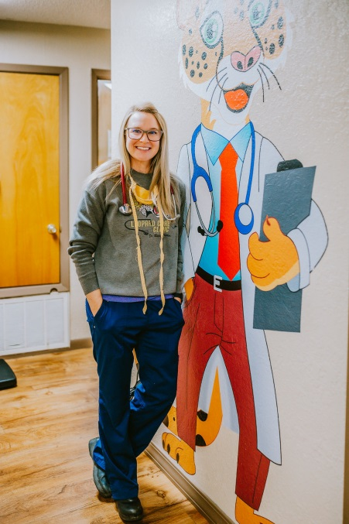
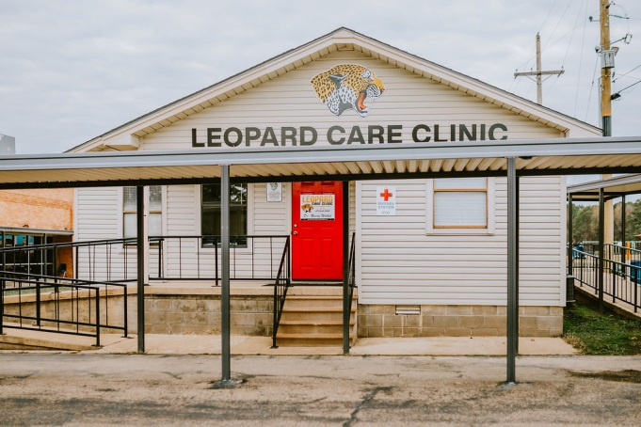
Comprehensiveness & Coordination
1. We must meet the needs of our community
Medical
Social
Behavioral
2. We must bring together our medical neighborhood.
Resource Guide
Transportation
Food Pantry
3. We must start to bring services in house to make them accessible to our patients
Notes:
?? Does Tonya coordinate with the school when there is a +SDOH finding? How does that partnership work?
While you have a school based clinic how does this partnership work with the school district?

Slide 12
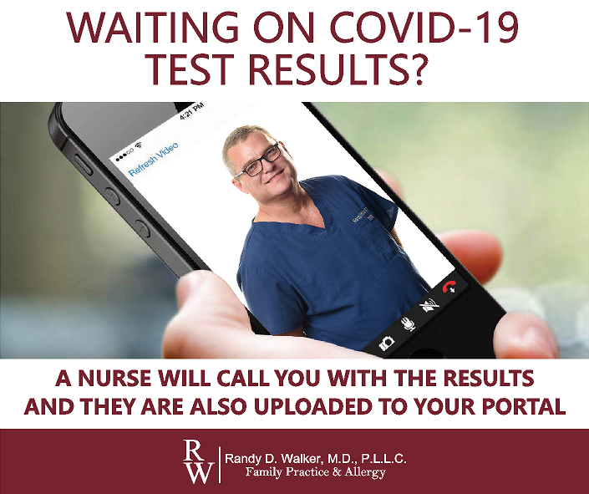
Comprehensiveness & Coordination Ideas!
Notes:
We Identified that our number one reason for sending patients to the ER was possible heart attack. My providers reviewed available equipment and we implemented Quidel Cardiac Triage. We can now tell with laboratory results whether or not a patient is having a heart attack or simply needs a stat referral to cardiology. The only cost to us was moving our lab from CLIA Waived to Moderate Complexity. (Any idea how many ED visits you have saved???)
We produce a Resource Guide for our patients. When we screen you for SDOH and you are positive for food, transportation or housing insecurities we provide you with a Resource Guide. (how often is this updated and where do you keep it?)
We have an in-office food bank. (Expand on how this came to be and if there are any partners. How do you justify this?)
We offer transportation – We had a patient who did not have transportation. They were going to call the Ambulance to go to the ER to get their 6 month medication refills. (How did you identify the need? How do you address the liability? How do you justify the cost?)
We offer onsite both a Marshallese and Hispanic translator. Both are available to go with the patients to the pharmacy to assist with navigation.
We offer coverage to the other primary care clinics in town so that their patients don’t feel the need to go to the ER (Expand on this and how it relates to SDOH)

Slide 13
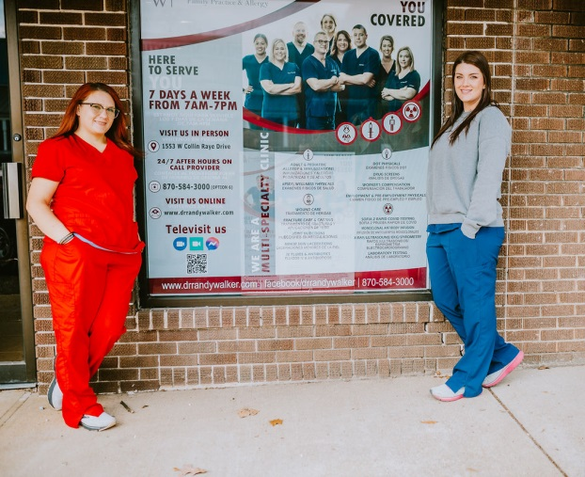
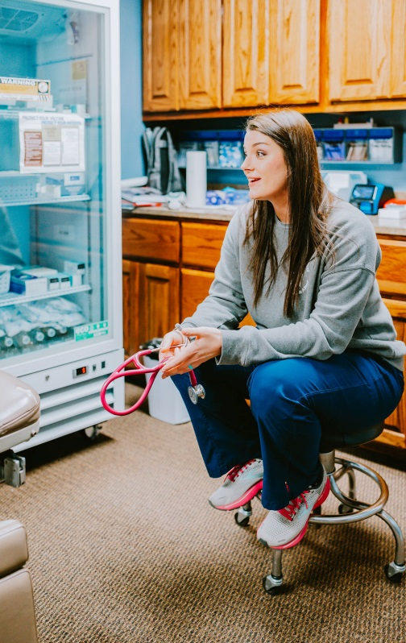
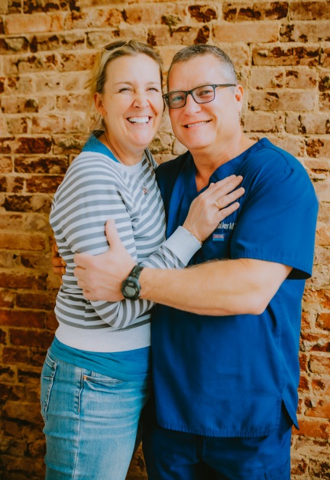
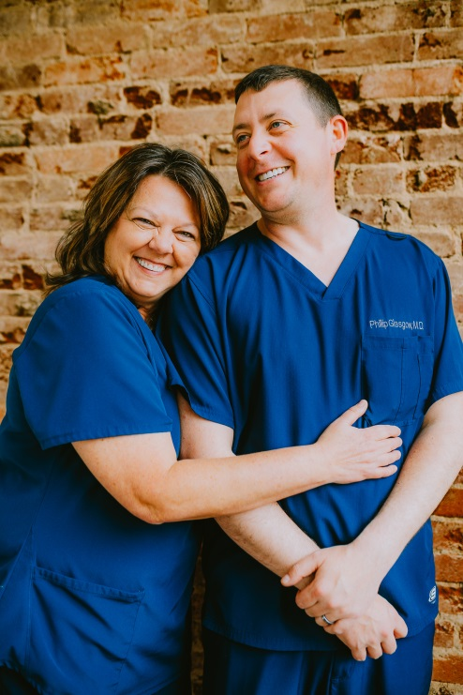
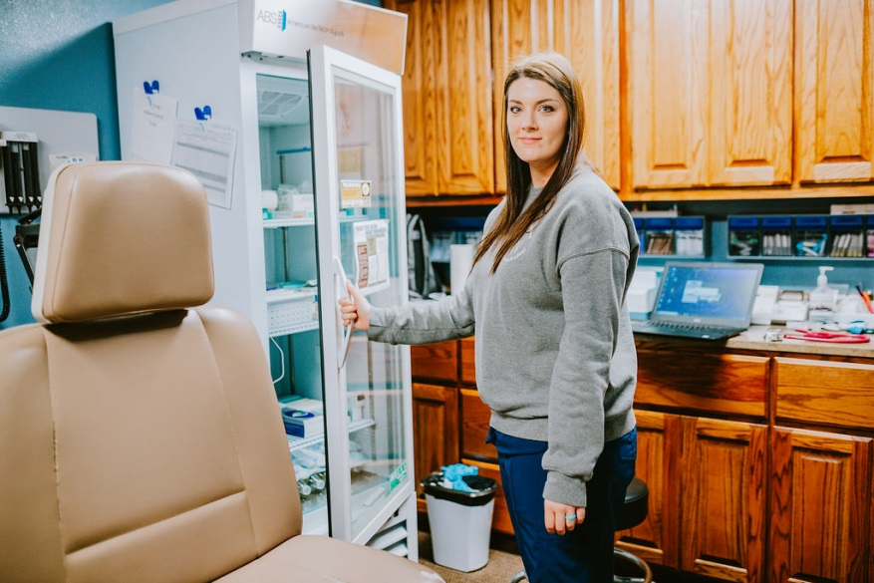
Patient & Community Engagement
1. Patient Advisory Board
2. Patient Engagement
3. Introduce Patient’s to your Team Members
4. Introduce Patient’s to the Services that you offer
5. Offer outlets for your patients to make recommendations.
Notes:
Relate back to SDOH.

Slide 14
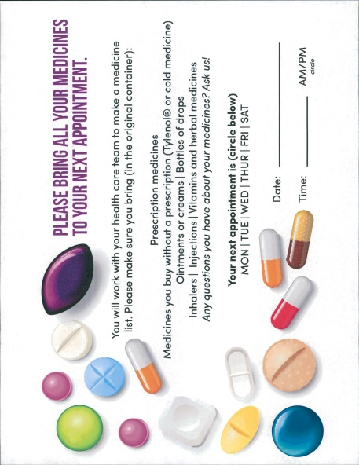
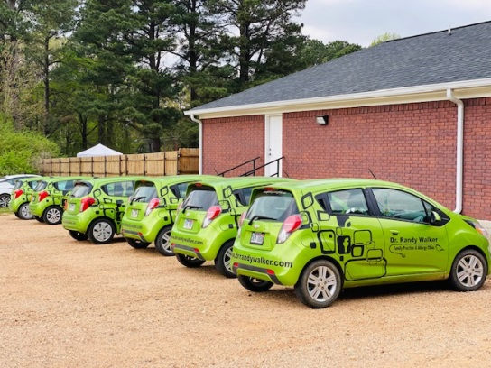
Patient Engagement Ideas!

Slide 15
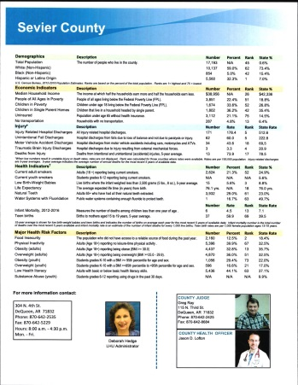
Planned Care @ Every Visit!
1. Look at your patient in totality. Do you identify their care-gaps?
2. What Clinical Quality Health Alerts can you set in your EMR?
3. Do you have SDOH Screeners for Staff to administer to patients consistently?
4. Are you having weekly Team Meetings to identify:
Quality Improvement Projects
PDSA Processes
Work flow Issues
Staff Recommendation
5. Are you acting and studying these recommendations?

Slide 16
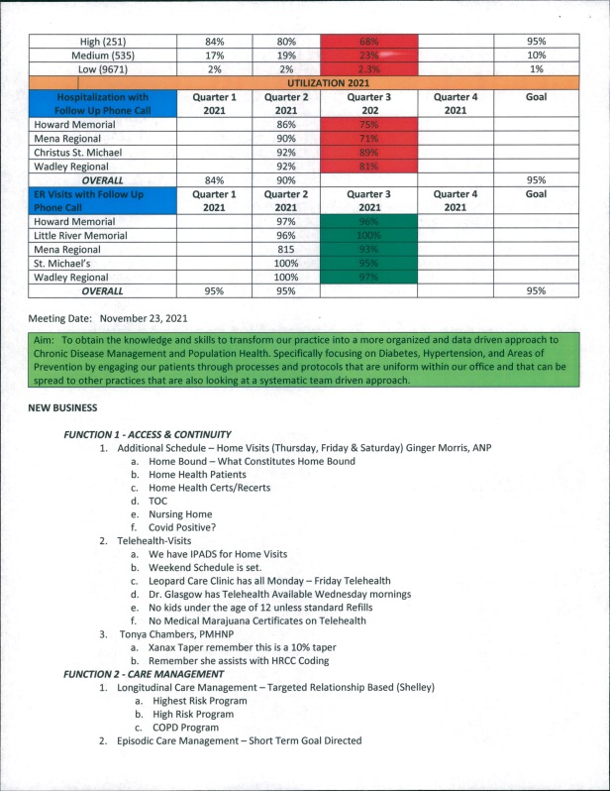
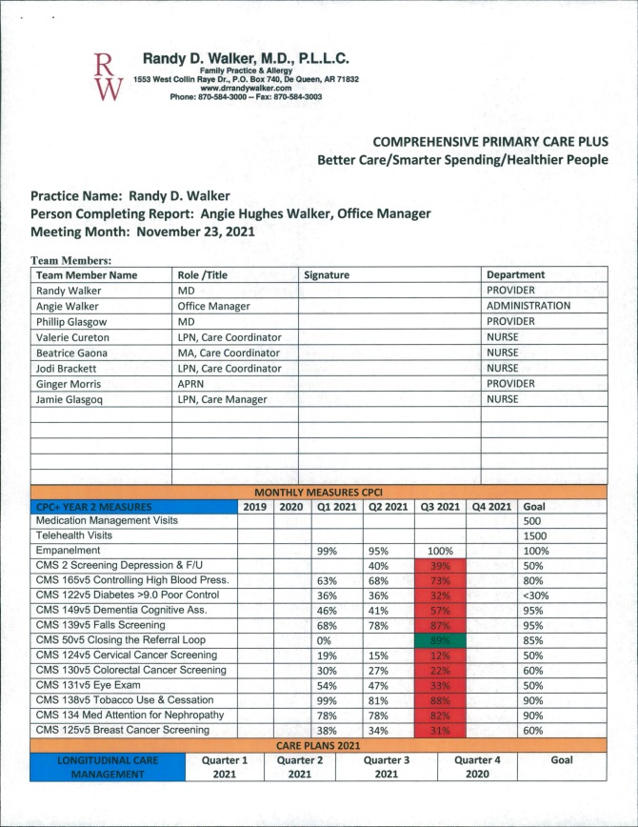
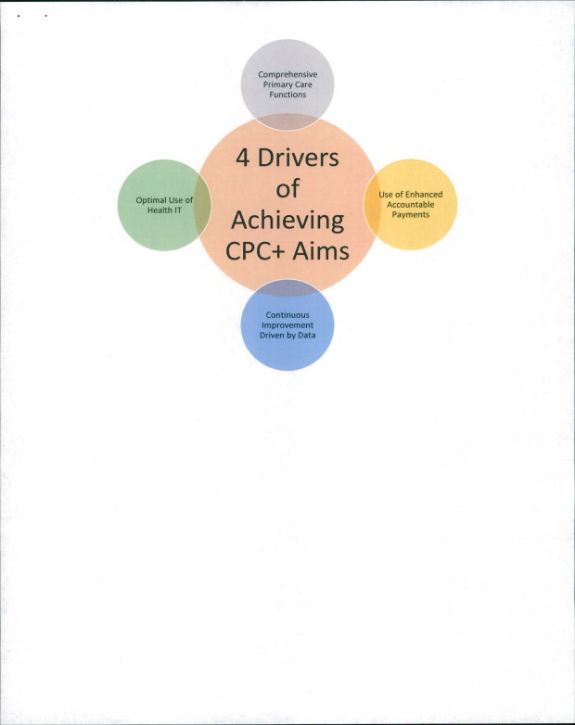
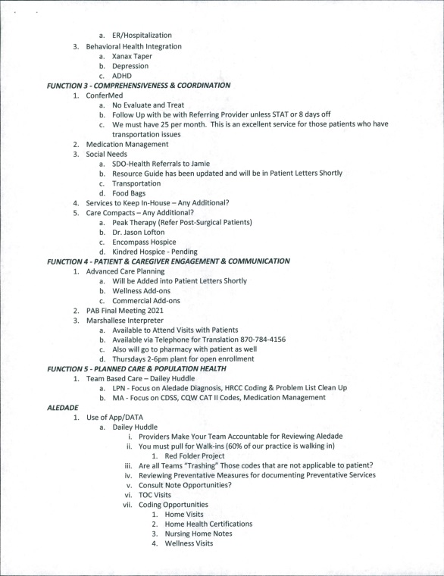
Planned Care Ideas!

Slide 17
Location of Services
Transportation Barriers are Barriers to Healthcare Access.
Dierks Clinic
2020 – 267
2021 – 363
2022 – 551
2023 - 418
Notes:
Transportation barriers lead to rescheduled or missed appointments, delayed care, and missed or delayed medication use. These consequences may lead to poorer management of chronic illness and thus poorer health outcomes. Transportation is a basic but necessary step for ongoing health care and medication access, particularly for those with chronic diseases (Fig. 1). Chronic disease care requires clinician visits, medication access, and changes to treatment plans in order to provide evidence-based care. However, without transportation, delays in clinical interventions result. Such delays in care may lead to a lack of appropriate medical treatment, chronic disease exacerbations or unmet health care needs, which can accumulate and worsen health outcomes

Slide 18
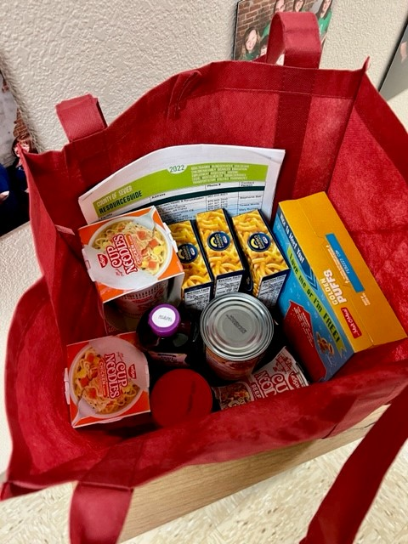
Food Pantry
82% of Arkansas counties have one or more communities that need improved food access. This means residents must travel more than one mile in an urban setting or more than 10 miles in a rural setting to access fresh, healthy food. Without access to healthy foods, people are at a higher risk for obesity and diabetes.
Notes:
80% of our healthcare happens outside of the walls of the doctor’s office

Slide 19
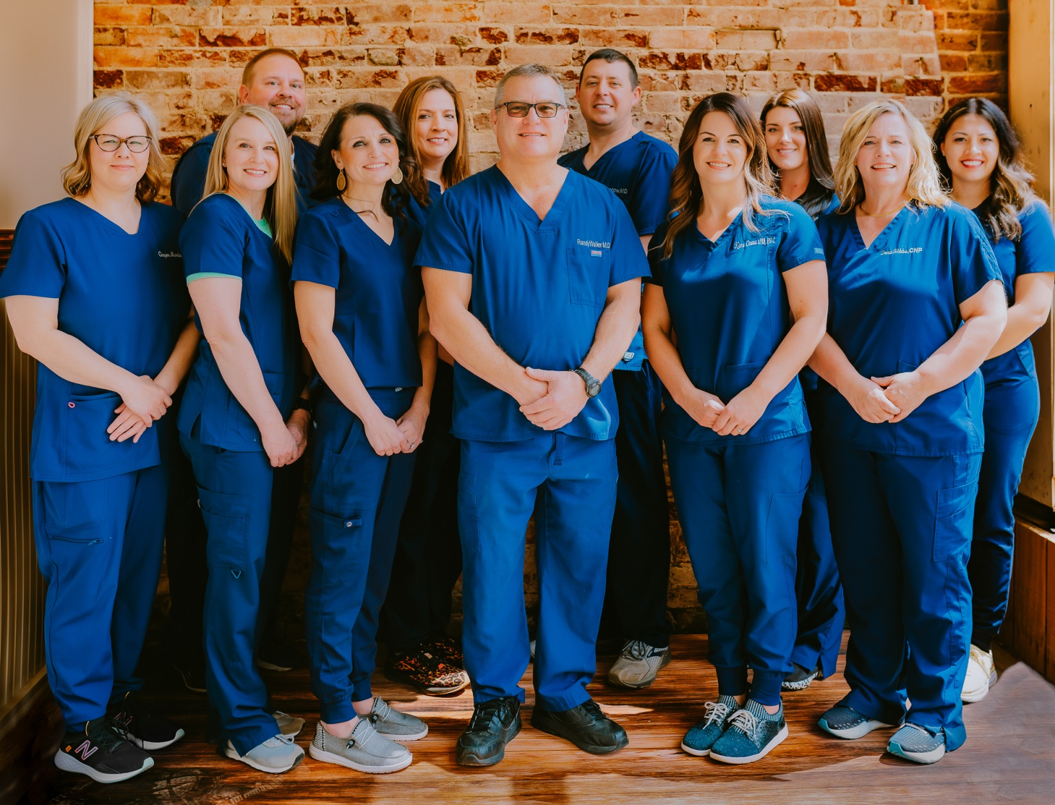
HEALTH EQUITY
Driving Innovation so that everyone gets the Healthcare they Need and Deserve. Underserved Communities Often Include:
• Low Income Americans
• Rural Americans
• Low Health Literacy
• People of Color
• Immigrants
• People with Disabilities
• Old Patients
• Under/Uninsured
Notes:
It is our responsibility as a providers to ensure equal access to quality telehealth/healthcare for our patients. This is important regardless of the patients social or economic status.
Have you looked at your patient panel. . .your community make up. What does health equity look like in your practice? In your community? Do you have directions for telehealth in all languages? Do you have a translator?

Slide 20
WITHOUT HEALTH EQUITY
Higher Mortality Rates
Higher Rates of Disease
Illness Severity
Higher Medical Costs
Lack of Access to Treatment
Lack of Access to Health Insurance
Notes:
What happens when underserved communities lack equal access to healthcare? We see higher mortality rates, higher rates of disease, more disease and disease severity, higher medical costs, lack of access to treatment, lack of access to health insurance. Think about those underserved populations that had a lack of access to healthcare during COVID? Think about those telehealth appointments that you performed? How many were for Hispanic? Marshallese?
How long did it take to engage those populations during the pandemic? (SHARE YOUR EXPERIENCE)
Think about the population who your suddenly removed barrier to telehealth from them by doing away with the strict requirements? How many patients accessed telehealth via facetime, facebook vide that had never accessed it before?

Slide 21
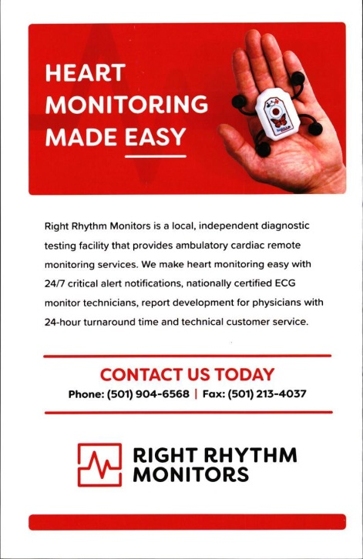
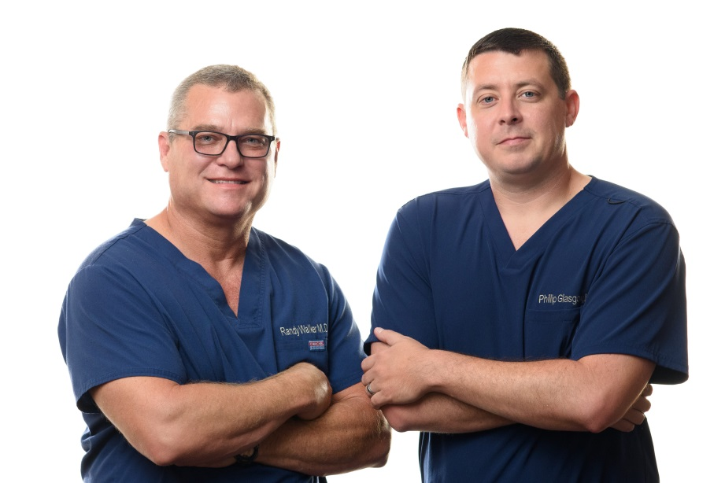
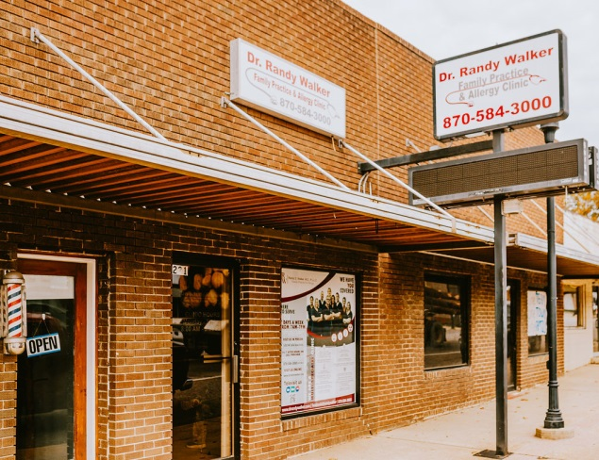
Coming Soon!

Slide 22
Better Care/Smarter Spending/Healthier People!
Notes:
Remember this population stands to benefit greatly from these services. WE have a responsibility to make sure that we don’t leave them behind.

