Slide 1


Arkansas Rural Health Partnership
Social Determinants of Health: Sustainability

Slide 2

CREATING A GRASSROOTS HEALTHCARE FOUNDATION
Arkansas Rural Health Partnership (ARHP) was founded by a handful of rural hospital leaders who knew the significance and stabilizing force of home, community, and local healthcare.
“Understanding of your community and those you serve”
OUR MISSION
Create and implement sustainable community solutions that support and improve the healthcare infrastructure and strengthen healthcare delivery across rural south Arkansas.
OUR VISION
Ensure that rural residents across south Arkansas have access to locally available, quality healthcare through collaborative efforts.

Slide 4
ARHP FOCUS AREAS
Long-Term Community Impact
  Healthier and viable Communities
  Decrease in Outward Migration
  Recruit & Retain Skilled Professionals & Their Families
  Increase in Investment Strong, Rural Ecosystem
  Attract New Residents, Businesses, & Events
At ARHP, we believe that rural communities thrive when residents and key stakeholders come together to determine and meet demonstrated need. ARHP is committed to strengthening the ecosystem of rural communities across rural Arkansas by engaging in transformative conversations, partnerships, and initiatives.
COMMUNITY INITIATIVES
&
POPULATION HEALTH
RURAL HOSPITAL VIABILITY
&
SUSTAINABILITY
HEALTHCARE PROVIDER TRAINING
&
EDUCATION
HEALTH WORKFORCE PIPELINE
Regional Resource Hub For Rural Communities

Slide 5



MEETING THE NEEDS OF THE COMMUNITY
THE GOOD FOOD RX
ENROLLMENT SERVICES
NAVIGATION SERVICES
  Pilot project with two clinics and their chronic care management programs
    Lake Village Clinic/UAMS East-Helena
  Food distribution centers for seniors (age 65+) with chronic disease experiencing food insecurity
  Participants provided with:
    Healthy food (delivery & grocery store)
    Nutritional/health coaching
    Cooking classes/Recipes
    Virtual patient education with nursing students
    Health improvement tracking/support
    Remote patient monitoring devices
    Virtual exercise classes
  Community Benefits Counselors
  Housing & Food Assistance
  Insurance Enrollment for Medicare and AR Works
    5,377+ Individuals have been served
  Prescription Assistance Enrollment
    5,577+ prescriptions obtained
    9.7 million dollars in cost savings
  Community Health Resource Hub
  Connection Point to Local Healthcare Resources
  Community Benefit Counselors provide free patient navigation services
  Toll free number serves as a hotline staffed 8 am to 5 pm Monday-Friday
  Resource directory

Slide 6
  Pilot project with two food distribution centers partnering with chronic care management programs to provide food for seniors (age 65+) with chronic disease experiencing food insecurity
  Participants provided with:
    Healthy food (delivery & grocery store)
    Nutritional/health coaching
    Cooking classes/Recipes
    Virtual patient education with nursing students
    Health improvement tracking/support
    Remote patient monitoring devices
    Virtual exercise classes

Slide 7
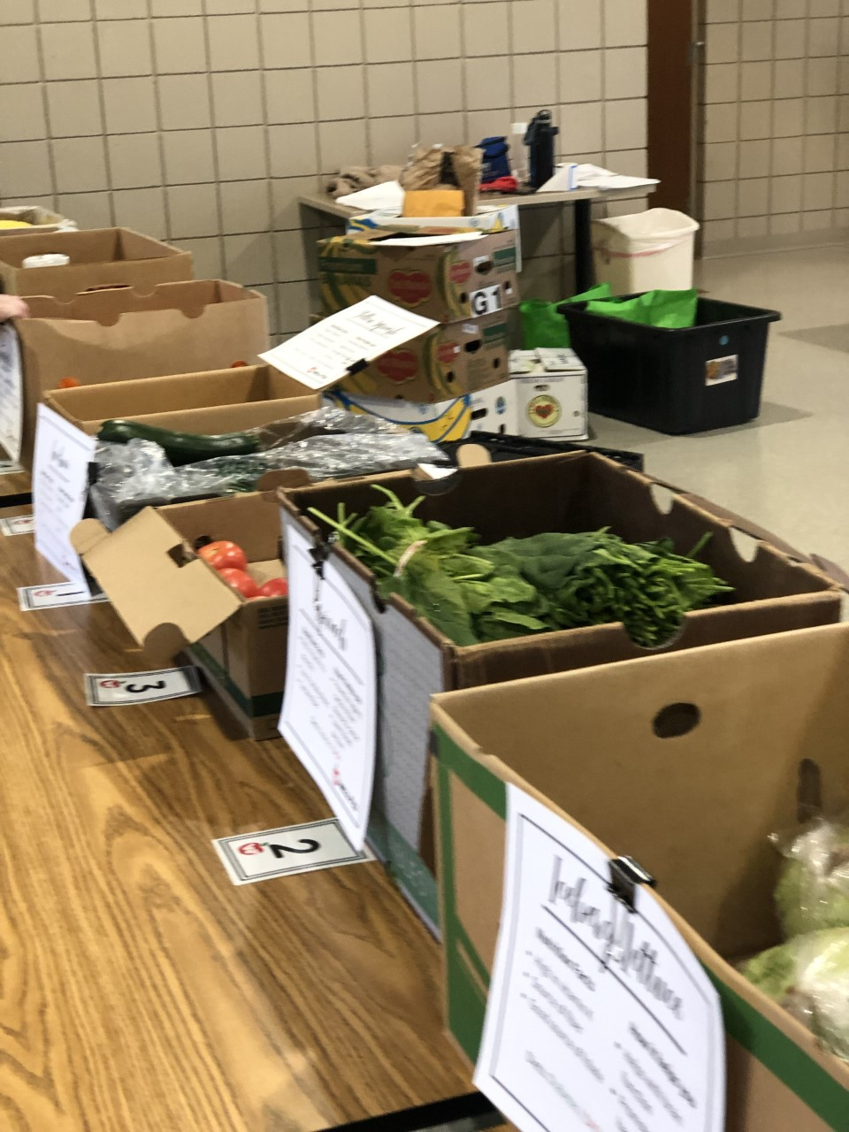
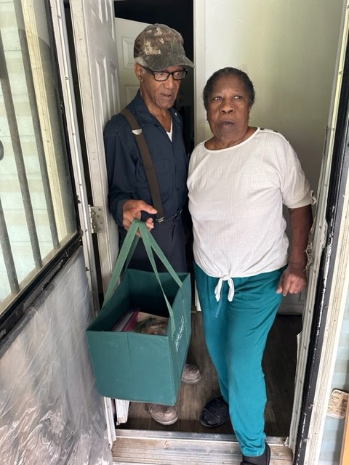
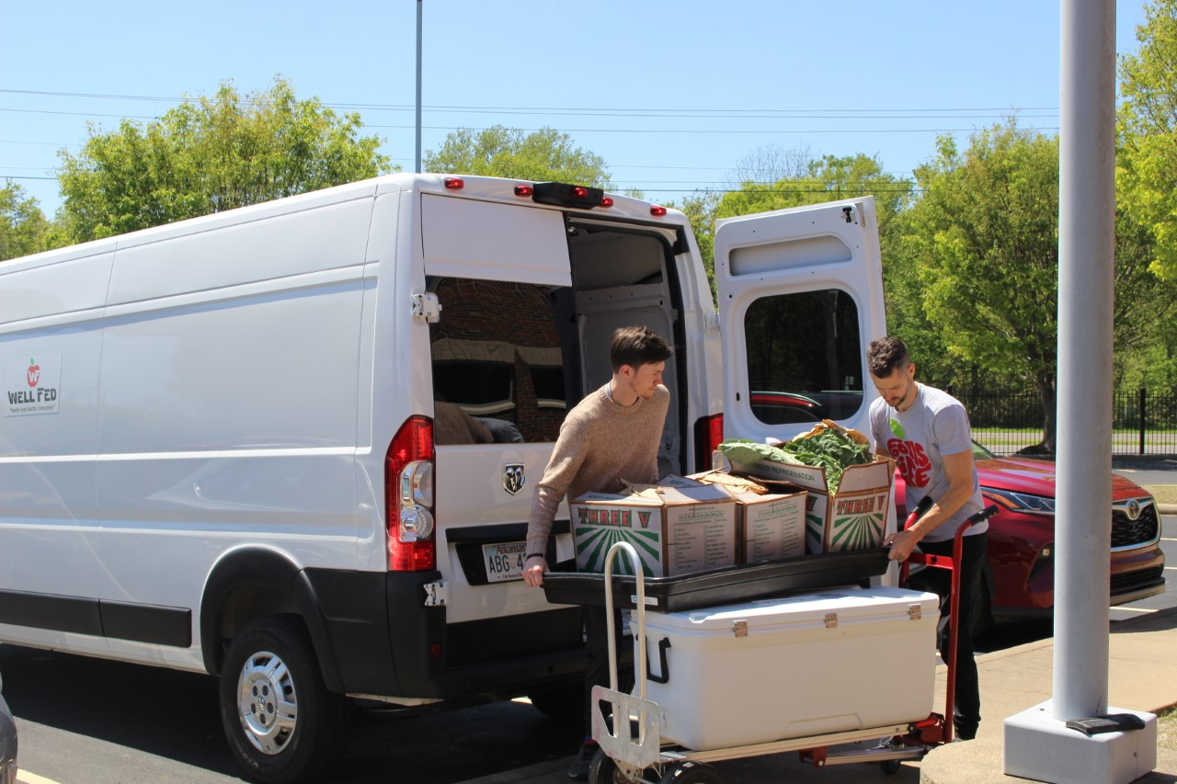
The Good Food RX Components
The Telehealth Resource Center in partnership with UAMS Institute of Digital Health
Patient Education in partnership with UAMS College of Nursing
Menu planning and recipes in partnership with UAMS Center on Aging
Fresh fruits and vegetables through Well Fed
Food Delivery services via community health workers
Exercise Classes in partnership with UAMS Center on Aging and local churches

Slide 8
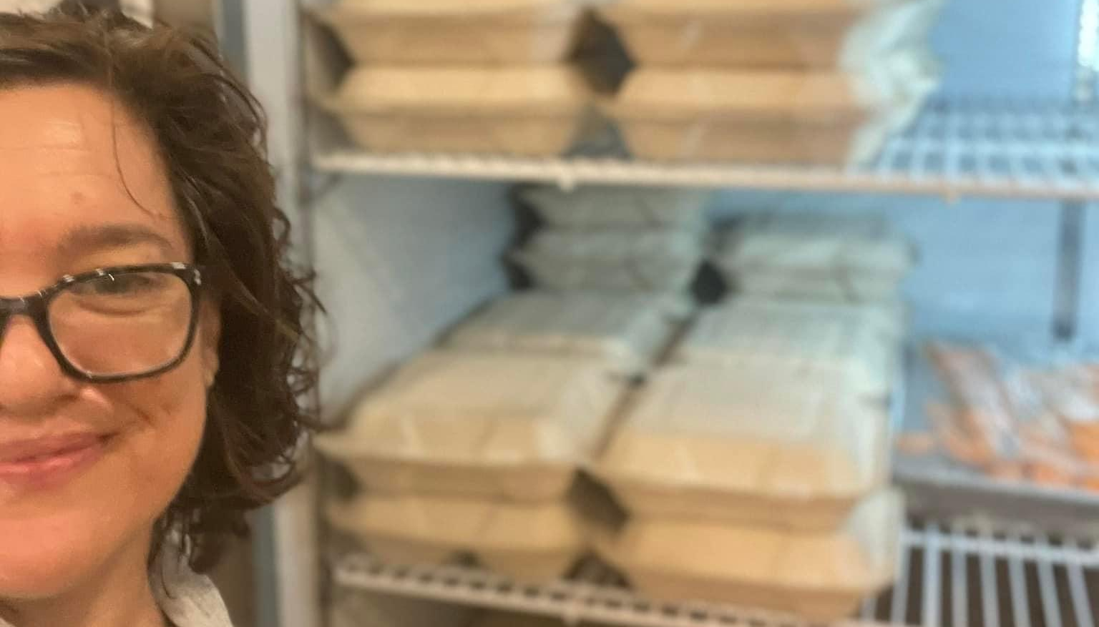

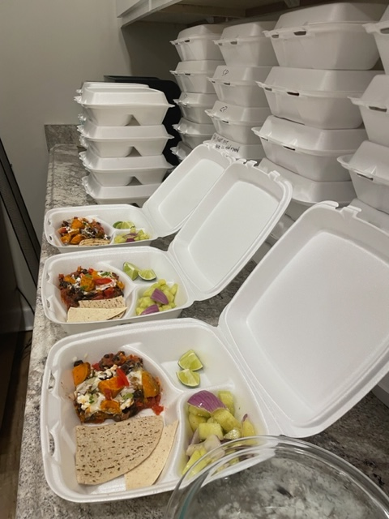


Slide 9
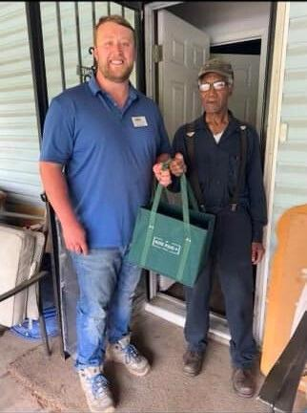
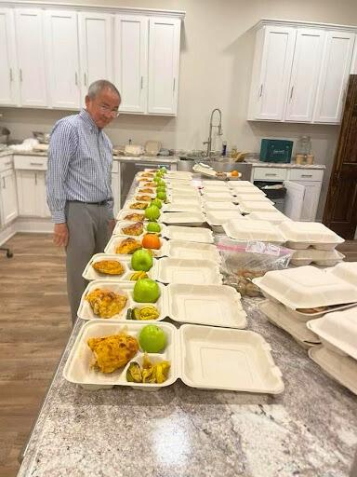
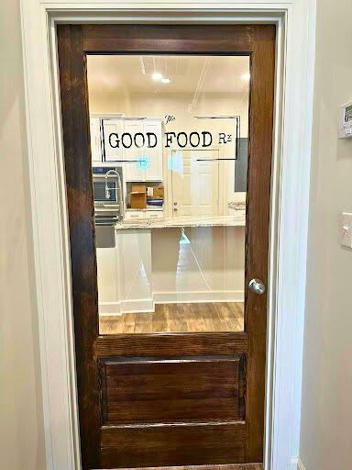
THE GOOD FOOD Rx
  Fill current workforce needs
  70 Arkansas Delta Students
  Degrees in Health Information Technology and Behavioral Health Technology
  Apprenticeships
  Community Health Worker Training
  Career Placement

Slide 10
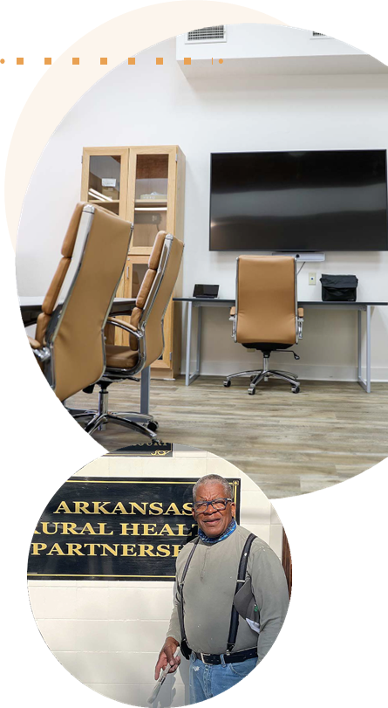
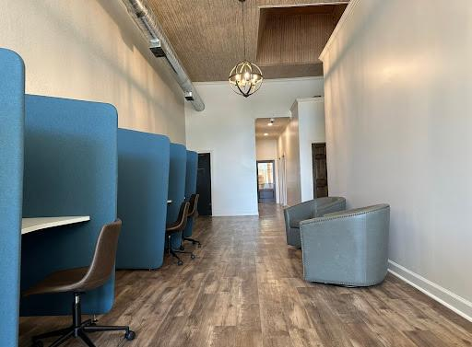
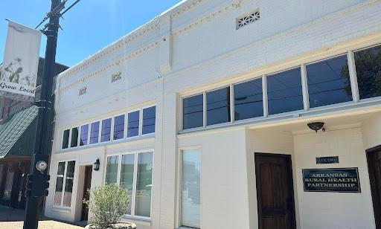
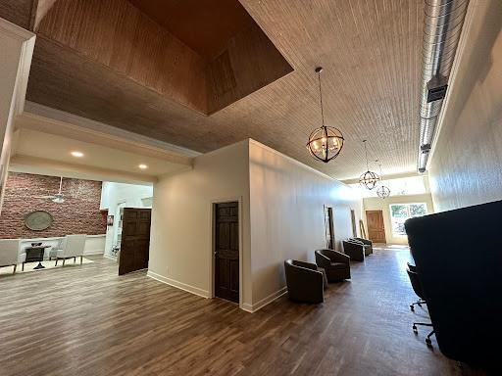
TELEHEALTH RESOURCE CENTERS
  Located in Lake Village, Pine Bluff, and Helena, Arkansas
  A hub used to promote, educate, and train healthcare professionals
  Offers capacity to provide telehealth visits and provides additional support from ARHP Community Benefits Counselors
  Educates and support healthcare providers and patients with remote telemonitoring devices
ARHP OFFICE
  The epicenter of operations and the launch pad for collaboration, innovation, and connection between diverse partners and community members.
  Houses the Telehealth Resource Center, a meeting/conference room space, and offices for project staff and senior leadership.
  In 2022, it will house the The Good Food Rx distribution center.

Slide 11
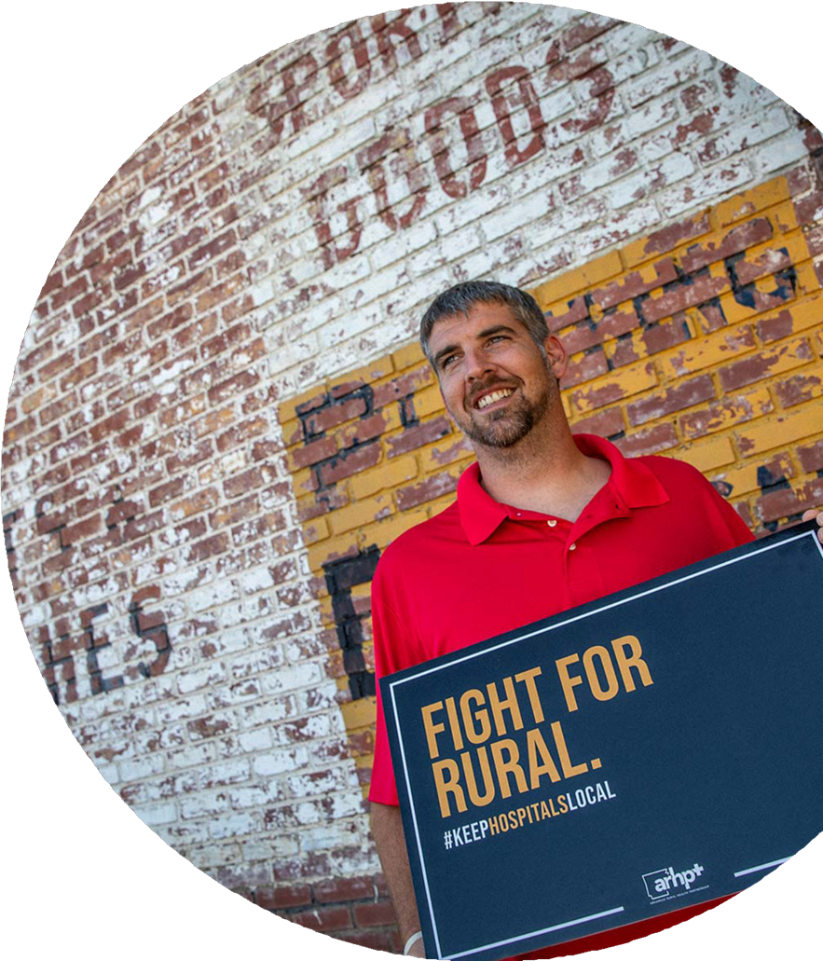
REMOVING BARRIERS TO
BEHAVIORAL HEALTH
OUR IMPACTS
BEHAVIORAL HEALTH TASK FORCE
  36 members since June 2018:
    Developed Regional Behavioral Health Strategic Plan
    Developed Pilot Drug Court Program
  Current efforts target increasing the availability of local inpatient behavioral health treatment facilities in rural South Arkansas.
1,017
Counseling Sessions
5
OPIOID CRISIS INFORMATIONAL VIDEO
Peer Recovery Specialists
  Produced an education and awareness video highlighting Delta residents, providers, and communities facing the opioid crisis.
2,838
AR County Southern District Pilot Drug Court served 2,828 individuals
SUBSTANCE USE DISORDER SERVICES
  SAMSHA Creating Safe Scenes training for law enforcement officers (LEO) – CLEST certification
  Produced a Peer Support Specialist video
  Be in the Know and Drugs of Abuse education in schools and communities
  Internship program providing SUD education including: Drug Take Back events, Don’t Run, Call 911, Narcansas APP
  Peer Support Specialist Services
  Naloxone Training and Kits
  ARHP SE AR Drug Summit to be held June 22, 2023
  Provide substance use screening and linkage to care including:
    Counseling
    Medication Assisted Treatment (MAT)
    Peer Recovery
102
LEO’s trained/CLEST certified in Creating Safe Scenes
ABOVE: Jarrid Duncan is a behavioral health counseling and substance use disorder treatment advocate with the Breaking ARM180 Ministry in the DeWitt, AR area.
Notes:
Partnered with 1st and 10th Judicial DTF to provide Creating Safe Scenes training:
Understand how individuals come to experience a behavioral health crisis
Understand how best to make a safe connection with an individual experiencing a crisis
Learn about de-escalation strategies for working with people in crisis
Learn strategies for developing community networks and referral resources
Understand how to improve the safety of both the responder and the individual in crisis

Slide 12
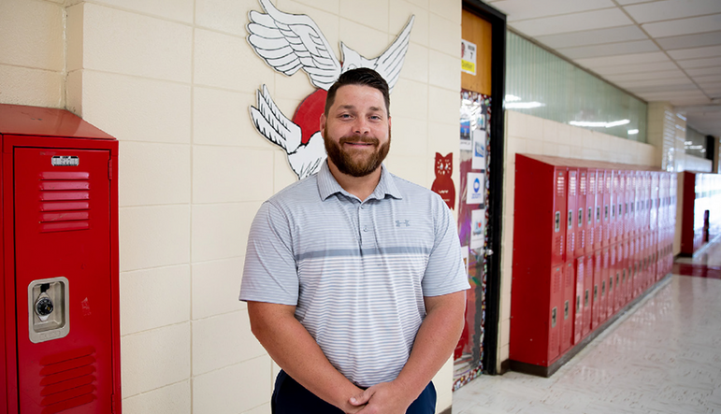
MENTAL HEALTH FIRST AID (MHFA)
1700+
educators, community leaders, law enforcement, and teens trained in Mental Health First Aid
COMMUNITY HEALTH NEEDS ASSESSMENTS
In 2016, 2019, and now again in 2022, the Arkansas Rural Health Partnership (ARHP) conducted Community Health Needs Assessments for each of its hospital members. The data unanimously prioritized behavioral health as the highest concern in every community surveyed.
MENTAL HEALTH FIRST AID (MHFA)
  an evidence-based training course that teaches individuals how to identify, understand, and respond to signs of mental illness and substance use disorders.
  designed to give laypersons the skills needed to reach out and provide initial help and support to someone who may be developing a mental health or substance use problem and/or experiencing a related crisis.
McGehee High School Principal, Justin Holt, is one of more than 1700 adults and teens trained in Mental Health First Aid through ARHP.

Slide 13

SUSTAINING OUR RURAL HOSPITALS/CLINICS
CONTRACT NEGOTIATION & VENDOR FACILITATION
OUR
IMPACTS
OUR
IMPACTS
  Includes insurance rate adjustments, discounted pricing on Medical Equipment, 340b consulting, Revenue Cycle Management, Compliance Software, IT Solutions, Radiology Services, ER Services, Medical Utilization Software, PR/Marketing, Recruiting, etc.
15
Focus groups across various healthcare professions
RECRUITMENT & RETENTION
3M
  Arkansas State Office of Rural Health
  Identifies and assists eligible hospital members to secure National Health Service Corp Certification
  Allows hospitals to participate in the Student Loan Repayment Program
In telehealth equipment and supplies were obtained for ARHP member organizations
2M
SERVICE/PROGRAM DEVELOPMENT
2020 numbers indicate $2M in savings through Clinically-Integrated Network
  Based on roundtable information ARHP is currently in development of a USAC reimbursement program to help reduce IT cost.
  Other internal services include service line/ product line review, contract negotiations, USAC program, Consultation, Job Board, Dietary, Marketing/PR, Laundry Assessment, Staffing Assessment, Community Health Needs Assessments, etc.

Slide 14
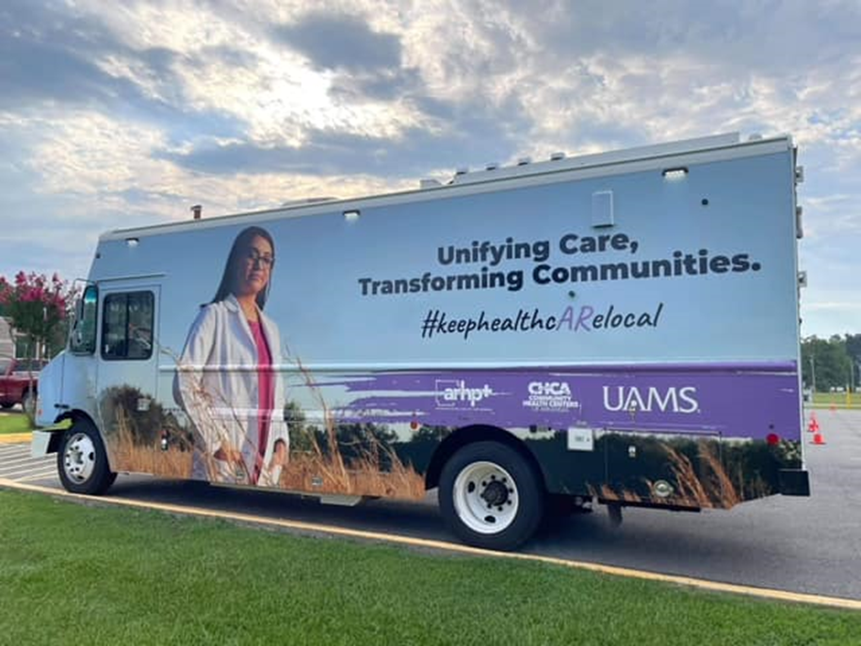
ADDITIONAL EFFORTS TO SUSTAIN OUR RURAL HOSPITALS/CLINICS
HEALTHCARE RECRUITER
BILLING & CODING EDUCATION
MEMBER JOB BOARD
BEHAVIORAL HEALTH
SWING BED PROGRAM
CONSULTING SERVICES
CLINICALLY-INTEGRATED NETWORK

Slide 15


EMPOWERING STUDENTS
K-12 PIPELINE
COLLEGE STUDENT INTERNSHIPS
(UAMS Partnership)
(UAMS Partnership)
  "Grow Your Own Healthcare Pipeline"
  Community Need: Allied health, nursing, and medical fields (everything!)
  Program Focuses: Develop interest of scholarship, interest, and engagement in healthcare fields
  82 Paid Internships
  High School Seniors and College Students
  Students worked with ARHP and in network hospitals
  Trainings included: Community Health Worker, Mental Health First Aid, and more.

Slide 16
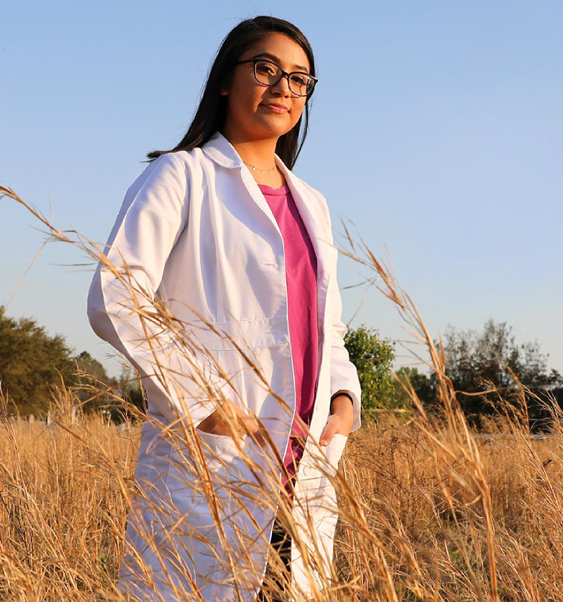
MEDICAL & NURSING STUDENTS
REGIONAL NURSING CLINICAL COLLABORATIVE
  8 nursing schools, 13 rural hospitals, and 2 federally qualified health centers
  Launched 1st nursing clinical collaborative in the region.
  Goal: Increase number of Delta nurses recruited, trained, and retained to serve the region.
MEDICAL SCHOOL PRECEPTORSHIPS
(UAMS, NYIT at AR State, and Arkansas College of Osteopathic Medicine Partnership)
  Assists with coordination and scheduling of medical student clinical rotations
  Goal: Work with Board-certified physicians throughout south Arkansas region
RURAL RESIDENCY TRAINING TRACK
South Arkansas Delta Rural Training Track (RTT) Consortium
  6 Education and Healthcare Partners
  ACGME Accredited program in Family Medicine
  Ashley and Chicot Counties
    A region known for high rates of poverty, unemployment, and significant barriers to care.

Slide 17
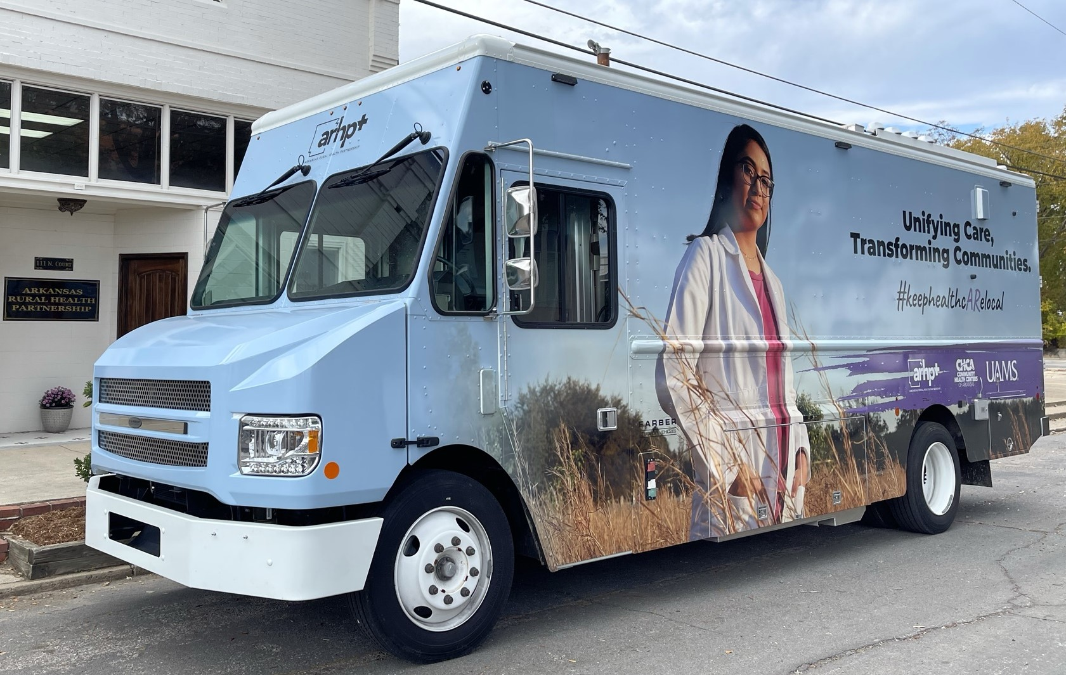
BUILDING SCHOLARSHIPS
HEALTH BUSINESS OPERATIONS INITIATIVE
(UA Grantham Partnership)
  Participants across 23 counties
  Growing trained and skilled healthcare staff through accessible degree programs
  Directly impact the financial viability and sustainability of hospitals
Proposed Program Tracks
  Medical Coding and Billing
  Health Information Management
  Clinical Documentation
  Healthcare Administration
CONNECT TO TECH
(PCCUA and UAM Partnership)
  Fill current workforce needs
  70 Arkansas Delta Students
  Degrees in Health Information Technology and Behavioral Health Technology
  Apprenticeships
  Community Health Worker Training
  Career Placement
  70 Arkansas Delta Students
    Apprenticeships
    One-on-one support
    Community health worker training
    Career Placement
  Degrees offered: Health Information Technology and Behavioral Health Technology
  Directly impacts the existing local healthcare workforce needs

Slide 18
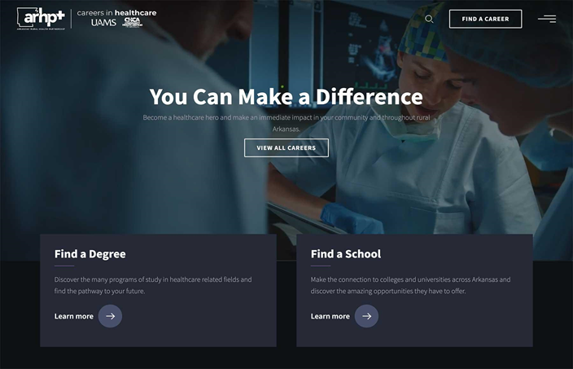
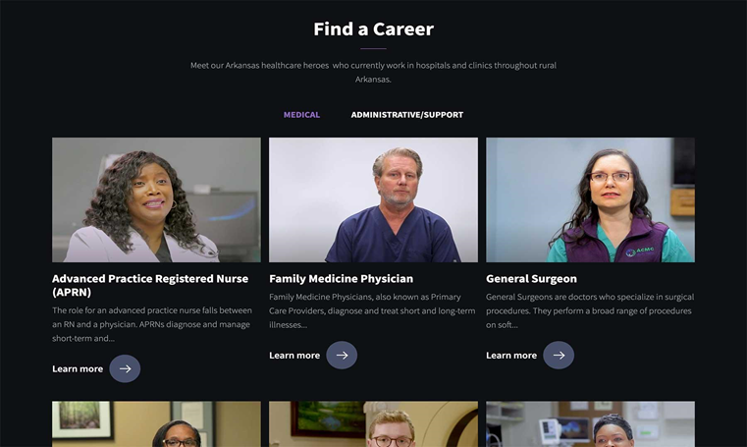
ARHP WORKFORCE WEBSITE
This website will be downloaded onto large smart boards on the workforce mobile unit that will travel to rural high schools, MASH and CHAMPS programs, community events, and community colleges educating on healthcare careers, educational pathways, and scholarship opportunities.
https://careers.arruralhealth.org/

Slide 20
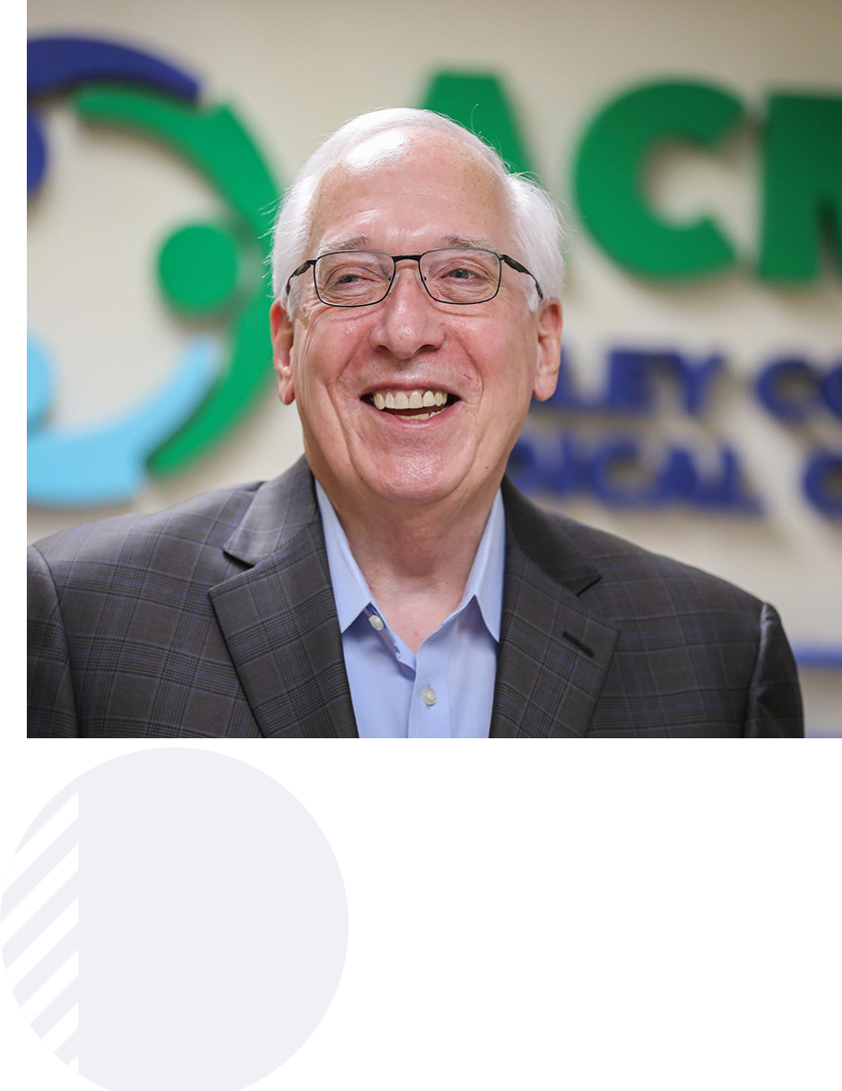
STRENGTHENING THE RURAL ECOSYSTEM
FAR BEYOND HEALTHCARE
16
HOSPITAL CEOS
ARHP's Board of Directors is made up entirely of CEOs from 14 member hospitals working together within our partnership.
  A primary source for healthcare
  Large, stable employer
  A recruiter for young professionals and seasoned experts
  An economic driver for local spending and innovation.
COLLABORATION AS SUSTAINABILITY
  Collaboration across hospitals
    Shared staffing models
    Educational platforms for healthcare professionals
    Professional roundtables
$43M
IN FUNDING
AN INVITATION TO NEW PARTNERS
ARHP has stewarded over 43 million dollars to date (grants, contracts, member & partner dues, sponsorships & donations)
  Focus on Inclusivity
  Federally qualified health centers, law enforcement, justice and court systems, K-12, colleges & universities, medical schools, and economic development.
"Through the work of ARHP, we have an incredible opportunity to not only support and strengthen our rural hospitals across the region, but also meet local health, workforce, and economic needs. When rural hospitals thrive, the entire community reaps the reward."

Slide 21
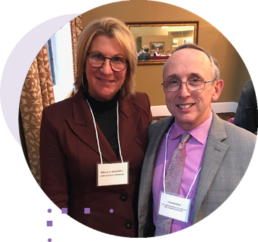
WORKING TOGETHER FOR A HEALTHIER ARKANSAS
OUR FUNDERS
OUR MEMBERS
  HRSA Federal Office of Rural Health Policy
  U.S. Department Of HHS - SAMHSA
  U. S. Department of Labor
  United States Department of Agriculture
  Bureau of Justice Assistance
  State Justice Institute
  Centers for Disease Control and Prevention
  Delta Regional Authority
  Blue and You Foundation for a Healthier You
  Arkansas Blue Cross and Blue Shield
  Arkansas Department of Health
  Arkansas Department of Human Services
  Arkansas Economic Development Commission
  Arkansas Children’s Hospital
  Arkansas Department of Finance & Administration
  Winthrop Rockefeller Foundation
  University of Arkansas for Medical Sciences
  Arkansas College of Osteopathic Medicine
  Ashley County Medical Center
  Baptist Health-Stuttgart
  Bradley County Medical Center
  Chicot Memorial Medical Center
  Dallas County Medical Center
  DeWitt Hospital & Nursing Home
  Delta Memorial Hospital
  Drew Memorial Health System
  Forrest City Medical Center
  Helena Regional Medical Center
  Jefferson Regional
  Magnolia Regional Medical Center
  Mainline Health Systems
  McGehee Hospital
  Medical Center of South Arkansas
  Mid-Delta Health Systems
  New York Institute of Technology - Jonesboro
  Ouachita County Medical Center
  University of Arkansas for Medical Sciences
  Sevier County Medical Center
Mellie Bridewell, ARHP CEO, and Tom Morris, Associate Administrator for the Federal Office of Rural Health Policy, Health Resources and Services Administration (HRSA).
"ARHP has an uncanny ability to tune into the rural story and then find ways to write new narratives for rural communities. They consistently are able to tap into funding from the Federal Office of Rural Health Policy and use that funding to drive innovation in rural health care..."
Alan Morgan
Chief Executive Officer of the National Rural Health Association

Slide 22
Thank you!
Mellie Bridewell
President, CEO, & Founder
melliebridewell@arruralhealth.org

