Slide 1
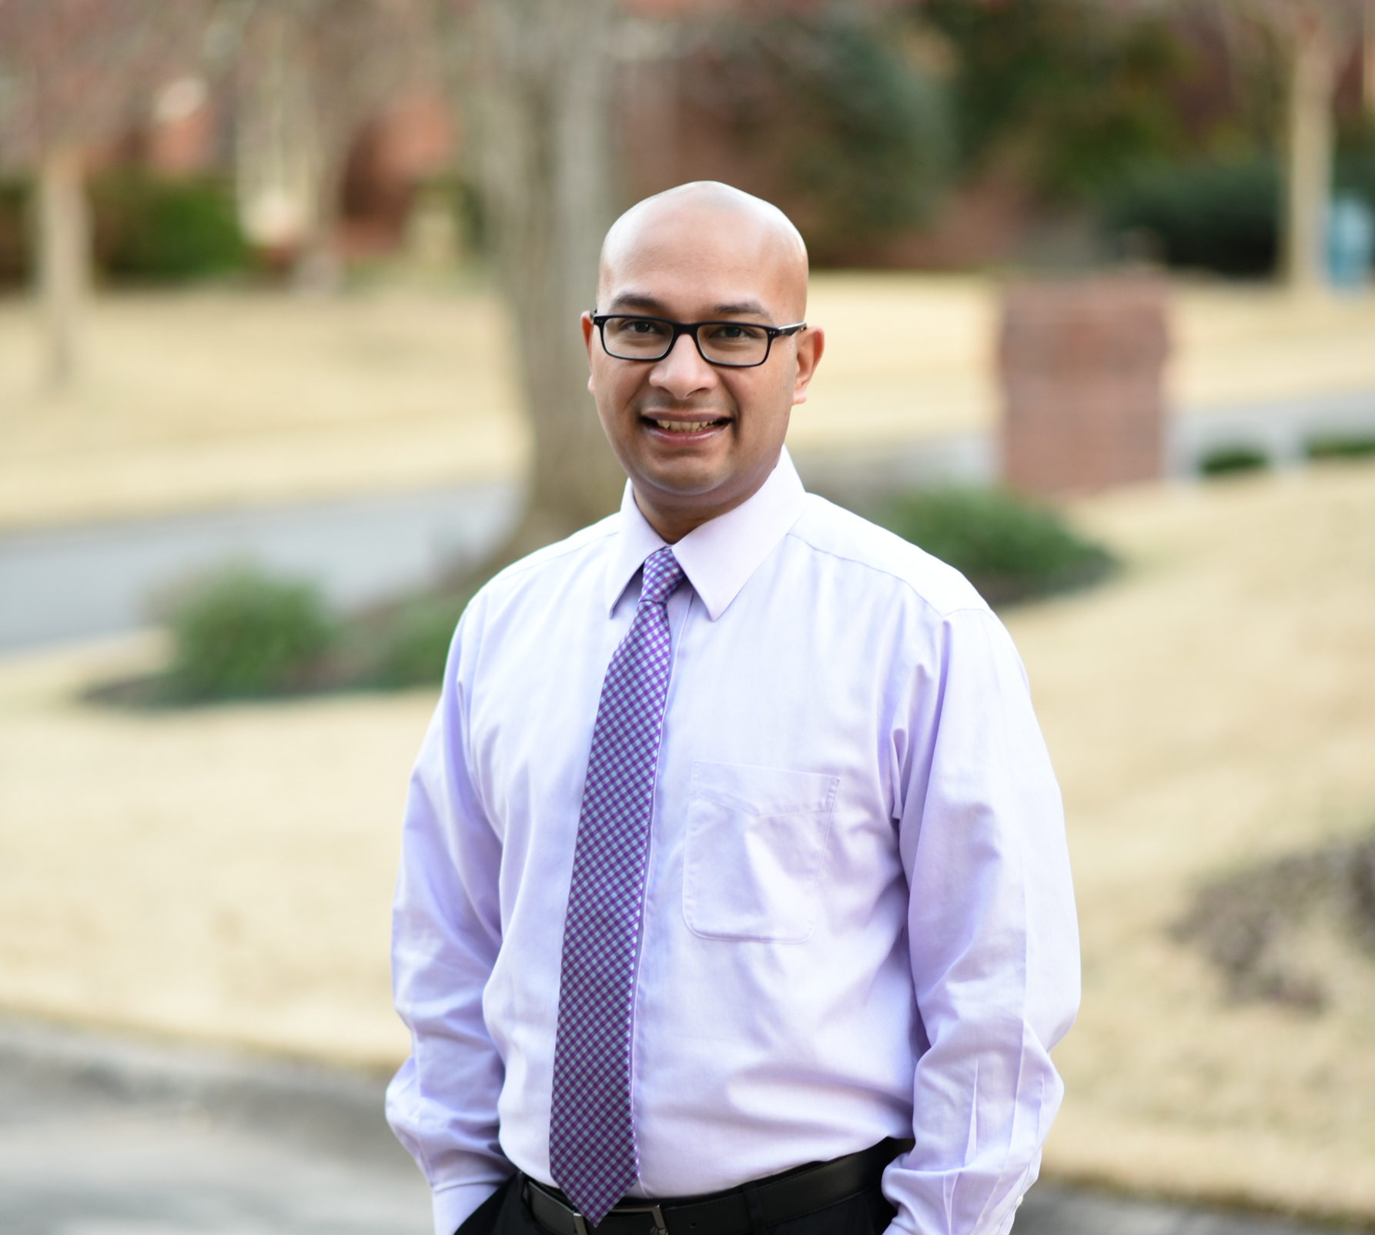

Medical Marijuana in Arkansas: Past, Present, and Future
Nihit Kumar, M.D.
August 2023
PositiveRecoveryAR.com

Slide 2

My Story
As a teenager my uncle struggled with alcohol use
Saw firsthand the effects of addiction on my entire family
Resolved to go through medical school and get specialty training in addictions
Worked with a lot of therapists over the years and learned from them
Great personal satisfaction helping individuals recover from addiction
Established POSITIVE RECOVERY as a premier institute for substance use disorder treatment

Slide 3

Disclosures
No financial disclosures or conflict of interest

Slide 4

Objectives
Summarize
Current literature on the efficacy and potential risks of using cannabis for common psychiatric and medical conditions
Compare
Past, present, and future landscape of marijuana legalization in Arkansas
Examine
Demographic, economic, and geographical trends in the distribution and use of medical marijuana in the state

Slide 5

Part 1
Efficacy and Risks of Cannabis on Psychiatric and Medical Conditions

Slide 6
Cannabis Effective For
Substantial Evidence
Chronic Pain (Adults)
Chemo induced nausea/vomiting
Moderate Evidence
Short-term sleep outcomes (obstructive sleep apnea, fibromyalgia, chronic pain, MS)
Limited Evidence
MS Spasticity (patient reported)
Improving appetite/weight (HIV/AIDS)
MS Spacticity (clinician reported)
Tourette symptoms
Social Anxiety (public speaking test)
PTSD symptoms
No/Insufficient Evidence
Cancer or cancer-associated cachexia
Epilepsy
ALS/Chorea/Huntington’s/Dystonia
Abstinence in Addiction
Schizophrenia/Psychosis outcomes

Slide 7
Cannabis Ineffective For
Limited Evidence
Dementia
Improving IOP in glaucoma
Reducing Depressive sxs in chronic pain or MS

Slide 8
Adverse Effects of Cannabis
Substantial Evidence
Motor Vehicle Crashes
Low Birth Weight (in offspring of maternal MJN users)
Moderate Evidence
Respiratory Distress (pediatrics)
Limited Evidence
Development of Schizophrenia/Psychosis (heavy MJN users)
Poor Academic Achievement/Educational Outcomes
No/Insufficient Evidence
All-cause Mortality
Learning, Memory, Attention
Increased Mania/Hypomania
Social Anxiety (regular MJN users)
Development of Depressive disorders; SI/Attempts/Completion
Development of Other SUD
Pregnancy Complications
Social Functioning/Unemployment/Low Income
Severity of PTSD symptoms
Overdose death
MI/Stroke/PVD
Asthma

Slide 9

Part 2
Marijuana Legalization Landscape in Arkansas

Slide 10
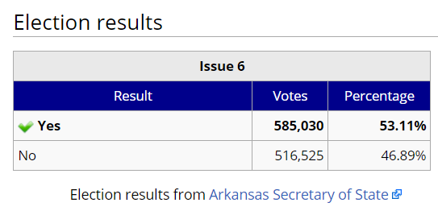
“Amendment 98”
…

Slide 11
Arkansas Medical MJN Laws & Provisions

Slide 12
Arkansas Medical MJN Laws & Provisions
Notes:
18 qualifying conditions

Slide 13
Limitations on Use
Allows for use of medical MJN at a private residence
Use is prohibited on:
School bus or operating any motor vehicle
Preschool, primary or secondary school grounds
Correctional facilities
State or local government buildings
Daycare, foster care, social services care
In the presence of a pregnant woman or a person under age 14
Wherever tobacco smoking is prohibited
Arkansas National Guard
US Military

Slide 14
Arkansas Medical MJN Laws & Provisions
2016
The marijuana growers and dispensaries have to get permits from the Arkansas Department of Human Services
The individual will need to obtain the ‘Marijuana card’ from the Arkansas Department of Health by submitting the physician letter and pay appropriate fees ($50/year)
The individual will take the ‘Marijuana card’ to an Arkansas-licensed dispensary to purchase marijuana
Limited to a purchase of 2.5 ounces every 2 weeks
Notes:
2.5 oz = 71 grams = 1 large egg = 14 paper = 65 jelly beans = 40 playing cards

Slide 15
Legislative Highlights 2019
HOUSE BILL 1150
Increase in number of Qualifying Conditions (from 18 to 57)
  Psychiatric (e.g. ADD, ADHD, GAD, BPDD, anorexia, bulimia)
  Medical (e.g. asthma, emphysema, chronic insomnia, migraines, CRPS, lupus, Parkinson’s, TBI)
Remove Glaucoma
DID NOT PASS/WITHDRAWN

Slide 16
Legislative Highlights 2019
SENATE BILL 440
No applying cannabinoid concentrates or extracts to trademarked or branded food, candy, or beverages
No foods that are likely to appeal to minors (due to shape, color, taste, or design)
  modeled after non-cannabis products primarily consumed by/marketed to children
  in the shape of an animal, vehicle, person, or character
  closely resemble foods or beverages attractive to minors and commonly sold in retail establishments
    includes candy, cookies, cakes, pastries, chewing gum, and brownies
ENGROSSED MARCH 14, 2019; NOW ACT 989

Slide 17
Legislative Highlights 2020
Arkansas Marijuana Legalization Initiative /“Arkansas Adult Use Cannabis Amendment”
Sponsor: Arkansans for Cannabis Reform
Would have legalized MJN use for individuals 21 years or older
The Arkansas Recreational Marijuana Amendment of 2020
Sponsor: Arkansas True & Grass
Provisions for recreational MJN licenses
Rights to cultivate, possess, and transport recreational MJN
NOT ON BALLOT
Notes:
Was not on ballot

Slide 18
Legislative Highlights 2021
Senate Bill 703
Medical Marijuana Telehealth Certification
Allow physicians to provide certification through telemedicine
ENGROSSED MAY 3, 2021; NOW ACT 1112

Slide 19
Legislative Highlights 2022
Issue 4: Marijuana Legalization Initiative (‘Recreational Use’)
Initiative would have allowed:
  Possess up to 1 ounce for adults 21 and over
  Sale of cannabis at licensed dispensaries
  Not allowed home cultivation
  Additional 10% tax on recreational sales
  Divide tax revenue between law enforcement, treatment facilities, and state drug court program
FAILED with 44% vote on November 8, 2022

Slide 20
Part 3
Demographic, Economic, and Geographical Trends in Distribution and Use of Medical Marijuana

Slide 21
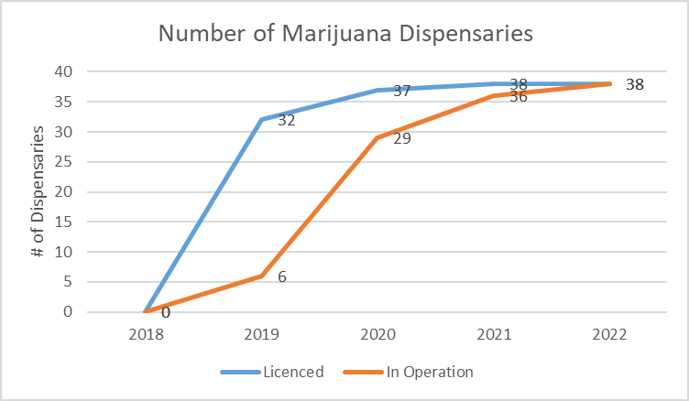
Arkansas Medical Marijuana Dispensary Statistics

Slide 22
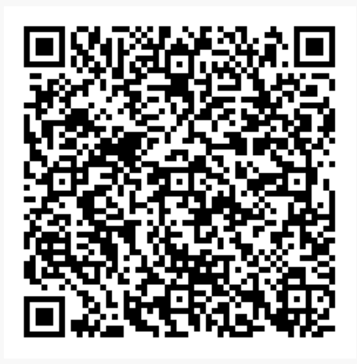
Notes:
QR code- updated dispensary locations handout; https://www.dfa.arkansas.gov/images/uploads/medicalMarijuanaCommission/UpdatedDispensaryLocations20200317.pdf

Slide 23
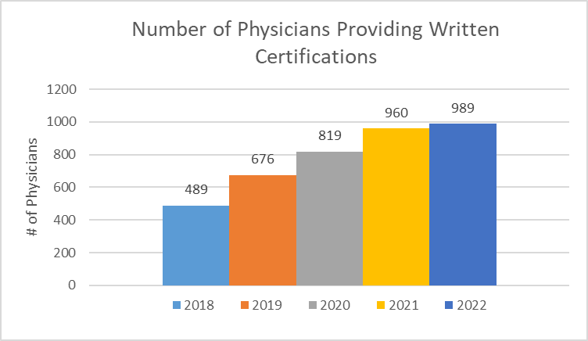
Arkansas Medical Marijuana Fiscal Year Report

Slide 24
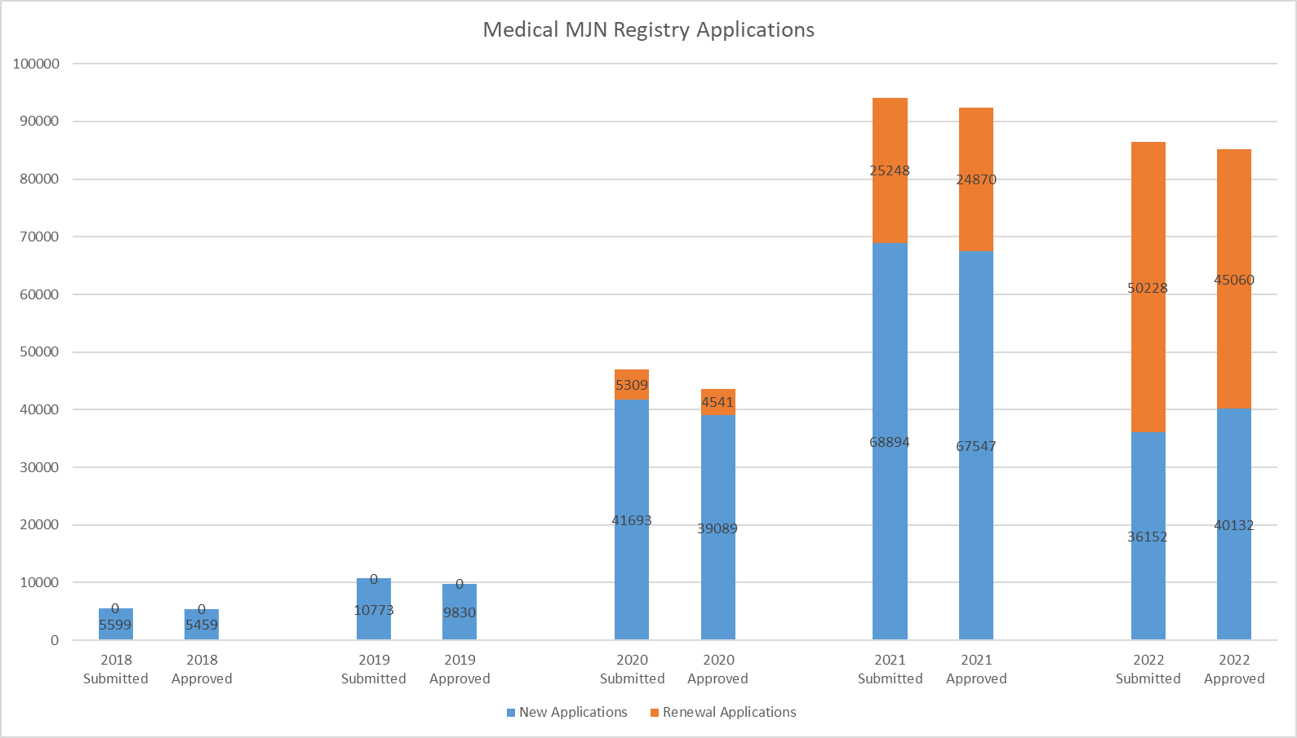
Arkansas Medical Marijuana Fiscal Year Report
Notes:
2022- pending applications in caregiver and visitor categories
2022- Arkansas population 3.04 million> Adult population (76.8%)=2.3 million; 2.64% of adults in Arkansas have approved ID cards

Slide 25
Patient’s Qualifying Medical Condition

Slide 26
Arkansas Medical Marijuana FY 2022 Report

Slide 27
Arkansas Medical Marijuana FY 2022 Report

Slide 28
Arkansas Medical Marijuana FY 2022 Report

Slide 29
Geographical Distribution of Medical Marijuana ID Cards

Slide 30
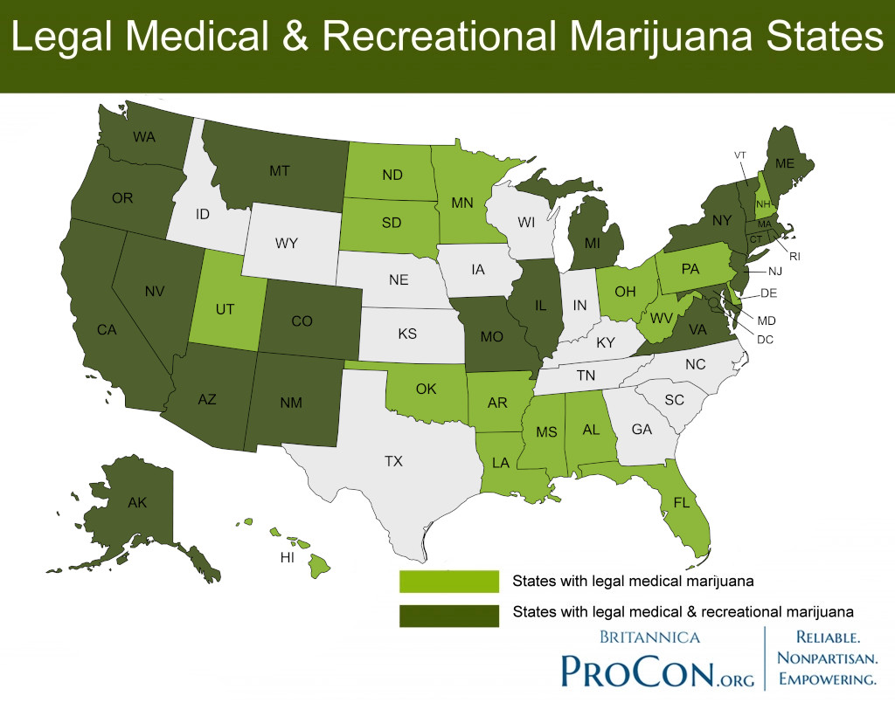

Slide 31
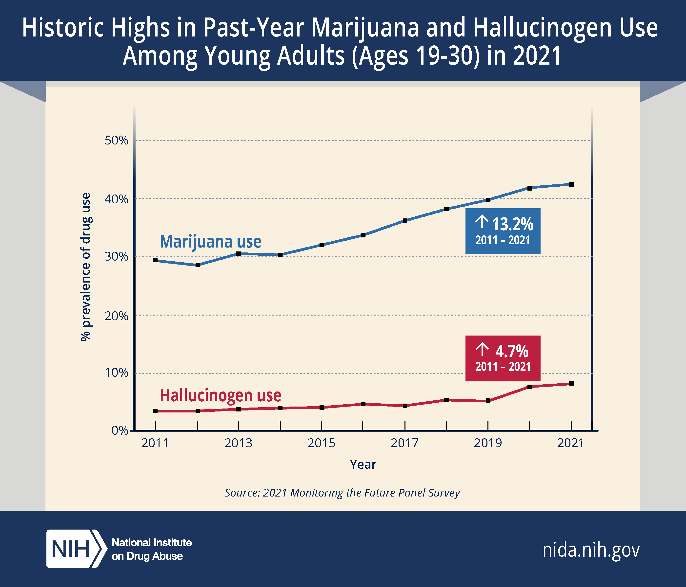

Slide 32

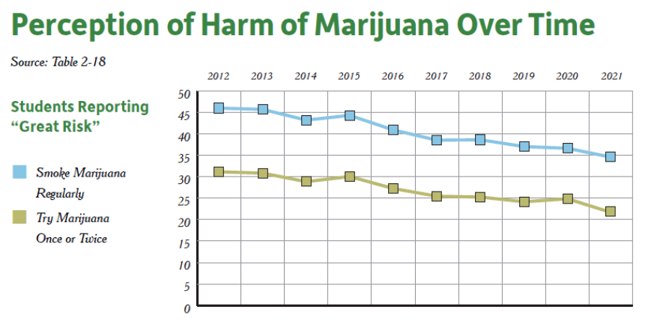
Arkansas Prevention Needs Assessment Survey 2021

Slide 33
Summary & Recommendations
Substantial Evidence of Effectiveness: | Substantial Evidence For Adverse Effects:
Chronic Pain (Adults) Chemo induced nausea/vomiting MS Spasticity (patient reported) | Motor Vehicle Crashes Low Birth Weight (in offspring of maternal MJN users) Development of Schizophrenia/Psychosis (heavy MJN users)
Watch
Watch for bills introduced to legalize the recreational use of MJN
Follow
Follow trends in the Medical MJN Fiscal Year Reports
Monitor
Monitor trends in MJN use in adolescents and young adults
Correlate
Correlate with prevalence rates of psychiatric disorders, especially psychosis

Slide 34

Acknowledgement
Dr. Ron Thompson/UAMS for sharing his slides and for his direction in preparing this presentation

Slide 35
Bibliography
National Academies of Sciences, Engineering, and Medicine; The Health Effects of Cannabis and Cannabinoids: The Current State of Evidence and Recommendations for Research. Washington (DC): National Academies Press (US); 2017 Jan 12. doi: 10.17226/24625
Bachhuber MA, Saloner B, Cunningham CO, Barry CL. Medical Cannabis Laws and Opioid Analgesic Overdose Mortality in the United States, 1999-2010. JAMA Intern Med. 2014;174(10):1668–1673. doi:10.1001/jamainternmed.2014.4005
Shover et al. Association between medical cannabis laws and opioid overdose mortality has reversed over time. PNAS. 2019;116(26):12624-26.
Arkansas Medical Marijuana Fiscal Year Report. Available from: https://www.healthy.arkansas.gov/programs-services/topics/medical-marijuana
Arkansas Prevention Needs Assessment Surveys. https://arkansas.pridesurveys.com/
www.ProCon.org

Slide 36
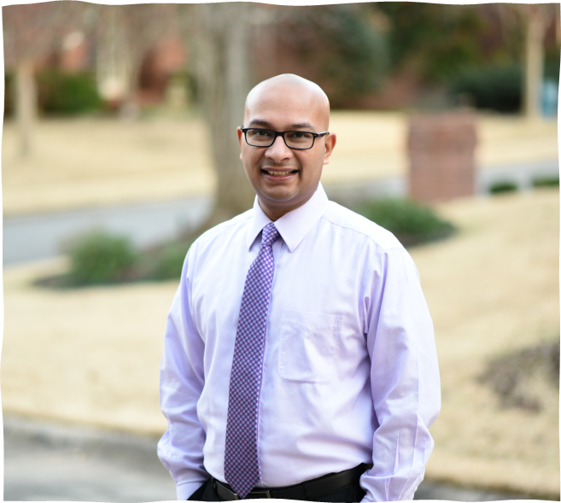
Thank you!
NKumar@PositiveRecoveryAR.com
(501) 830-1162

