Slide 1
AR CoCM Stakeholder Meeting Update
Patty Gibson, MD
2/9/24
Notes:
https://www.aafp.org/pubs/afp/issues/2006/1001/p1159.html

Slide 2
BHI/CoCM update
AR Blue Cross Blue Shield
AR Psychiatric Society
AR Medical Society
AMA BHI Collaborative
American Psychiatric Association
Mayo Integrated Care Conference
North Carolina Medicaid
Bipartisan Policy Institute
CFHA including CoCM Workgroup
AIMS Center

Slide 3
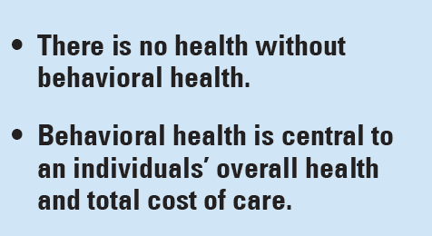
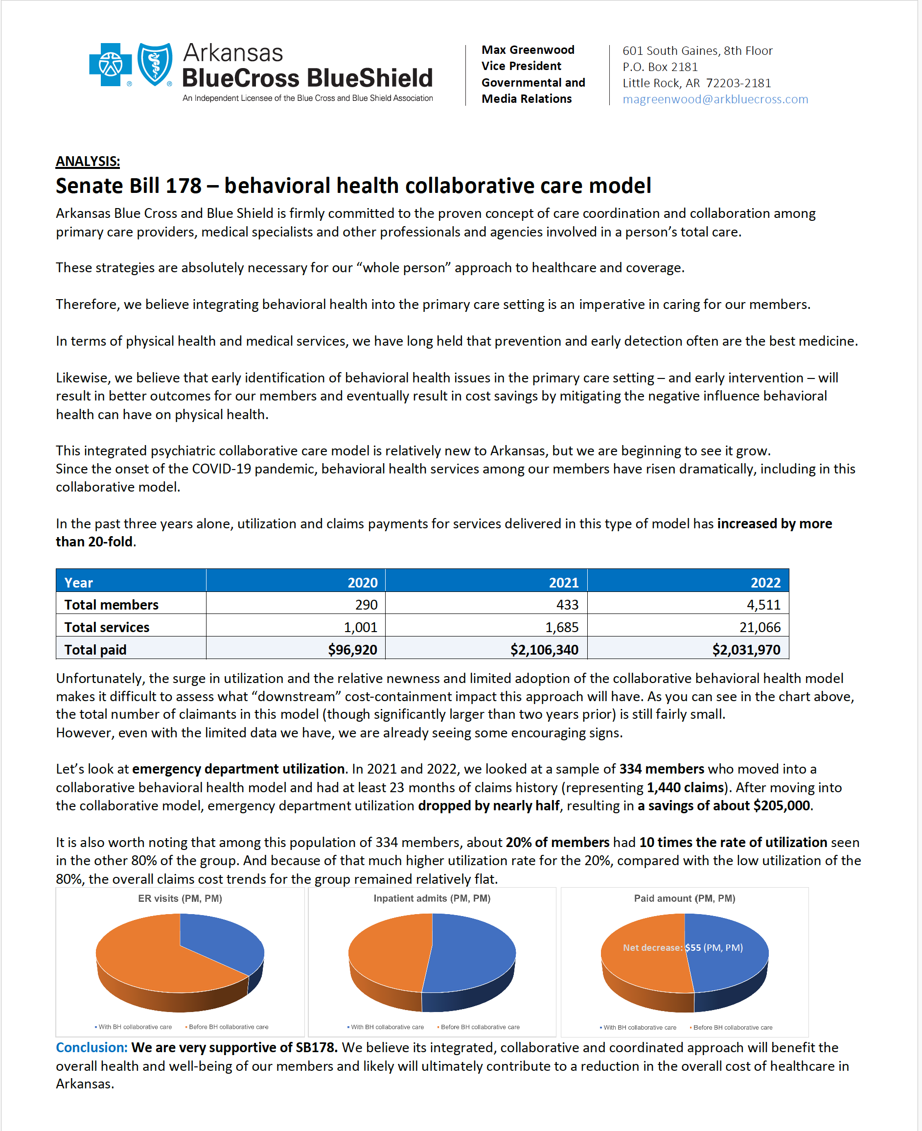
Notes:
https://www.aafp.org/pubs/afp/issues/2006/1001/p1159.html

Slide 4
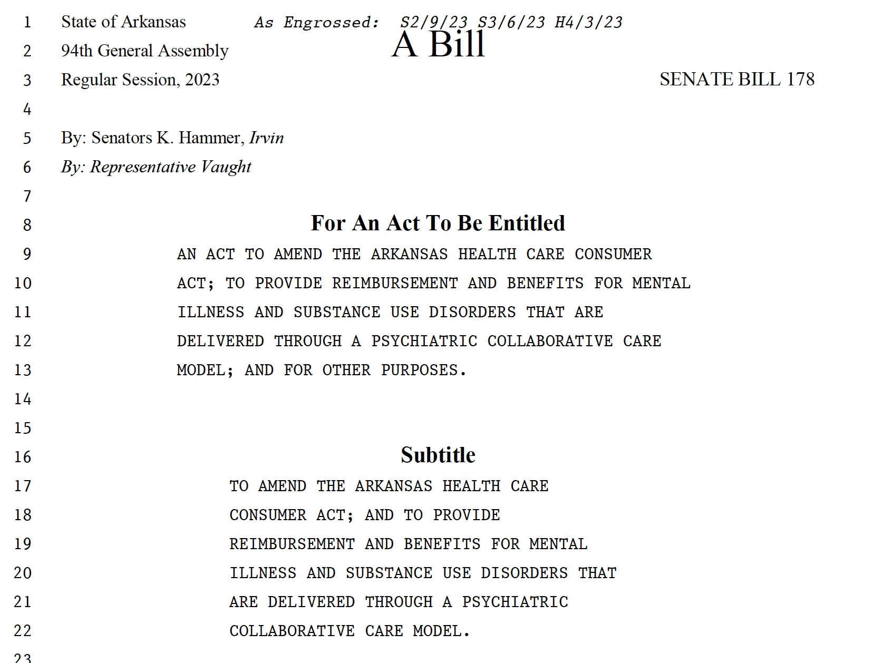
https://arpsychesociety.org/
Untangling the Web of Addictions
CoCM and Substance Use Disorders

Slide 5
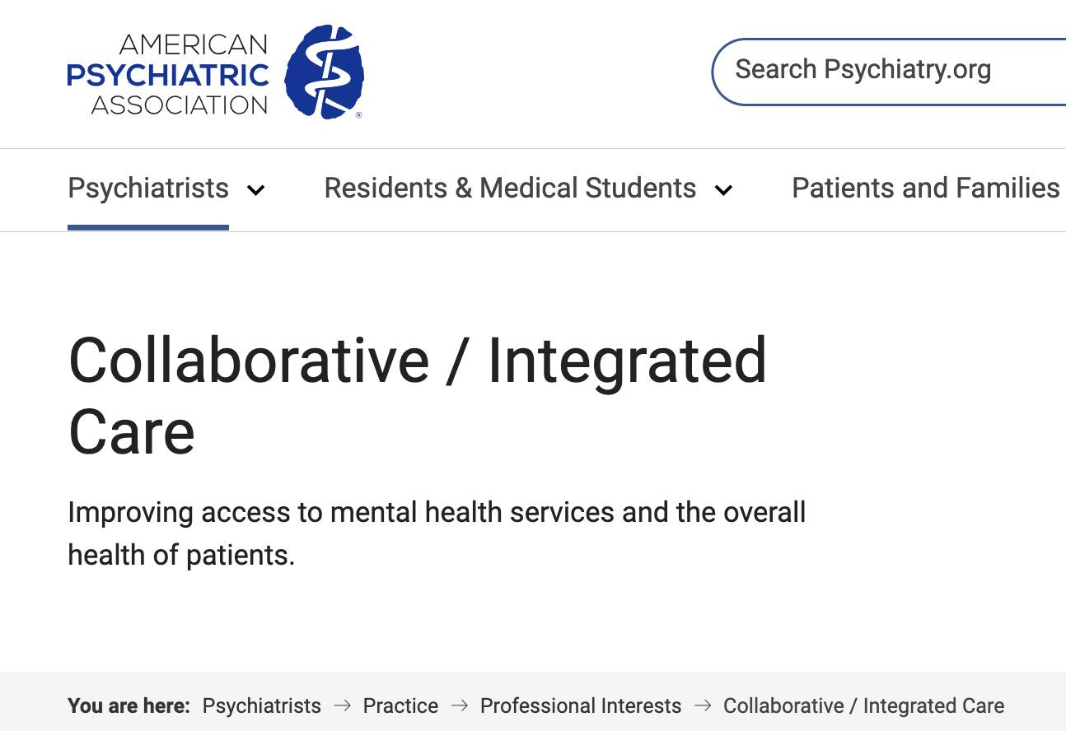
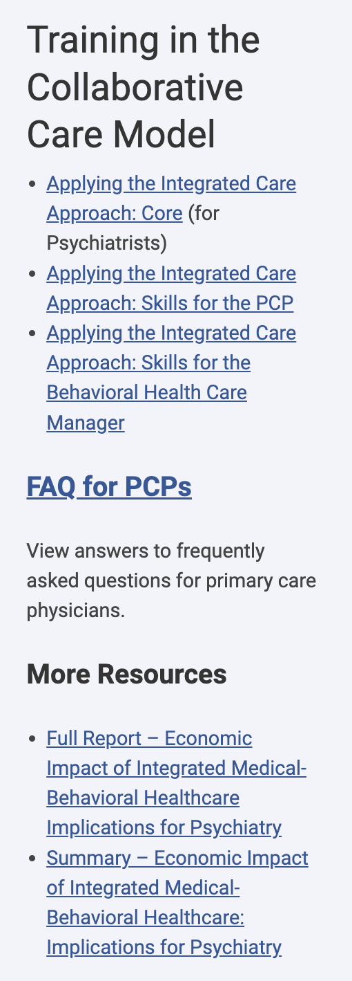
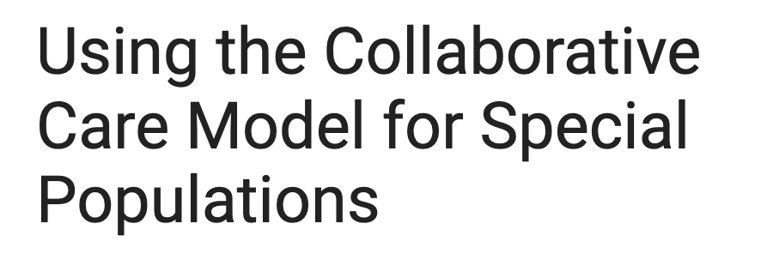
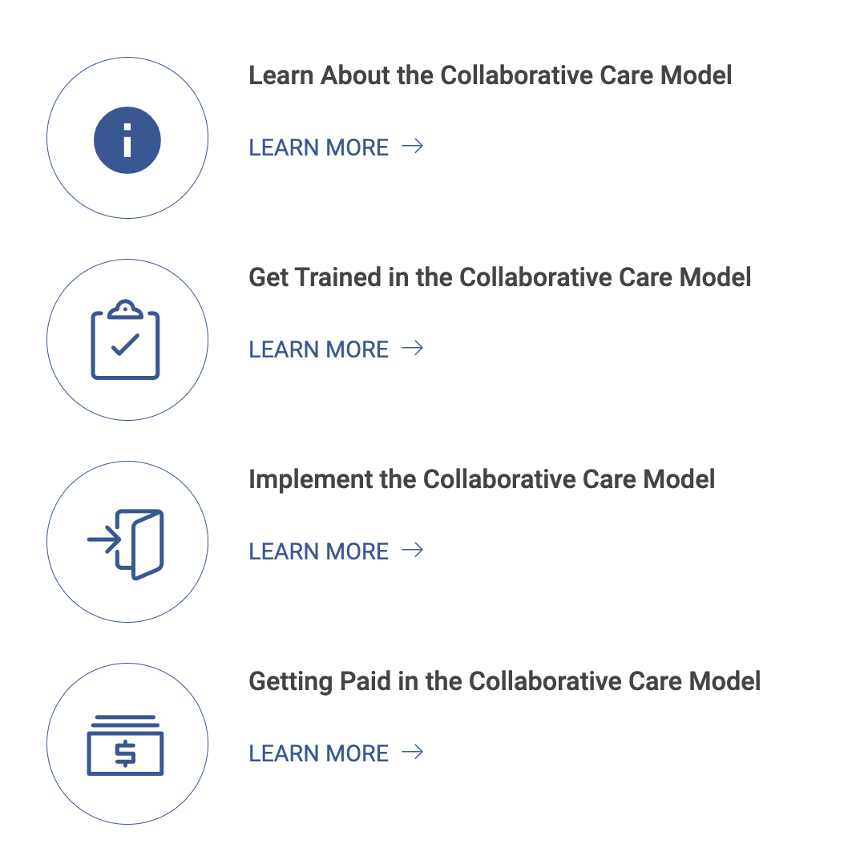
Geriatric
Pediatric
Perinatal
Substance Use Disorders
https://www.psychiatry.org/psychiatrists/practice/professional-interests/integrated-care

Slide 6
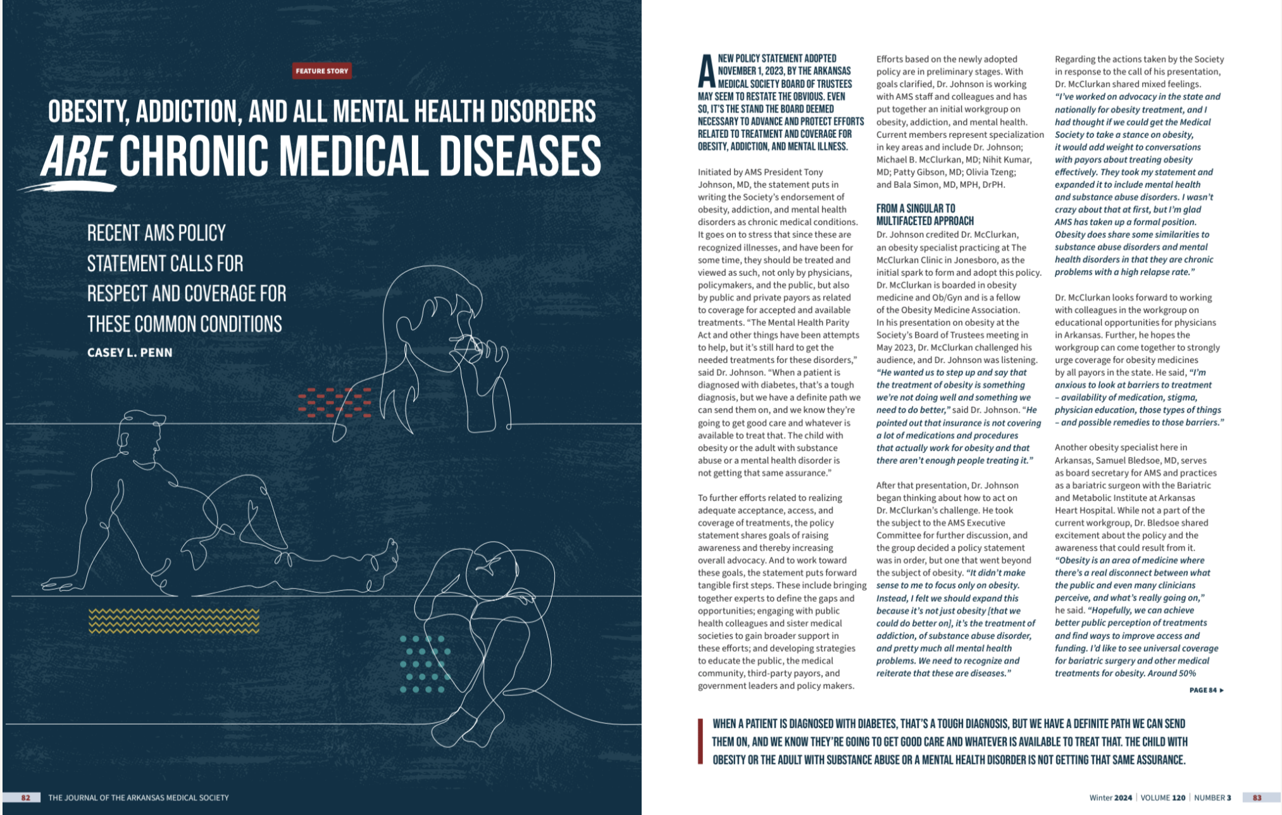
https://www.arkmed.org/journal/

Slide 7
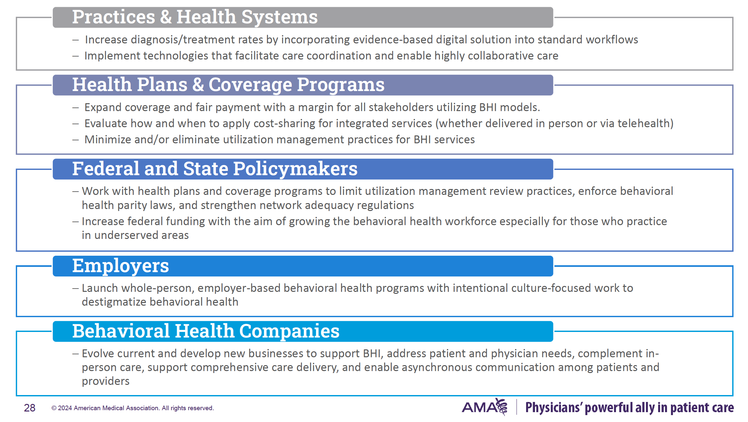
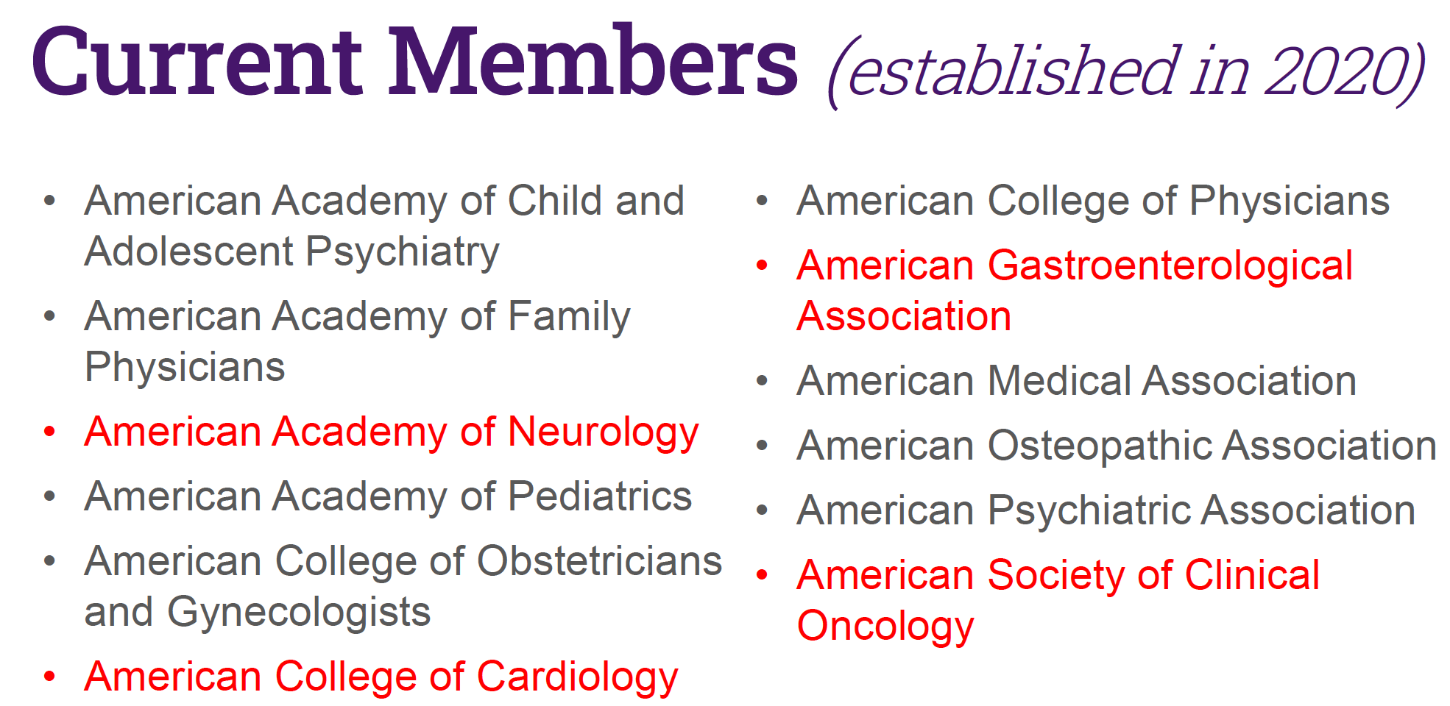
https://abhinetwork.org/webinar-library/
https://www.ama-assn.org/delivering-care/public-health/behavioral-health-integration-physician-practices

Slide 9
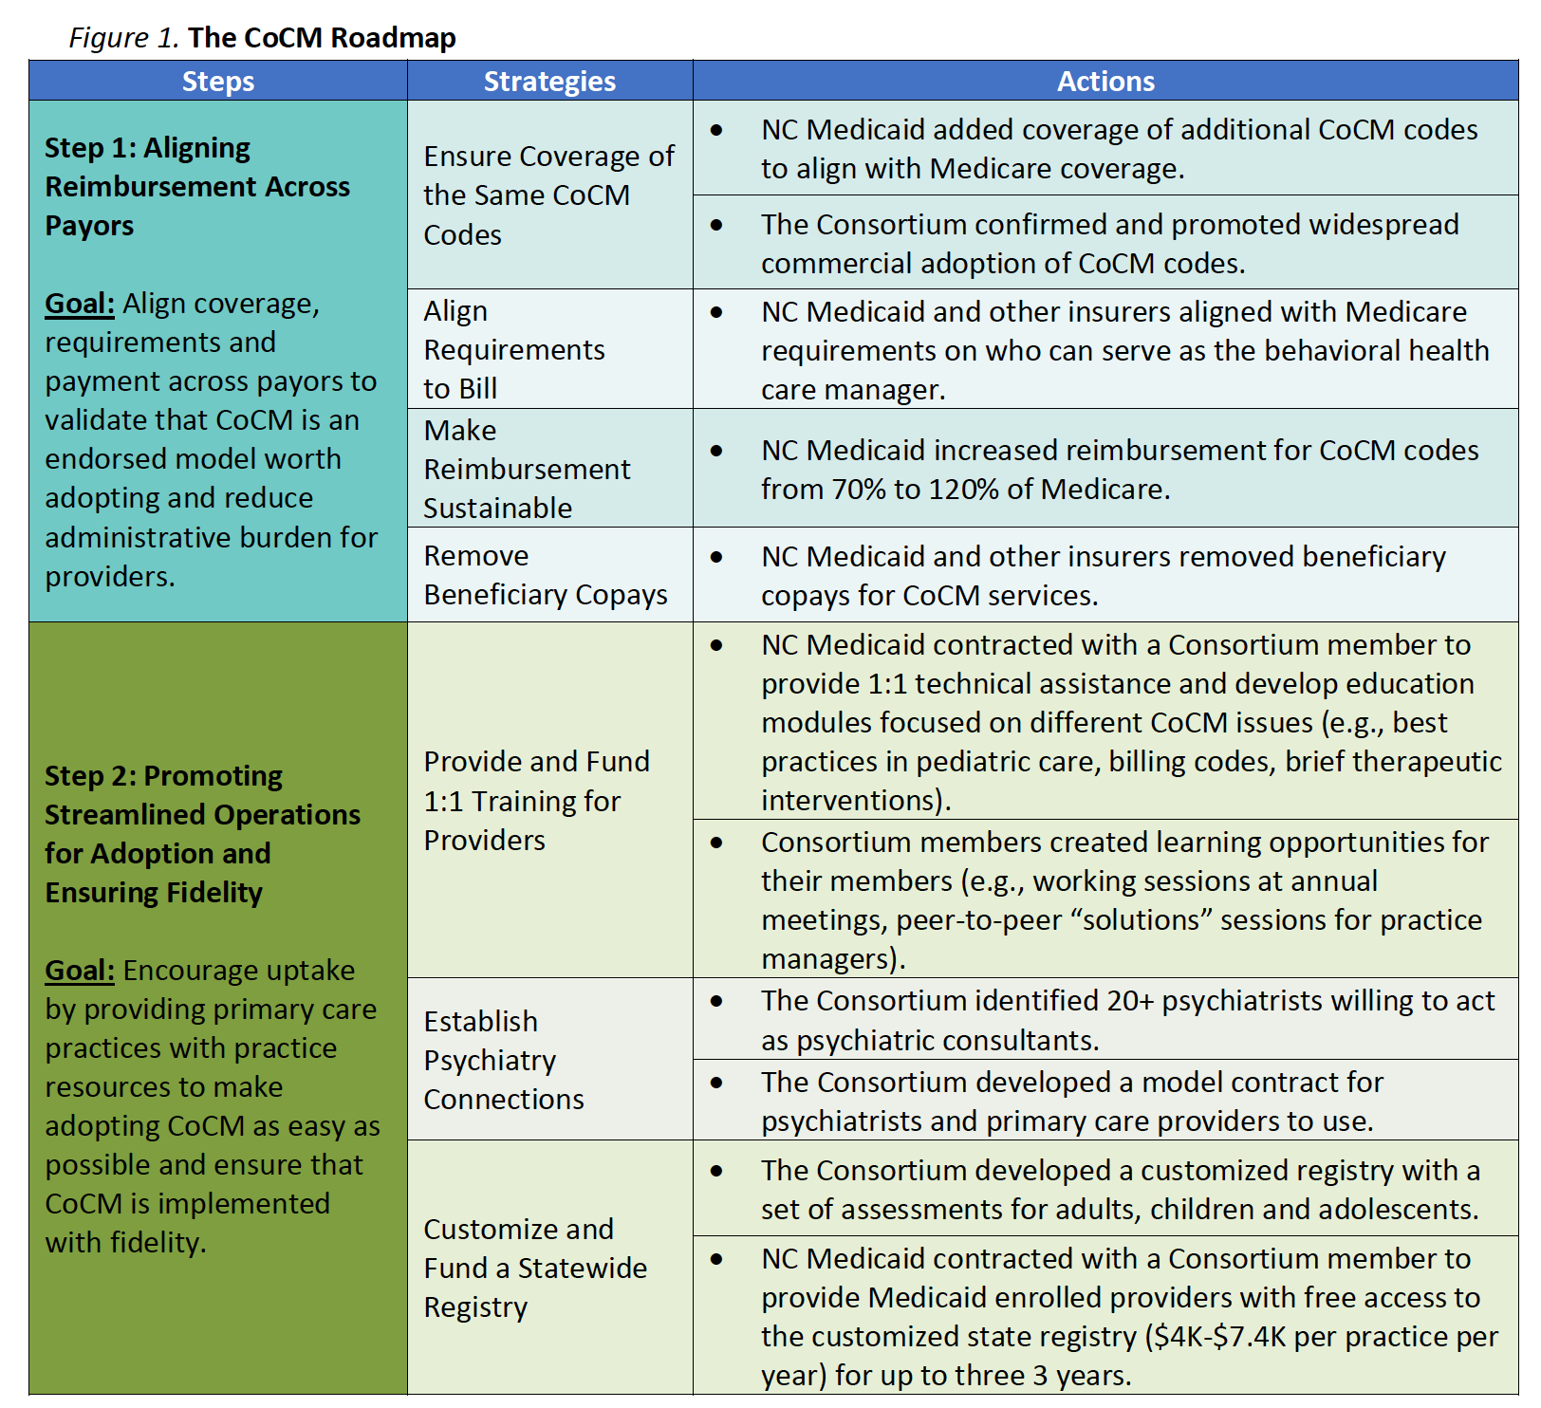
chrome-extension://efaidnbmnnnibpcajpcglclefindmkaj/https://medicaid.ncdhhs.gov/collaborative-care-model-north-carolina-policy-paper/download?attachment
https://www.manatt.com/insights/webinars/integrating-physical-and-behavioral-health-through

Slide 10
https://www.manatt.com/insights/webinars/integrating-physical-and-behavioral-health-through

Slide 11
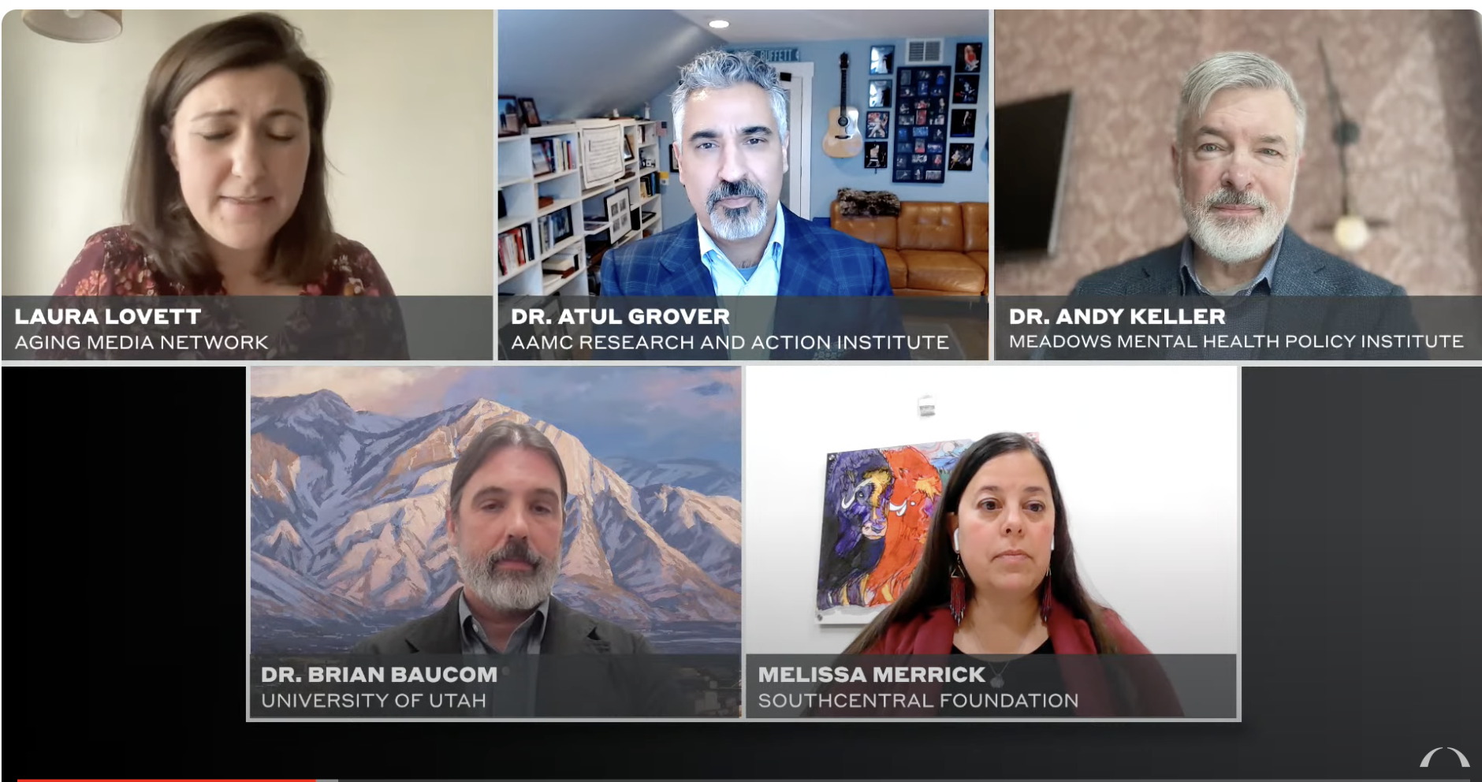
https://bipartisanpolicy.org/report/strengthening-the-integrated-care-workforce/
https://www.youtube.com/watch?v=rikNLhuJy24

Slide 12
https://www.cfha.net/learn-network/special-interest-group/collaborative-care-model-sig/

Slide 13
https://aims.uw.edu/
Notes:
https://www.aafp.org/pubs/afp/issues/2006/1001/p1159.html

