Slide 1
Arkansas CoCM Stakeholder Meeting
6-14-2024
Patty Gibson, MD

Slide 13
Arkansas

Slide 14
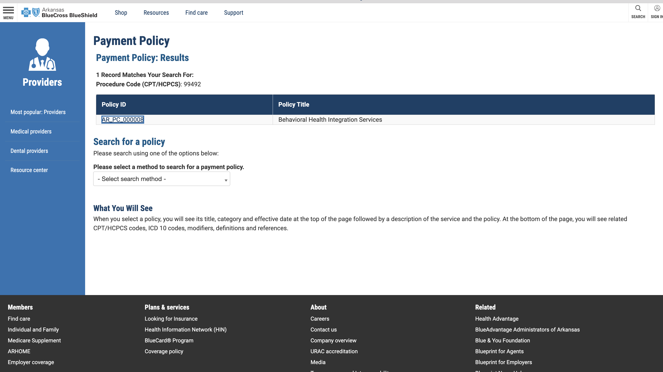

Slide 15
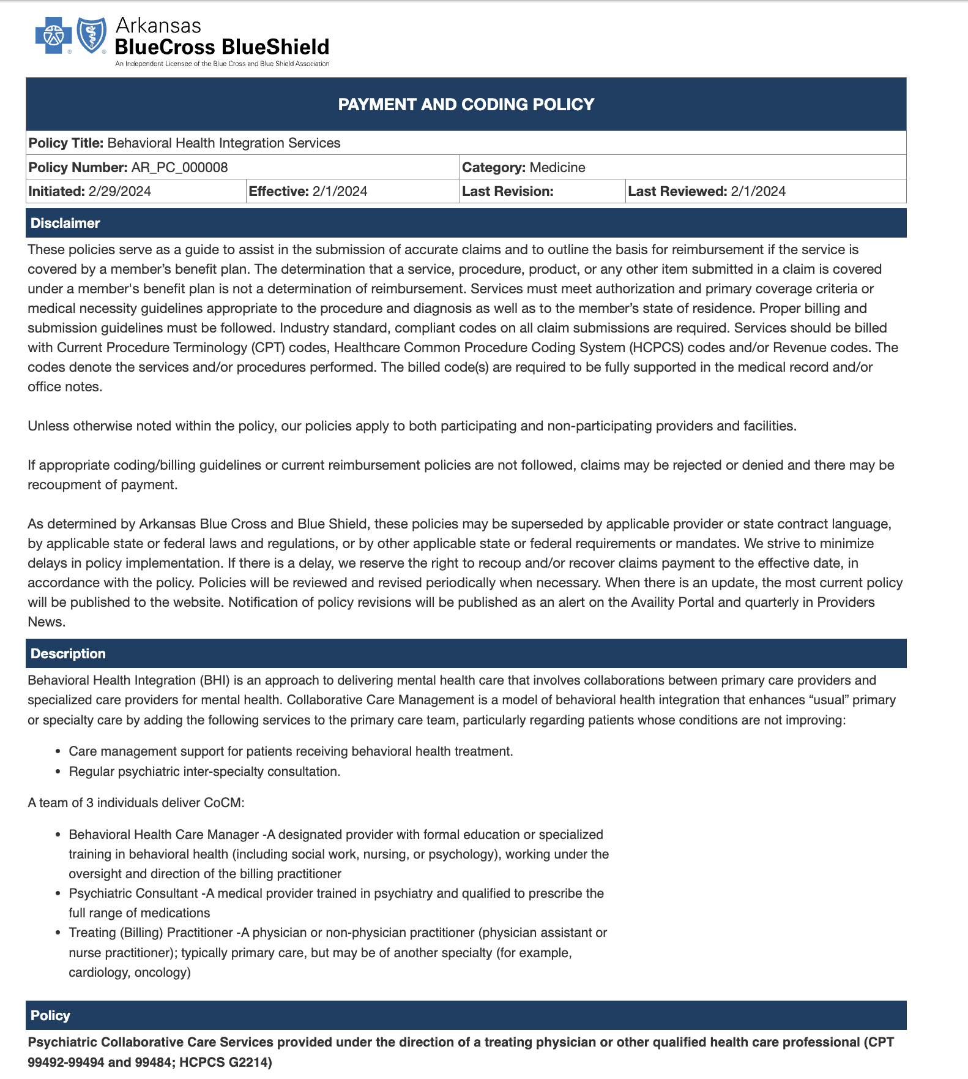
https://secure.arkansasbluecross.com/providers/PaymentPolicy_View.aspx?ID=000008

