Slide 1
Addiction-Related Substances
and what to do about them
James B. Shuler, DO, MS, FACOEP, FAWM, FASAM
SUD Consultants, LLC
shulers@aol.com, (970) 217-3882

Slide 2
Introduction
ALL “addictive” substances have one thing in common: they alter the brain’s dopamine
In about 20% of the population, their brains are reprogrammed with a new survival command
Numerous different mechanisms
All have the same result
Their chemical structure denotes their function

Slide 3
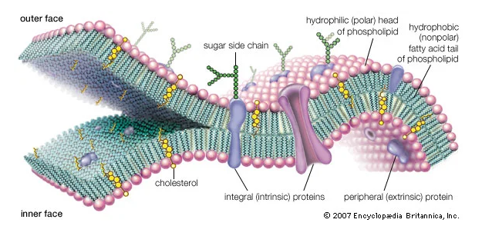
SOME GENERAL SCIENCE
All substances interact with our cells
Cells are surrounded by a cell membrane called the phospholipid bilayer
This layer is the barrier between the inside and the outside of any individual cell
All substances entering the body react with this layer in different ways.
The major method of this interaction is through protein-based receptors that cross the membrane
Alcohol penetrates the membrane and changes cell chemistry

Slide 4
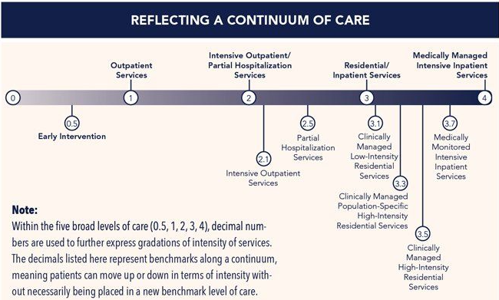
SOME GENERAL TREATMENT INFO
ALL SUD requires multimodal treatment IN A LONG-TERM CONTINUUM OF CARE!!!
The substance “unlocks” addictive wiring-so it’s not about the substance!

Slide 5
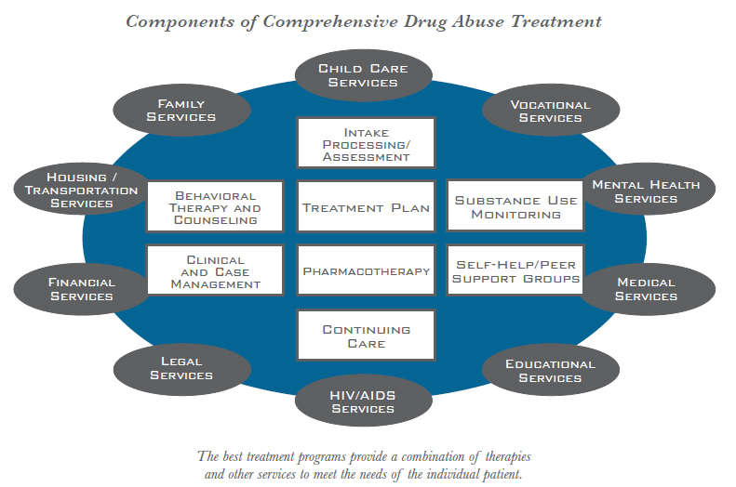
GENERAL TREATMENT
You must consider ALL the moving parts.

Slide 6
SUCCESSFUL TREATMENT
Sober support groups are essential to long-term recovery
Like ALL illnesses, increased severity of illness requires more aggressive treatment
Treat underlying mental health
Counseling for alternative “tools” is essential
Case management is vital
Term of treatment is life-long as with all chronic illness
REPEAT! Sober support groups are essential!!

Slide 7
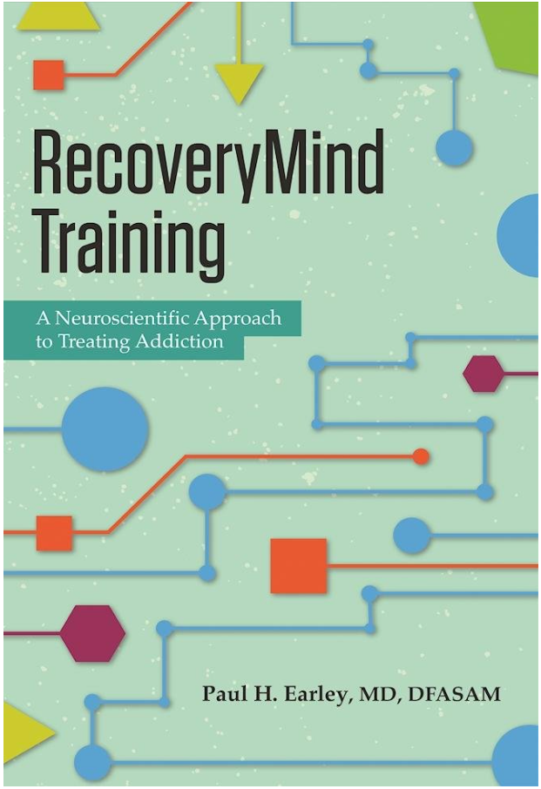
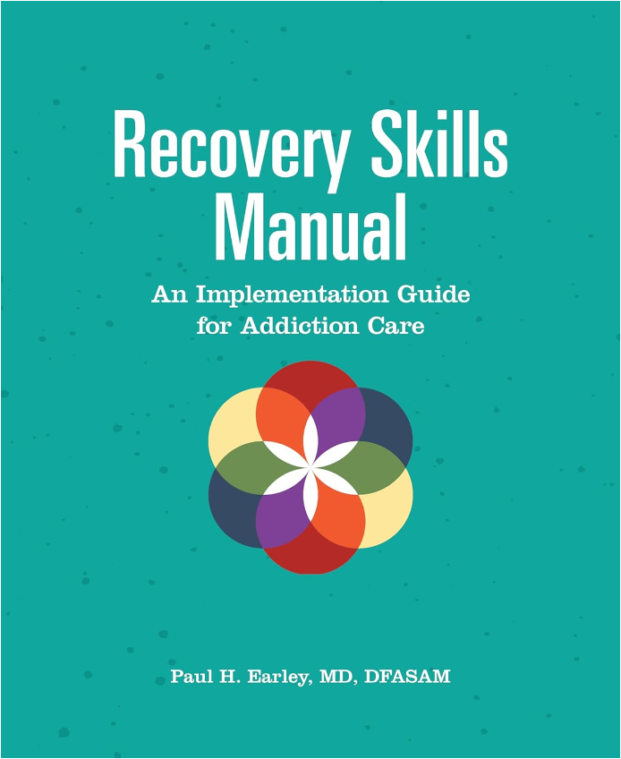
GENERAL TREATMENT
Recovery Mind Training
Best overall book
Has an accompanying Recovery Skills Manual
Domains of recovery - crucial!
A-Containment
B-Recovery Basics
C-Emotional Awareness and Resilience
D-Healthy Internal Narrative
E-Connectedness and Spirituality
E-Relapse Prevention

Slide 8
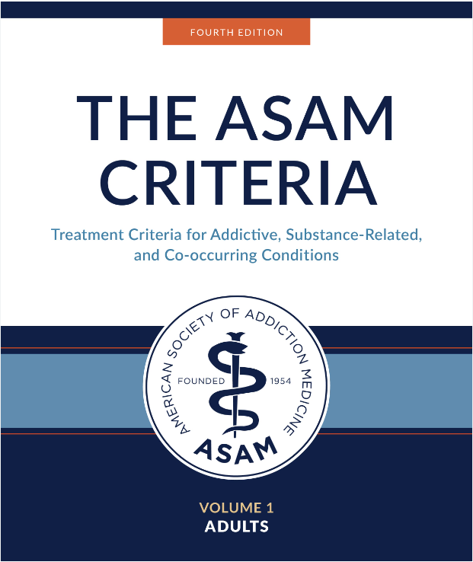
GENERAL TREATMENT
ASAM Criteria-A MUST these days
Multidimensional assessment
Individualized treatment with a fixed “term”
Broad and flexible levels of care, a continuum
Clarified treatment goals
Interdisciplinary approach
Outcome focused
Informed consent/shared decision making
ALL clients/patients WILL have trauma
The illness in and of itself is traumatizing
CBT/DBT, EMDR, Exposure, etc., and research just beginning on Rapid Resolution Therapy (RRT)

Slide 9
GENERAL TREATMENT
Big picture of what increases the chances of staying in long-term recovery (>5 years)
Do nothing: Lots of factors here but ~ <5%
Professional counseling: 5-8%
Professional groups: 5-8%
Pharmacotherapy/MAT: 5-8%
Peer support groups like AA/NA, etc.: 40-60%!!

Slide 10
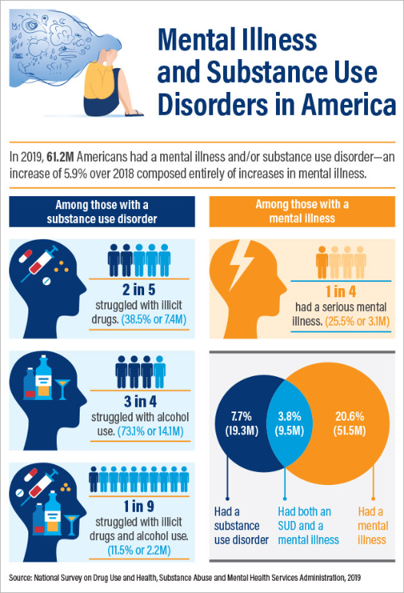
CO-OCCURRING DISORDERS
If you have one mental health illness/disorder, there is a 80% chance you’ll have another
Co-occurring mental health disorders are common with SUD
If you don’t treat the underlying mental health disorder(s) the return of the SUD is almost certain.

Slide 11
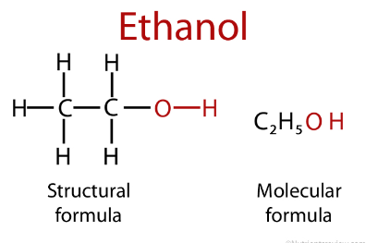
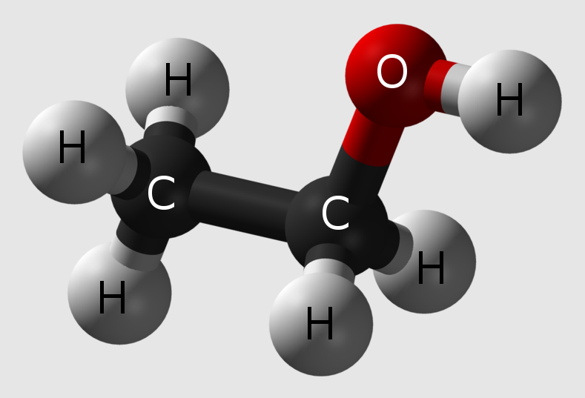
ALCOHOL
Dating back 9,000+ years
About 25% of the US population are “binge” drinkers
Genetically, 2 types of alcoholism
Earlier onset
Later onset
Chemical structure explains its function
Simple molecule

Slide 12
ALCOHOL OVERALL
Influences the dopamine system by a different mechanism
Increases GABA or the “brakes” on the brain
Decreases the stimulatory (glutamate and “adrenalin” system)
The withdrawal syndrome is the opposite, you see “stimulation” (lack of brakes + outpouring of catecholamines. “runaway freight-train”)
Has deleterious effects inside every cell in the body

Slide 13
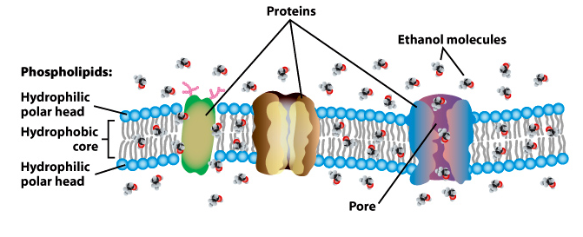
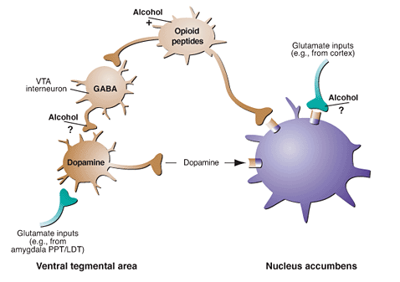
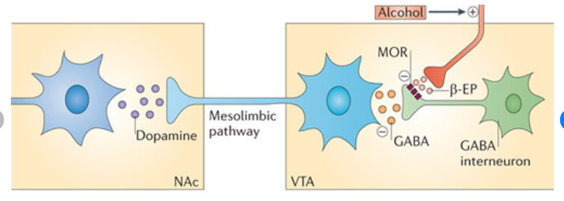
HOW ALCOHOL WORKS
“Bi-polar” molecule, charged and uncharged parts
Dipole moment
Directly crosses the cell membrane and alters the chemistry in the cell.
The effects in each cell are wide-ranging

Slide 14
HOW ALCOHOL WORKS
Rapidly absorbed when consumed
Half-life of 4-5 hours
Can remain in the system of heavy daily users for well over 24 hours!
Levels correlate fairly well with impairment
“Toxic” levels vary with everyone; some unconscious at 0.1%, others are walking and talking at 0.5%
Testing
Direct levels
EtG and EtS, PEth
Liver enzymes, ancillary liver like coags, PT/PTT, CBC (MCV)

Slide 15
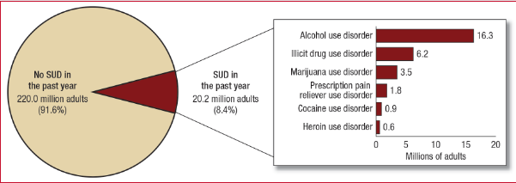
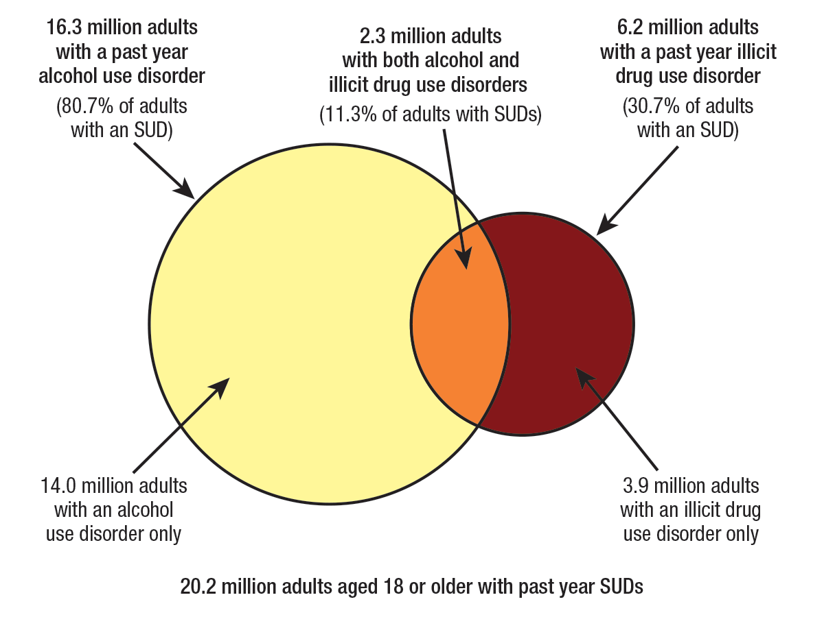
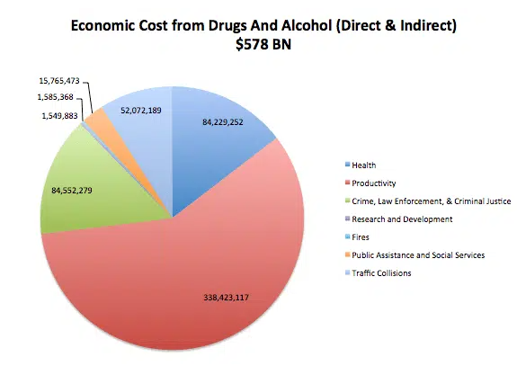
SCOPE OF THE PROBLEM
As far as SUD’s go, alcohol is #1 in the US

Slide 16
MEDICAL TREATMENT
Acute intoxication
Supportive care
Protect the airway
Ondansetron or other antiemetics
Acute withdrawal
One of two fatal withdrawal syndromes, the other is benzodiazepines
Hydration, thiamine and folate (B’s in general)
Inpatient (SUD facility):
Clonidine, Gabapentin, Hydroxyzine, Barbiturates (with O2 monitoring!), Benzodiazepines
Outpatient/ED:
Benzodiazepines, Clonidine, Gabapentin, Hydroxyzine, Barbiturates (ED only)

Slide 17
MEDICAL TREATMENT
Craving reduction
Acamprosate-Works through GABA and Glutamate, effective but no one will comply with two tabs TID!
Baclofen-Works through GABA. Drug of choice to add for cravings, muscle spasms, etc.
Carbamazepine, Divalproex and Topiramate all “sort of” effective but side effects
Disulfiram-Aldehyde dehydrogenase inhibitor. Punitive, loaded with side-effects, use only if you must, then start low and go slow.
Naltrexone-Opioid antagonist. Effective, do an oral trial first and then the long-acting injectable
Start at 25mg for 4-5 days then go full dose, then injectable

Slide 18
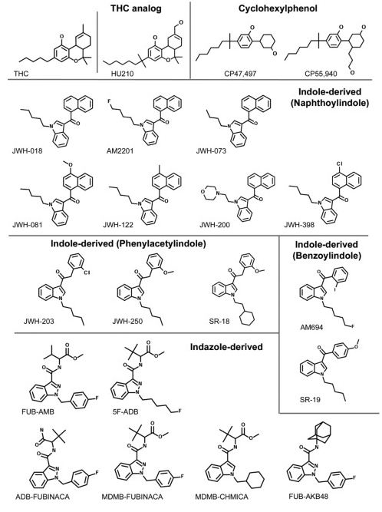
CANNABINOIDS
CBD nonpsychoactive
THC psychoactive
Chemical structures
Dating back over 12,000 years with medicinal use dating back almost 5,000 years
Used by ~36% of the 18-25 yo US population
Both plant-derived and synthetic
Endocannabinoids moderate neurotransmitter release

Slide 19
CANNABINOIDS OVERALL
Smoked, vaped, topical (CBD), oral/ingested
Influences the dopamine system indirectly
THC activates CB1 receptors about 20%, Synthetics can approach 100%!
Has widespread activity with multiple neurotransmitters in general “reducing” output
Has cognitive, psychopathologic and psychomotor effects
Current research is showing that those predisposed to psychosis “prefer the refer”
Likely reason behind cannabis “induced” psychosis

Slide 20
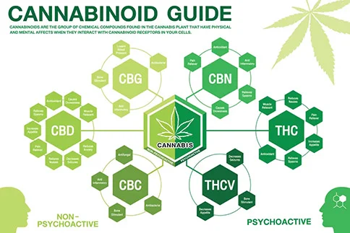
HOW CANNABINOIDS WORK
The “great moderators” of the nervous system-feedback coordinators/integrators

Slide 21
HOW CANNABINOIDS WORK
Rapidly absorbed when smoked, slow when ingested
In the 1960’s and 70’s, the THC level in plant material was ~2-6% with a CBD level of ~1-2%
Currently, plant material ranges from ~12-45% and CBD levels? Forget it… Zero, zip, zilch…
“Waxes, dabs and oils” contain up to 80%
And “shatter” is 99.8% THC
Half-life of 20-30 hours, highly lipophilic
Can remain in the system of heavy daily users for 3-4 months!
Unlike EtOH, Levels correlate POORLY with impairment

Slide 22
MEDICAL USES OF CANNABINOIDS
The research is just beginning
There are many uses, most for the non-psychoactive components like CBD
Dronabinol, nabilone

Slide 23
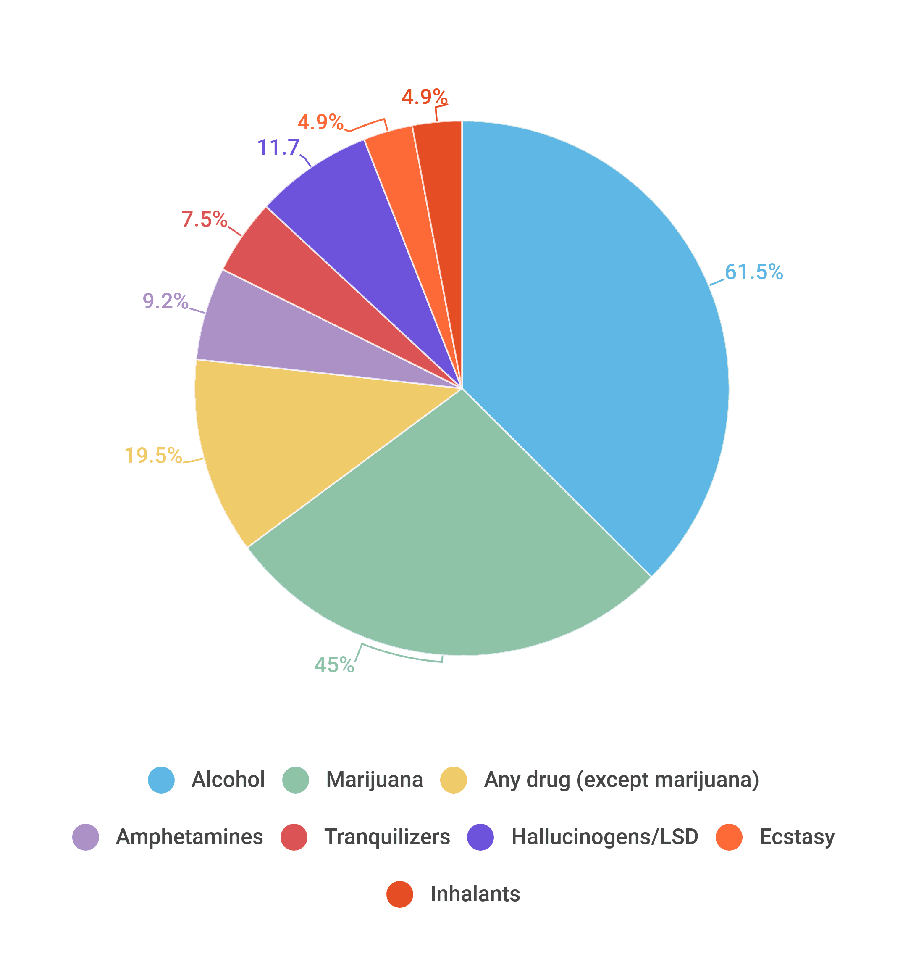
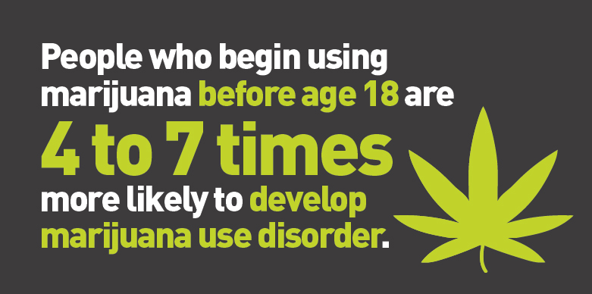
SCOPE OF THE PROBLEM
About 17M adults use MJ daily in the USA, 55M in the past year
Use prior to age 12 doubles the incidence of mental illness
About 6% of high-school seniors use MJ daily, 24% in the past year

Slide 24
MEDICAL TREATMENT
Acute intoxication
Supportive care-Generally mild, depression, decreased appetite, anxiety/agitation, sleep disturbance.
Similar to nicotine cessation
Ondansetron or other antiemetics (Cannabis-induced hyperemesis is prevalent)
Acute psychosis generally resolves fairly quickly, benzodiazepines are especially helpful in the first few hours.
Acute withdrawal
Gabapentin is front-line like in many other w/d sx
Dronabinol, 10mg cap BID (max 60mg daily) may help

Slide 25
MEDICAL TREATMENT
CUD treatment/pharmacotherapy
No FDA approved therapies
In teens, N-Acetyl Cysteine 1,200mg BID is helpful but not in adults (we don’t know why)
Further, topiramate may help, but the side-effects are prevalent with this drug
Contingency management, psychotherapy (CBT)
Of course, address underlying psychiatric issues

Slide 26
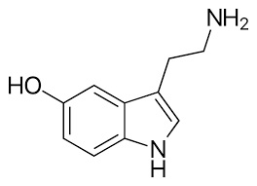
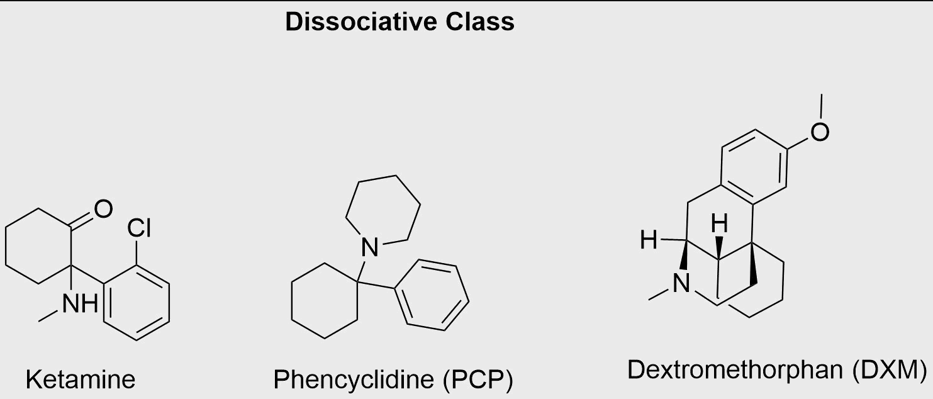
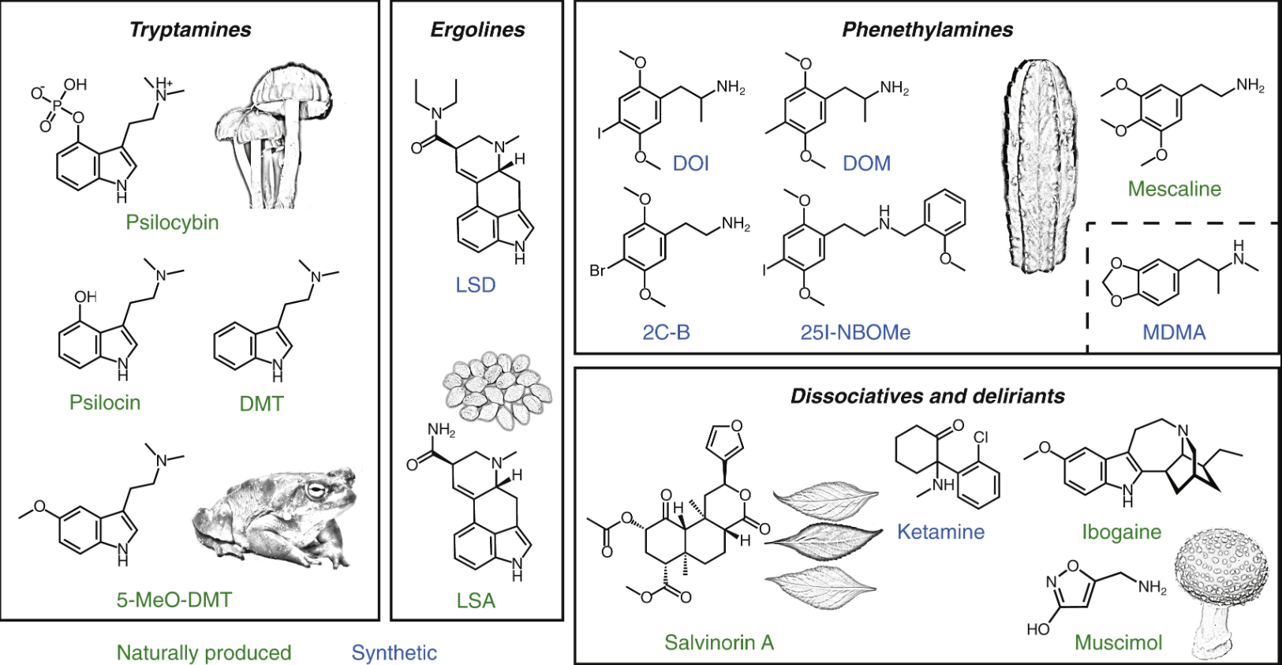
DISSOCIATIVES AND HALLUCINOGENS
Dissociatives
Ketamine, PCP, Dextromethorphan
Psychedelics
Psilocybin, LSD, DMT, Mescaline, N-benzylphenethylamines (NBOM’s-New!
Both
MDMA, Ibogaine, Salvia
Chemical structures
Serotonin

Slide 27
DISSOCIATIVES AND HALLUCINOGENS OVERALL
Dissociatives are synthetic
Cause a dissociation from the physical self and are anesthetics at higher concentrations
PCP and DXM cause B-vitamin deficiencies
Acute rhabdomyolysis is a possibility along with serotonin syndrome
Hallucinogens can be both natural and synthetic
Produce altered states of consciousness and alterations in mood, thought, perception and others
Many will not show up on drug screens
Research on these is burgeoning with many possibilities for addiction and psychiatric health

Slide 28
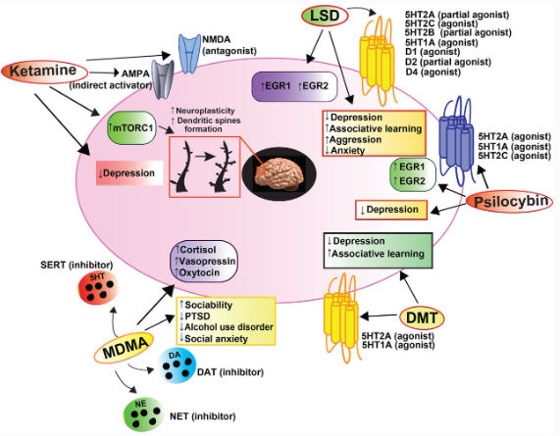
HOW DISSOCIATIVES AND HALLUCINOGENS WORK
Dissociatives generally work at the NDMA receptor (antagonists)
PCP has the longest half-life of ~21 hours
Hallucinogens work at a variety of serotonin receptors

Slide 29
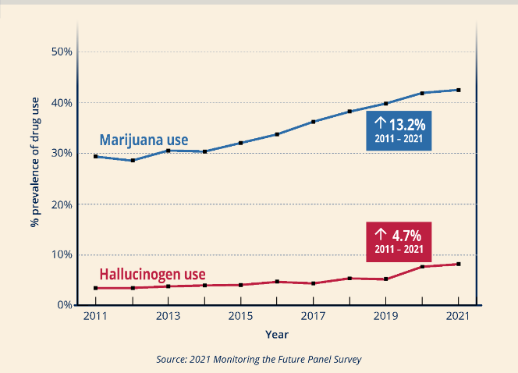
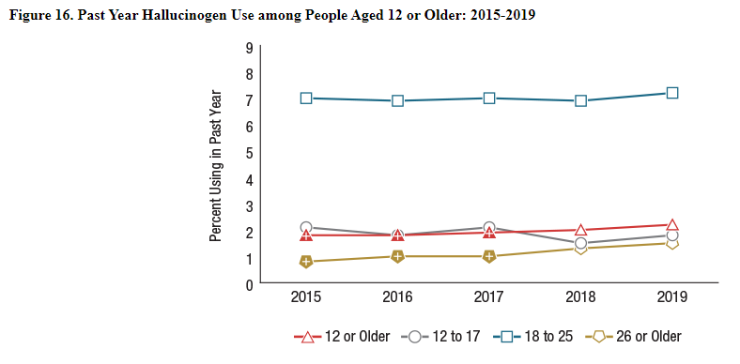
SCOPE OF THE PROBLEM
Perceived as “safe,” but single-use effects can be frightening/devastating and long-term
On the increase because of the increasing body of research-”News sells!”
That’s in the hands of professionals
Those with addiction hear their lives will be better doing those drugs

Slide 30
MEDICAL USES OF DISSOCIATIVES AND HALLUCINOGENS
Dissociatives
PCP no longer used
Ketamine
Anesthetic
Psychiatric, addiction
Hallucinogens/psychedelics
Experimental-psychiatric/ addiction
MDMA-PTSD treatment
Ibogaine-withdrawal/addiction, other countries
Lots of cardio side-effects

Slide 31
MEDICAL TREATMENT
Acute intoxication
PCP classically has horizontal/rotatory nystagmus
Supportive care, calm environment
Stage II and III should be handled in the ED
PCP can take a few weeks to completely resolve
Ondansetron or other antiemetics may help and benzodiazepines are first-line if general support fails
Antipsychotics like Haldol, risperidone, etc., may be needed but avoid in MDMA intoxication (hyperthermia/seizure/serotonin syndrome)

Slide 32
MEDICAL TREATMENT
Acute withdrawal
Generally minimal and fatigue is primary
Hallucinogen persisting perception disorder (HPPD), aka “Flashbacks” is not true “withdrawal”, it’s learned
Clonidine, BZD’s, and antipsychotics may help
Management
No FDA approved medications
A number of the serotonin receptor moieties, especially psilocybin, cause cardiac valvopathies so don’t miss those

Slide 33
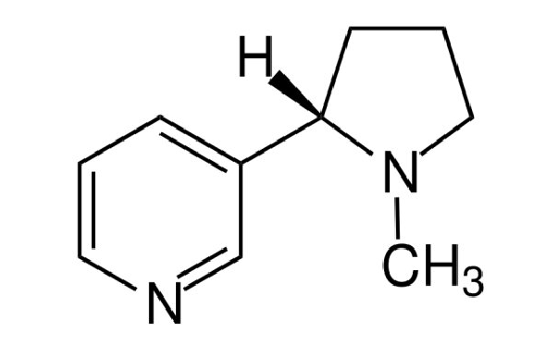
NICOTINE
Tobacco
Smoke, “chew”, “snuff”
Nicotine derivatives
Vape, oral, topical
Chemical structure

Slide 34
NICOTINE OVERALL
Originated in South America
Both recreational and medical applications
And pesticide
An alkaloid produced in the nightshade plant family
Tobacco, potato, tomato, eggplant, peppers
Is a stimulant
Associated with multiple health effects
Unknown if nicotine is “safer” from non-tobacco sources like vaping

Slide 35
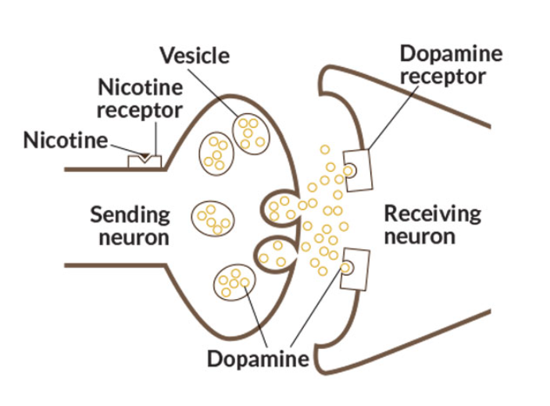
HOW NICOTINE WORKS
Agonist at most nicotinic acetylcholine receptors throughout the body including receptors in the VTA
Multiple effects throughout the body and brain

Slide 36
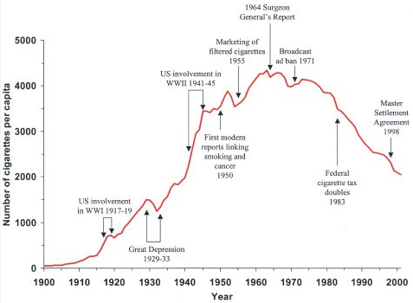
SCOPE OF THE PROBLEM
Remember, as far as SUD harms/prevalence go, alcohol is #1 in the US, but cigarettes are #1 for preventable disease, death and disability
1 in 5 deaths
~12% of the US population currently, peak was ~45%

Slide 37
MEDICAL TREATMENT
Acute intoxication
Supportive care
Protect the airway
Ondansetron or other antiemetics
Acute withdrawal
Supported best by replacement (NRT) with taper
Cessation support
Best with motivation/intent
Support groups
NRT (patch, 7mg/half-pack), varenicline (~3 months), bupropion (up to a year)
National quit-line, 1-800-QUIT-NOW

Slide 38
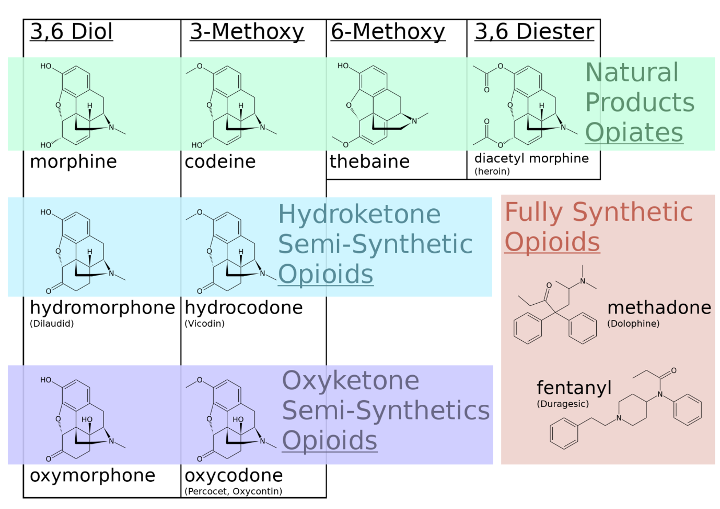
OPIOIDS
Class of drugs that are derived from or mimic the effects of natural substances found in the opium poppy Papaver somniferum
Evidence of use/trade dates to the 8th century AD
Numerous medical uses

Slide 39
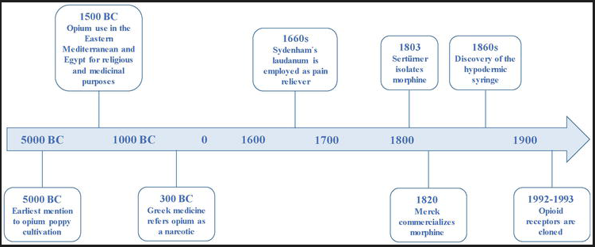
OPIOIDS OVERALL
Both natural and synthetic
Function at the mu, kappa
and delta endorphin
(opioid) receptors
Endorphins are primarily produced and released by the pituitary and act on the CNS and PNS typically in a response to pain
Been in use for thousands of years but refinement in the early to mid 1800’s propagated medical use
Incidence of abuse from prescription use is ~8%

Slide 40
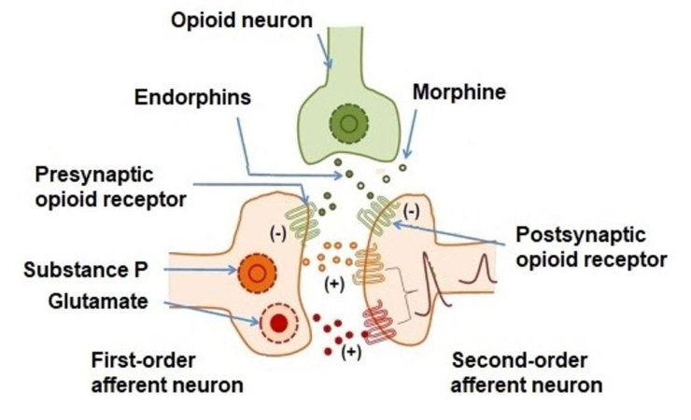
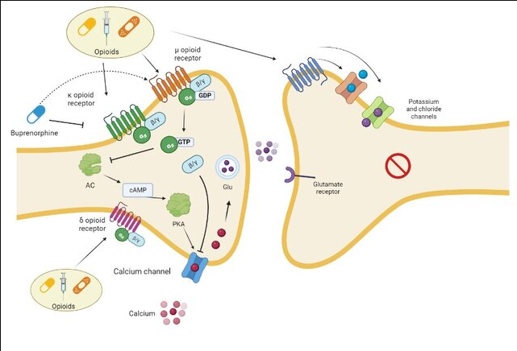
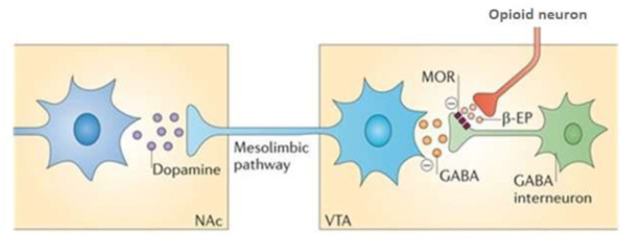
HOW OPIOIDS WORK
Binding at opioid receptors causing mainly “inhibitory” function
Block pain
Dopamine release (“excitatory” here)
Reduced neuronal excitability
Decreased intracellular cAMP

Slide 41
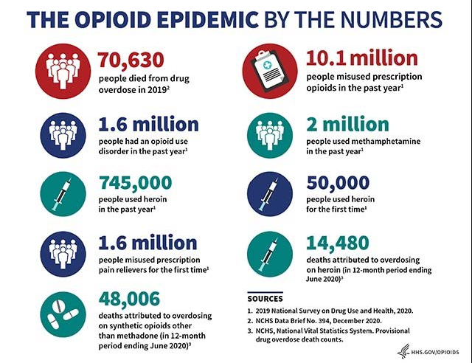
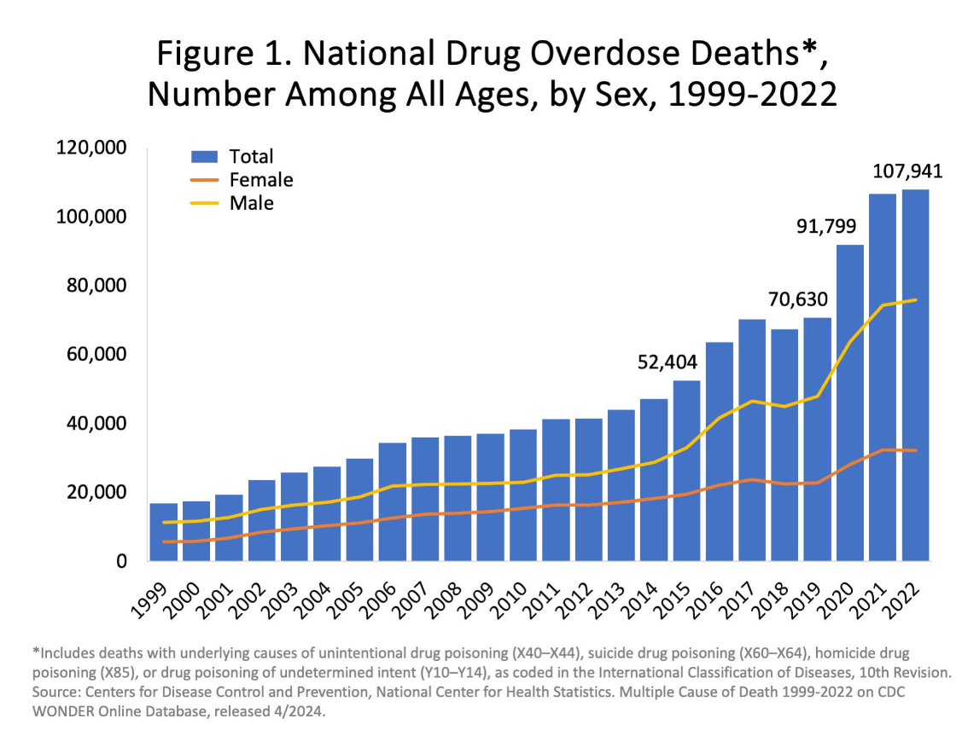
SCOPE OF THE PROBLEM
No secret here, it has been all over the news for years
CDC prescribing guidelines

Slide 42
MEDICAL TREATMENT
Acute intoxication
Supportive care
Protect the airway
Reversal agents, naloxone, nalmefene
More, longer isn’t better
Rule out other causes of mental status change like hypoglycemia, acidosis, injury and fluid/electrolyte abnormalities
Ondansetron or other antiemetics

Slide 43
MEDICAL TREATMENT
Acute withdrawal
Inpatient:
Clonidine, Gabapentin, Hydroxyzine, benzodiazepines
MAT (buprenorphine/methadone) induction
Lots of methods; Standard, slow (e.g. Bernese) and rapid. Bottom-line: NEVER back away, keep adding
Induction is the subject of another lecture!
Outpatient/ED:
Benzodiazepines, Clonidine, Gabapentin, Hydroxyzine
MAT (buprenorphine/methadone) induction
Naltrexone
An option after longer-term stability is achieved

Slide 44
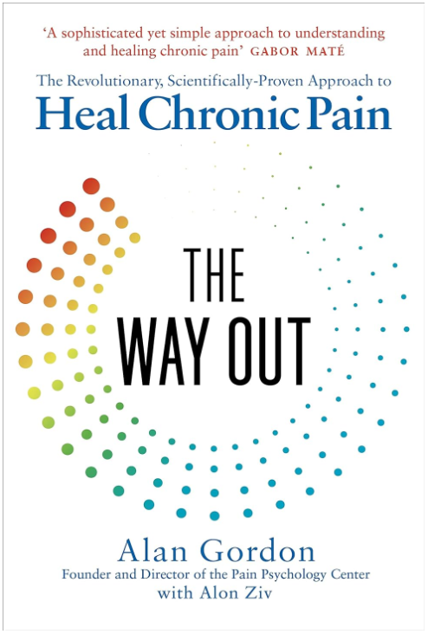
MEDICAL TREATMENT
Long-term
Long-acting injectables are the gold standard
Advantage of a built-in taper
Advantage of pain management
Term of MAT is determined by patient
Life-long has best outcomes
Must be a strong/mitigating reason to stop
Have a definitive plan for what to do not if, but WHEN opioids will get into their bodies next
Co-morbid chronic pain common here
Deserve full work-up and definitive/supportive care
The Way Out by Alan Gordon

Slide 45
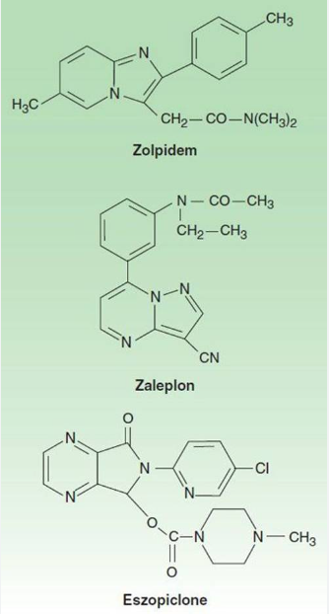
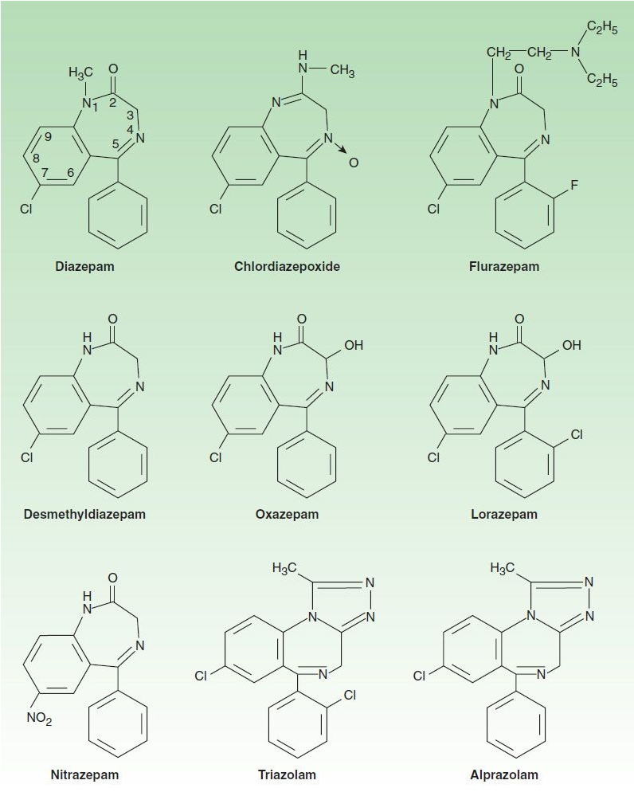
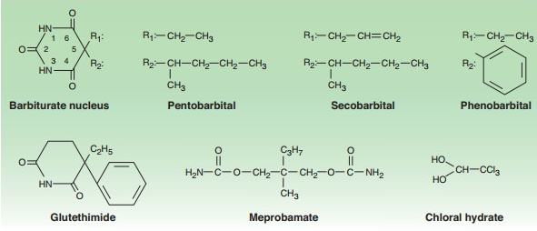
SEDATIVE-HYPNOTICS
Benzodiazepines, barbiturates
“Miscellaneous”
Chloral hydrate
Carisoprodol (Soma)
Cyclobenzaprine (Flexeril)
The “Z” drugs
Others
Chemical structures
Avoid using

Slide 46
SEDATIVE-HYPNOTICS OVERALL
Chloral Hydrate (derivative of alcohol) was the first in 1869. Barbiturates were next in 1903 and about 50 years later the benzodiazepines came into being
Prescribing is prevalent
Inappropriate long-term
BINDS
“Benzo-Induced Neurologic Dysfunction”
Won’t be long before the government limits prescribing like opioids because we won’t do it on our own
All work at the GABA receptor enhancing release
Are ONLY indicated for short-term (<2 weeks) use

Slide 47
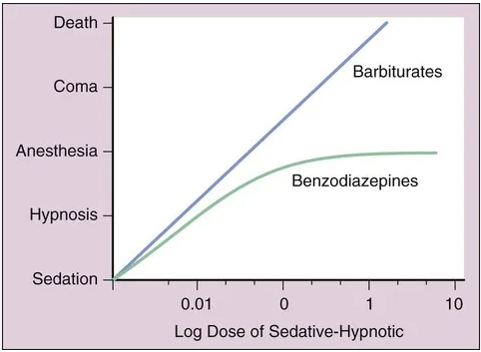
HOW SEDATIVE-HYPNOTICS WORK
Binding at GABA receptors
Increase duration of opening (Bar)
Increase frequency of opening (Benz)
Gaba receptors are on nerve cells that are inhibitory, or “put the brakes” on brain circuits
Withdrawal onset within 24hours, peak is 7-14 days

Slide 48
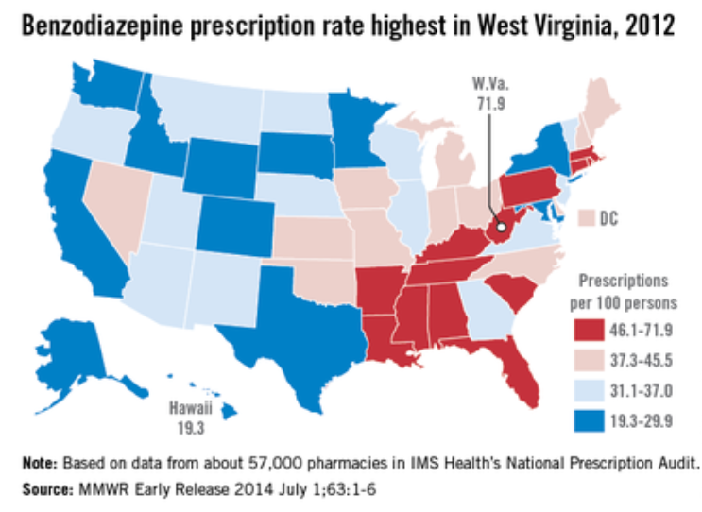
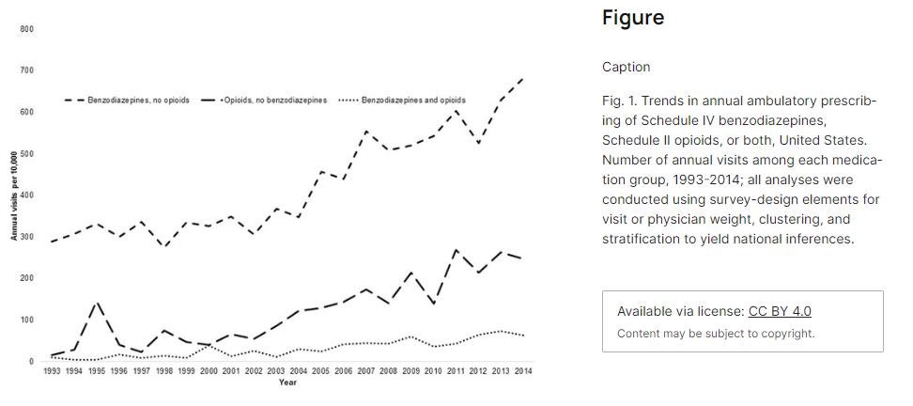
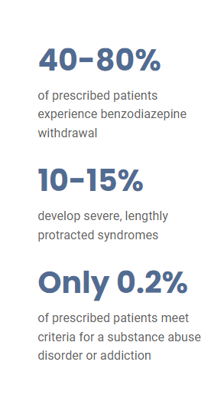
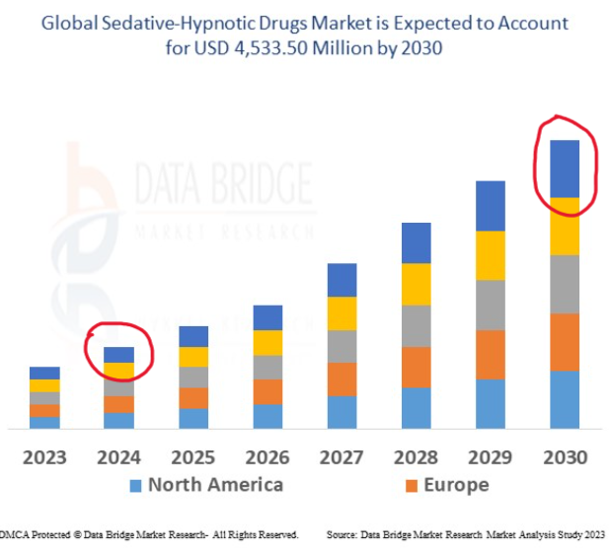
SCOPE OF THE PROBLEM
We’ve known this for years but somehow, it’s still under the radar
30% of OD’s involve BZD’s
About 10% of the population has used a BZD in the last year and 5% have a prescription
3 million (1%) Americans misused benzos in the last year (up 4X from 2007)

Slide 49
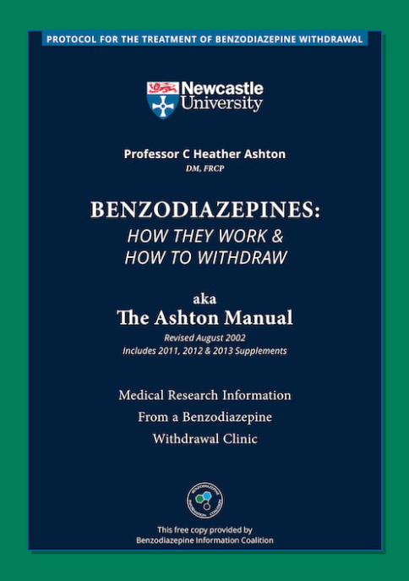
MEDICAL TREATMENT
A great resource, The Benzodiazepine Information Coalition: https://www.benzoinfo.com/
Oddly, relatively little literature on “how” to get patients off benzodiazepines
Can get away with “rapid” tapers, most evidence suggest slow is best
~5-10%/week
Depending on dose, this will usually take a few months
Ashton Manual

Slide 50
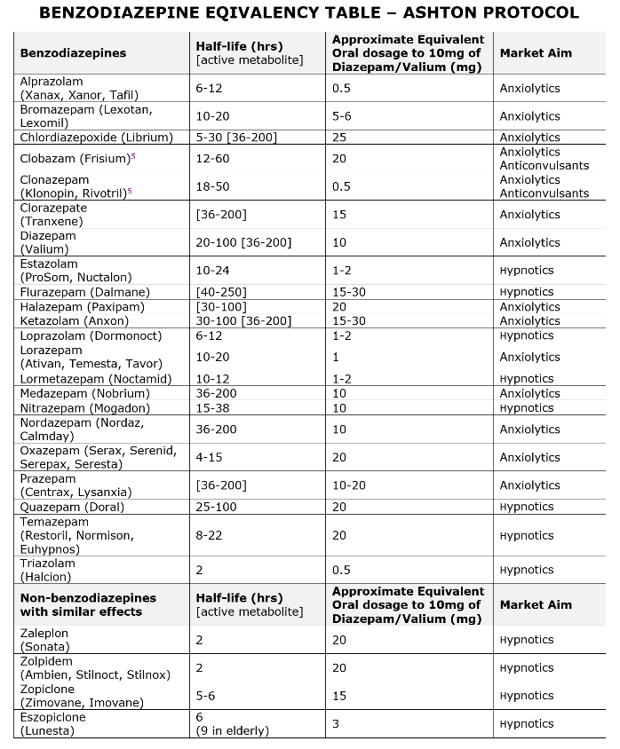
MEDICAL TREATMENT
Convert to long-acting, diazepam (Valium) is easiest to control
Numerous on-line dose calculators exist
Once stable (~1 week) begin weekly taper of 5%
When the 5% becomes 10%, reduce again
Immediately begin sourcing sustainable skills and medications

Slide 51
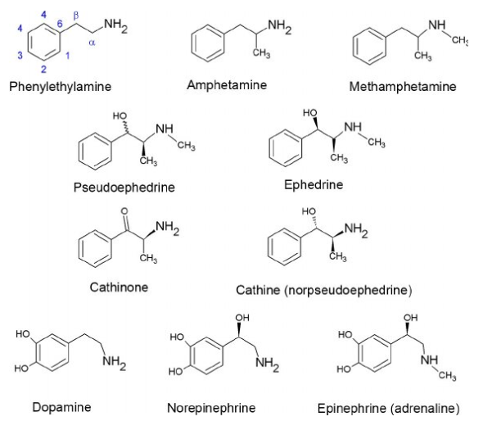
STIMULANTS
Amphetamines, Armodafinil, Atomoxetine,Betel Nut, Caffeine, Cocaine, Dexamphetamine, “Ice,” Khat, Mephedrone, Methamphetamin, Methylphenidate, MDMA, Modafinil, Nicotine, Oxybate, Oxymetazoline, Pitolisant, Phenylephrine, Phenylpropanolamine, Pseudoephedrine, Solriamfetol, Synthetic Cathinones!!!
Chemical structures

Slide 52
STIMULANTS OVERALL
Stimulants “speed-up” the body’s systems
Medically used to treat narcolepsy, ADHD, obesity, depression, enhance performance, etc.
First known in “medicinal plant” form in South America about 2500 BC
Amphetamine was first synthesized in 1887 and Cocaine was isolated from the coca plant about the same time
Widely used in “tonics” until the various drug control acts stopped that by the Harrison Act in 1914 and further controls in the 1930’s and later

Slide 53
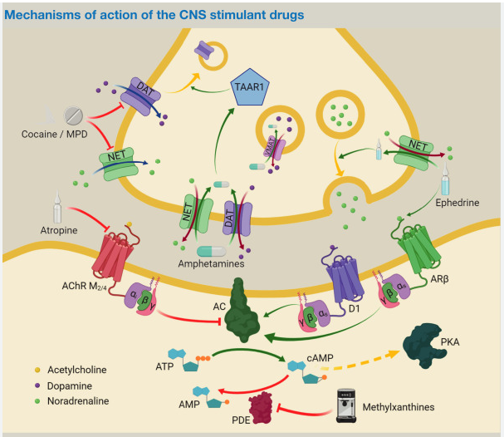
HOW STIMULANTS WORK
In general, they mimic or affect neurotransmitters like dopamine, norepinephrine, serotonin and others
The central theme here in addiction is increasing dopamine in the VTA by various mechanisms
Chemical structures

Slide 54
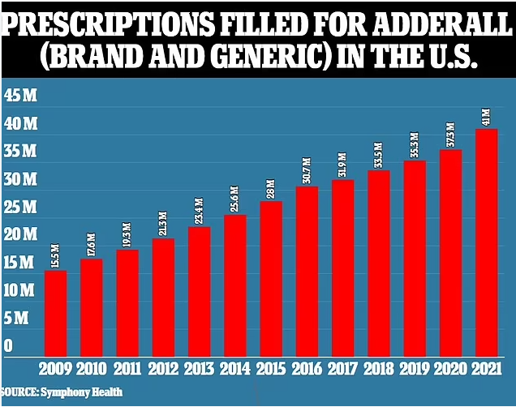
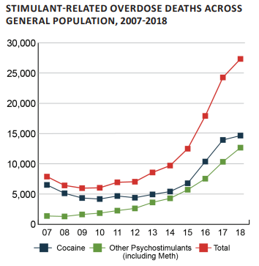
SCOPE OF THE PROBLEM
~6.6% of US adults are on prescription stimulants
About 25% misuse
Methamphetamine use was up ~40% 2015-19
Stimulant prescribing is still increasing
Stimulant-related offenses are up 75%

Slide 55
MEDICAL TREATMENT
A very challenging realm-Contingency Management is best here
If you simply block the dopamine response, you block the drive to survive!
For amphetamines and cocaine, there are no “high quality evidence” pharmacological interventions, but lots of studies have been done
Switch to long-acting stimulants, long-acting bupropion (short acting is known as “poor man’s cocaine”), naltrexone, SSRI’s, desipramine, topiramate
Appears that combination therapy tailored to your individual patient is the way to go
Lots of stuff being tested like antibodies, other receptor blockers, ketamine, vaccines, enzymes,

Slide 56
MEDICAL TREATMENT
Amphetamine/Methamphetamine-related psychosis can persist for months or be permanent.
What I like to do:
MI can really help here
Get them involved in a sober support group!
Contingency management
Support any underlying psych medically and clinically
Support the low dopamine of w/d with long-acting bupropion, can take up to 450mg/day
I add naltrexone, usual dosing
I usually add topiramate, start low (25mg/day) and increase by 25mg/week up to 200mg/week. Stop if not helpful

Slide 57
A FEW WORDS ON DRUG TESTING
A UA is a urinalysis
It tests for kidney function, urinary infections and some metabolic functions
A UDS is a urine drug screen
Most often this is an ELISA or enzyme-linked immunoassay
A UDS is designed to have high sensitivity so has low specificity
This means very few false negatives
A good thing
This also means lots of false positives
A bad thing

Slide 58
A FEW WORDS ON DRUG TESTING
The standard UDS will miss lots of things, examples:
Opioids will not pick up fentanyl or the new synthetics like nitrazine.
Lots of molecules cross-react
Ibuprofen=barbiturate
Benadryl=opioids

Slide 59
A FEW WORDS ON DRUG TESTING
If you have a positive UDS you need confirmation
The patient can confirm
The lab can confirm
This is done by chromatography and mass-spectrometry and determines the exact molecule

Slide 60
A FEW WORDS ON DRUG TESTING
So, the UDS is “the conversation opener”
The confirmation is “the conversation closer”
Is your confirmation up-to-date with all the newest stuff out there?
CALL THE LAB!

Slide 61
A FEW WORDS ON DRUG TESTING
Know your metabolites
Often the lab will print that for you on the report

Slide 62
Questions? Thank you!
James B. Shuler, DO, MS, FACOEP, FAWM, FASAM
970-217-3882
shulers@aol.com
Please, USE THESE!

