Slide 1
THE SCIENCE AND STIGMA OF
ADDICTION
James B. Shuler, DO, MS, FACOEP, FAWM, FASAM
shulers@aol.com, 970-217-3882

Slide 2
Introduction
Dr. Jim Shuler is dual board-certified in Addiction and Emergency Medicine and has a fellowship in Wilderness Medicine
Medical Director of multiple in and outpatient SUD treatment facilities
Owner of SUD Consultants, LLC providing Medical Director, Speaking and expert witness services
No financial disclosures

Slide 3
STIGMA
Webster-A set of negative and unfair beliefs that a society or group of people have about something. A mark of shame or discredit
SUD=Moral Failing
Substituting one drug for another
Lack of knowledge

Slide 4
Don’t forget genetics!

Slide 5
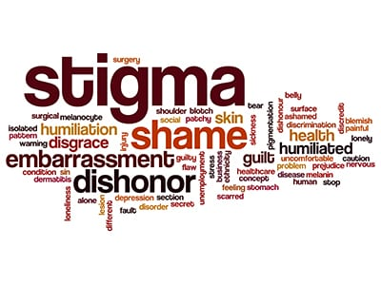
STIGMA
Experience of being “deeply discredited” because of one’s “undesired differentness”
Substance use disorder is the most stigmatized physical or behavioral condition in the world.
Media rarely portray people in treatment/recovery

Slide 6
HOW MUCH STIGMA?
80% of people on methadone reported stigma in one study
60% say it affects their daily life
50% feel ashamed to be on MMT
30% agree that stigma has affected their treatment
Family/friends>health care workers (30% apiece)

Slide 7
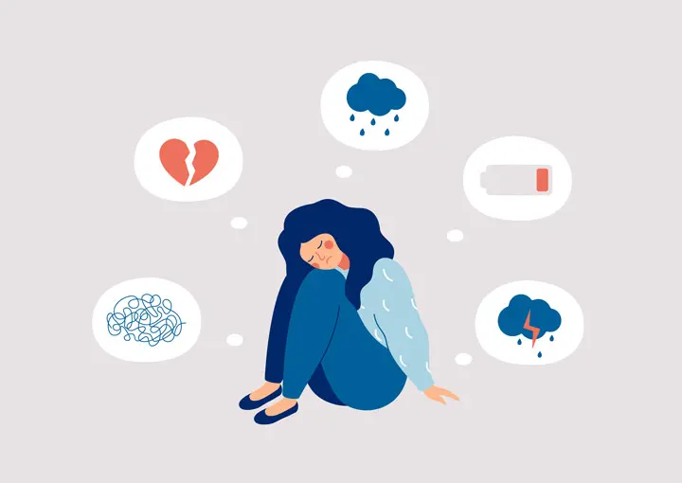
HOW MUCH STIGMA?
89% thought the public held negative stereotypes of MMT
78% thought the public preferred abstinence-based over MMT
50% held the same negative stereotypes of themselves

Slide 8
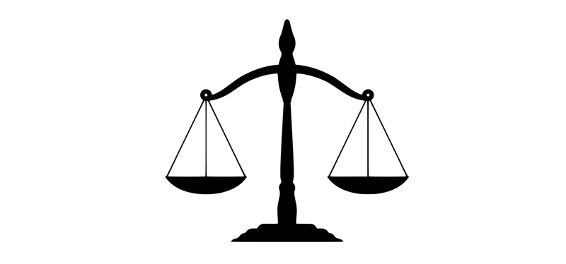
Where does it come from?
Family members/friends
Healthcare providers
Coworkers/employers
Counselors
Recovery organizations particularly 12-Step Groups, Sponsors
Treatment organizations
Criminal Justice organizations

Slide 9
WHAT IS THE RESULT?
Less likely to benefit from treatment
Less likely to benefit from punishment
Long delays in seeking treatment
Prevents access to treatment
Patient may forgo naloxone, buprenorphine, methadone
Shames people in treatment, causing them to minimize involvement, hide activities, or discontinue treatment
Causes people to leave adjunct services like syringe access

Slide 10
WHAT IS THE RESULT?
Judgment in other medical settings
Low self-esteem
Friend/family relationships, dating
Employment
Referrals to treatment unlikely
PCPs also less likely to refer for appropriate physical health services NOT RELATED to SUD (preventative care, hepatitis treatment, transplant)
Many organizations unwilling to offer treatment ESPECIALLY in facilities that offer “safety net” care; very little treatment in jails/prisons
Payment for treatment is inadequate
Family/friends may urge abstinence-based treatment

Slide 11
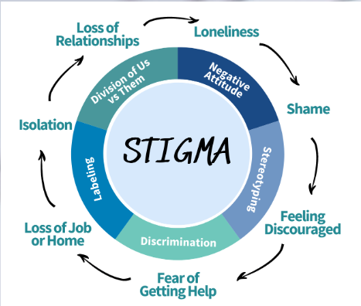
WHAT IS THE RESULT?
Reduced access to services (housing, jobs) while on MAT
People may avoid talking about treatment, minimize dose, accessing services
Leads people to cease treatment as soon as possible
Particularly acute among already marginalized groups, like children/adolescents, pregnant women

Slide 12
NO PROBLEMS IN 12-STEP MEETINGS, RIGHT?
Conflicting messages!
“The only requirement for membership is a desire to stop using.”
1996 pamphlet: NA has the right to limit such members’ participation in meetings
No sharing
No service positions
No sponsoring
In practice, these are rarely enforced, but sharing about MAT and using MAT are still highly discouraged

Slide 13
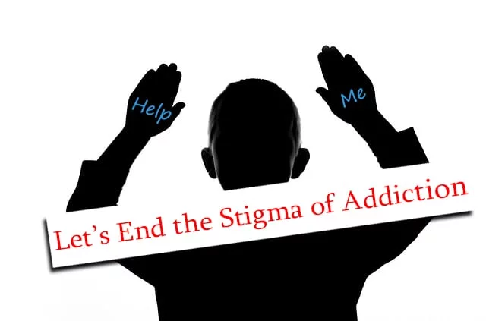
WAYS TO REDUCE STIGMA
Methods and Targets
Legal
Policy/Advocacy
Professional Education
Legislators
Housing Providers
Employers
Criminal Justice
Health Care Providers

Slide 14
MEDICINE TODAY
other medicine today
Addiction medicine today

Slide 15
IN SHORT
The brain is a 3-part (triune) system that is essentially a hard-wired “computer” that runs software and is “programmable”
Addiction is a “software/malware” program running on perfectly operating hardware
It is a neurobiologically based illness that expresses itself through thoughts and behavior
It is a maladaptive learned response “programmed” by the “survival” center of the brain
First, a definition…

Slide 16
Definition: From the American Society of Addiction Medicine (asam) (April 2012, the “short” definition)
Addiction is a primary, chronic disease of brain reward, motivation, memory and related circuitry. Dysfunction in these circuits leads to characteristic biological, psychological, social and spiritual manifestations. This is reflected in an individual pathologically pursuing reward and/or relief by substance use and other behaviors.
Addiction is characterized by inability to consistently abstain, impairment in behavioral control, craving, diminished recognition of significant problems with one’s behaviors and interpersonal relationships, and a dysfunctional emotional response. Like other chronic diseases, addiction often involves cycles of relapse and remission. Without treatment or engagement in recovery activities, addiction is progressive and can result in disability or premature death.

Slide 17
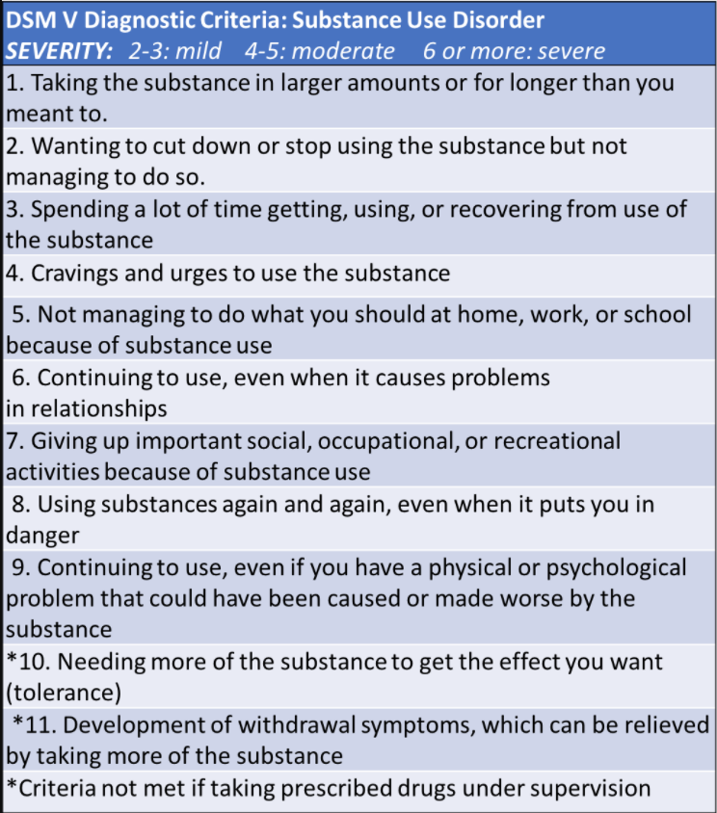
CRITERIA FOR ADDICTION
How many are present for you?

Slide 18
THE BRAIN
Neocortex: The rational or thinking brain
Limbic Area: The emotional or feeling brain
Reptilian Complex: The instinctual or reptilian brain

Slide 19
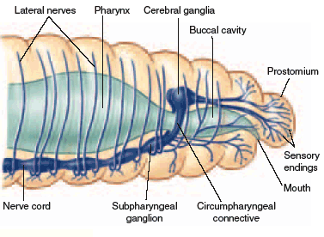
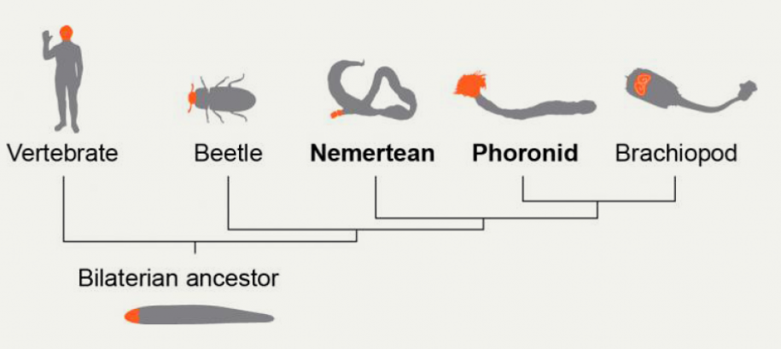
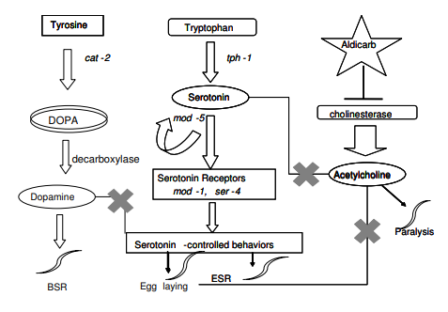
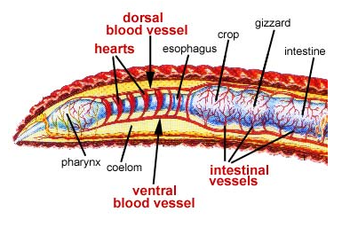
HOW DID IT ALL BEGIN?
Worms are pretty basic, but we’re related!

Slide 20
BASIC BRAIN WIRING
Bottom-up processing
Older parts of the brain are fast and newer are slower
It’s a POOR design

Slide 21
DOPAMINE “REWARD” CENTER I CALL IT “The survival center”
Also known as the “Incentive Salience” center and drives all the instincts of life-forms with a brain:
Maintaining hydration
Ensuring adequate food/nutrition
Maintain shelter from cold/heat
Ensure safety/preserve life of self/family/tribe
Engaging in sexual reproduction
Nurture/protect young

Slide 22
How it’s wired
Dopamine
Dopamine with “learning”
respiratory

Slide 23
YOU HAVE TO “LIKE” IT! (Sort of…)

Slide 24
“LIKING” SOMETHING IS A LITTLE COMPLEX

Slide 25
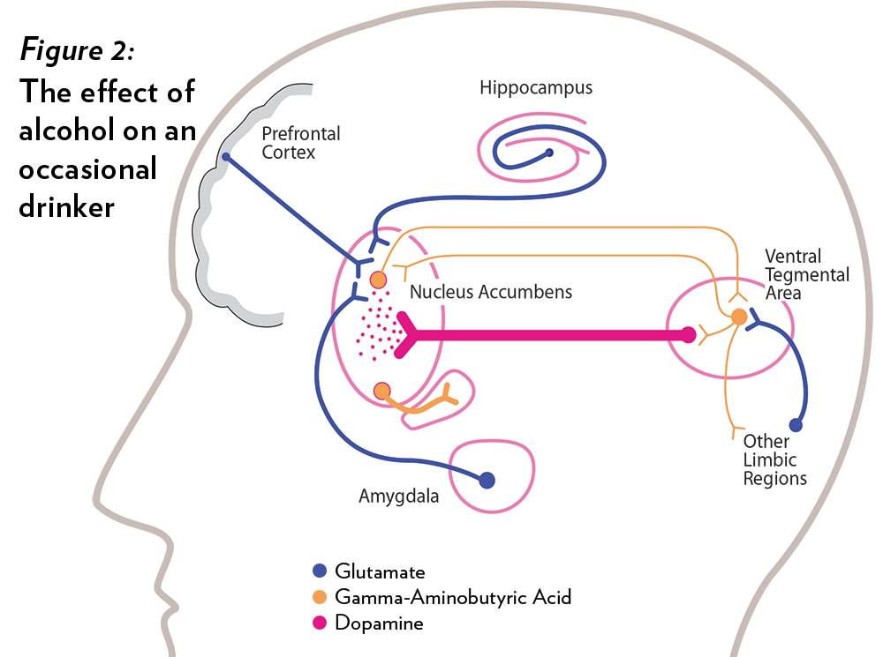
HOW DO YOU PUT THE BRAKES ON?
It’s a complex interplay of multiple neurotransmitters in multiple areas in the brain
Currently there is a great deal of research on medications to help “normalize” these pathways

Slide 26
HERE’S WHAT IT LOOKS LIKE FOR FOOD
“Broken” Feedback Loops in Addiction
X
Delicate balance between many brain and body mechanisms or “Feedback Circuits”
X

Slide 27
IMAGING TELLS THE DRAMATIC STORY

Slide 29
PUTTING IT TOGETHER
Very complex and lots of “targets” to go after medically. BUT that will have an effect on other things, so the balance is difficult

Slide 30
THE LEVEL OF DOPAMINE IS CRUCIAL

Slide 31
SCOPE OF THE PROBLEM SAMHSA “SELF-REPORT” CROSS-SECTIONAL STUDY

Slide 32
THE PROCESS OF ADDICTION
The simple story
What’s really involved

Slide 33
THE “ATACK” OF ADDICTION What it looks like
FOUR PARTS
Initial “hijack” of instincts
Pleasure/euphoria replaced with insatiable hunger to repeat
“Normal” rewards fade in importance (survival order)

Slide 34
MOTIVATION REDIRECTION
It redirects “motivation” circuits to ensure its own survival
Attention/focus circuits turned toward seeking/using (seen as critical to survival)
“Learning” behaviors around seeking/using are enhanced

Slide 35
ESTABLISHMENT OF STEREOTYPICAL RESPONSES
Ensures continued use
Most of this learning is at a subconscious level
All other learning priorities are relegated to a lower priority!

Slide 36
REARRANGEMENT OF REALITY
An attempt to prevent detection
The victim’s own reality changes like a computer virus running in “stealth” mode
“Justifications” for not stopping/continuance that seem “unreal” to the unaffected person/others

Slide 37
MORE ADDICT BRAIN “DIRTY TRICKS”
Urgency and Impulsiveness
Just like hunger or other drives
Relapse is inevitable
Use patterns become hardwired subconsciously
You get the opposite of what you want
It stops “working”

Slide 38
MORE ADDICT BRAIN “DIRTY TRICKS”
Loss of Self
We give up and accept we ARE our addiction
Shameful, not Sick
Our own self-judgement feeds the illness
Loss of Values
Values transgression feeds shame
Going Silent
Disease progresses without use, “fooling” the individual into thinking they’ve recovered

Slide 39
**SUMMARY** “A MALADAPTIVE LEARNED RESPONSE”
A primitive drive to consume chemicals or behaviors combined with learning, brain adjustment, reality distortion
It is a newly engineered artificial instinct
It hijacks primitive control centers, shifts motivation and sets-up its own learning
It operates in “stealth mode” like a computer virus bent on its own survival

Slide 40
FOR NEXT TIME
A deeper dive on addiction medicine
More specific neurobiology
How each drug causes addiction
What we can do about it

Slide 41
THANK YOU
James B. Shuler, DO, MS, FACOEP, FAWM, FASAM​
970-217-3882
shulers@aol.com

