Slide 1
Pathways
Virna Little, PsyD, LCSWr

Slide 2
What Are Pathways?
Clinical process
They are not workflows
What does excellent care look like

Slide 3
Why Do We Need A Pathway ?
Helpful for new staff and existing staff
Regulatory
Defines a process and care
Uncovers holes
Population health

Slide 4
Pathway Process
Define the clinical need
External literature search best practices, tools, data review, outcomes
Internal data review
Review of internal and external data, tool selection
Research informs practice document
Tool and outcome selection , definition
Pathway creation
Quality measures, chart reviews, dashboards
Data dictionary ( inclusions, exclusions)
Training materials ( onboarding and existing team)

Slide 5
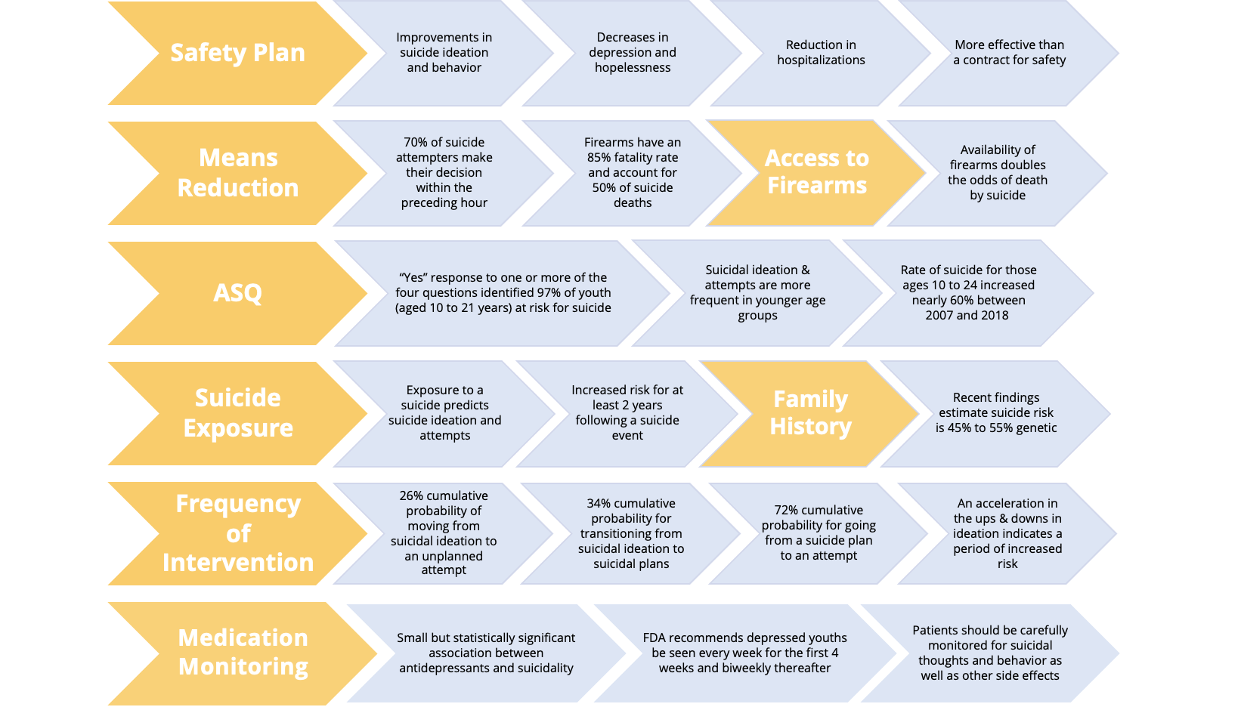
Suicide Research Informs Pathway

Slide 6
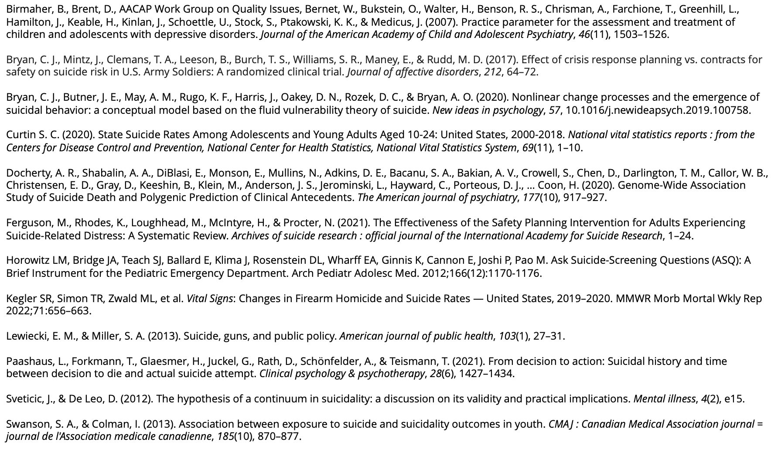

Slide 7
Variables in Pathways
Fixed variables- things that you do that be modified , such as risk level or score
Fluid variables- things that you do not do as part of your regular process such as wellness check, or waiting room time

Slide 8
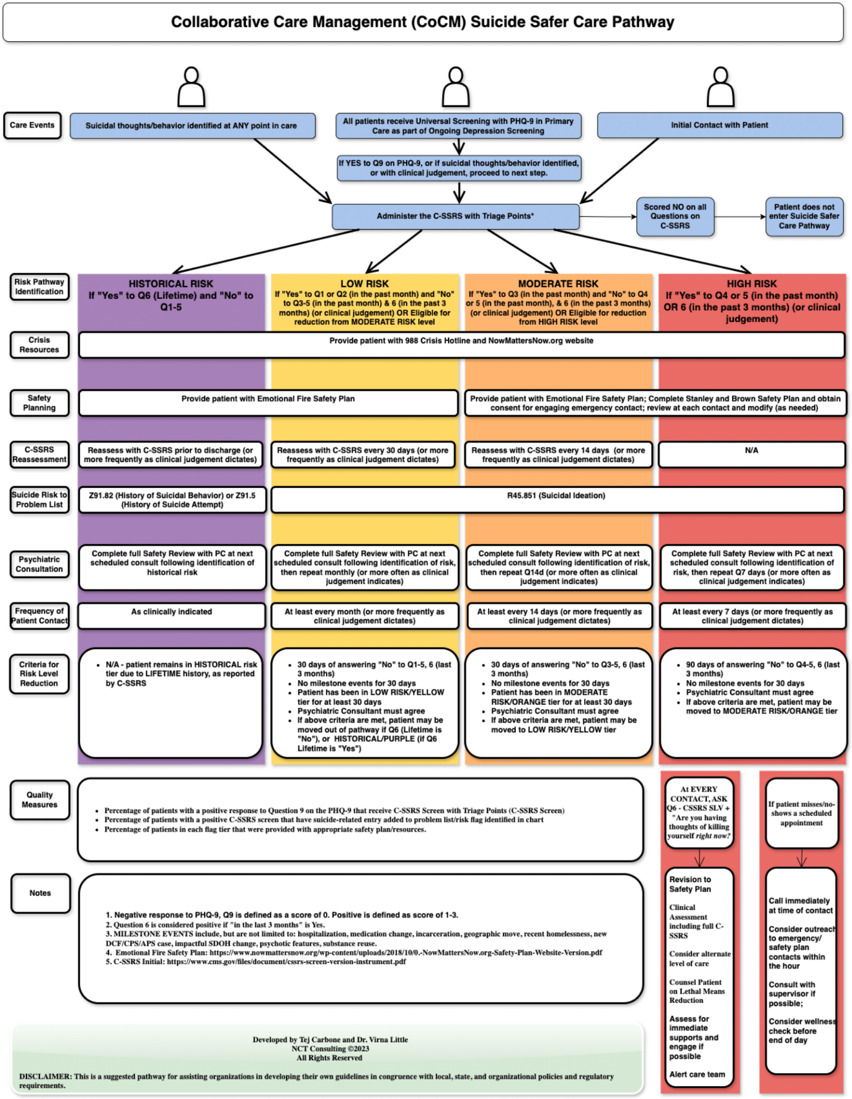

Slide 9
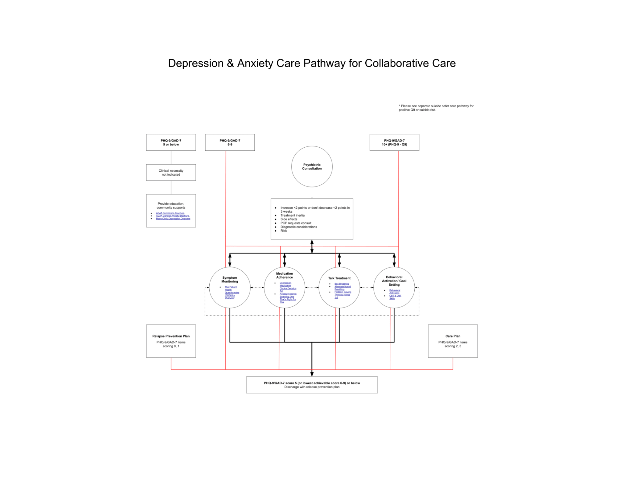

Slide 12
Things to Include
Variables
Outcomes
Types of treatment /choices
Decision points
Resources or tools

Slide 16
Questions/Comments
Unknown Author is licensed under CC BY-SA-NC

