Slide 1
Building the Future of BHI
Kim Shuler, LCSW, Caitlyn Johnson, LCSW, Kristen Martin, DO, Will McCoy, Tessa Huneycutt, Curtis Harris Jr, Anna Watson

Slide 2

WHAT is Integrated Behavioral Health?
Integrated behavioral health care blends care in one setting for medical conditions and related behavioral health factors that affect health and well-being.
Integrated behavioral health care, a part of “whole-person care,” is a rapidly emerging shift in the practice of high-quality health care.
It is a core function of the “advanced patient-centered medical home.”
Integrated behavioral health care is sometimes called “behavioral health integration,” “integrated care,” “collaborative care,” or “primary care behavioral health.”
No matter what one calls it, the goal is the same: better care and health for the whole person.

Slide 3
A Spectrum of Integration
Coordinated Care (off-site)
- Level 1: Minimal collaboration
Patients are referred to a provider at another practice site and providers have minimal communication
- Level 2: Basic Collaboration
Providers at separate sites periodically communication about shared patients
Co-Located Care (On-Site)
- Level 3: Basic Collaboration
Providers share the same facility but maintain separate cultures and develop separate treatment plans for patients
- Level 4: Close Collaboration
Providers share records and some system integration
Highly Integrated Care
- Level 5: Close Collaboration
Providers develop and implement collaborative treatment planning for shared patients but not for other patients
- Level 6: Full Collaboration
Providers develop and implement collaborative treatment planning for all patients
Coordinated Care Co-Located Care Integrated Care
Adapted from: Gerrity, M., Zoller, E., Pinson, N., Pettinari, C., & King, V. (2014). Integrating Primary Care into Behavioral Health Settings: What Works for Individuals with Serious Mental Illness. New York, NY: Milbank Memorial Fund

Slide 4
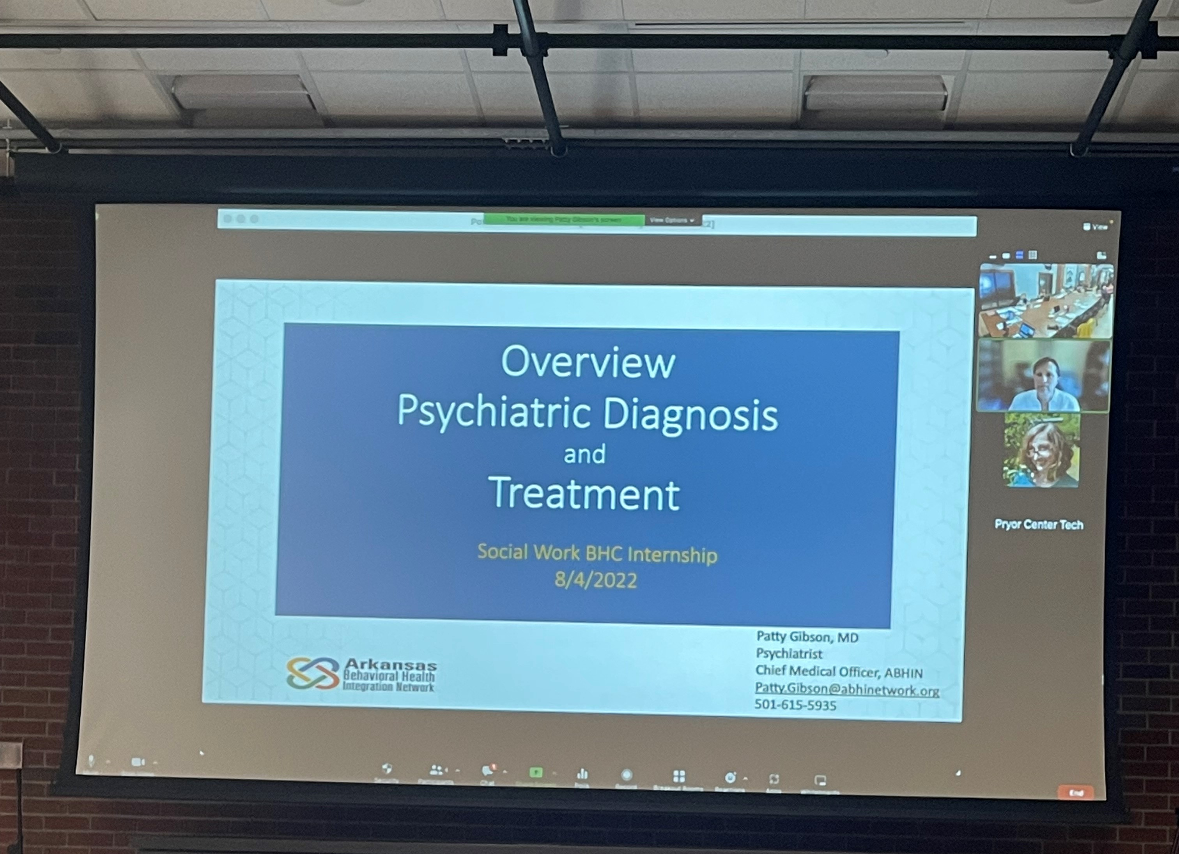
Behavioral Health Integration Bootcamp
Two Day Bootcamp
Subjects include:
Overview of BHI Models
Referrals/ warm hand offs, initial interviews
Psychopharmacology with Dr. Gibson
Planning screening and assessment
Brief interventions in primary care
Suicide assessment and treatment
Notes:
Networked and got to know other interns as well as field supervisors Kim and Caitlyn

Slide 5

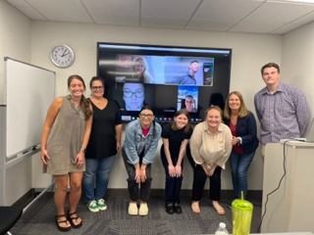
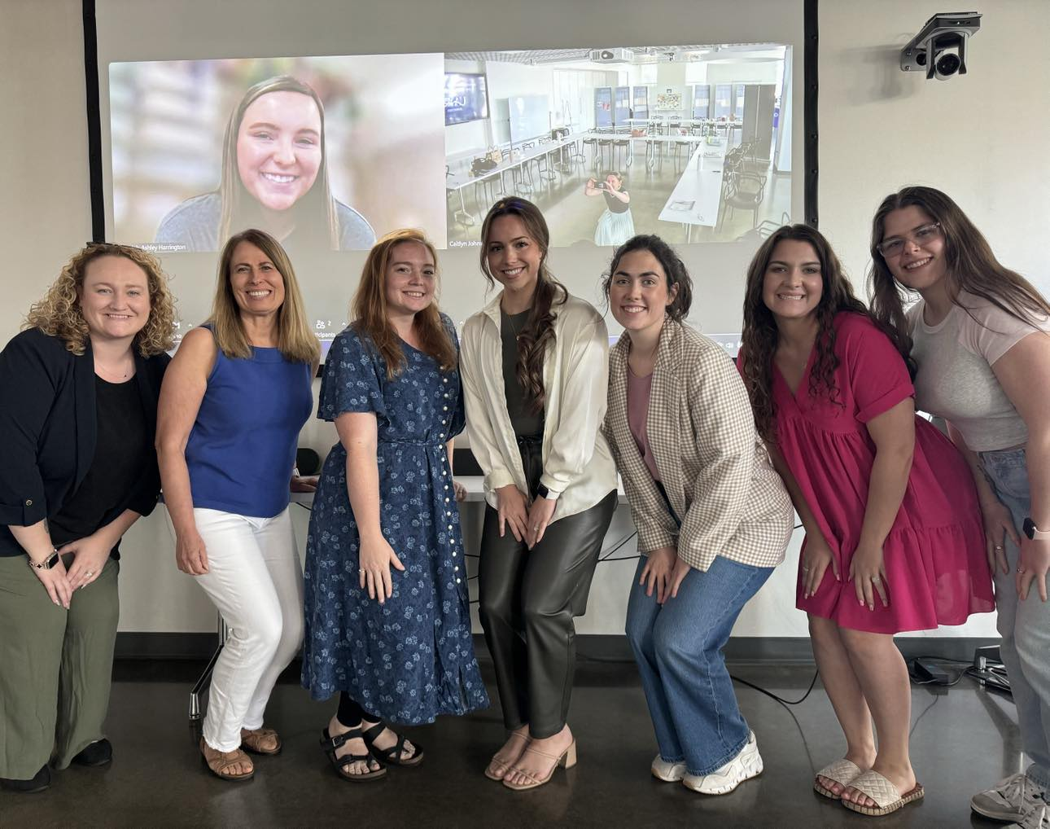
Master of Social Work Programs
University of Arkansas and University of Arkansas at Little Rock
Variety of placements
5 participating clinics

Slide 6
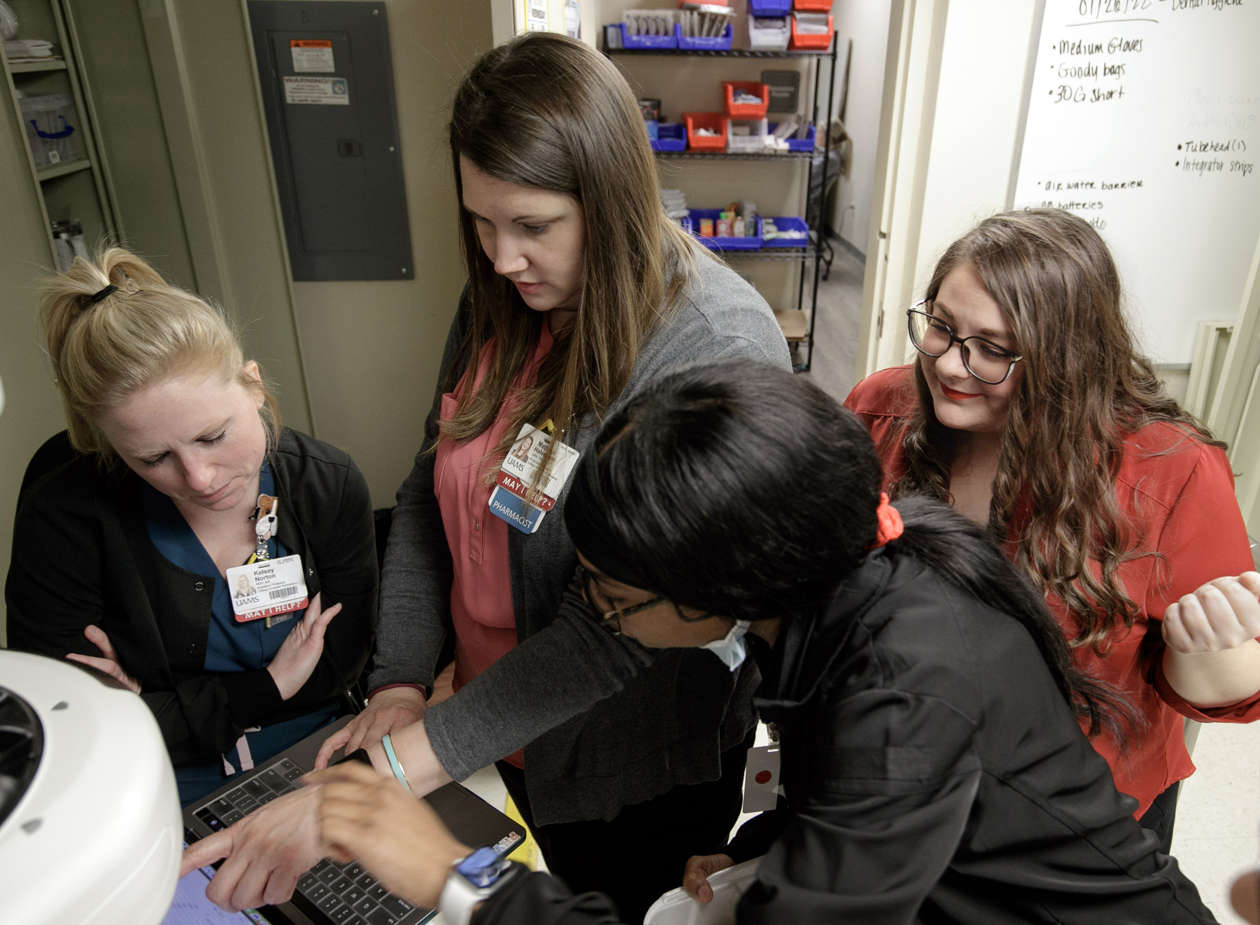
Supervision
Weekly virtual supervision
Group supervision every 6 weeks with case presentation and review
Onsite session audits
Implementation Assistance
Online library
worksheets
patient education
assessment tools

Slide 7
Year Three Results
Notes:
Students saw 421 patients
Language:
95 percent English
3.8 percent Spanish
1 percent other
Insurance:
Medicaid 11.5
Medicare 19.5
Private 60
Uninsured 10.5
Dual Eligible .5

Slide 8
Year Three Referrals
Notes:
Misc includes attention deficits, sleep disorders, dementia, SUD, SI, SMI, Chronic pain

Slide 9
Year Three Intervention Efficacy
Notes:
Average PHQ9 score: 10.2
Average Ending: 8.4
11% decrease
Average Beginning GAD7 8.5
Average Ending 7.3
Percentage decrease 14%

Slide 10


Clinic Spotlight

Slide 11

Student Panel Discussion

Slide 12

Audience Q & A

Slide 13






Thank You!
Notes:
Include Ruth and Anonda

