Slide 1
Causes & Conditions Substance and Process Use Disorder Understanding Etiology and What Drives the Behaviors
Daniel David Sumrok, MD DFASAM FAAFP DABAM DABPM

Slide 2
“Alcohol was but a symptom of our disease. We had to get to the causes and conditions.”
-Bill W.

Slide 3
Daniel David Sumrok, MD DFASAM, FAAFP, DABAM, DABPM
Region X ASAM Board Member
Regional Medical Director
Landmark Recovery
Immediate past president
TNSAM
Director Center for Addiction Science
UTHSC, Memphis

Slide 4
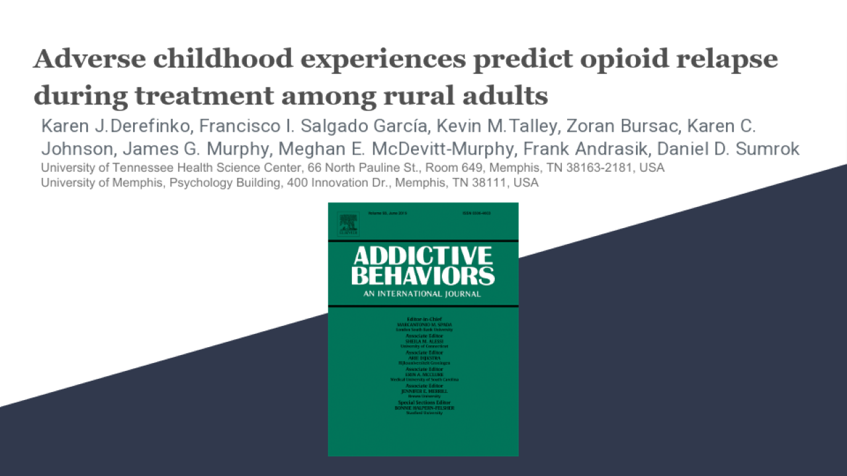
Adverse Childhood Experiences Predict Opioid Relapse During Treatment among Rural Adults
Dr. Daniel Sumrok, Et Al.
Journal of Addictive Behaviors September 2019

Slide 5
Results: Descriptive
Sample was 100% Caucasian and 75% male
Age ranged from 21 to 81 years old (M=39.9, SD=9.5
Number of office treatment visits ranged from 1 to 80 (M=23.6, SD=22
Majority (91%) of patients were prescribed Suboxone (8mg), 7% were prescribed Bunavail (4.2/0.7mg), and 2% were prescribed Zubsolv (5.7/0.7mg)
Mean ACE score was 3.5 (SD=2.9)
18% of participants reported no ACE
46% reported four or more
Most commonly reported ACE included parent separation/divorce (59%), alcohol abuse by adult in the household (53%), verbal abuse (45%), and emotional neglect (40%)

Slide 6
Results: Relapse during treatment
Relapse
Of the 87 patients, 47 (54%) relapsed at least once.
Of the 2,052 visit observations, 145 (7%) indicated a positive result for opioid relapse
The median number of visits to relapse was 1
Highest relapse rate (34%) on the first visit

Slide 7
Results: ace as a risk factor
GEE repeated measures model allowed us to include patients with different numbers of follow-up visits and make use of all available data while adjusting for number of visits for each patient
Results demonstrated that for every unit increase in ACE score, the odds of opioid relapse were 17% higher
(OR=1.17, 95% CI: 1.05-1.30, p=.005)

Slide 8
Results: benefit of staying in treatment
Odds of opioid relapse were 2% lower for every additional treatment visit
(OR=0.98, 95% CI: 0.97-0.99, p=.008)
Neither gender (OR=1.49, 95% CI: 0.68-3.28, p=.313) nor age (OR=0.99, 95% CI: 0.96-1.02, p=.697) were associated with opioid relapse
DFBETA statistics indicated that no observations (individuals with multiple relapses) influenced findings or were out of bounds of normal expectancy

Slide 9
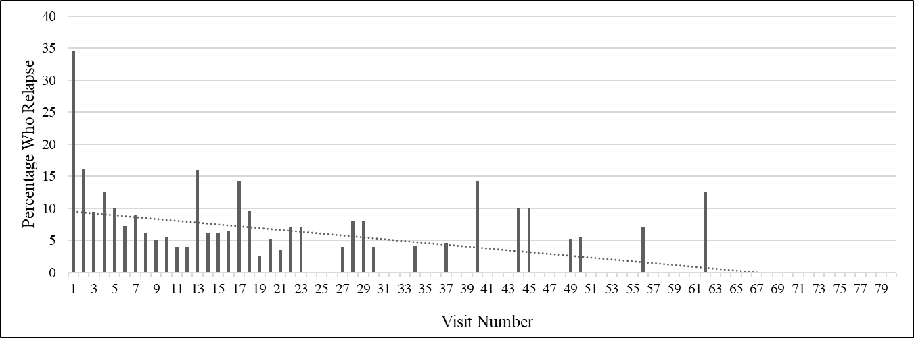
Results: Benefit of staying in treatment
*Derefinko KJ, Salgado Garcia F, Talley K, Bursac Z, Johnson K, Murphy JG, McDevitt-Murphy M, Andrasik F, & Sumrok DD. (in press). Adverse Childhood Experiences Predict Opioid Relapse During Treatment among Rural Adults. Addictive Behaviors.

Slide 10
Conclusions
This is the first study to evaluate the association between ACE scores and opioid relapse during combined buprenorphine-naloxone treatment and group counseling
This finding is of concern for rural populations that are at risk for both ACE and opioid use
May also suggest that trauma-informed care may be quite relevant for rural individuals with OUD given the relevance of ACES
Finding that remaining in treatment was related to reduced relapse risk was encouraging
Promoting treatment adherence among those who are newly engaged in buprenorphine-naloxone treatment could be beneficial

Slide 11
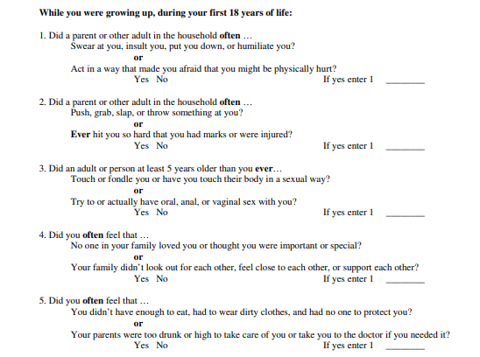

Slide 12
Unpacking Trauma
ACE Study - 1998
Kaiser Permanente and Center for Disease Control
Vincent Felitti & Robert Anda
Exposure to childhood adversity has an impact on adult mental health, increasing the risk for depression and suicide. Associations between Adverse Childhood Experiences (ACEs) and several adult mental and behavioral health outcomes are well documented in the literature, establishing the need for prevention. The current study analyzes the relationship between an expanded ACE score that includes being spanked as a child and adult mental health outcomes by examining each ACE separately to determine the contribution of each ACE. Data were drawn from Wave II of the CDC-Kaiser ACE Study, consisting of 7465 adult members of Kaiser Permanente in southern California. Dichotomous variables corresponding to each of the 11 ACE categories were created, with ACE score ranging from 0 to 11 corresponding to the total number of ACEs experienced. Multiple logistic regression modeling was used to examine the relationship between ACEs and adult mental health outcomes adjusting for sociodemographic covariates. Results indicated a graded dose-response relationship between the expanded ACE score and the likelihood of moderate to heavy drinking, drug use, depressed affect, and suicide attempts in adulthood. In the adjusted models, being spanked as a child was significantly associated with all self-reported mental health outcomes. Over 80% of the sample reported exposure to at least one ACE, signifying the potential to capture experiences not previously considered by traditional ACE indices. The findings highlight the importance of examining both cumulative ACE scores and individual ACEs on adult health outcomes to better understand key risk and protective factors for future prevention efforts.

Slide 13
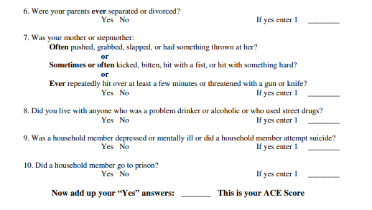

Slide 14
Other Traumatic Events/Circumstances
Racism/historical trauma
Poverty
Combat exposure – combatants OR civilians
Serious illnesses (cancer, diabetes)

Slide 15
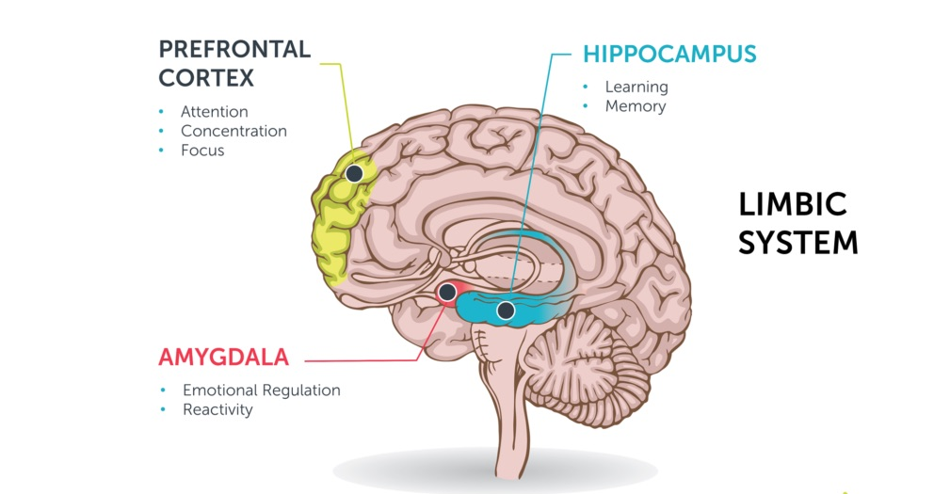

Slide 16
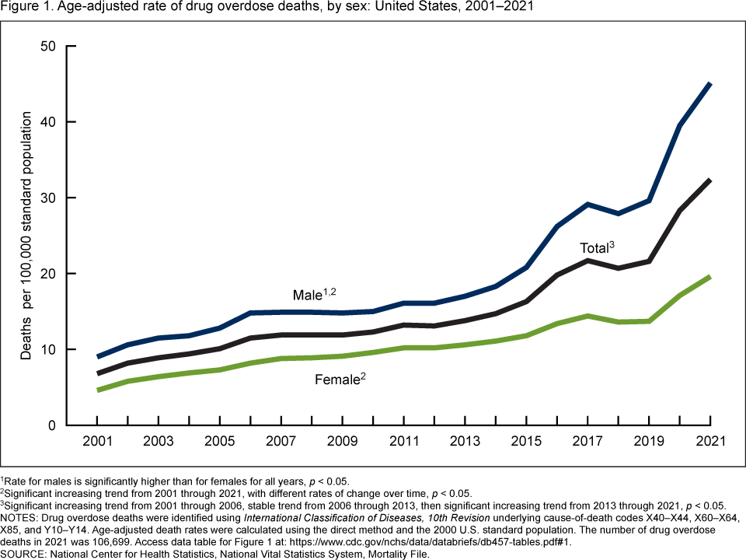

Slide 17
Opioid Use Disorder
Opioid Use Disorder (OUD) is an epidemic in the US
Currently, 1.5% of all deaths in the US are attributable to opioids*
There are large gaps in our ability to treat individuals with OUD
Those with OUD may not know that medicine exists/have no resources to get care
Not enough physicians are trained and/or waivered to treat OUD
Even for those who reach treatment: Relapse is extremely high
Our goal with this research was to examine treatment outcomes in individuals with OUD
Relapse
Prediction of treatment relapse
Prediction of treatment success
* Gomes T, Tadrous M, Mamdani MM, Paterson JM, Juurlink DN. The Burden of Opioid-Related Mortality in the United States. JAMA Netw Open. Published online June 01, 20181(2):e180217. doi:10.1001/jamanetworkopen.2018.0217

Slide 18
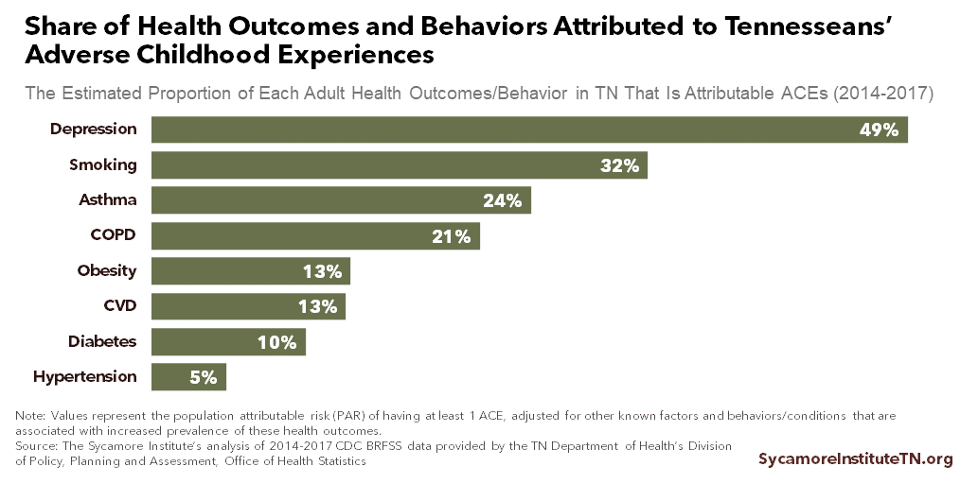

Slide 19
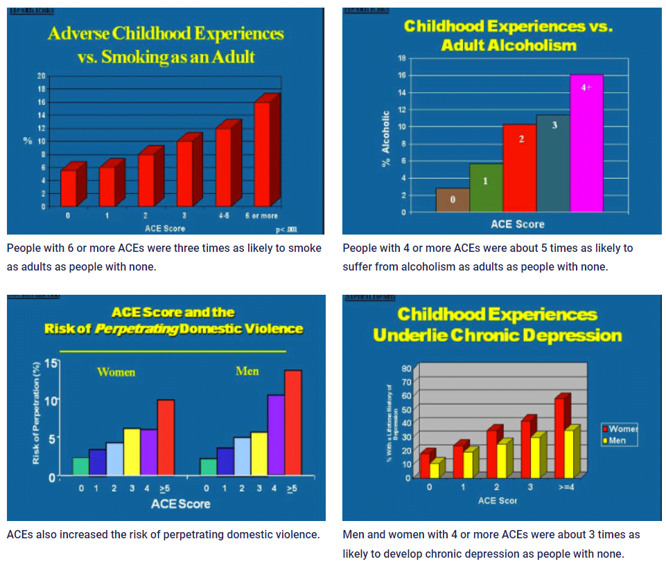

Slide 20
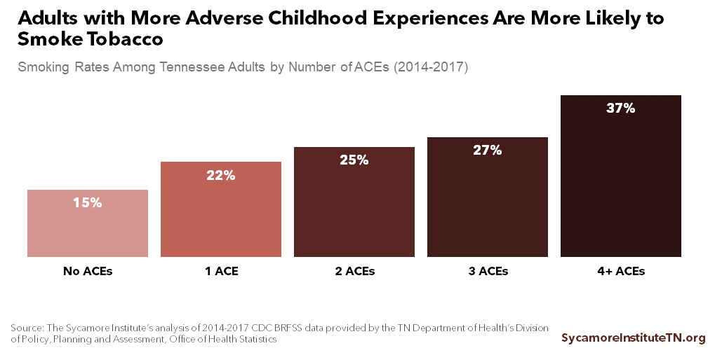

Slide 21
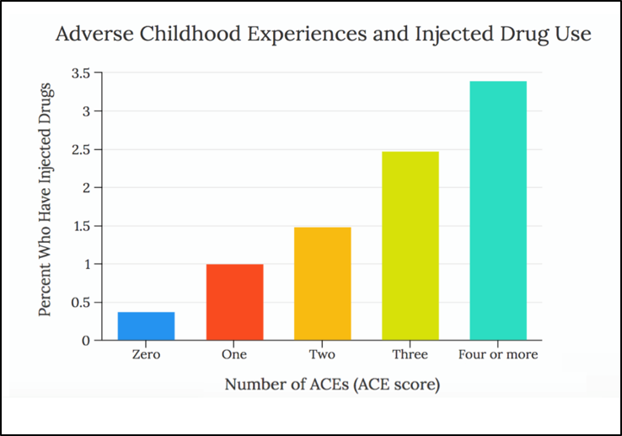

Slide 22
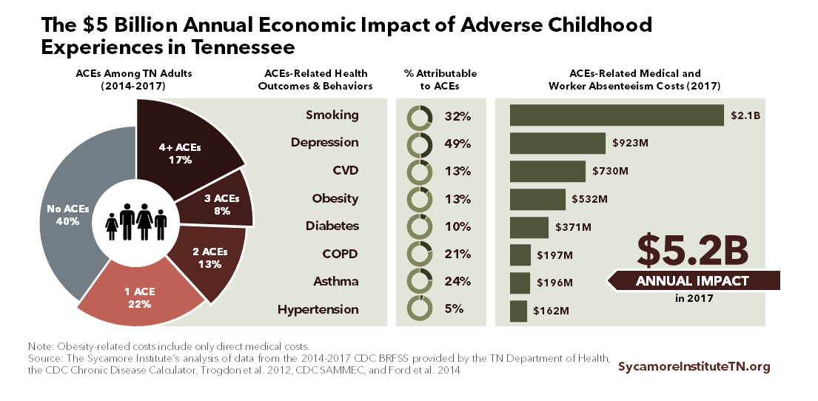

Slide 23
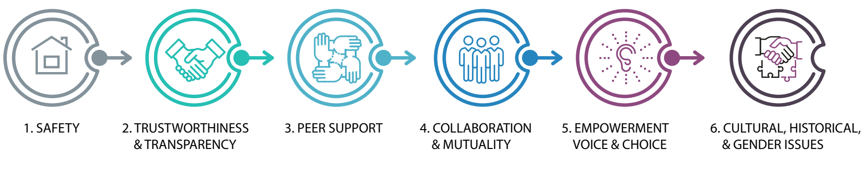

Slide 24
Treatment for Opioid Use Disorder
Medication Assisted Treatment (MAT)
Buprenorphine-naloxone = most widely accepted form of MAT*
Vivitrol/Oral Naltrexone
Sublocade
Methadone
Adjuntive (Robaxin, Clonodine, Etc.)
Reduces cravings but does not make the patient “high”
Very good outcomes in scientific research (↓relapse, ↑quality of life)
Prescribed on outpatient basis
Treatment course: 6 months – indefinitely
PAWS
Counseling
Federally required practice when a patient receives MAT
Medication reduces cravings
Counseling helps patients make lifestyle changes
* Main, F., & Kelly, L. (2016). Systematic literature review on buprenorphine/naloxone use in outpatient opioid dependence treatment. Canadian Journal of Addiction, 7(1).

Slide 25
Crossing the Corpus Callosum: Treatment of PTSD
Activity:
Yoga
Dance
Weight training
Team Sports
Martial Arts
Therapy:
PET
EMDR
CBT
CPT
MI
Medication:
SSRI’s
Prazosin
NO BENZO’s!
Experimental Approaches
Quickly growing evidence
Psychedelics (MDMA, Ketamine, Psilocybin, Ayahuasca, Peyote, others)
Everything helps a little, nothing gives complete relief.

Slide 26
Thank you
Causes & Connections Substance and Process Use Disorder Understanding Etiology and What Drives the Behaviors
Daniel David Sumrok, MD DFASAM FAAFP DABAM DABPM

