Slide 1
Screening for Social Determinants of Health in Arkansas
Benjamin Amick, PhD

Slide 2
Introduction
A statewide survey of Arkansas healthcare providers was conducted to understand their use of social determinants of health (SDOH) screening tools along with barriers and facilitators in addressing SDOH needs
Surveying current practices, challenges, and opportunities for collecting and using SDOH data can inform state health policies to improve SDOH integration among Arkansas healthcare providers
The survey instrument was developed by the Arkansas Department of Health with partners from The University of Arkansas for Medical Sciences, the University of Arkansas – Fayetteville, and the University of Arkansas – Little Rock.

Slide 3
Survey Instrument
The survey instrument was developed in collaboration with staff from the Arkansas Department of Health (SHARE), the project team, and external stakeholders building on information from both the published and gray literature.
A review of the published literature indicated tools for assessing social determinants of health vary significantly in how they are used, which tool is used, and the domains considered.¹
Recent studies have highlighted tools used by US healthcare institutions and the domains included in each tool.² Most of the grey literature reported on tools assessed in the published literature. ^{3,4}
  1. Neshan M, et al. Screening tools to address social determinants of health in the united states: A systematic review. J Clin Trans Sci.
  2. Moen M, et al. A review of tools to screen for social determinants of health in the united states: A practice brief. Population Health Management. 2020;23(6):422.
  3. NORC at the University of Chicago, American Health Information Management Association (AHIMA). Social determinants of health data: Survey results on the collection, integration, and use. 2023. https://www.norc.org/.
  4. Colorado Health Institute, Colorado Office of eHealth Innovation, eHealth Commission, OeHI Care Coordination Community Engagement Task Force. Implementation guidance for screening for social determinants of health in an electronic health record. https://www.coloradohealthinstitute.org/. Updated 2021

Slide 4
Survey Administration
Limited published literature on barriers and facilitators to screening for social determinants of health. Thus, we relied primarily on grey literature for survey questions addressing factors influencing screening decisions.
Based on the review of literature, a preliminary screening tool was developed and vetted by the research team. A draft version of the survey was then vetted with stakeholders from the hospital association, Arkansas Medicaid, and other organizations.
The final survey was uploaded into Qualtrics.
Finally, a letter was sent to participating organizations asking to complete the survey online. After several mail outs, a team of research assistants called non-completing organizations to get surveys completed by phone or other means. The final sample of 145 represented 1376 hospitals, clinics, and healthcare facilities statewide with a survey completion rate of 91.8%.

Slide 5
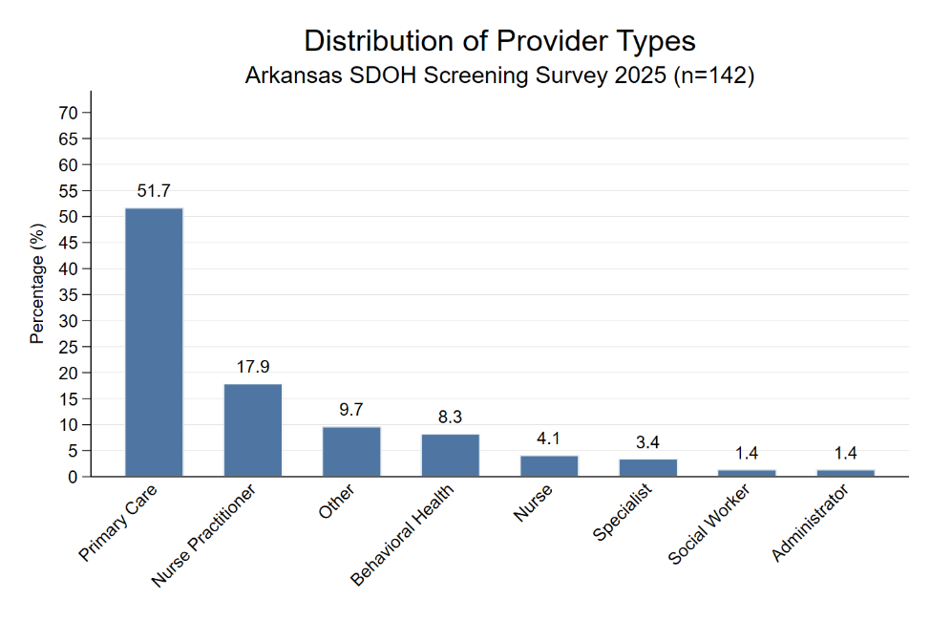
Results – Responses by Provider Types

Slide 6
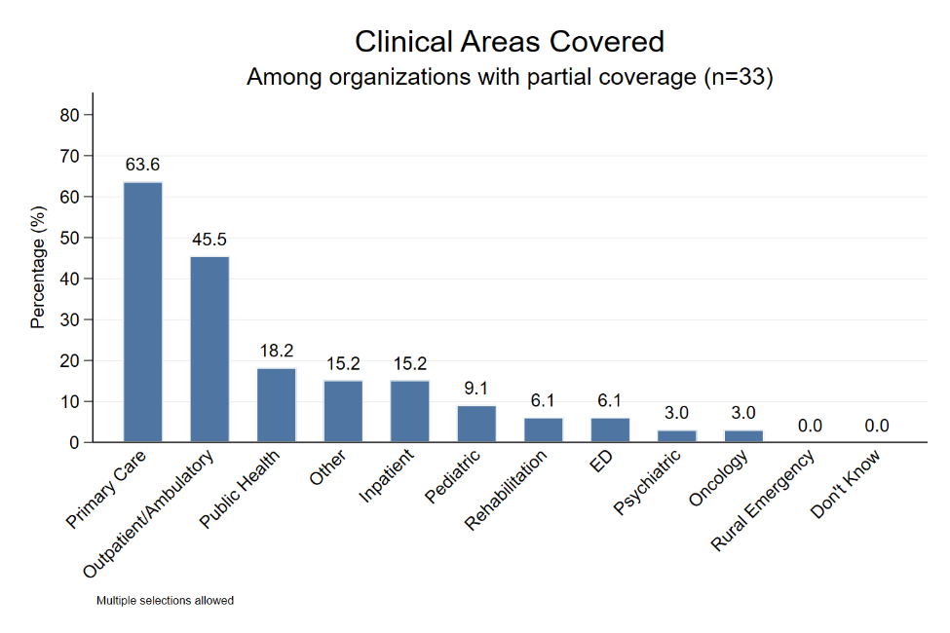
Results – Responses by Clinical Area

Slide 7
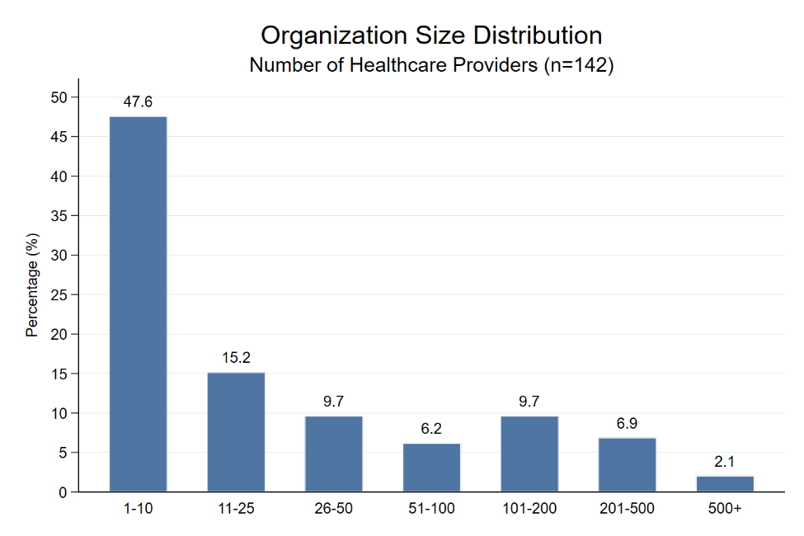
Results – Responses by Organization Size

Slide 8
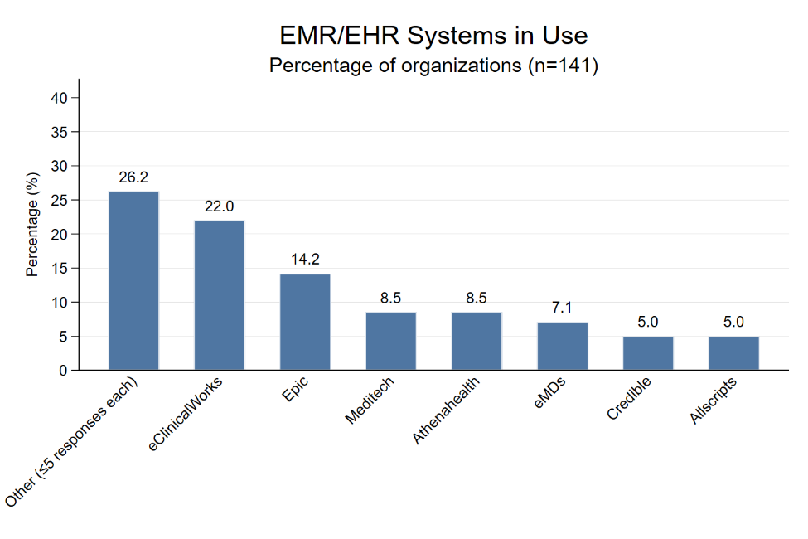
Results – EMR System

Slide 9
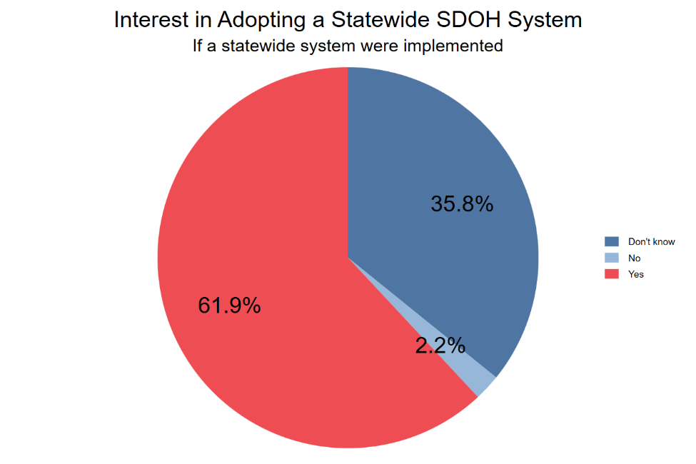
Results – Interest in Statewide SDOH System

Slide 10
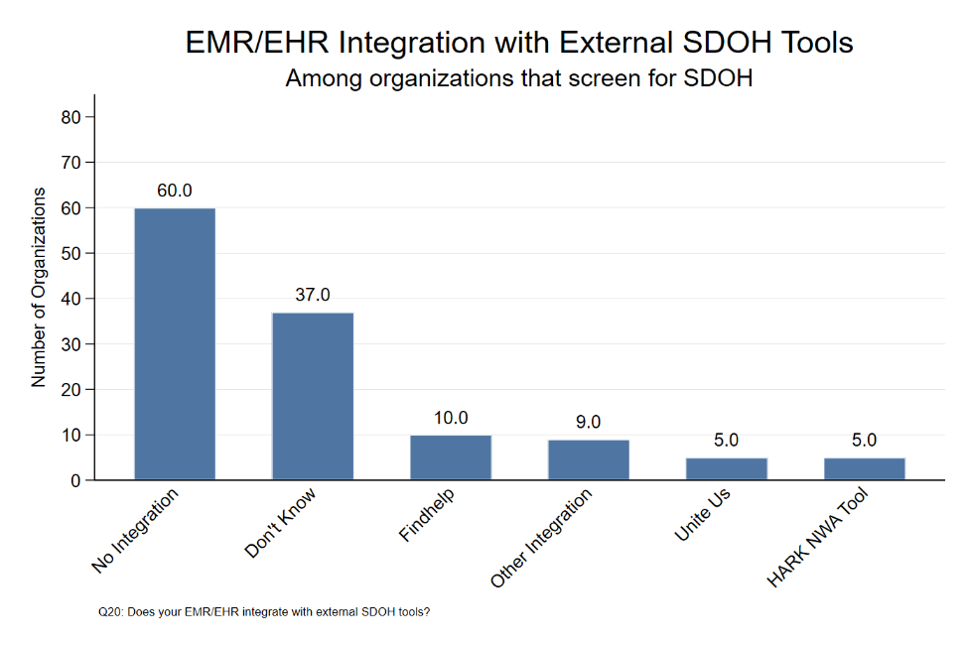
EMR Integration with External SDOH Tools

Slide 11
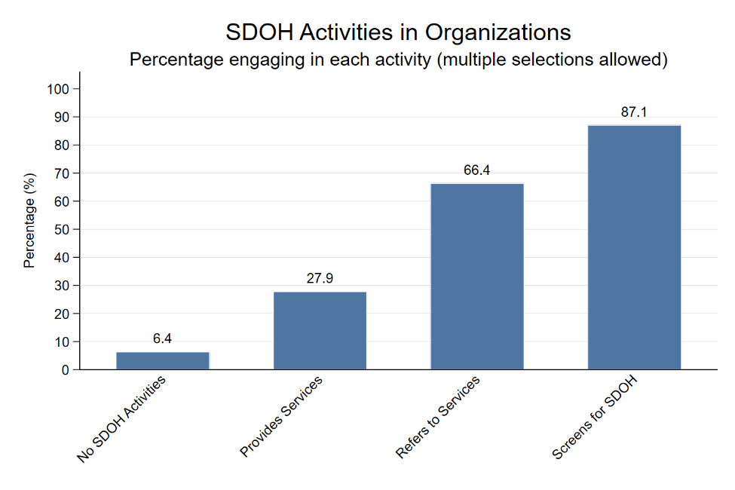
Results – SDOH Activities

Slide 12
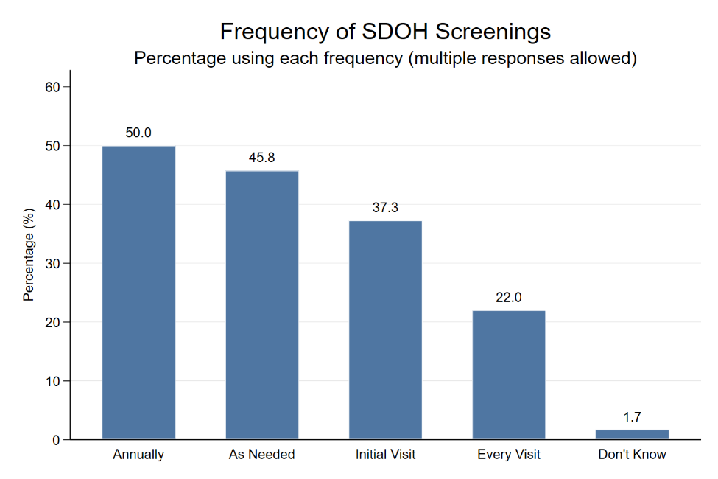
Results – Screening Frequency

Slide 13
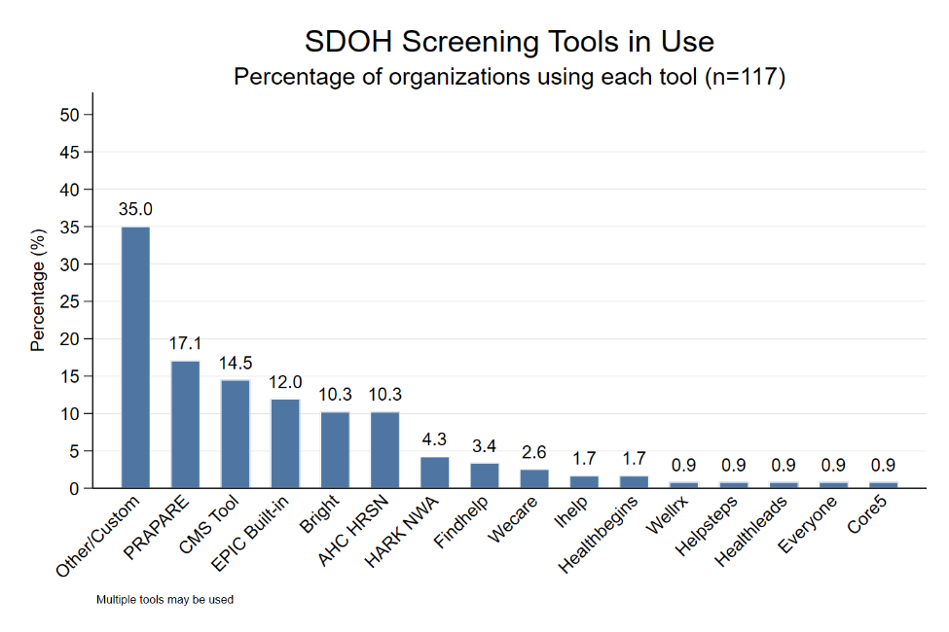
Results – Screening Tools

Slide 14
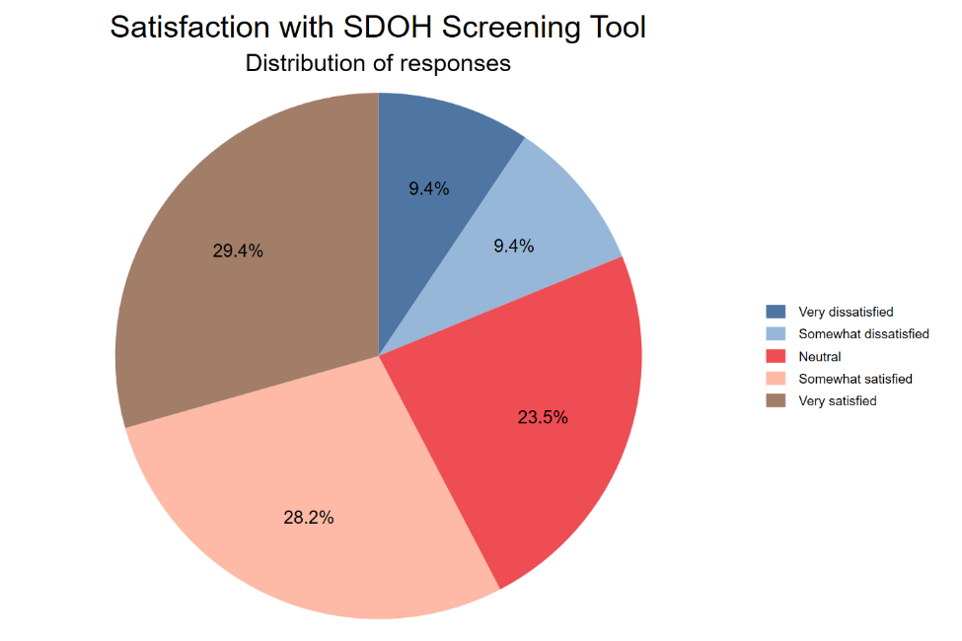
Results – Satisfaction with Screening Tool

Slide 15
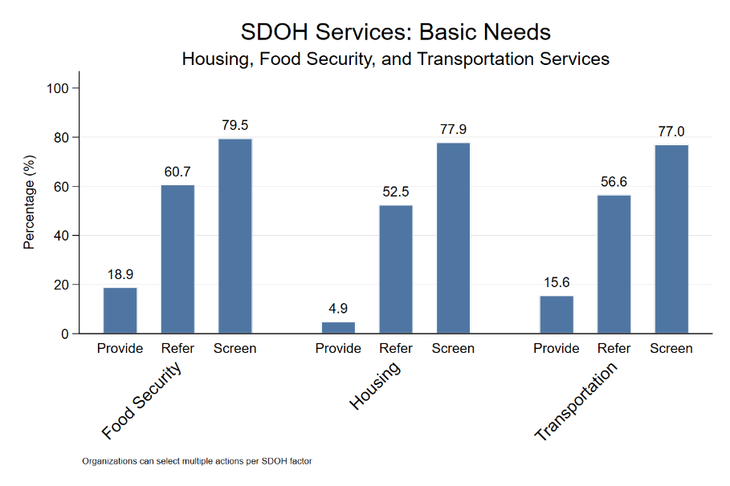
Results – Screening and Doing by Domain

Slide 16
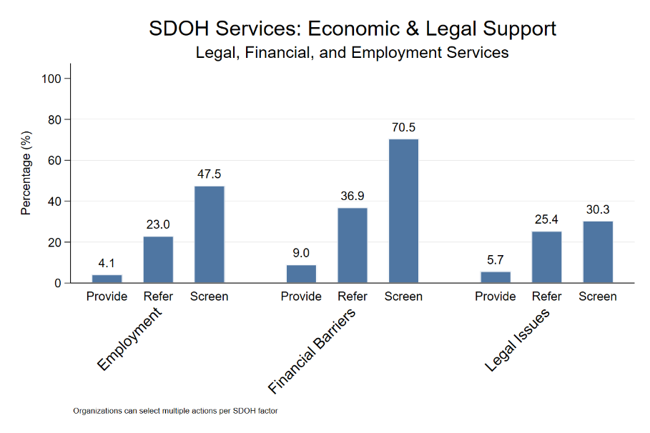
Results - Screening and Doing Economic and Legal

Slide 17
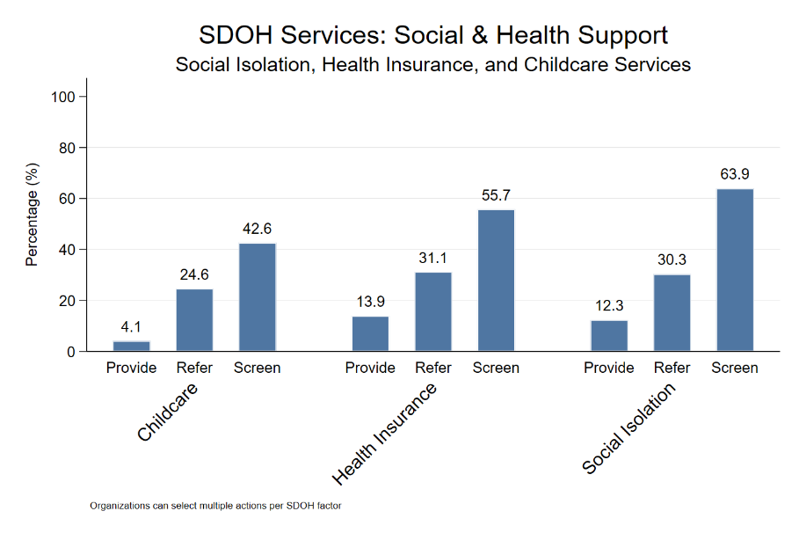
Results – Screening and Doing for Social Services

Slide 18
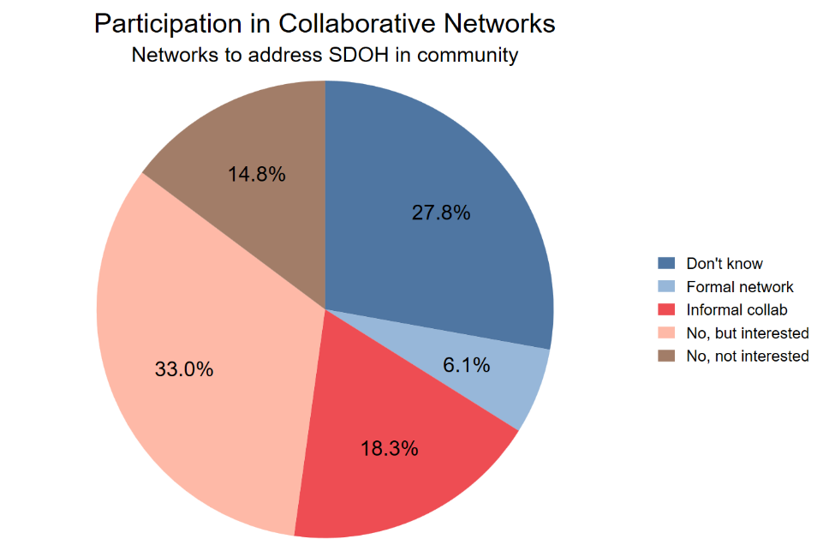
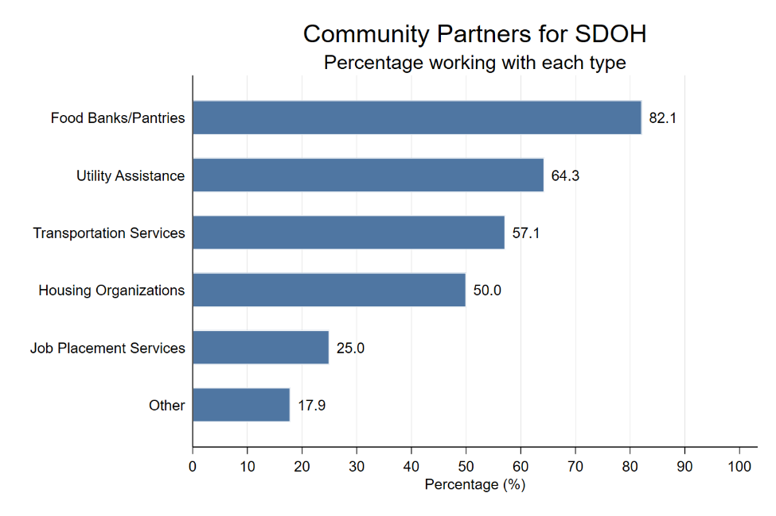
Results - Collaborations

Slide 19
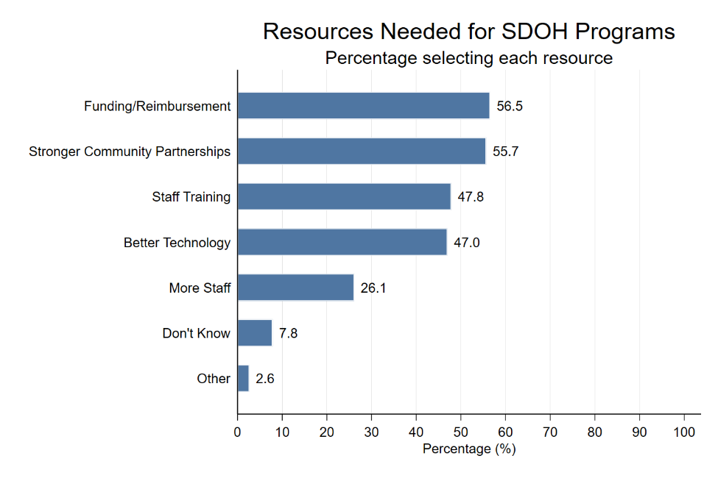
Results – Resources Needed for SDOH Activities

Slide 20
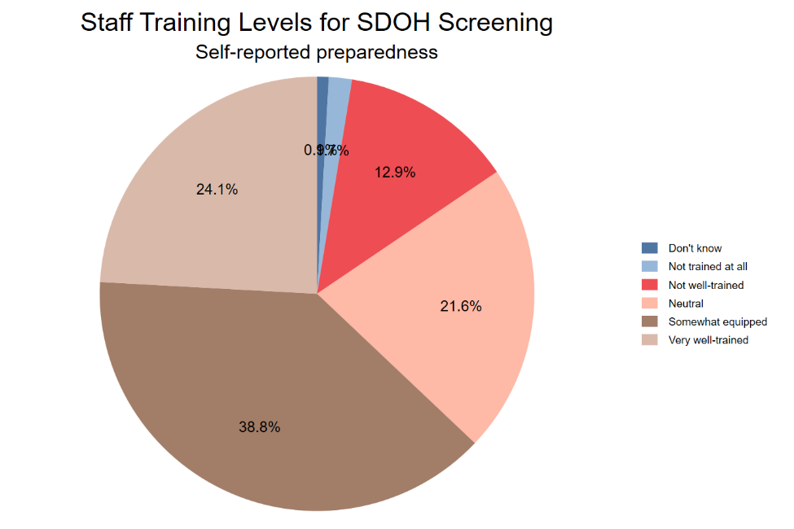
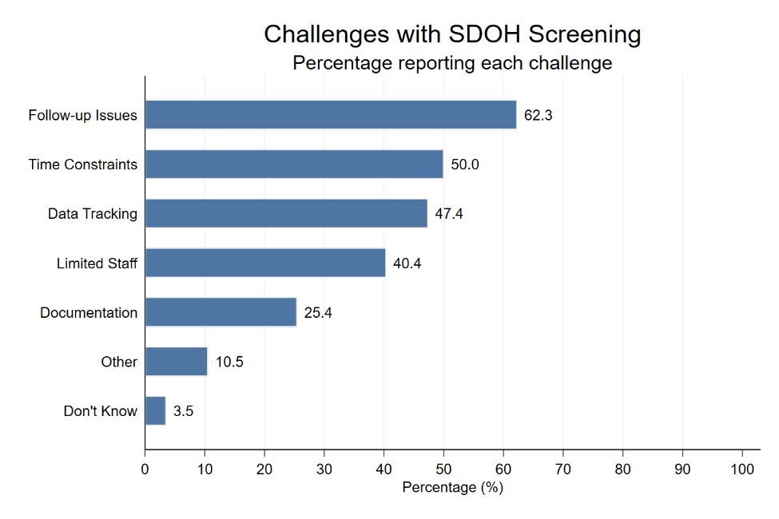
SDOH Screening Challenges

Slide 21
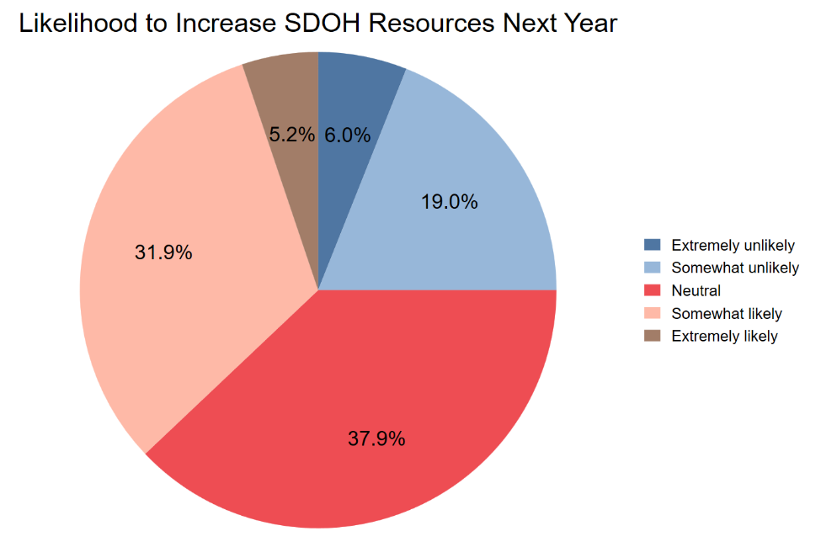
Results – Plans to Increase Resources for SDOH?

Slide 22
Recommendations: Policymakers
Develop a Sustainable Financing Model for SDOH.
  Action: Actively promote and provide technical assistance for the adoption of newly available reimbursement codes, such as HCPCS code G0136, which allows for payment for SDOH risk assessments under Medicare.
  Action: Work with QHPs/Qualified Health plans to incorporate SDOH-related activities into value-based payment (VBP) arrangements. This can include using incentive payments or quality withhold arrangements to reward plans for screening, making effective referrals, and forming partnerships with CBOs, a strategy supported by CMS guidance and explored by other states.
  Action: Frame SDOH investment not as a new cost, but as a long-term strategy for improving health outcomes and controlling costs, which is a key priority for Arkansas Medicaid sustainability. Evidence suggests addressing social needs can reduce high-cost utilization like emergency department visits and hospital readmissions.

Slide 23
Recommendations: Policymakers Cont.
Catalyze a Statewide Collaborative Infrastructure.
  Action: Fund the development and implementation of a statewide or regional Community Information Exchange (CIE) platform. A CIE is a shared technology infrastructure that enables standardized, closed-loop referrals between healthcare and social service organizations.
  Action: Provide grants and technical assistance to formalize regional collaborative networks, leveraging the 33% of providers who are interested in joining one. These networks should bring together providers, CBOs, and public health agencies to coordinate care and share resources.

Slide 24
Recommendations: Policymakers cont
Promote Standardization of Tools and Data. The fragmentation of screening tools and data practices hinders system-wide improvement.
  Action: Incentivize the adoption of a single, validated, nationally recognized screening tool, such as PRAPARE, which is evidence-based and designed for this purpose. Incentives could be tied to VBP models or grant funding.
  Action: Promote the consistent use of ICD-10-CM "Z codes" (Z55-Z65) to document identified social needs within the EHR. This aligns with CMS recommendations and is essential for creating standardized, analyzable data at the population level.

Slide 25
Recommendations: Health Care Systems and Providers
Invest in Workflow Integration and Workforce Training. Move beyond the simple act of screening to build robust internal processes.
  Action: Develop, document, and implement clear clinical workflows that specify what happens after a positive SDOH screen, including who is responsible for the referral, how it is documented, and what the follow-up procedure is.
  Action: Invest in comprehensive training for all staff involved in the SDOH process from front desk personnel to nurses and physicians. Training should cover not only how to use the screening tool but also best practices for sensitive communication, cultural competency, and trauma-informed care.

Slide 26
Recommendations: Systems and Providers Cont.
Forge Proactive and Formal Community Partnerships. Do not wait for a state-led system to build essential relationships.
  Action: Proactively identify key CBOs in the service area that align with the most common patient needs (e.g., food, housing, transportation).
  Action: Establish formal Memoranda of Understanding (MOUs) or partnership agreements that clearly define roles, responsibilities, communication channels, and protocols for sharing patient information securely and with consent. This formalizes relationships and builds a foundation for a more effective referral network.

Slide 27
Recommendations: CBO’s and Philanthropic Partners
Advocate for and Invest in CBO Capacity.
  Action: CBOs should use the data from this report, particularly the finding that 63% of collaborating providers see limited CBO resources as a primary barrier, to advocate for increased funding from state, local, and philanthropic sources.
Actively Participate in Network and System Design.
  Action: Engage actively in the formation of regional collaborative networks and the design of statewide Community Information Exchange. The perspective and expertise of CBOs are essential to ensure that the resulting systems are practical, effective, and truly meet the needs of the community.
  Action: Partner with healthcare organizations on joint grant applications and advocacy efforts to present a united front, demonstrating a shared commitment to building a more integrated system of care for all Arkansans.

Slide 28
Take Home Message

