Slide 1


Maternal Mental Health:
A National Landscape Review & State Policy Opportunities
July 9, 2026
Joy Burkhard, MBA
Executive Director
The Policy Center for Maternal Mental Health

Slide 2
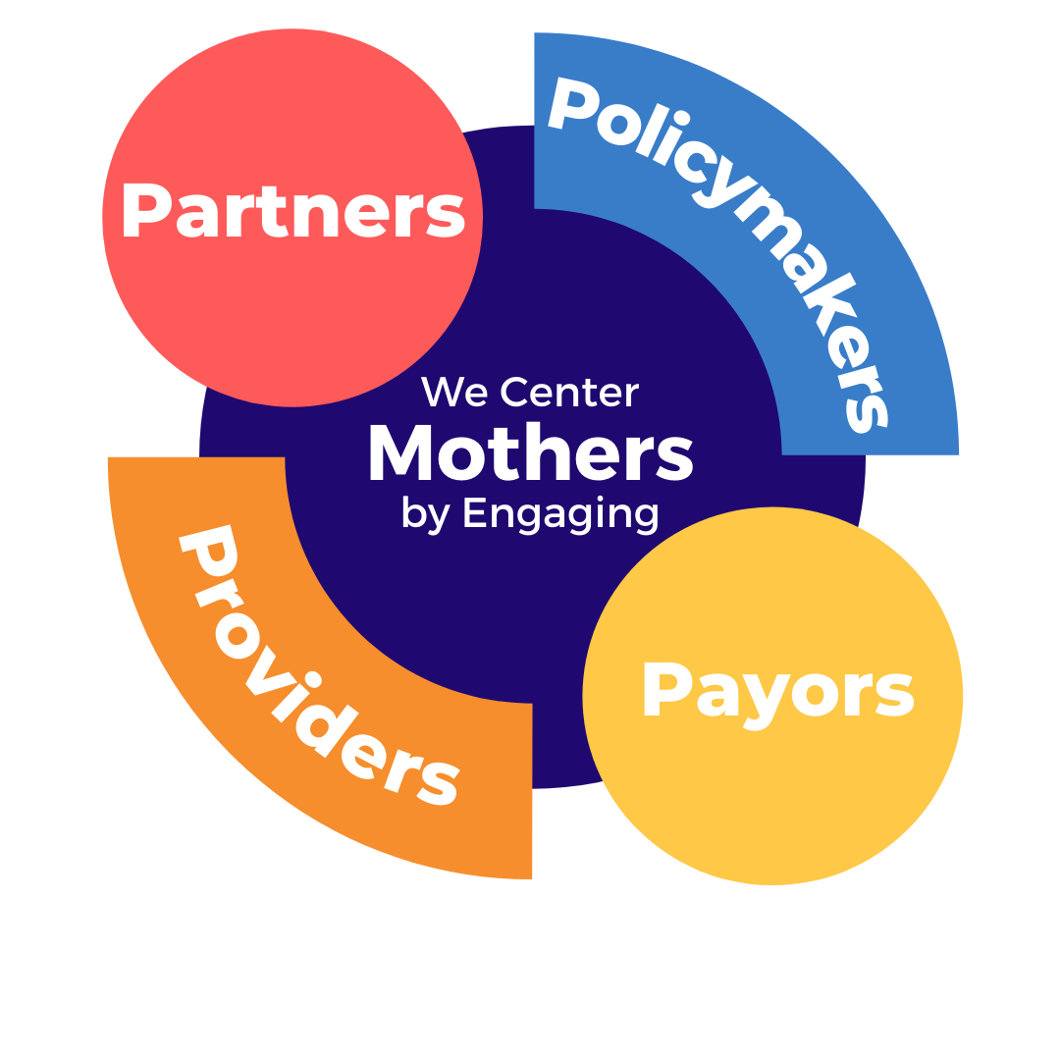
What Does the Policy Center Do?
We are a nonprofit research and policy think tank and field catalyst.
We inform and facilitate systems change so mothers, children, and families have the best opportunity to thrive.

Slide 3


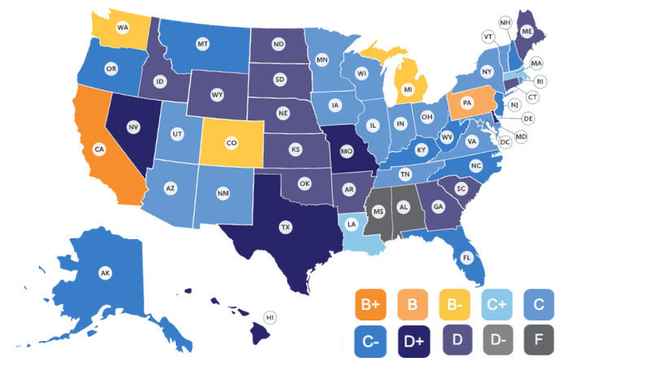

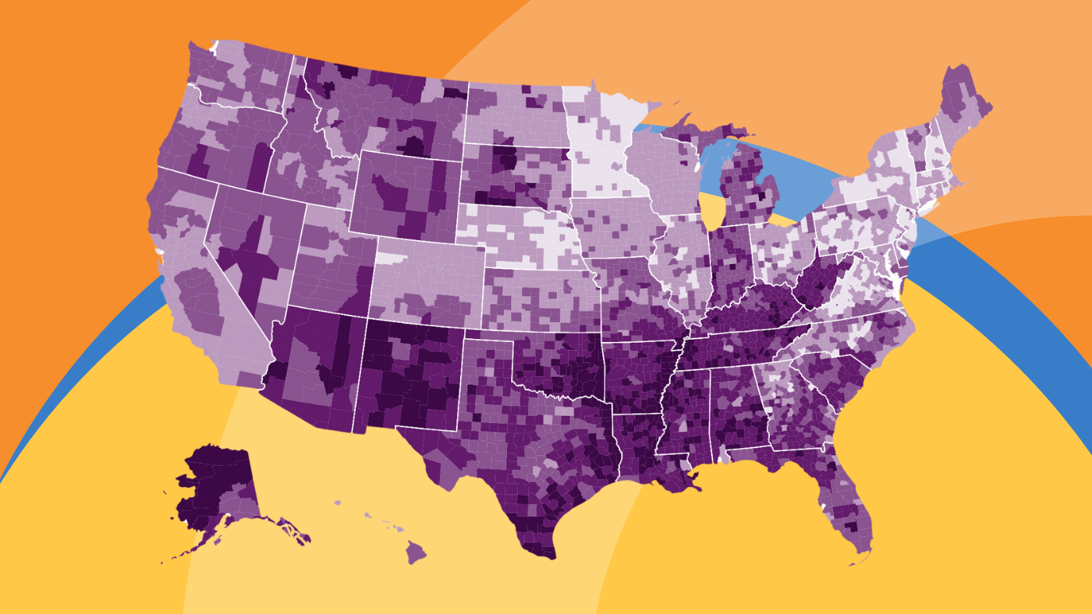


Reports/Tools/Training/TA
Notes:
Produce reports, insights, TA, trainings, convene important SH’s in the MMH space, including at our annual forum.

Slide 4


Terms We Use
Why Maternal Mental Health?
Postpartum Depression (PPD) - Researched First
Onset of new disorders in pregnancy, pre-existing untreated depression
Not Accurate as an Umbrella Term -“Do No Harm”
Perinatal Mood and Anxiety Disorders - Used by Mental Health Clinicians
“PMAD” has become a no-no
Maternal Mental Health / MMH Disorders
Easy for non-clinicians to understand
Leaves no disorder or time period out
Hopeful

Slide 5
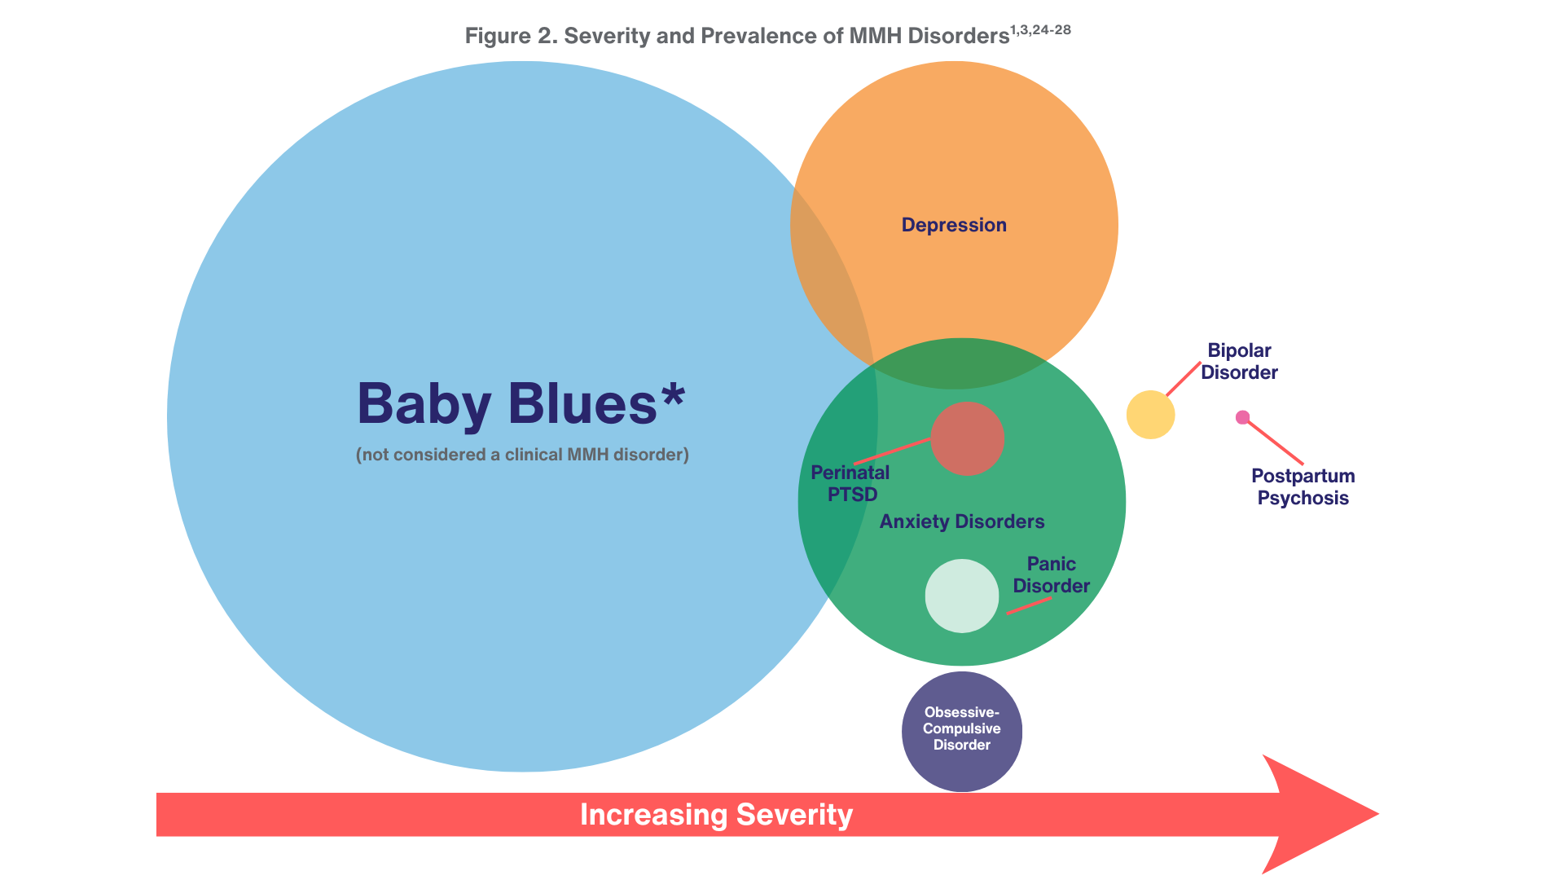
The Range of Disorders
Notes:
https://policycentermmh.org/black-maternal-mental-health-issue-brief/
https://policycentermmh.org/maternal-mental-health-fact-sheet/

Slide 6
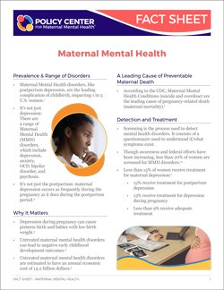
Maternal Depression Onset
⅓ Prior to Pregnancy
⅓ During Pregnancy
⅓ in the Postpartum

Slide 7
Maternal Mental Health - The 20s & 2s
20% of the perinatal population will suffer from an MMH disorder
Less than 20% are screened for MMH disorders
Less than 20% receive treatment
Roughly 20% of maternal deaths are due to suicide
Medicaid enrollees, more than 2x more likely to suffer

Slide 8
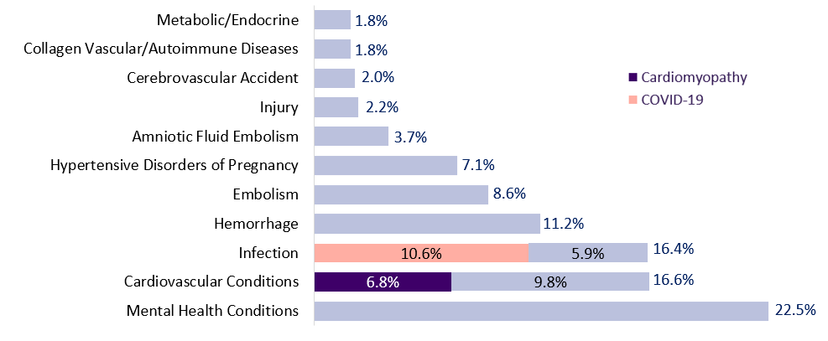
Suicide & OD a Leading Cause of MM
MMRCs in 38 U.S. States, 2020: Most frequent underlying causes of pregnancy-related deaths
https://www.cdc.gov/maternal-mortality/php/data-research/index.html

Slide 9

Maternal Suicide
Risks exist throughout pregnancy and the postpartum period
62% of pregnancy-related suicides occur between 43 and 365 days postpartum
Highest rates during the late postpartum (between 9 and 12 months)
Notes:
Maternal suicide rates are highest during the postpartum period, specifically peaking between 9 and 12 months after delivery, rather than immediately after birth. While risks exist throughout pregnancy, 62% of pregnancy-related suicides occur between 43 and 365 days postpartum, making the late postpartum period the highest-risk time.

Slide 10
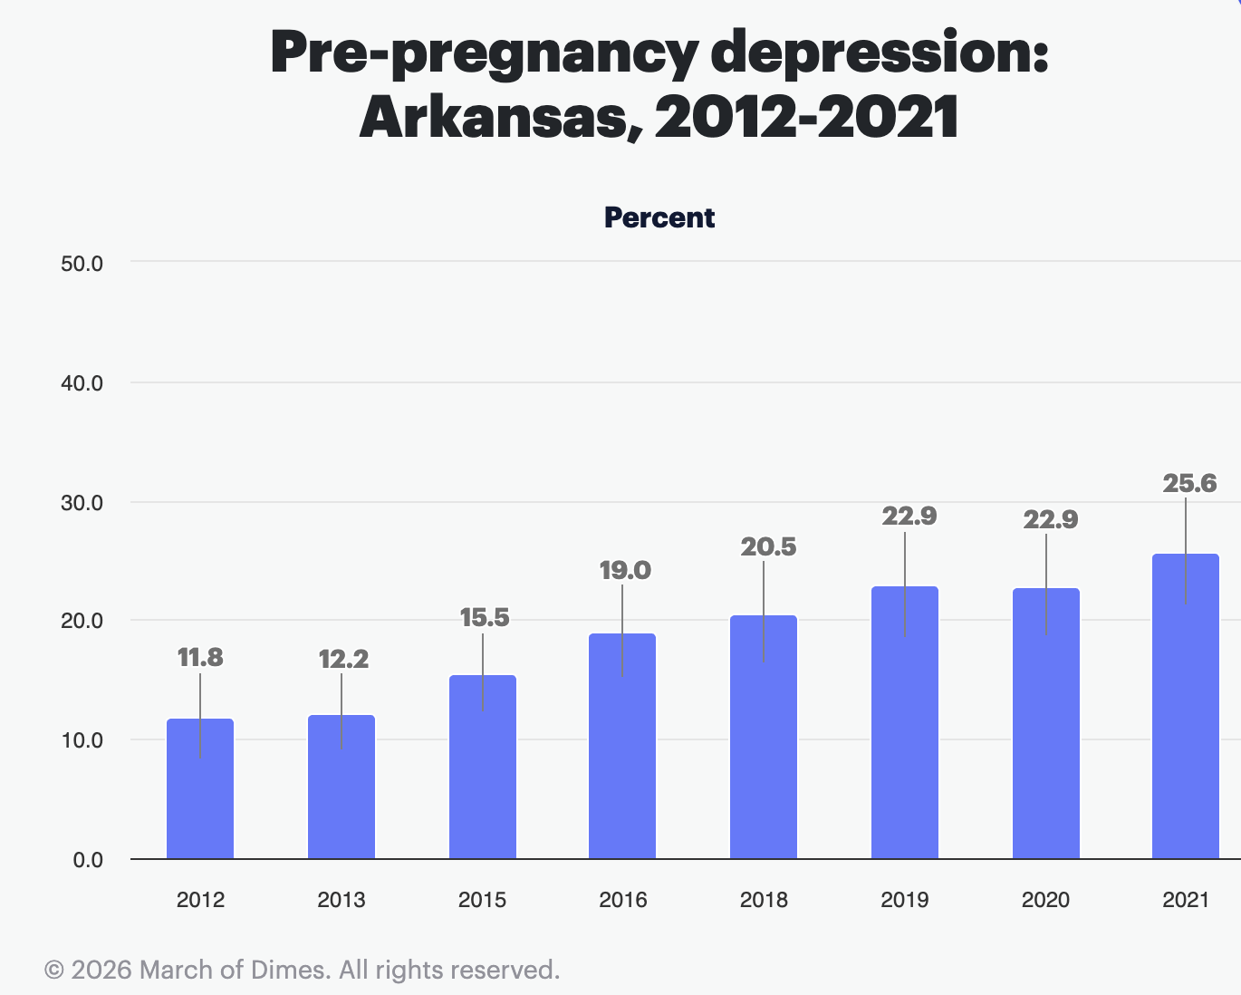
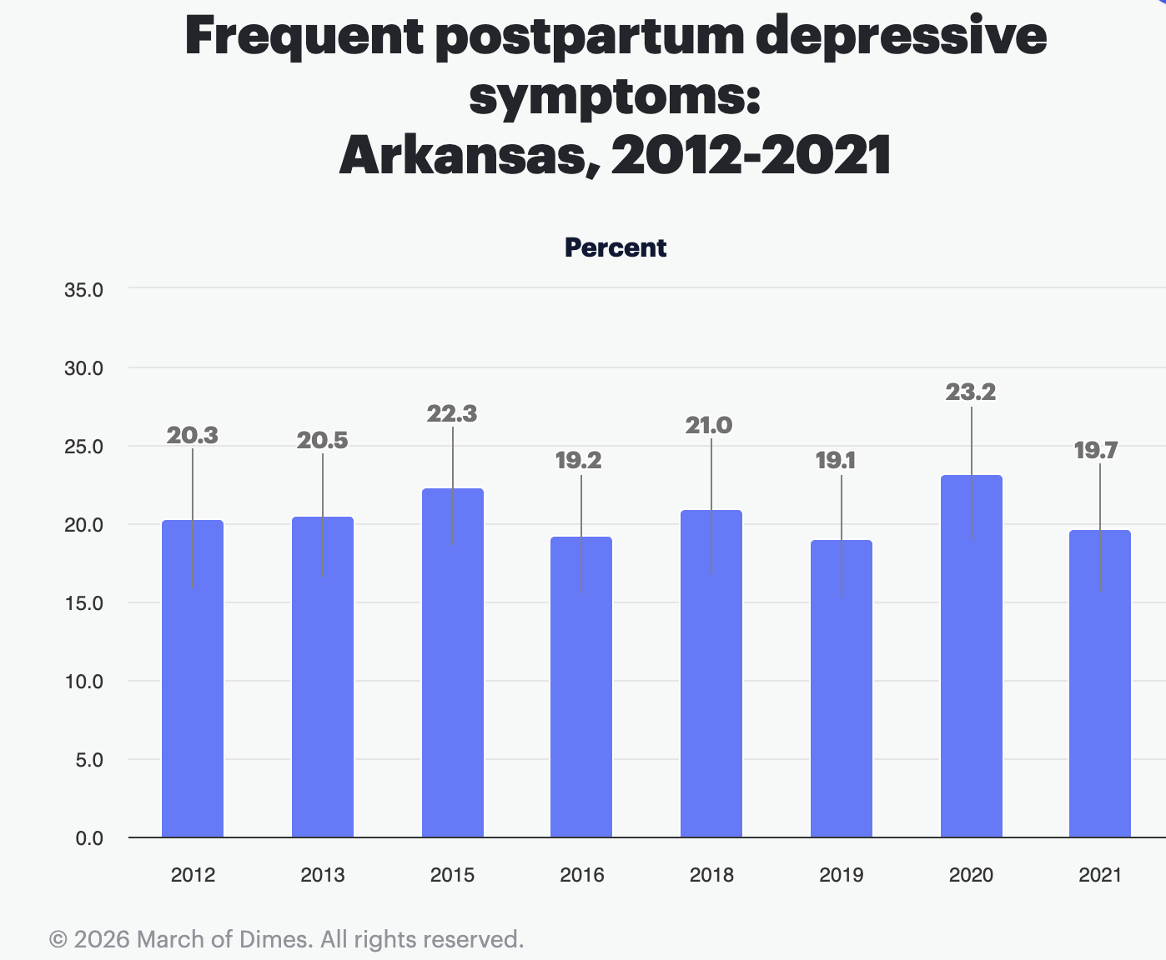
AR Maternal Depression (Self Report)
Notes:
https://healthy.arkansas.gov/wp-content/uploads/2023-AR-PRAMS-Surveillance-Report.pdf

Slide 11

MMH: Did you know?
When untreated, linked to:
Increase risk of Preterm/Low Birth Weight Babies (x4)
Increase risk of Preeclampsia
Increase her risk of substance abuse & smoking
Increase her risk of ER visits
Interfere with her relationship stability
Impact a mom and partner’s ability to work (+presenteeism)
Increase potential for abortion or adoption
Impact her long-term well-being and sense of worthiness
Increase risk of neglecting her children
Increase her risk of suicide
Notes:
https://policycentermmh.org/maternal-suicide-issue-brief-2025/ (update graphic with new brief)
https://policycentermmh.org/substance-use-disorders-and-maternal-mental-health/

Slide 12
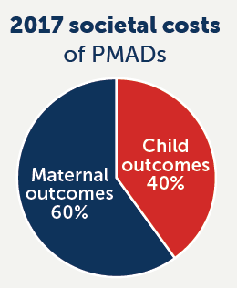
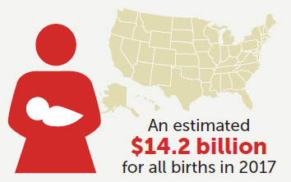
MMH: Did you know?
Untreated MMH Disorders cost $32,000 per mother and child over 6 years
Arkansas’s share is estimated at roughly $125–$130 million.

Slide 13
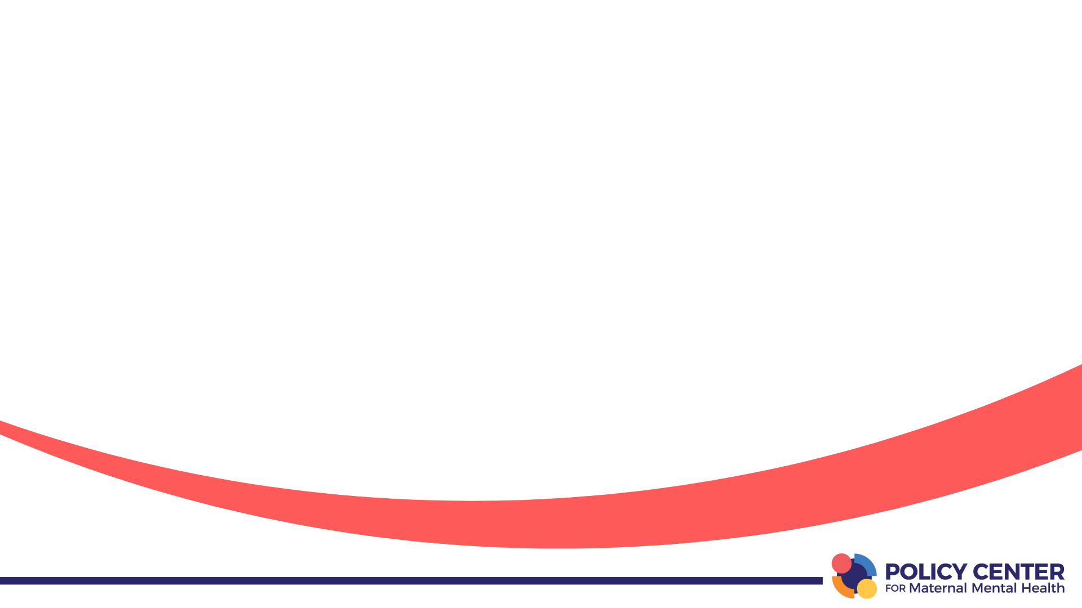
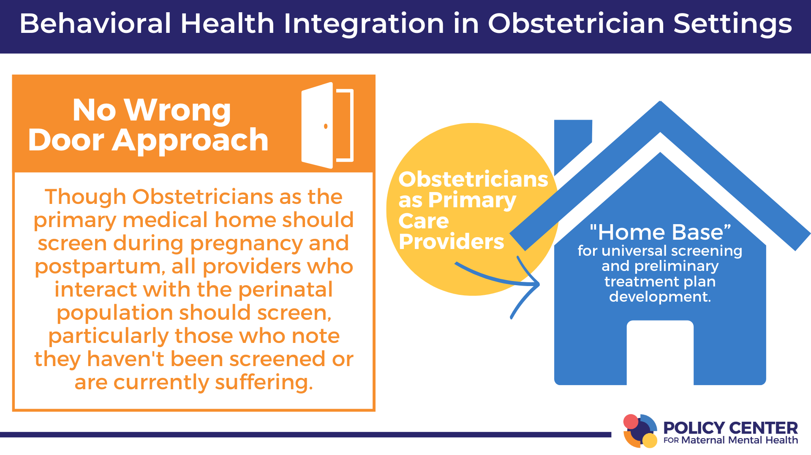
Notes:
Ask if she has been screened, if not offer and if positive coordinate with the OB.

Slide 14
ACOG Clinical Practice Guidelines MMH
Obtain individual and family mental health history at intake
Screen for depression/anxiety at initial prenatal visit, later in pregnancy, and at postpartum visits
Screen for bipolar disorder before initiating pharmacotherapy
When concern exists for suicidality due to response in depression screening tool or interaction with patient, conduct a clinical interview & screen
• Columbia Suicide Severity Rating Scale (C-SSRS)
In the Future the Policy Center Recommends a 30-day rescreen (Follow-up), and Self-Harm and Intrusive Thoughts vs Suicidality be Addressed + Suicide Safety Planning vs Referral to ER/CPS
Notes:
In June 2023, The USPSTF issued a recommendation on depression and suicide screening. While screening for depression was recommended for all adults, including pregnant and postpartum persons (as had been the case previously), the task force concluded that “the current evidence is insufficient to assess the balance of benefits and harms of screening for suicide risk in the adult population, including pregnant and postpartum persons.” ³⁶

Slide 15

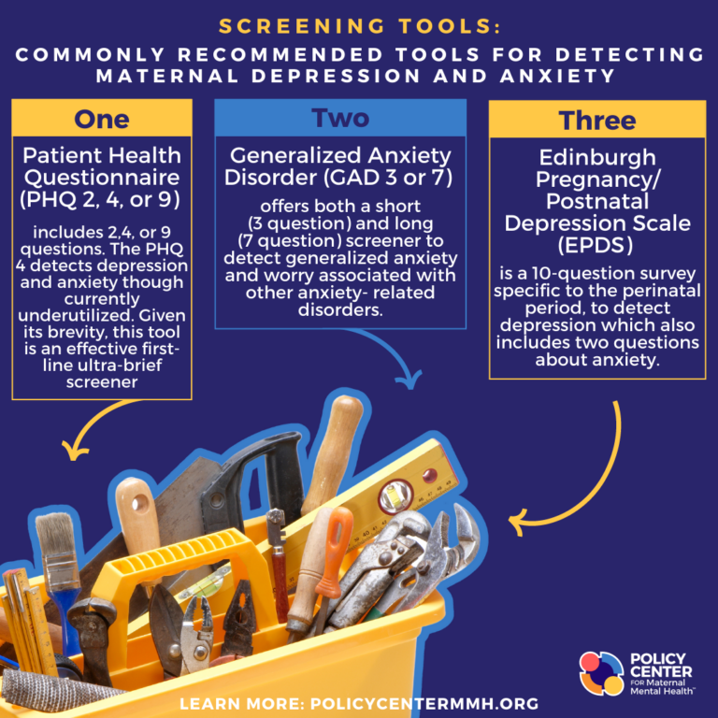
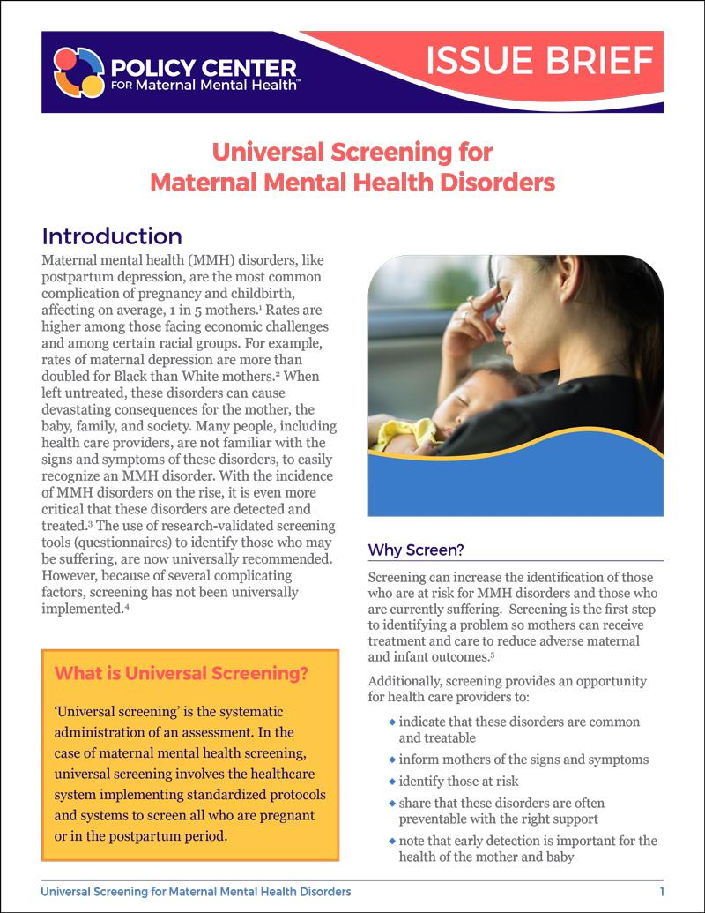
Universal Screening
Resources
Notes:
https://policycentermmh.org/screening-overview/
https://policycentermmh.org/universal-screening-for-maternal-mental-health-disorders-issue-brief/

Slide 16
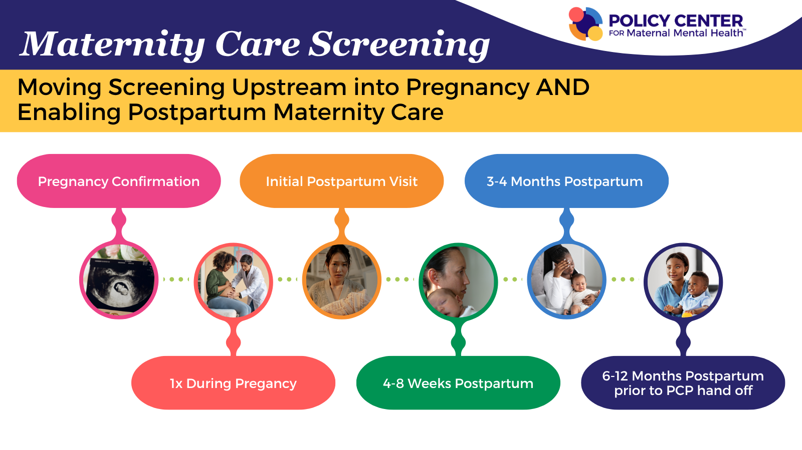

Slide 17
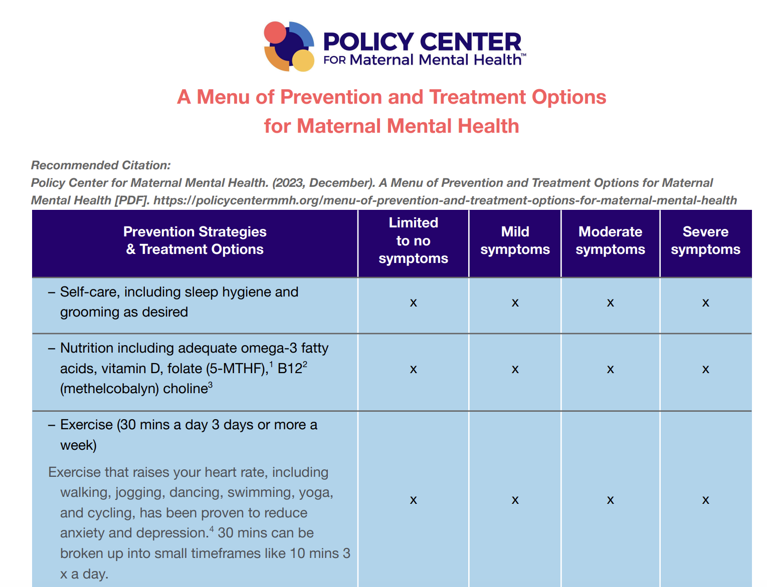
ACOG Perinatal Mental Health Tx CPG
Psychotherapy: Individual therapy, dyadic therapy (mother-baby), and group therapy
Pharmacotherapy: Zuranolone, effective dosing of Selective serotonin reuptake inhibitors (SSRIs) are recommended, specifically sertraline or escitalopram. Serotonin-norepinephrine reuptake inhibitors (SNRIs).
Specialized Care from Reproductive Psychiatry:
Bipolar Disorder: Requires specialized management, often involving mood stabilizers.
Postpartum Psychosis: Requires emergency care.
Notes:
https://policycentermmh.org/app/uploads/2025/04/Menu-of-Prevention_Treatment-Options-4.2025.pdf

Slide 18
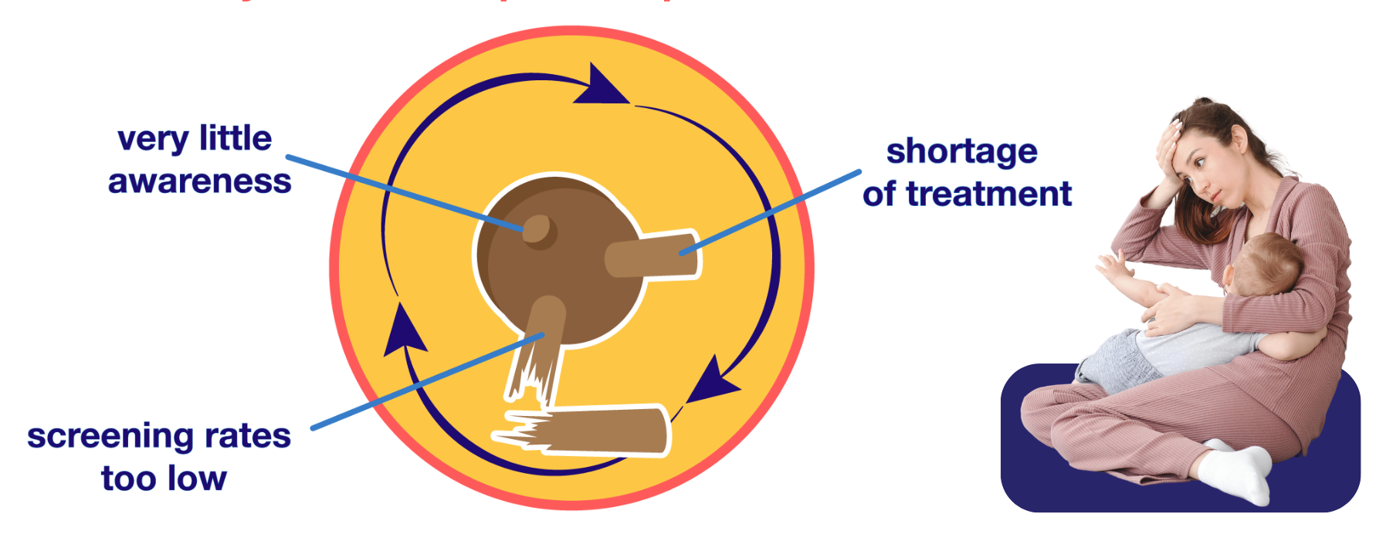
Barriers to Care - Obs
Survey of OB/Gyns
Those who don’t screen indicate:
Don’t feel qualified/No interest
Not enough time to screen/manage
Don’t know where to refer*
(Psychiatrist shortages, MMH specialists shortages, shortages of those in-network)
No financial incentive**
Pediatricians raise similar concerns and that mom isn’t their patient.
*Shortage of psychiatrists and trained MMH therapists,
**Aetna study: paying for PCP depression screening outside of standard office visit rate didn’t increase screening rates.

Slide 19


Measurement: What is HEDIS?
The Healthcare Effectiveness Data and Information Set monitors how often services are delivered in the U.S. as reported by Health Insurers/Plans
Depression Screening Pregnancy PND-E & Postpartum PDS-E
The percentage of deliveries in which members were screened for clinical depression using a standardized instrument during the postpartum period.
Follow-Up on Positive Screen: The percentage of positive screens which received follow-up care within 30 days of a positive depression screen finding.

Slide 20
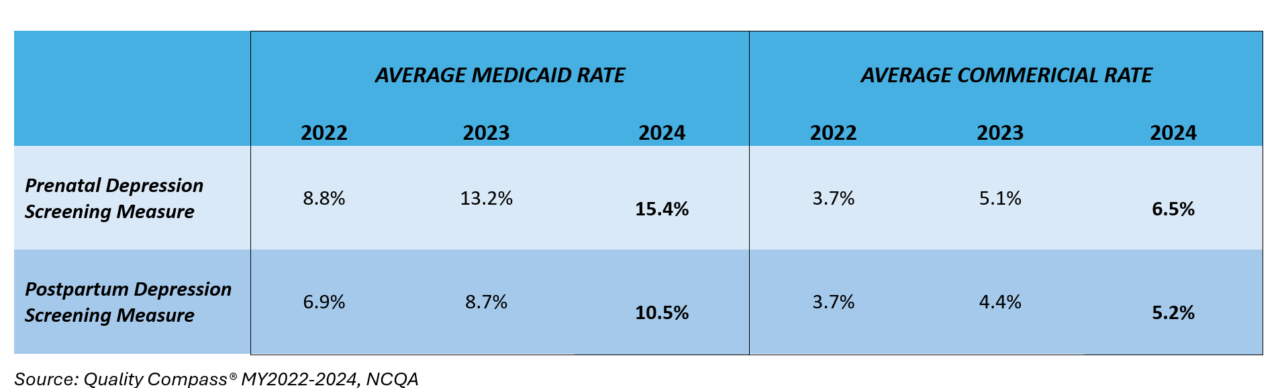
Prenatal and Postpartum Depression Screening Rates Reported into HEDIS, 2022-2024

Slide 21
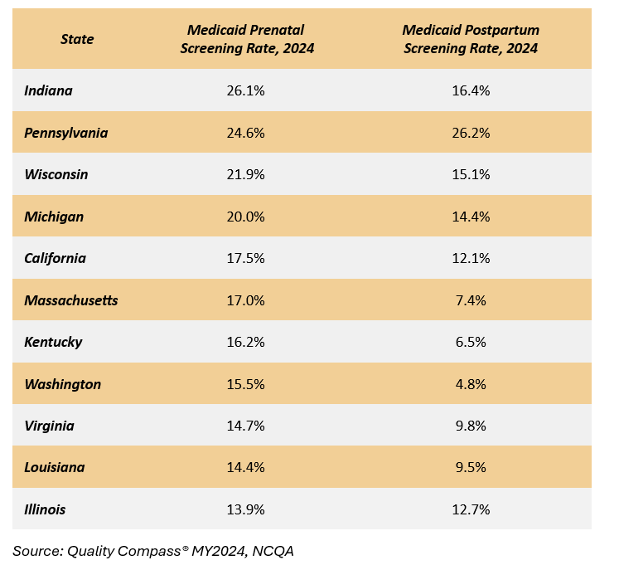
Top
Performing States
Screening
Rates
Medicaid
Source:
Quality Compass*
MY2024, NCQA

Slide 22
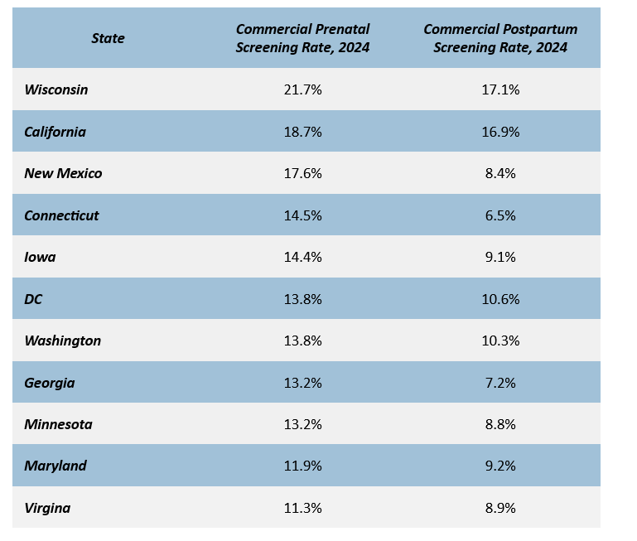
Top
Performing
States
Screening
Rates
Private
Insurance
Source:
Quality Compass*
MY2024, NCQA

Slide 23

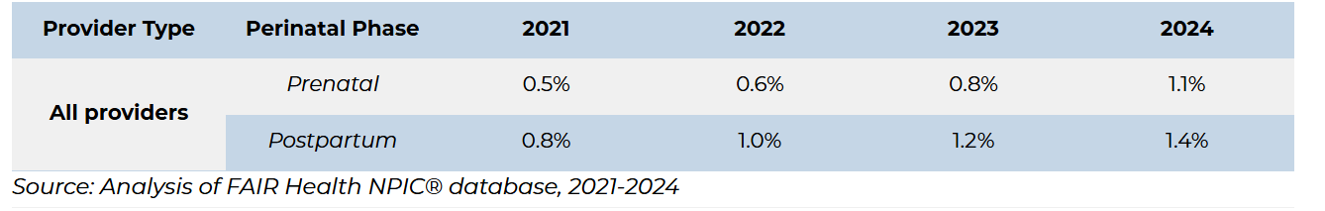
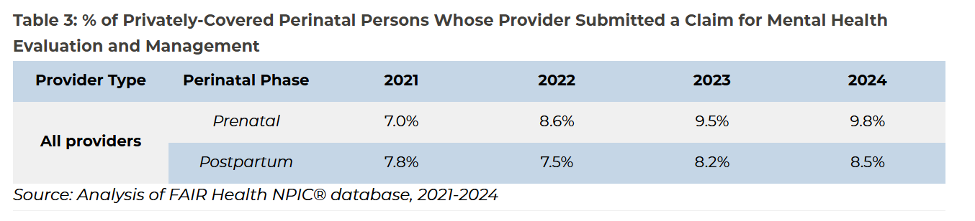
OB Billing Rates for MMH Screening & Treatment,
Among Private Insurance

Slide 24

Treatment and Suicidality Rates
 | 2016-2020 Commercial* | 2021 Medicaid**
Delivery Population with Perinatal Mood and Anxiety Disorder Diagnoses | 61,814 | 148,652
Treatment
Psychotherapy | 31,211 (50.49%) | 67,600 (45.48%)
Antidepressant | 27,390 (44.31%) | 66,544 (44.76%)
Outcome
Suicidality | 1,865 (3.02%) | 4,340 (2.92%)
*Commercial enrollment criteria:1 year before and 1 year after delivery continuously enrolled (private insurance) **Medicaid enrollment criteria: 9 months before and 3 months after delivery continuously enrolled

Slide 25

Unbundling Maternity Care Payment

Slide 26
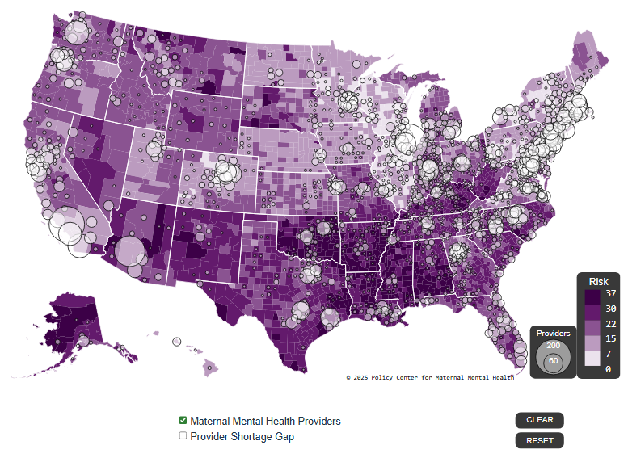
2025 U.S
Maternal Mental Health Risks & Resources
by County

Slide 27
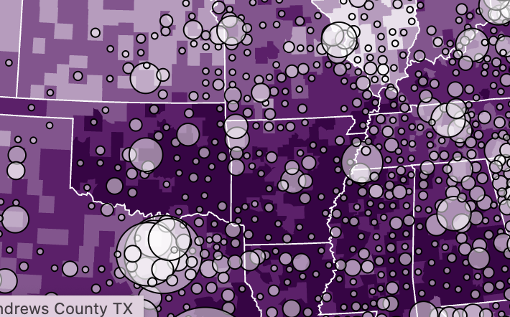
2025 U.S
Maternal Mental Health Risks & Resources
by County
Dark = Highest Risk
Bubbles = provider shortage area gaps

Slide 28
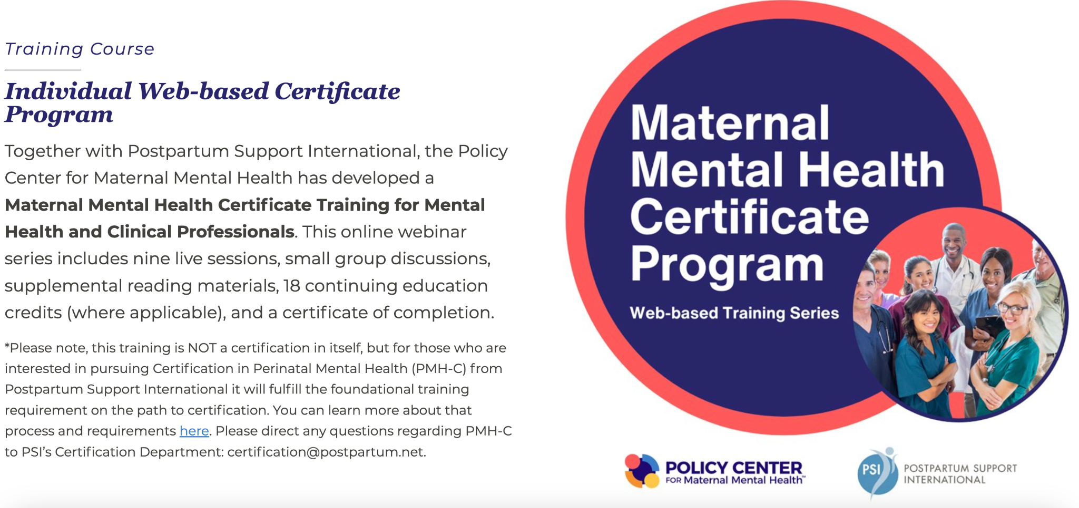

Slide 29
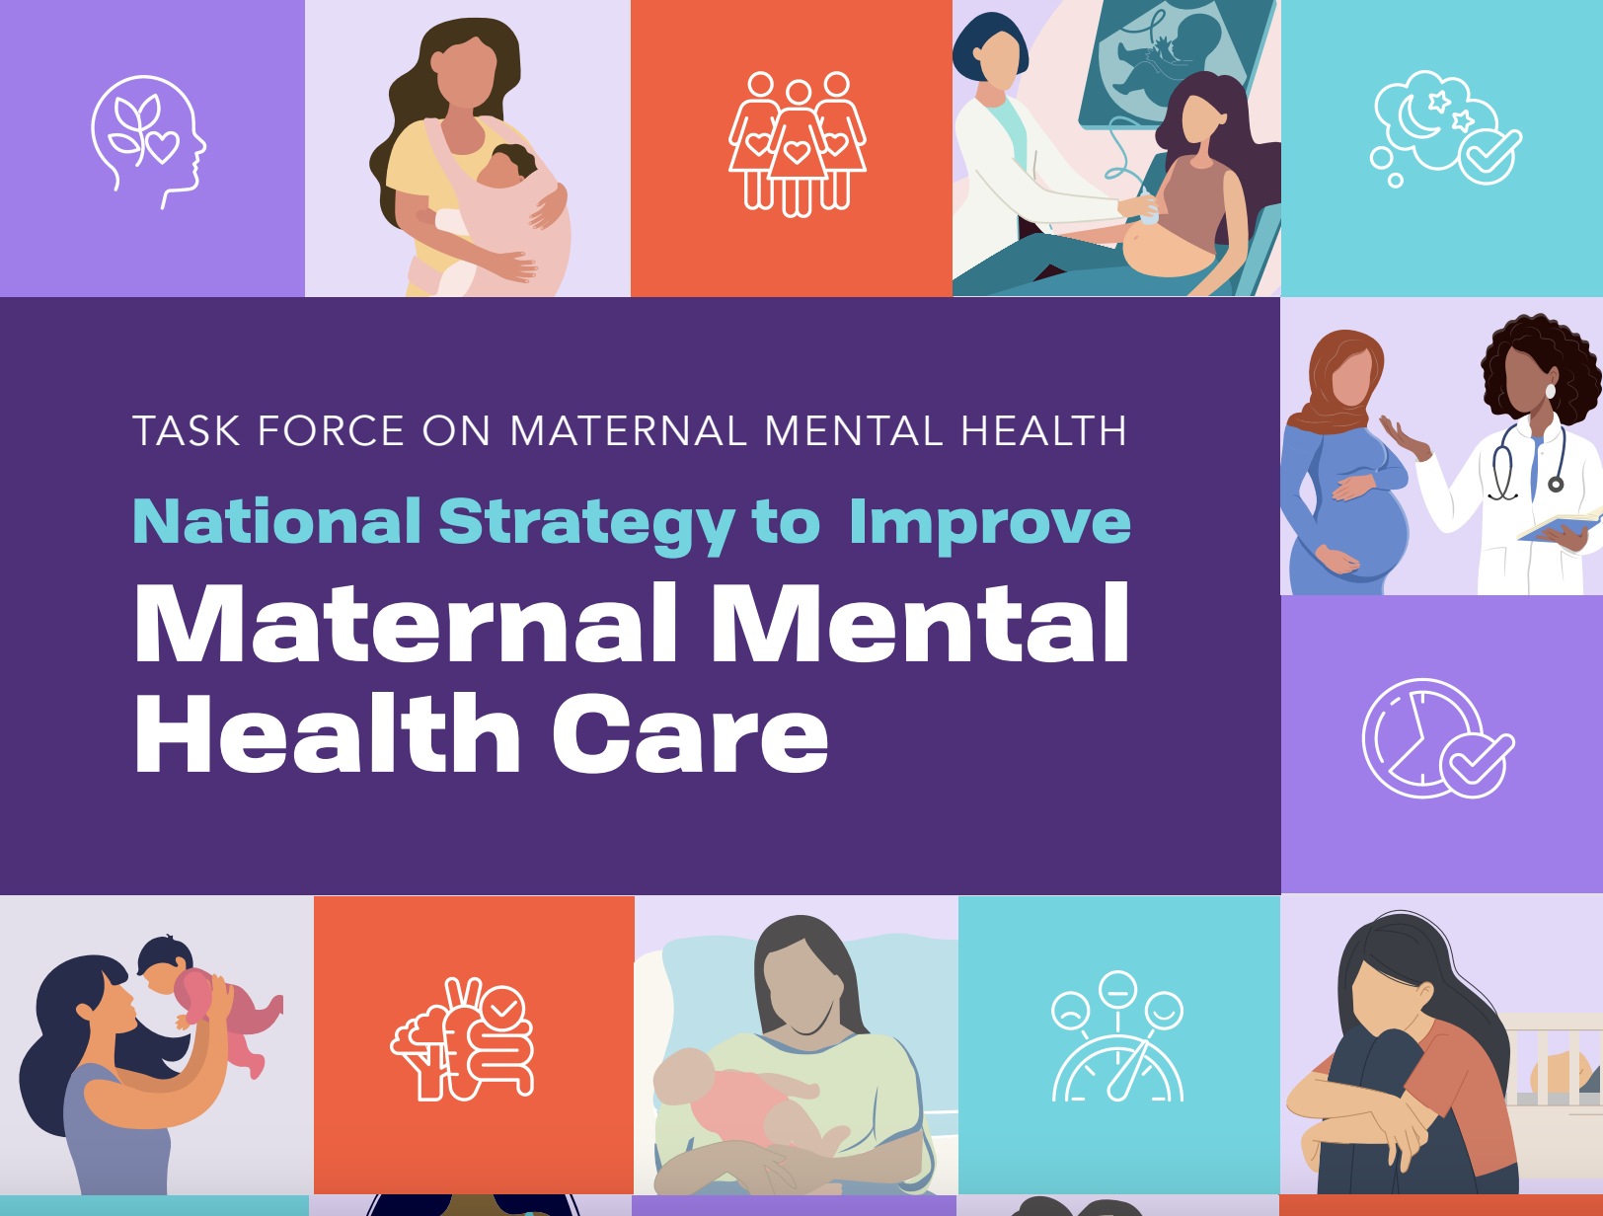
Maternal Mental Health Task Force
Areas of Focus
Prevention, Screening, and Diagnosis
Evidence-based Intervention and Treatment
Evidence-based Community Practices
Data, Research, Quality Improvement and Health Equity
Communications and Community Engagement
Key Recommendations
Maternity Care Centers Starting in Desserts (FQHCs w/ midwifery, Ob/Gyns, birth facilities, MH/SUD and pediatrics)
Improve/Clarify Interactions w/ Child Welfare (mandatory support vs. report)
Psychiatry Consultation for OB providers in All States
Notes:
https://idhi.uams.edu/high-risk-pregnancy-program/outreach/angels-womens-mental-health-program/

Slide 30
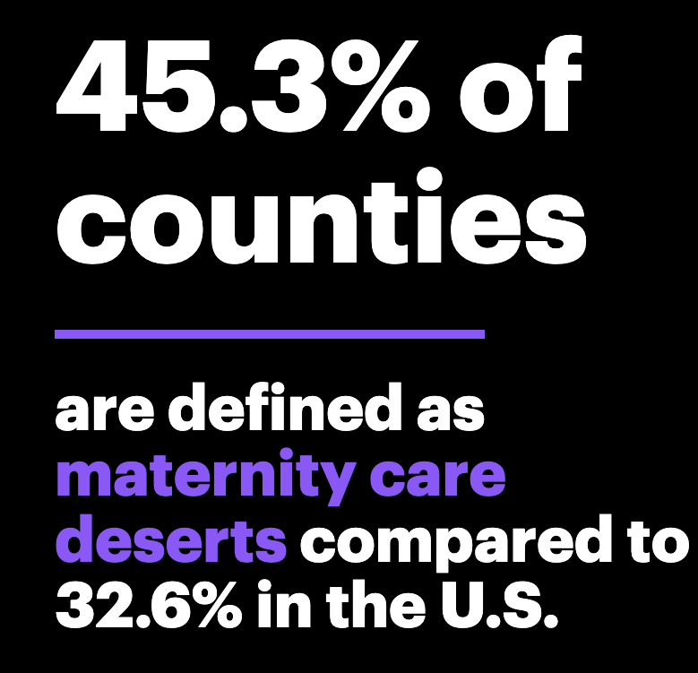
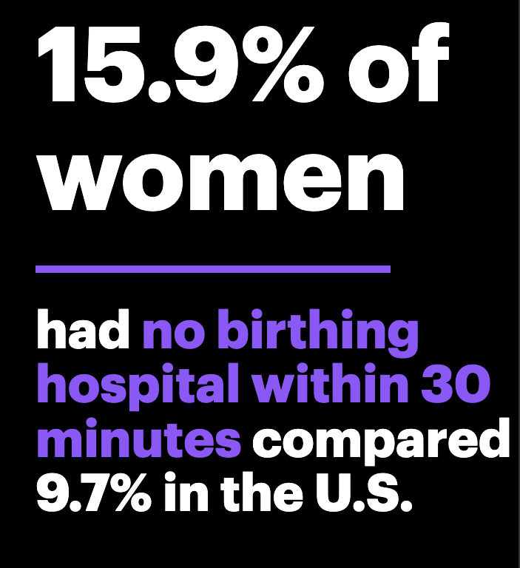
Maternity Care Deserts
https://www.marchofdimes.org/peristats/reports/arkansas/maternity-care-deserts

Slide 31
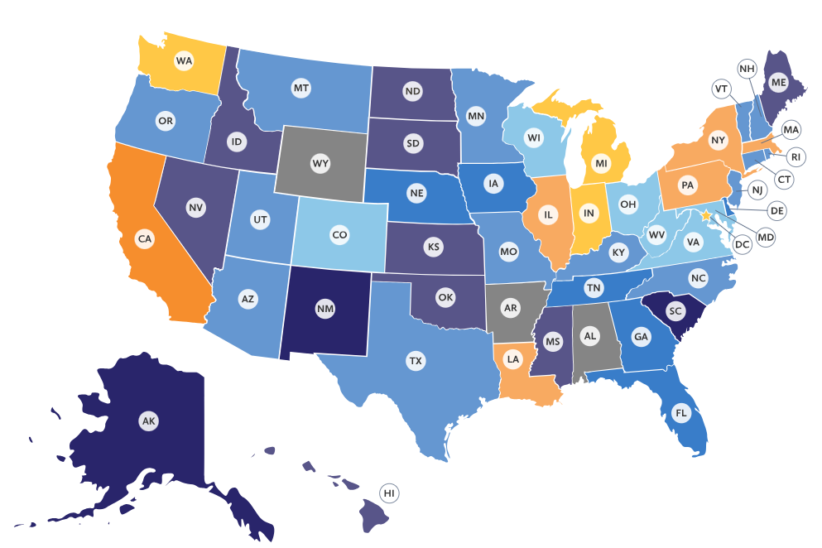


2026 Maternal Mental Health Report Cards
US Grade is a “C”
No As or Fs; 15 states received Ds

Slide 32



27 key measures provide a snapshot of state efforts
to address MMH across four categories.
  Screening/
  Detection
  Parental Support (New!)
  Providers and
  Treatment
  Policy and Payment
  Screening rates
  Screening as a performance measure
  Medicaid coverage
  Quality improvement programs
  State MMH strategic plan
  PQC MMH efforts
  Paid leave
  Childcare availability
  and affordability
  Provider-patient ratios
  MMH inpatient & outpatient programs
  Perinatal psychiatry consultation programs

Slide 33
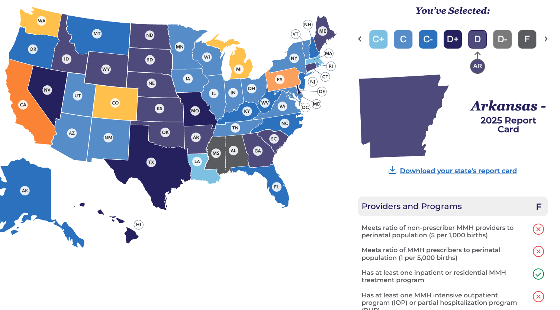
Arkansas 2025 State Report Card:

Slide 34
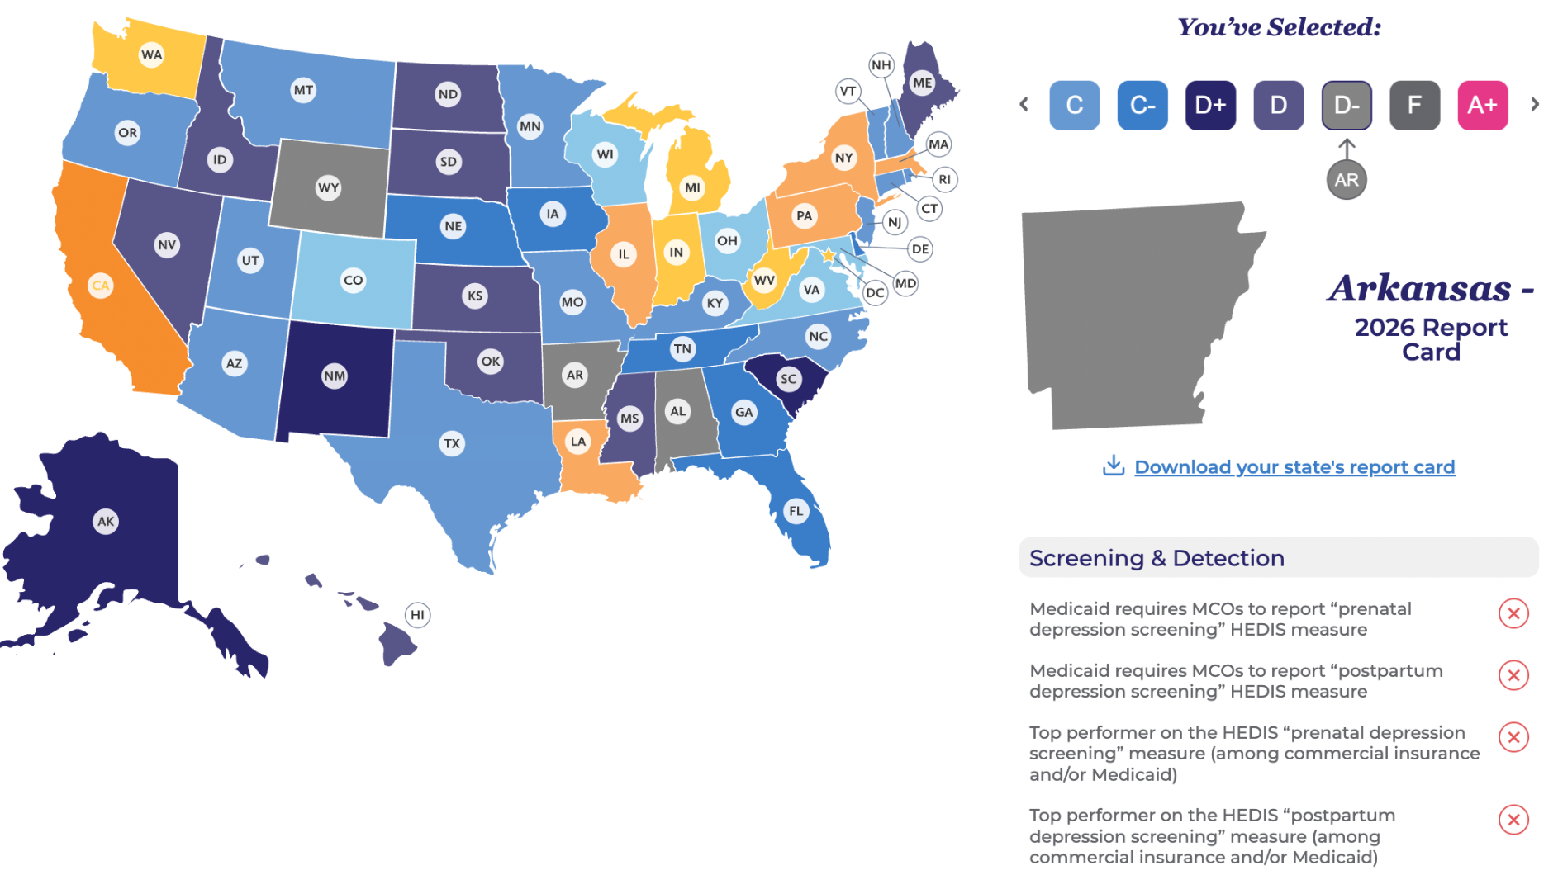
Arkansas 2026 State Report Card:

Slide 35
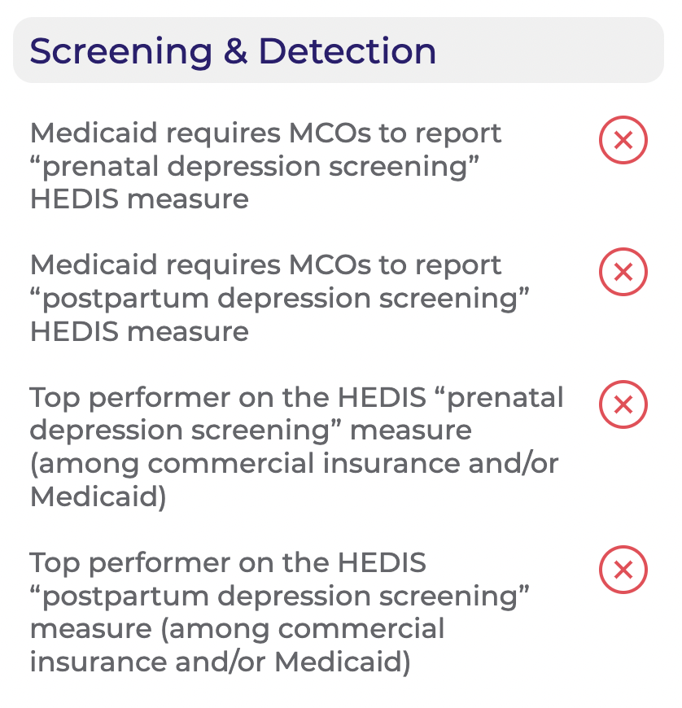
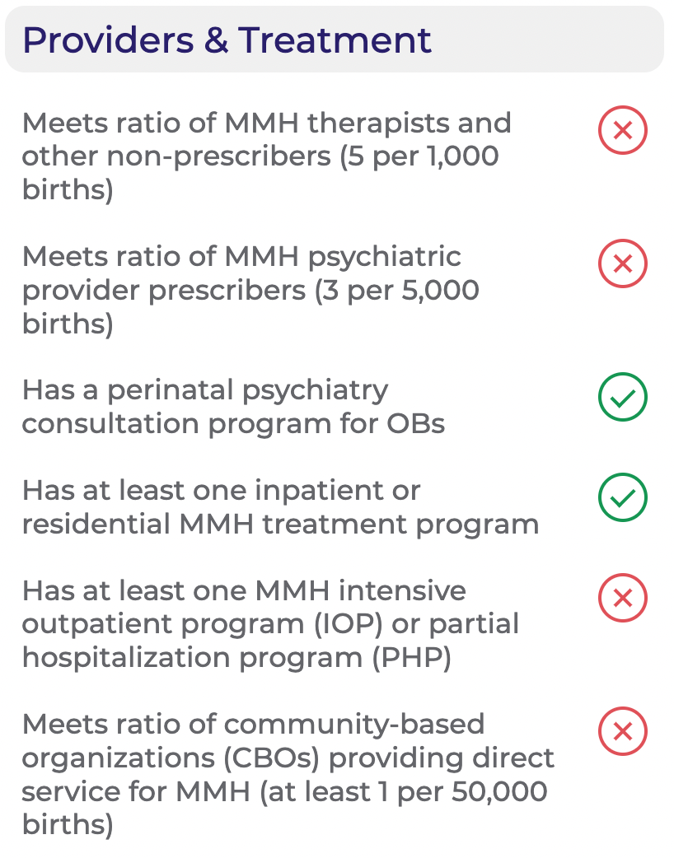
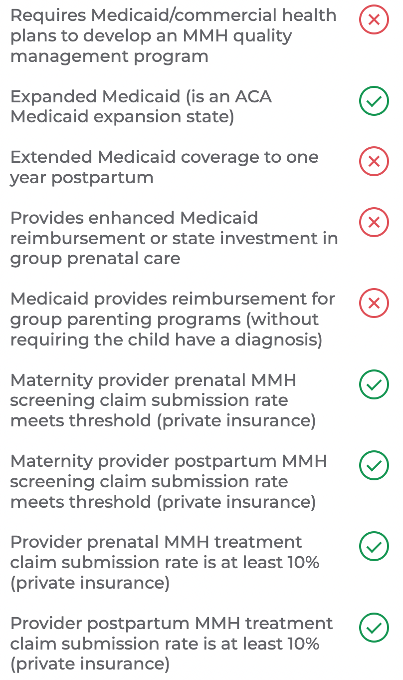
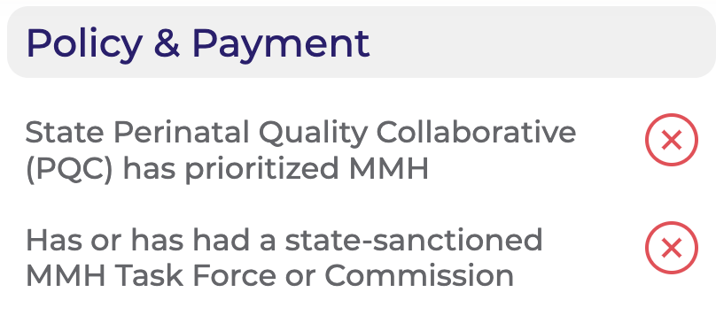
Arkansas 2026 State Report Card:
Notes:
Red box indicates measure that changed from 2025 - AR’s overall grade fell because the HEDIS postpartum depression screening rates fell below 10% (less than 5% for both Medicaid and commercial).

Slide 36
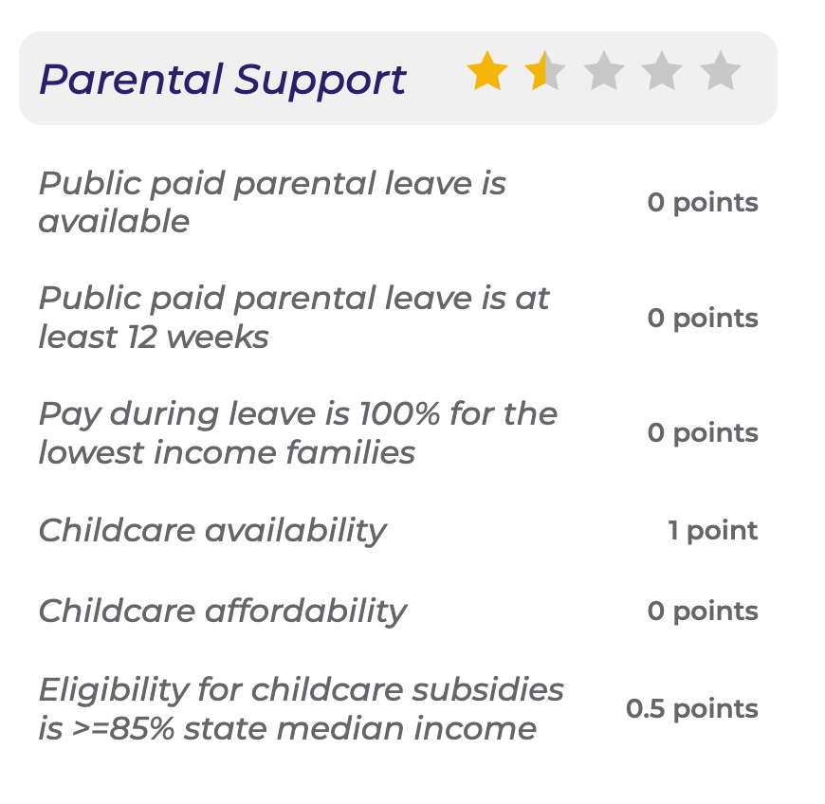
Arkansas 2026 State Report Card Cont.:
New Parental Support Domain

Slide 37

Arkansas MMH Laws
HOUSE BILL 1035 (2023, Eff 1-1-2024)
Requires the OB provider (“who is attending birth”) to facilitate screening within 6 weeks of birth
Insurance coverage at no cost share
HOUSE BILL 1011 (2023)
Requires the Medicaid Program to reimburse for depression screening of a pregnant woman (through 6 weeks postpartum and outside of the bundle).
Notes:
https://www.arkleg.state.ar.us/Home/FTPDocument?path=%2FACTS%2F2023R%2FPublic%2FACT316.pdf
https://www.arkleg.state.ar.us/Home/FTPDocument?path=%2FACTS%2F2023R%2FPublic%2FACT562.pdf

Slide 38

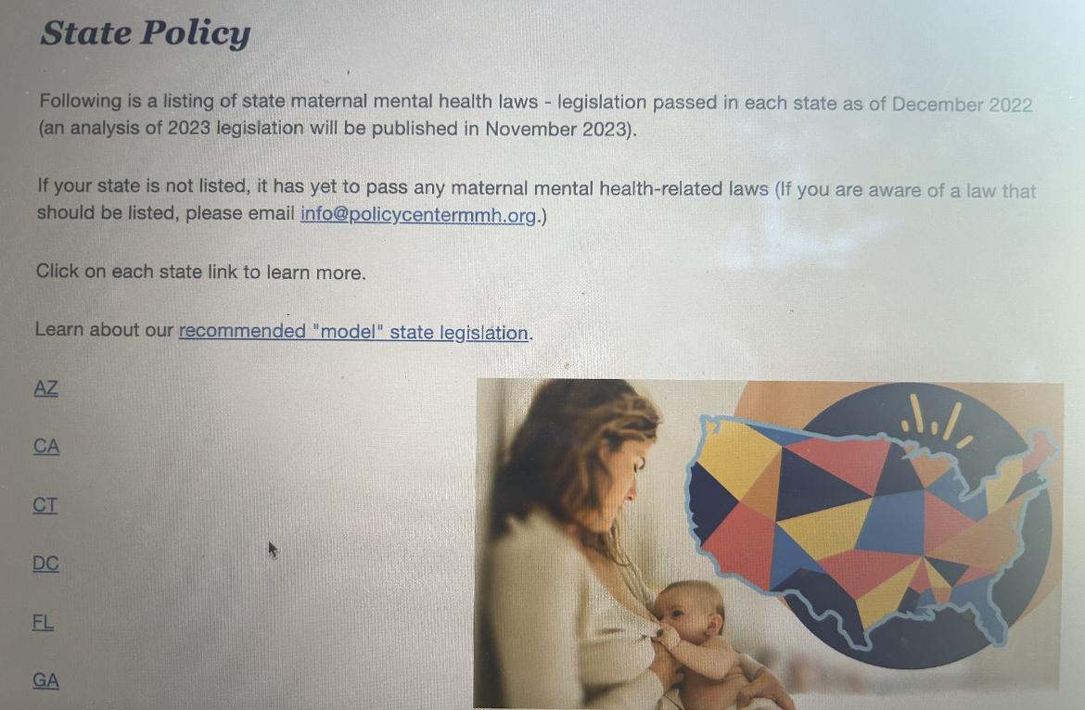
State Policy
State Legislation Tracking
Model Legislation
Awareness Month Proclamation
Task Force
Screening, Utilization Management and Case Management
Access to Providers
Policy Fellows
Notes:
https://policycentermmh.org/state-policy/

Slide 39
Recommendations
Require screening in pregnancy and through 12 months postpartum
Require insurers/plans:
  Track & report HEDIS-Like Perinatal Depression Screening & Follow-up/Treatment Measures
    (OB Claims Data or LOINC)
  Create MMH QI Plans w/ Data Collection & QI initiatives
  Case Management Programs
  Publish MMH Billing Guidance for OB Screening & Postpartum Home Visiting (Doulas, RNs etc)
Plant Comprehensive Dyadic Maternity Care Center FQHCs starting in Maternity Care Deserts (Philanthropy)
Provide 12 weeks Paid Maternity Leave

Slide 40

Learn More:
www.policycentermmh.org/rht

Slide 41



Now is the Time for Maternal Mental Health!
Learn More: www.PolicyCenterMMH.org

