Slide 1
Treating Substance Use Disorders in the Collaborative Care Model
Jennifer Thomas, MD, FASAM​
Family Medicine and Addiction Medicine Physician
Medical Director of Integrated Behavioral Health​
Morris Hospital​
Morris, IL
National Medical Co-Director for Integrated Behavioral Health
CFHA

Slide 2


Slide 3
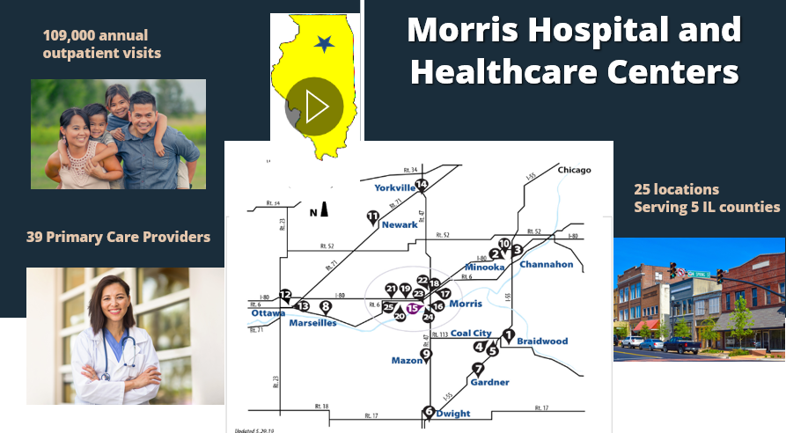

Slide 4
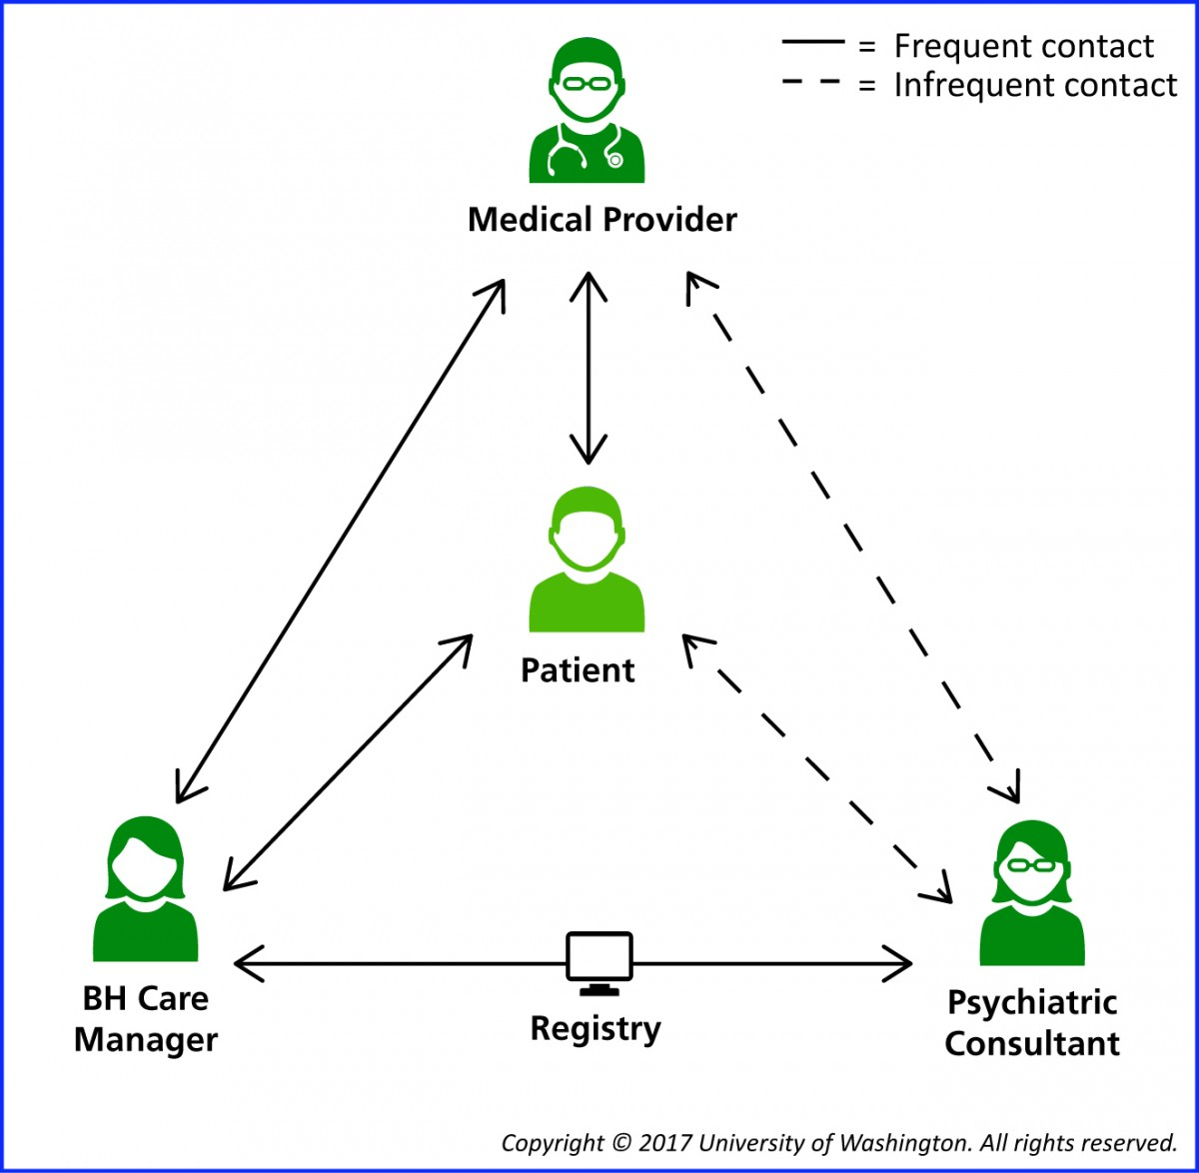
Collaborative Care Model (CoCM)
Defined group of patients
Tracked in a registry
Measurement based treatment to target
  Validated screening tool: PHQ-9

Slide 5
Integrated Behavioral Health Can Address Co-occurring Mental Health and Substance Use Disorders

Slide 6

Screening for Substance Use in Primary Care
Who?
When?
What?
Why?

Slide 7
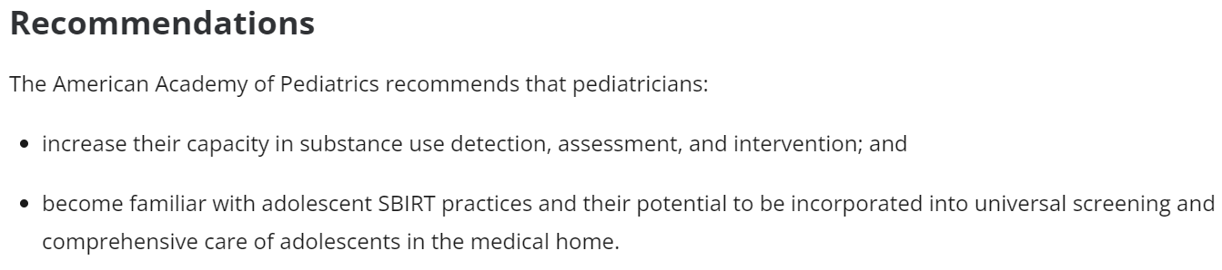
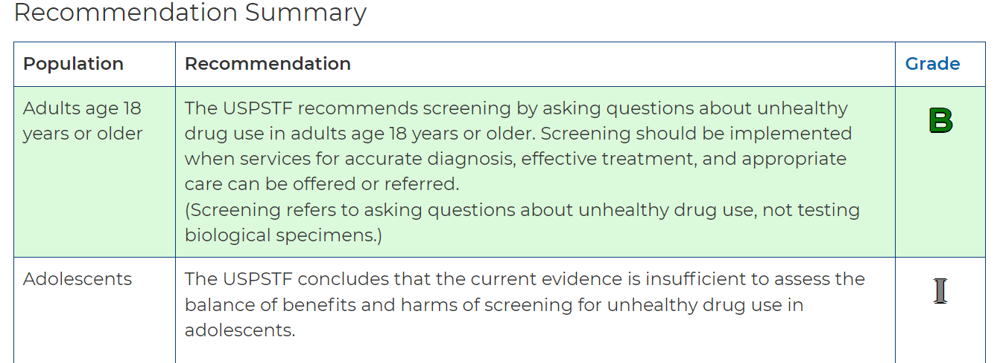
Screening for Substance Use in Primary Care:
Who?
Adolescents: AAP recommendations
Adults: USPSTF

Slide 8



Screening for Substance Use in Primary Care:
When?
Annually
(Universal Screening)
When clinically appropriate
(Targeted Screening)

Slide 9
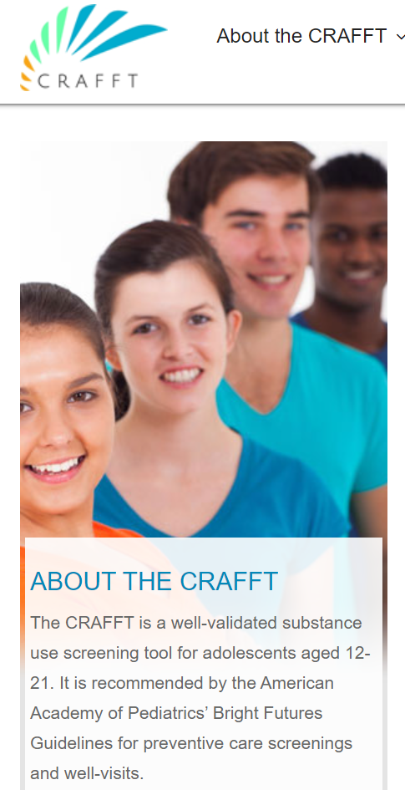
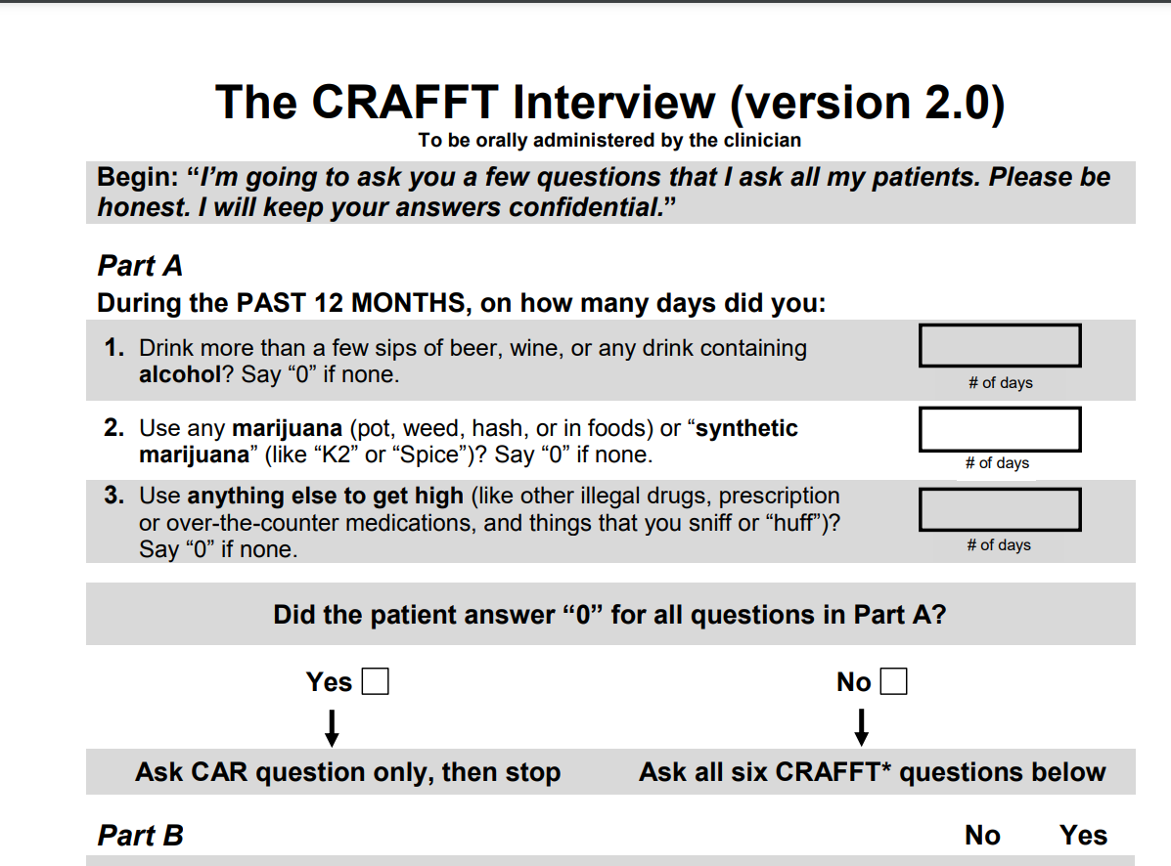
Screening for Substance Use in Primary Care:
What?
Adolescents:
CRAFFT

Slide 10
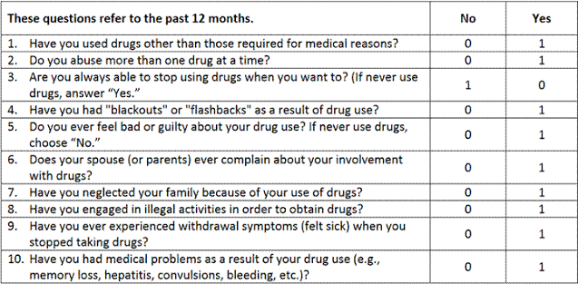
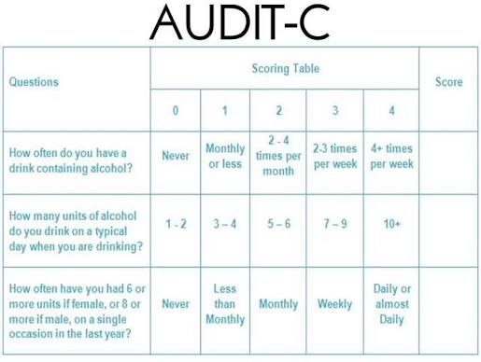
Screening for Substance Use in Primary Care:
What?
Adults:
DAST ( Other illicit substances)
AUDIT-C ( Alcohol)
Five A’s (Tobacco): Ask, Advise, Assess, Assist, Arrange
DAST
Tobacco Screening
“In the past 30 days, have you smoked cigarettes or used any other forms of tobacco (cigars, pipe, smokeless tobacco, electronic cigarettes)?”
    Every day
    Some days
    Not at all

Slide 11
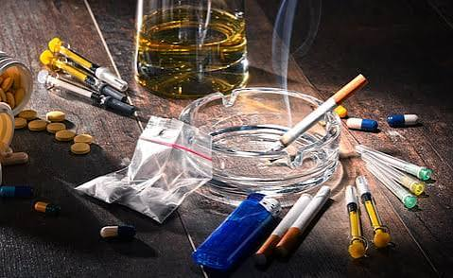
Screening for Substance Use in Primary Care:
Why?
Approximately 20% to 36% of adult primary care patients have a substance use disorder
A multisite study using DSM-5 criteria found that over one in three adult primary care patients met the criteria for a substance use disorder.
Patients frequently underreport risky or illicit behaviors due to stigma or fear, with biological testing showing significant underreporting for substances like prescription opioids and stimulants.
https://pubmed.ncbi.nlm.nih.gov/27753718/

Slide 12
Understanding Substance Use Disorders

Slide 13
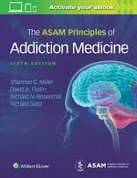

“Why is addiction a disease and why does it matter?”
Substance Use Disorders are Chronic Medical Conditions
ASAM defines addiction as a "primary, chronic disease of brain reward, motivation, memory and related circuitry"

Slide 14

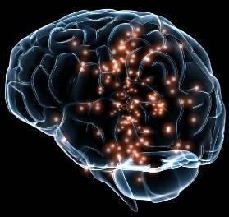

Bio-psycho-social Model of Addiction
Addiction can occur regardless of a person’s character, virtue or moral fiber
Rather than one cause, numerous biological, psychological and social factors can increase or decrease a person’s risk for developing addiction
Source: https://www.psychologytoday.com/us/blog/understanding-addiction/202107/what-exactly-is-the-biopsychosocial-model-addiction
BIO
PSYCHO
SOCIAL
Personality traits
Mental health conditions (ex: anxiety, depression)
Life experiences ( ex: trauma)
Genetics
While there is no “addiction gene”, some people can be genetically predisposed to developing addiction
Social norms
Availability
Modeling
Cultural beliefs
https://pmc.ncbi.nlm.nih.gov/articles/PMC3767415/
https://www.psychologytoday.com/us/blog/understanding-addiction/202107/what-exactly-is-the-biopsychosocial-model-addiction

Slide 15


3 Key Points to Understand the Brain and Addiction
Some characteristics of addiction are similar to other chronic diseases.
Substance use alters the brain’s reward system.
The brain can recover- but it takes time.
Source: https://www.recoveryanswers.org/recovery-101/brain-in-recovery/

Slide 16
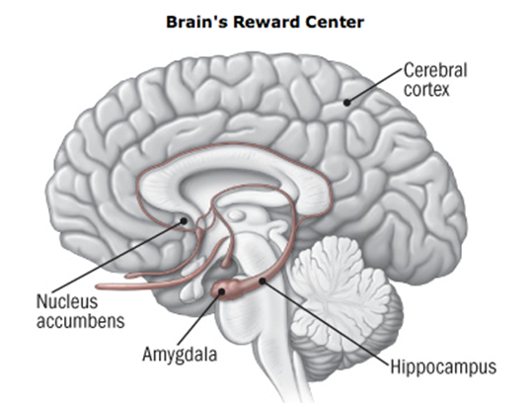
Brain and Addiction
Brain experiences pleasure by releasing dopamine into the nucleus accumbens
Naturally, dopamine is released by pleasurable activities, (eating dessert or watching a funny movie)
Using large amounts of substances for long periods of time floods the nucleus accumbens with dopamine
Overtime, people may not experience pleasure with everyday activities
Brain becomes tolerant to dopamine over time, cravings increase
Source: https://www.recoveryanswers.org/recovery-101/brain-in-recovery

Slide 17
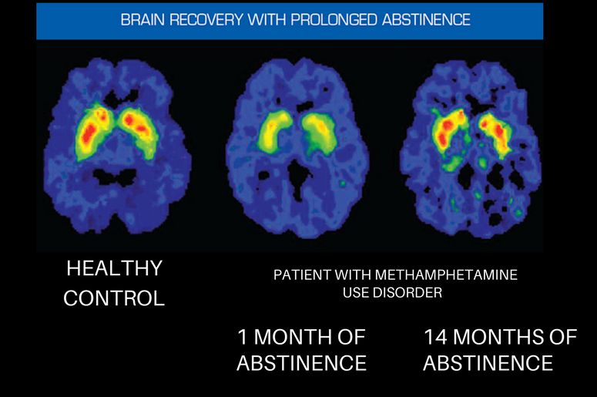
The Brain Can Recover- But it Takes Time
Red= greater activity= healing
Source: https://www.recoveryanswers.org/recovery-101/brain-in-recovery
Source: https://www.recoveryanswers.org/recovery-101/brain-in-recovery

Slide 18
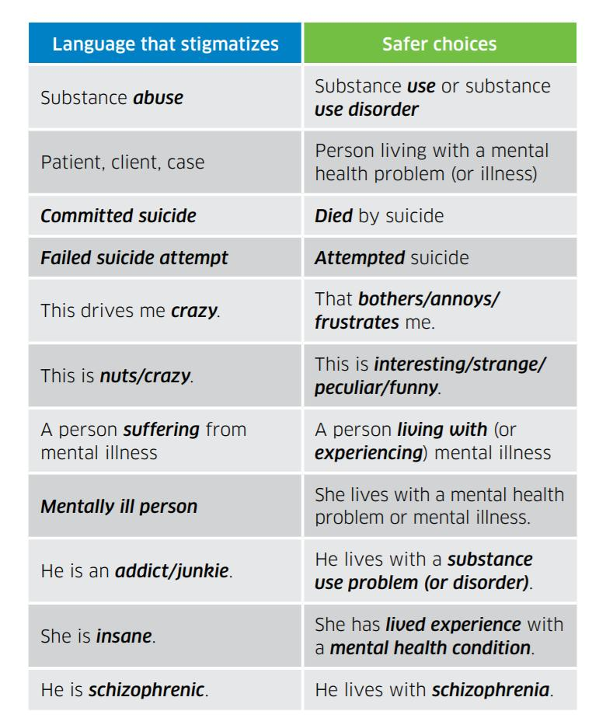
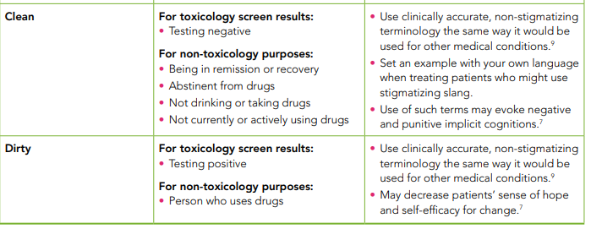
Word Choice Matters…

Slide 19
Keep in Mind the 3 C’s
when discussing substance use/ at risk use
Loss of Control
Continued use despite adverse consequences
Cravings

Slide 20
DSM-5 Criteria for Substance Use Disorders
Taken in larger amounts or for longer period of time than intended
Unsuccessful efforts to cut down
Great deal of time obtaining substance or recovering from its effects
Cravings to use substance
Recurrent use despite failing to meet obligations at work, school or home
Continued use despite social or interpersonal problems due to use
Social, occupational or recreational activities given up due to use
Recurrent use in physically hazardous situations
Continued use despite knowledge of having a persistent or recurrent physical or psychological problem that is likely to have been caused or exacerbated by the substance
Tolerance
Withdrawal
https://pmc.ncbi.nlm.nih.gov/articles/PMC3767415/

Slide 21

Classes of Substances
TACO- BIS
Tobacco
Alcohol
Cannabis
Opioids
Benzodiazepines
Inhalants
Stimulants

Slide 22
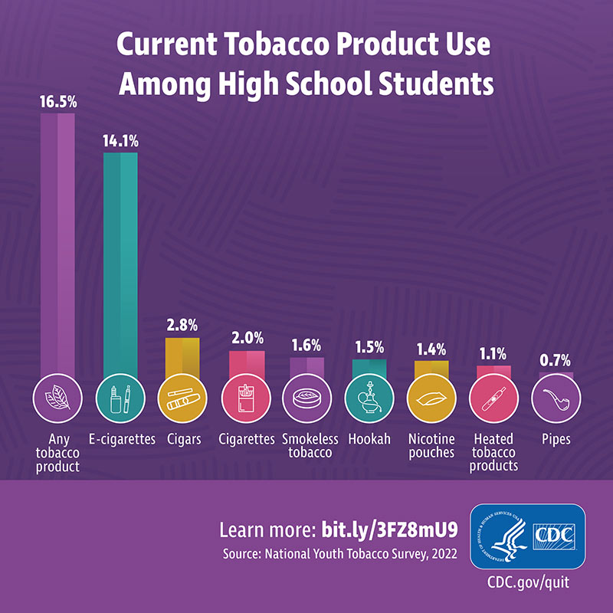
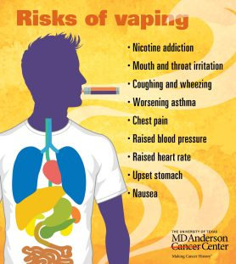
Tobacco
Tobacco use prevalence in primary care settings generally mirrors national adult rates (around 11.5% to 12% in the U.S.), though screening and intervention gaps remain common.
Vaping ( e-cigarette use) in on the rise, especially in adolescents and teens

Slide 23
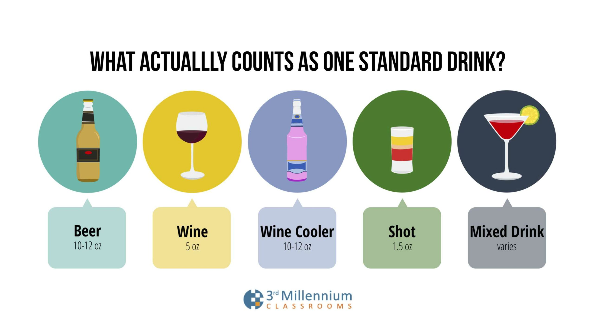
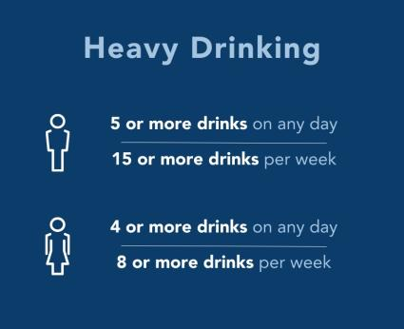
Alcohol
Prevalence of alcohol use disorder (AUD) in primary care settings ranges widely from 11.8% to 25% when using active screening and diagnostic interviews, though provider-documented rates in electronic health records are often much lower
Unhealthy alcohol use in adult primary care settings generally ranges from 10% to over 30%

Slide 24
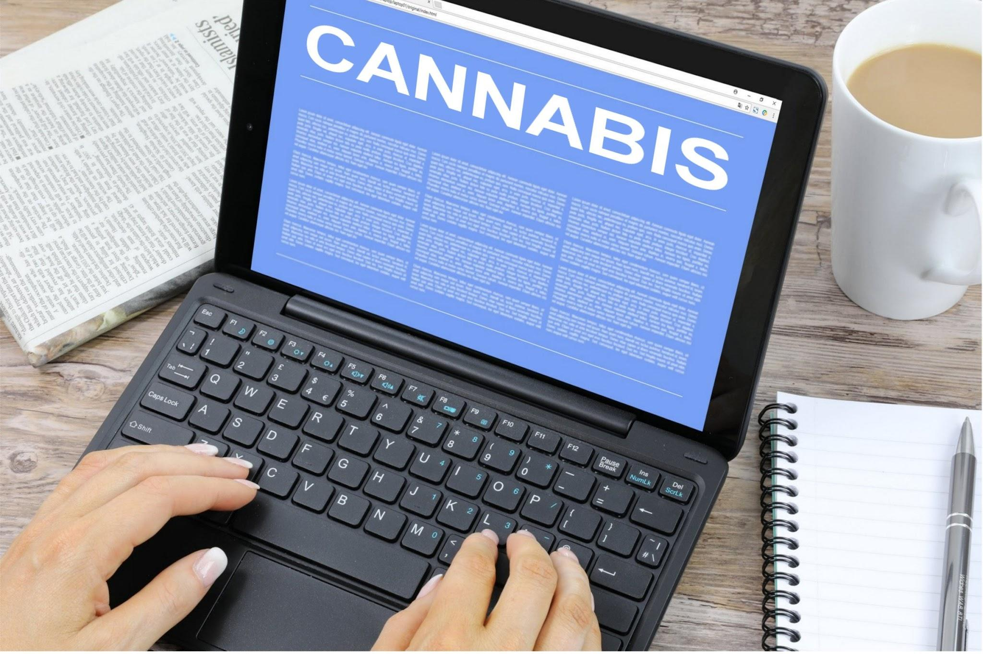
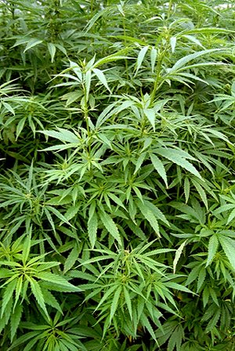
Cannabis
The term “cannabis” refers to all products derived from the plant, Cannabis sativa
  THC : Tetrahydrocannabinol
    The more psychoactive substance
  CBD : Cannabinol
    chemically similar to THC but does not have the same psychoactive properties as THC
Cannabis legality varies by state
Recreational vs. Medical use laws vary as well
Cannabis sativa plant

Slide 25
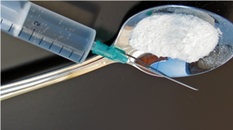
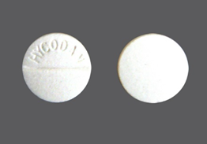
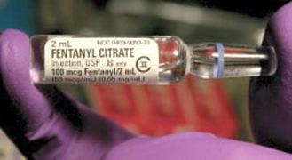
Opioids
Prescribed
  Hydrocodone ( Norco), oxycodone (Oxycontin, Percocet), morphine, fentanyl, tramadol
Non-prescribed
  Heroin, illicit fentanyl, kratom

Slide 26
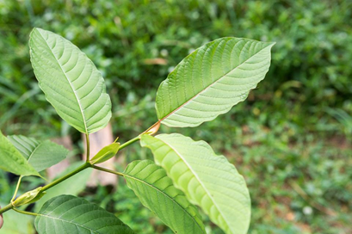
What is Kratom?
Mitragyna Speciosa
2 main psychoactive alkaloids:
  mitragynine
  7-OH mitragynine
Tropical tree from the coffee family native to Southeast Asia
Sold in tablet, capsule, loose raw leaves
7-OH kratom can be known as
“gas station heroin” or “gas station oxy”
to Southeast As
At low doses
Stimulating, energizing, uplifting
At higher doses
Acts like an opiate causing drowsiness and euphoria
Can cause opioid withdrawal

Slide 27
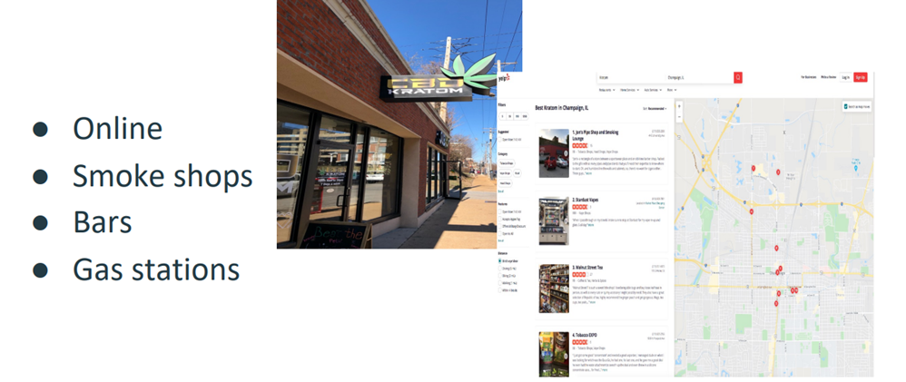
Kratom is sold legally in many states
to Southeast As

Slide 28
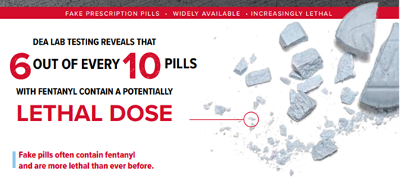
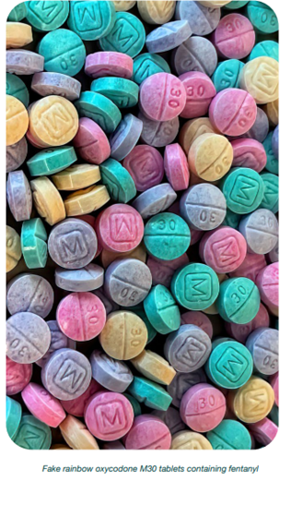
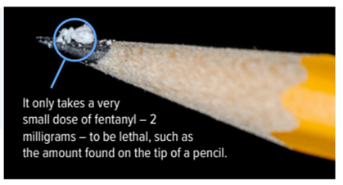
Opioids: The Fentanyl Era
Fentanyl is a potent synthetic opioid
  100 x more potent than morphine
  50 x more potent than heroin as an analgesic
Other contaminants such xylazine are common in the current opioid drug supply 1
to Southeast As
www.dea.gov/sites/default/files/2022-12/DEA-OPCK_FactSheet_December_2022.pdfDEA Fact Sheet

Slide 29
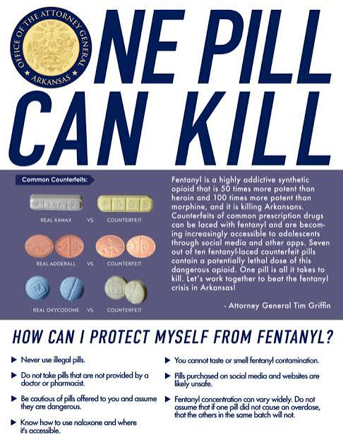
Counterfeit pills are very common
A significant number of people purchase Adderall and Xanax on dark web markets and/or social media referrals (1)
These pills are often contaminated with fentanyl and/or methamphetamine
Some students begin using stimulants as “study drugs” with the belief that these meds will boost academic performance
3
Source: DEA Fact Sheet, Fake Pills
4
https://www.dea.gov/sites/default/files/2022-12/DEA-OPCK_FactSheet_December_2022.pdf
https://www.dea.gov/sites/default/files/2021-12/Emoji%20Decoded.pdf

Slide 30
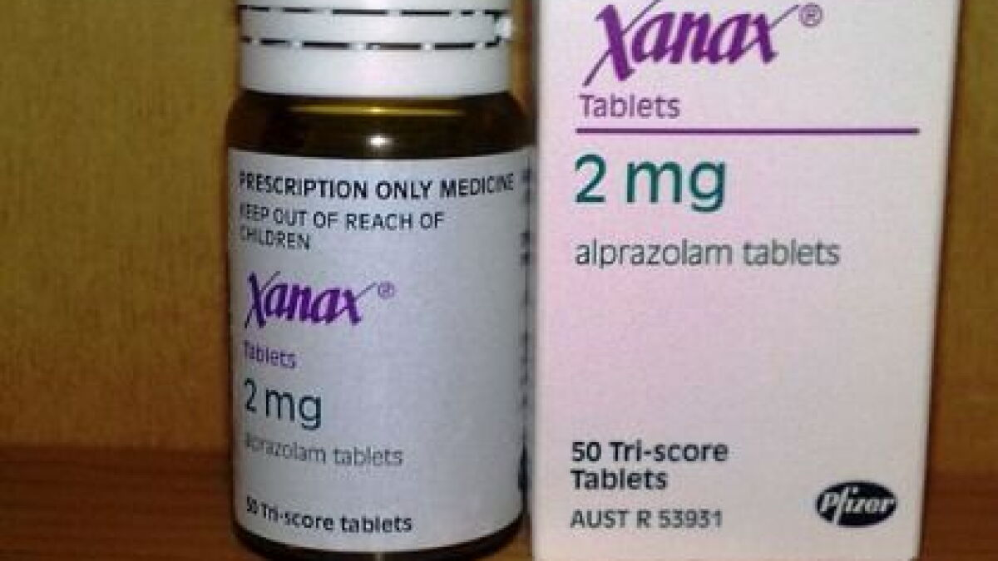
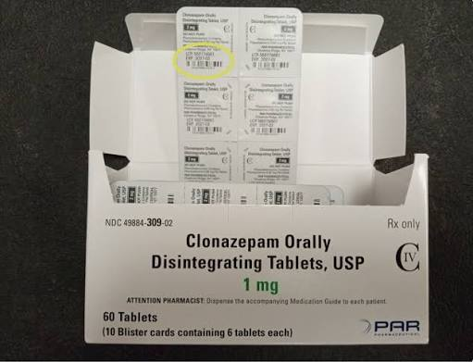
Benzodiazepines
Class of prescription central nervous system depressants used to treat anxiety, seizures, insomnia, and alcohol withdrawal
Examples:
  Alprazolam
  Lorazepam
  Diazepam
  Clonazepam

Slide 31
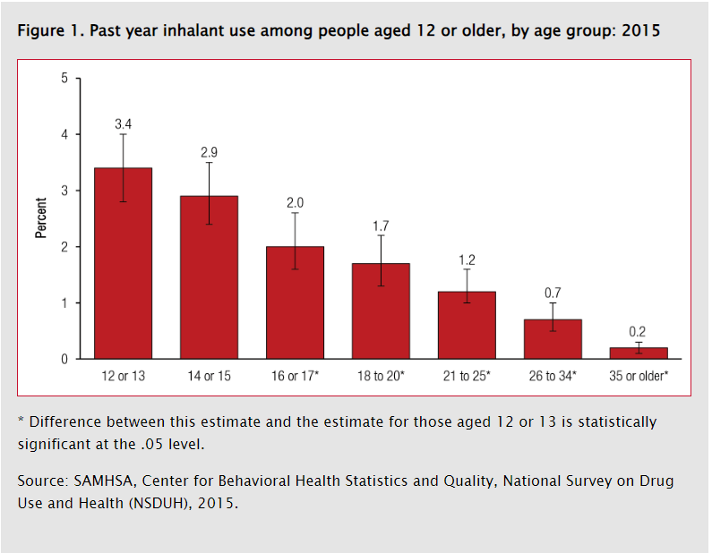
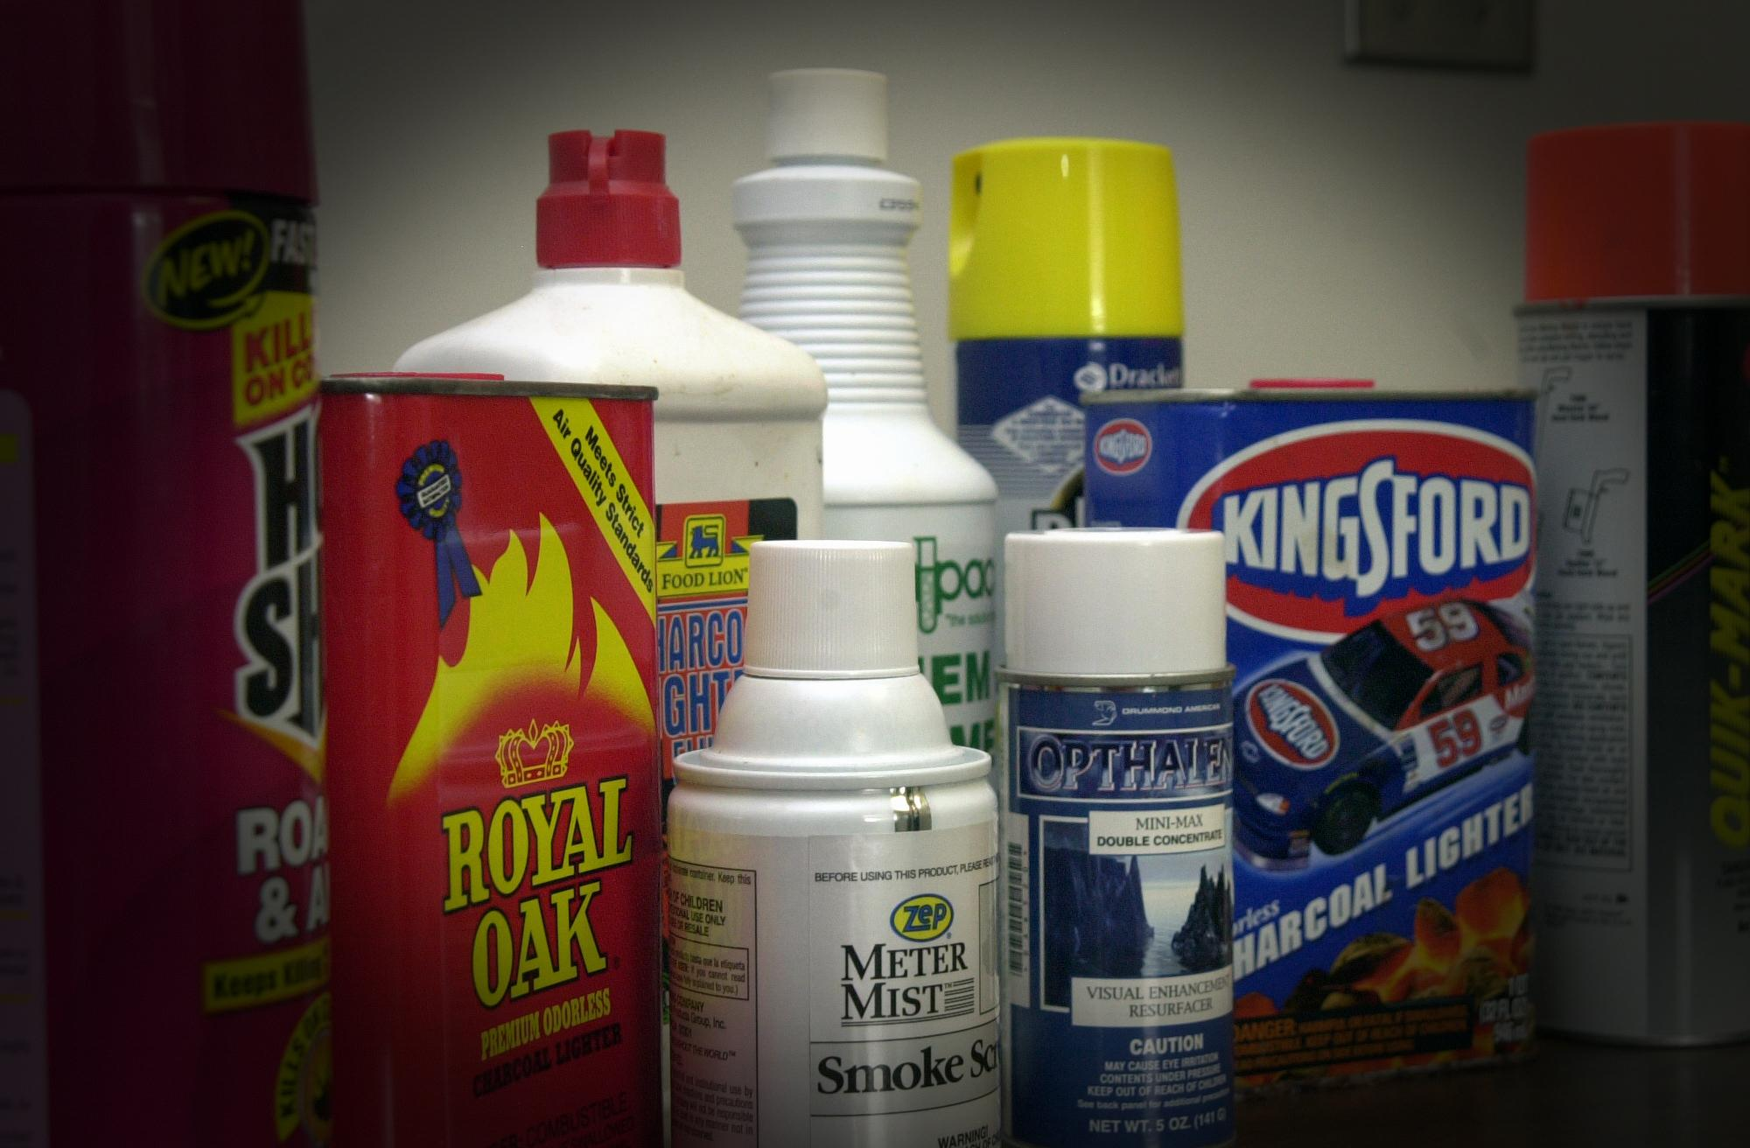
Inhalants
In 2021, 0.8% of persons age 12 and older reported inhalant use in the past 12 months
Accessible, cheap, easy to hide
Can produce a rapid high, similar to alcohol intoxication
Use can cause impaired judgement, nausea and vomiting, slurred speech, lethargy, stupor

Slide 32
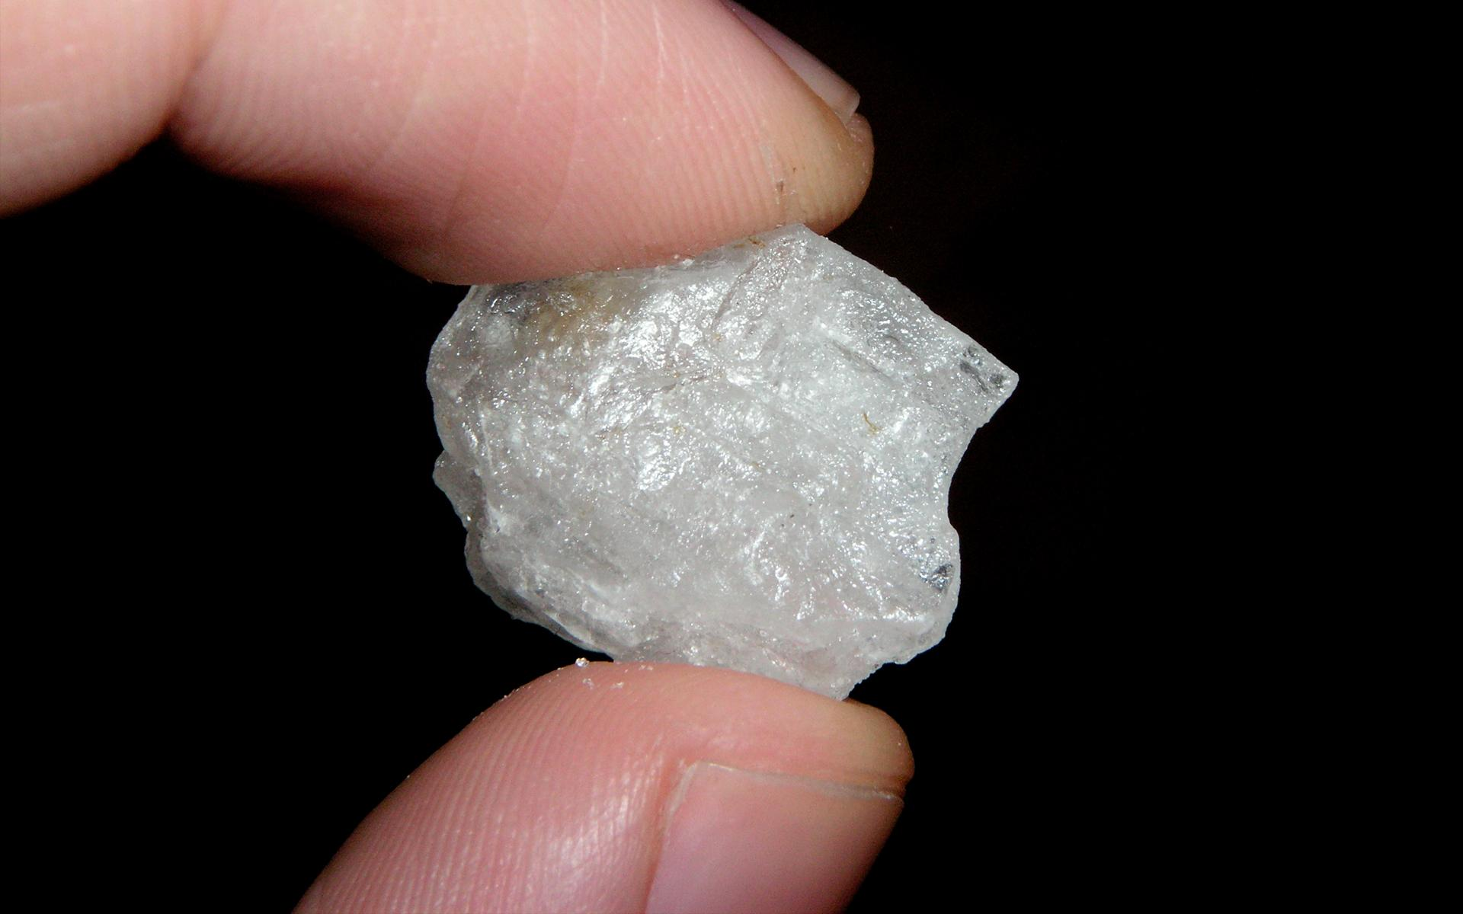
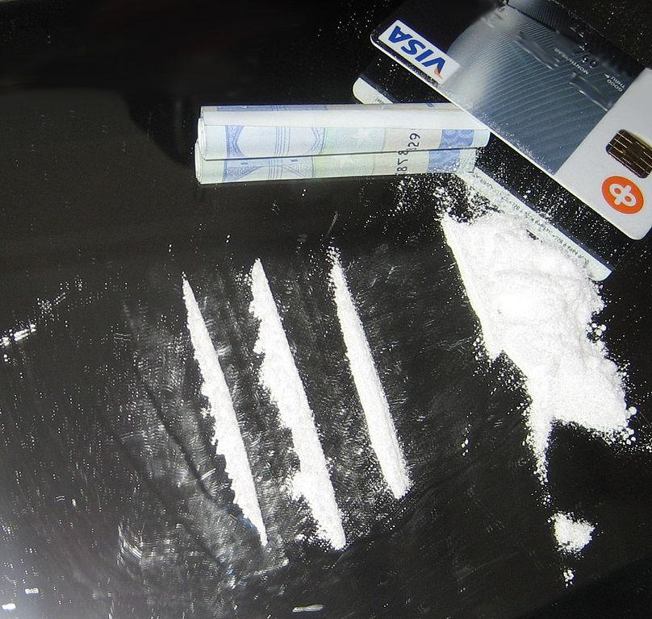
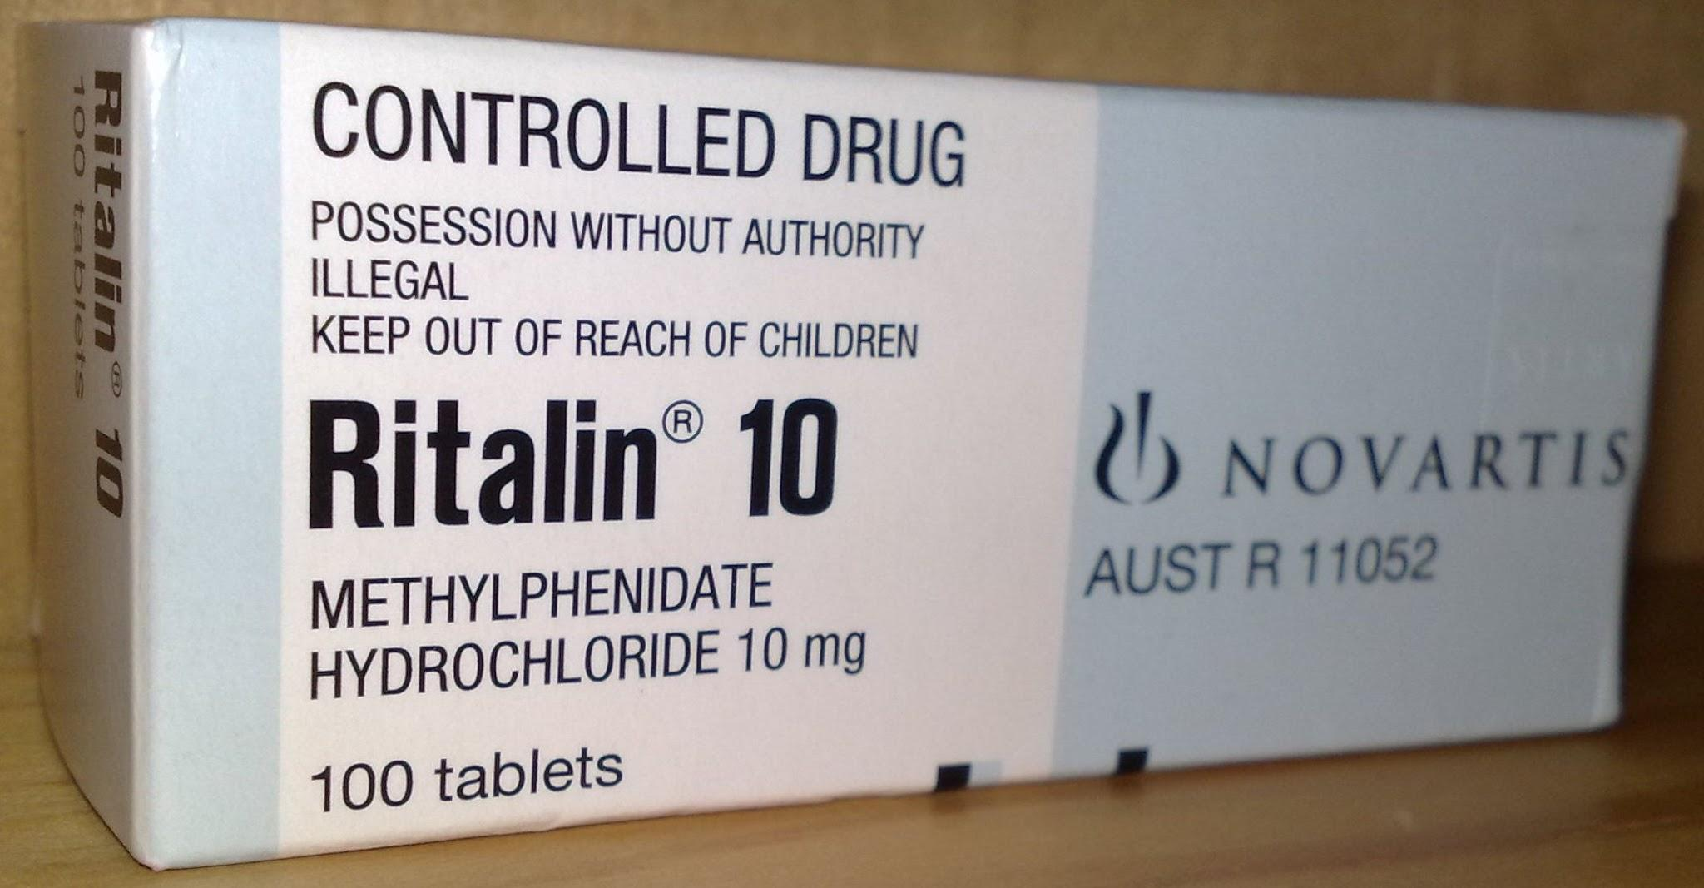
Stimulants
Stimulants can include prescription stimulants (Ritalin, Adderall) and illegal stimulants (cocaine, methamphetamine)
Stimulant misuse: taking without a prescription or taking in a way other than prescribed
When taken at higher than recommended doses, stimulants can cause dangerous elevations in body temp, seizures, cardiac events

Slide 33

Medications to treat SUDs
Are there FDA-approved medications?
Tobacco
Alcohol
Opioids
Stimulants
Benzodiazepines
Cannabis
Inhalants

Slide 34
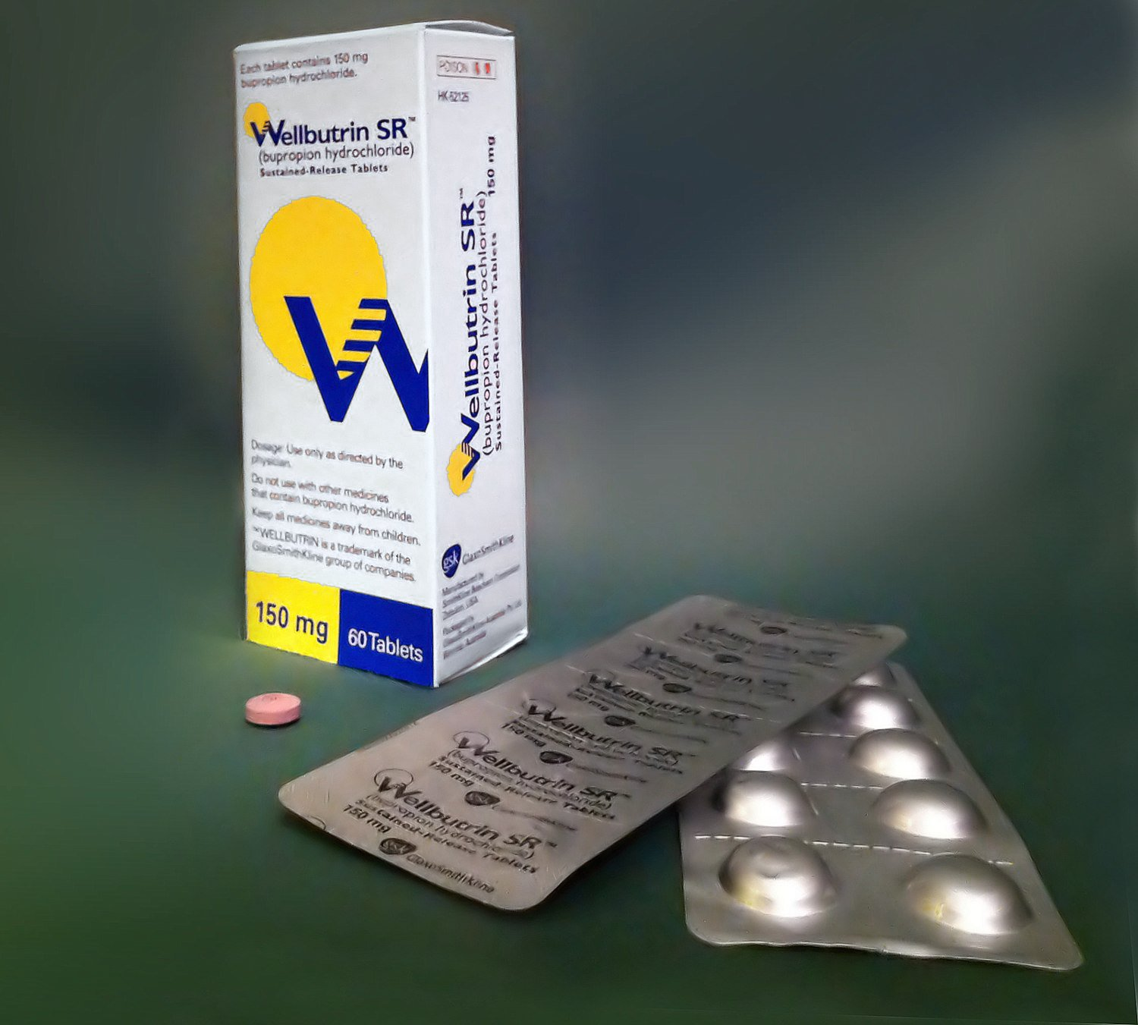
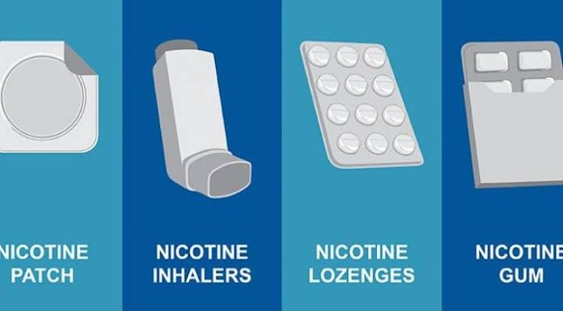
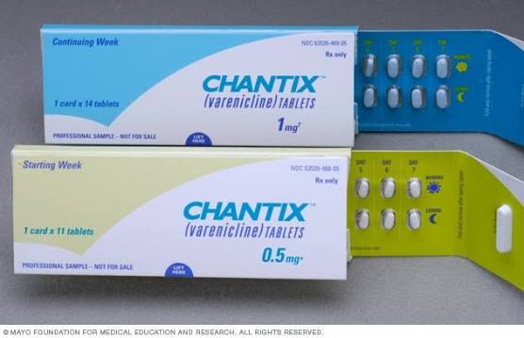
Medication to Treat Tobacco Use Disorder
Varenicline ( Chantix)
Bupropion ( Zyban, Wellbutrin)
Nicotine Replacement Therapy ( NRT), available OTC
FDA-approved age ranges:
Chantix: 16 and older
Bupropion: 18 and older
NRT: 18 and older

Slide 35
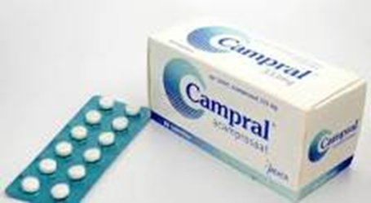
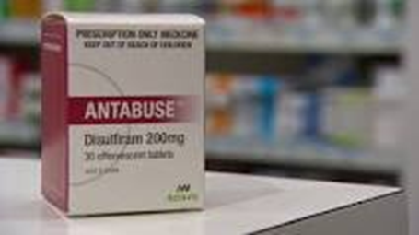
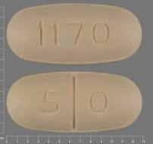
Medication for Alcohol Use Disorder
Naltrexone
  Oral 50 mg daily, common dose
  May decrease risk of binge drinking
Disulfiram ( Antabuse)
  Blocks the breakdown of alcohol in the body, alcohol use while on disulfiram will cause severe nausea and vomiting
Acamprosate ( Campral)
  May help decrease alcohol cravings; may help patients remain in remission

Slide 36
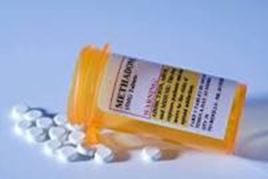
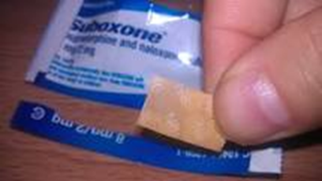
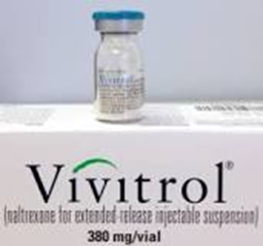
Medication for Opioid Use Disorder
Methadone
  Can only be prescribed my clinicians at opioid treatment programs ( OTPs)
  Federally regulated by SAMHSA and DEA
Naltrexone
  Vivitrol- IM injection monthly
Buprenorphine
  Suboxone, Zubsolv: sublingual film or tab
  Sublocade: SQ injection monthly
  DEA eliminated x-waiver in Jan. 2023 (special licensure for providers to prescribe)
  Currently, any provider with a standard DEA registration number can prescribe buprenorphine

Slide 37

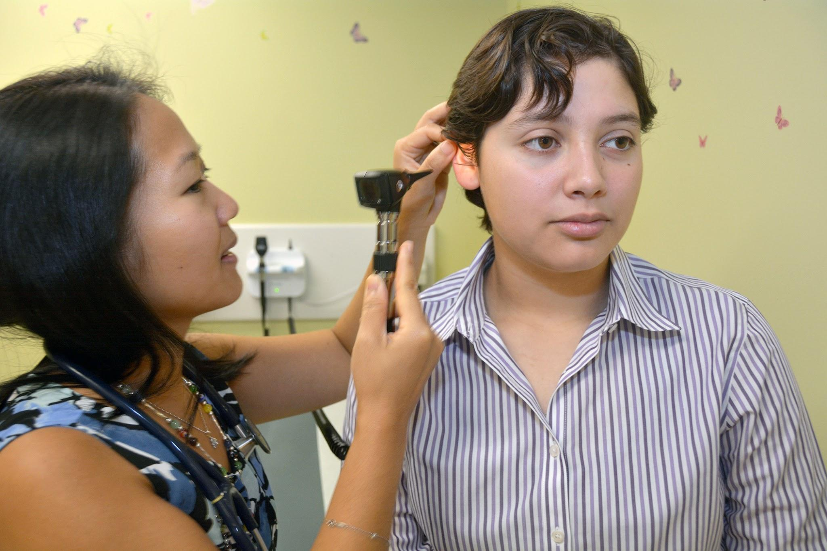

Primary care is a great place to engage patients in substance use conversationions
Notes:
PCPs see patients over the childhood/adolescent lifespan and develop trust
Yearly well visits
Substance use can be part of preventative health conversations

Slide 38
Team-Based CoCM Can Work Well for Co-occurring Mental Health and SUDs
Behavioral Interventions with evidence base for primary care:
Behavioral Activation ( BA)
Cognitive Behavioral Therapy (CBT)
Motivational Interviewing (MI)

Slide 39
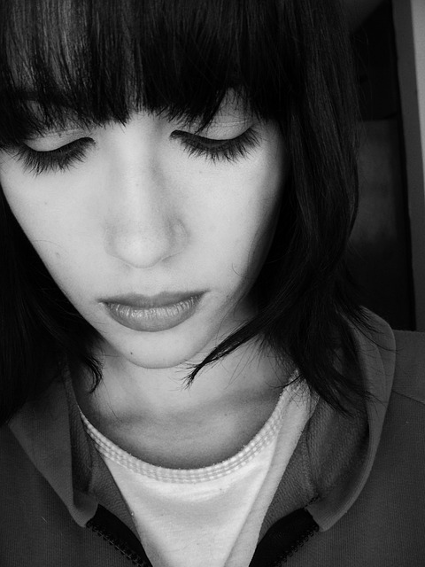
Co-Occurring Mental Health Disorders and SUDs
Certain substances can cause people with an addiction to experience one or more symptoms of a mental health problem
Mental health problems can sometimes lead to alcohol or drug use, as some people with a mental health problem may misuse these substances as a form of self-medication
Mental health and substance use disorders share some underlying causes, including changes in brain composition, genetic vulnerabilities, and early exposure to stress or trauma
https://www.samhsa.gov/mental-health/what-is-mental-health/conditions/co-occurring-disorders

Slide 40
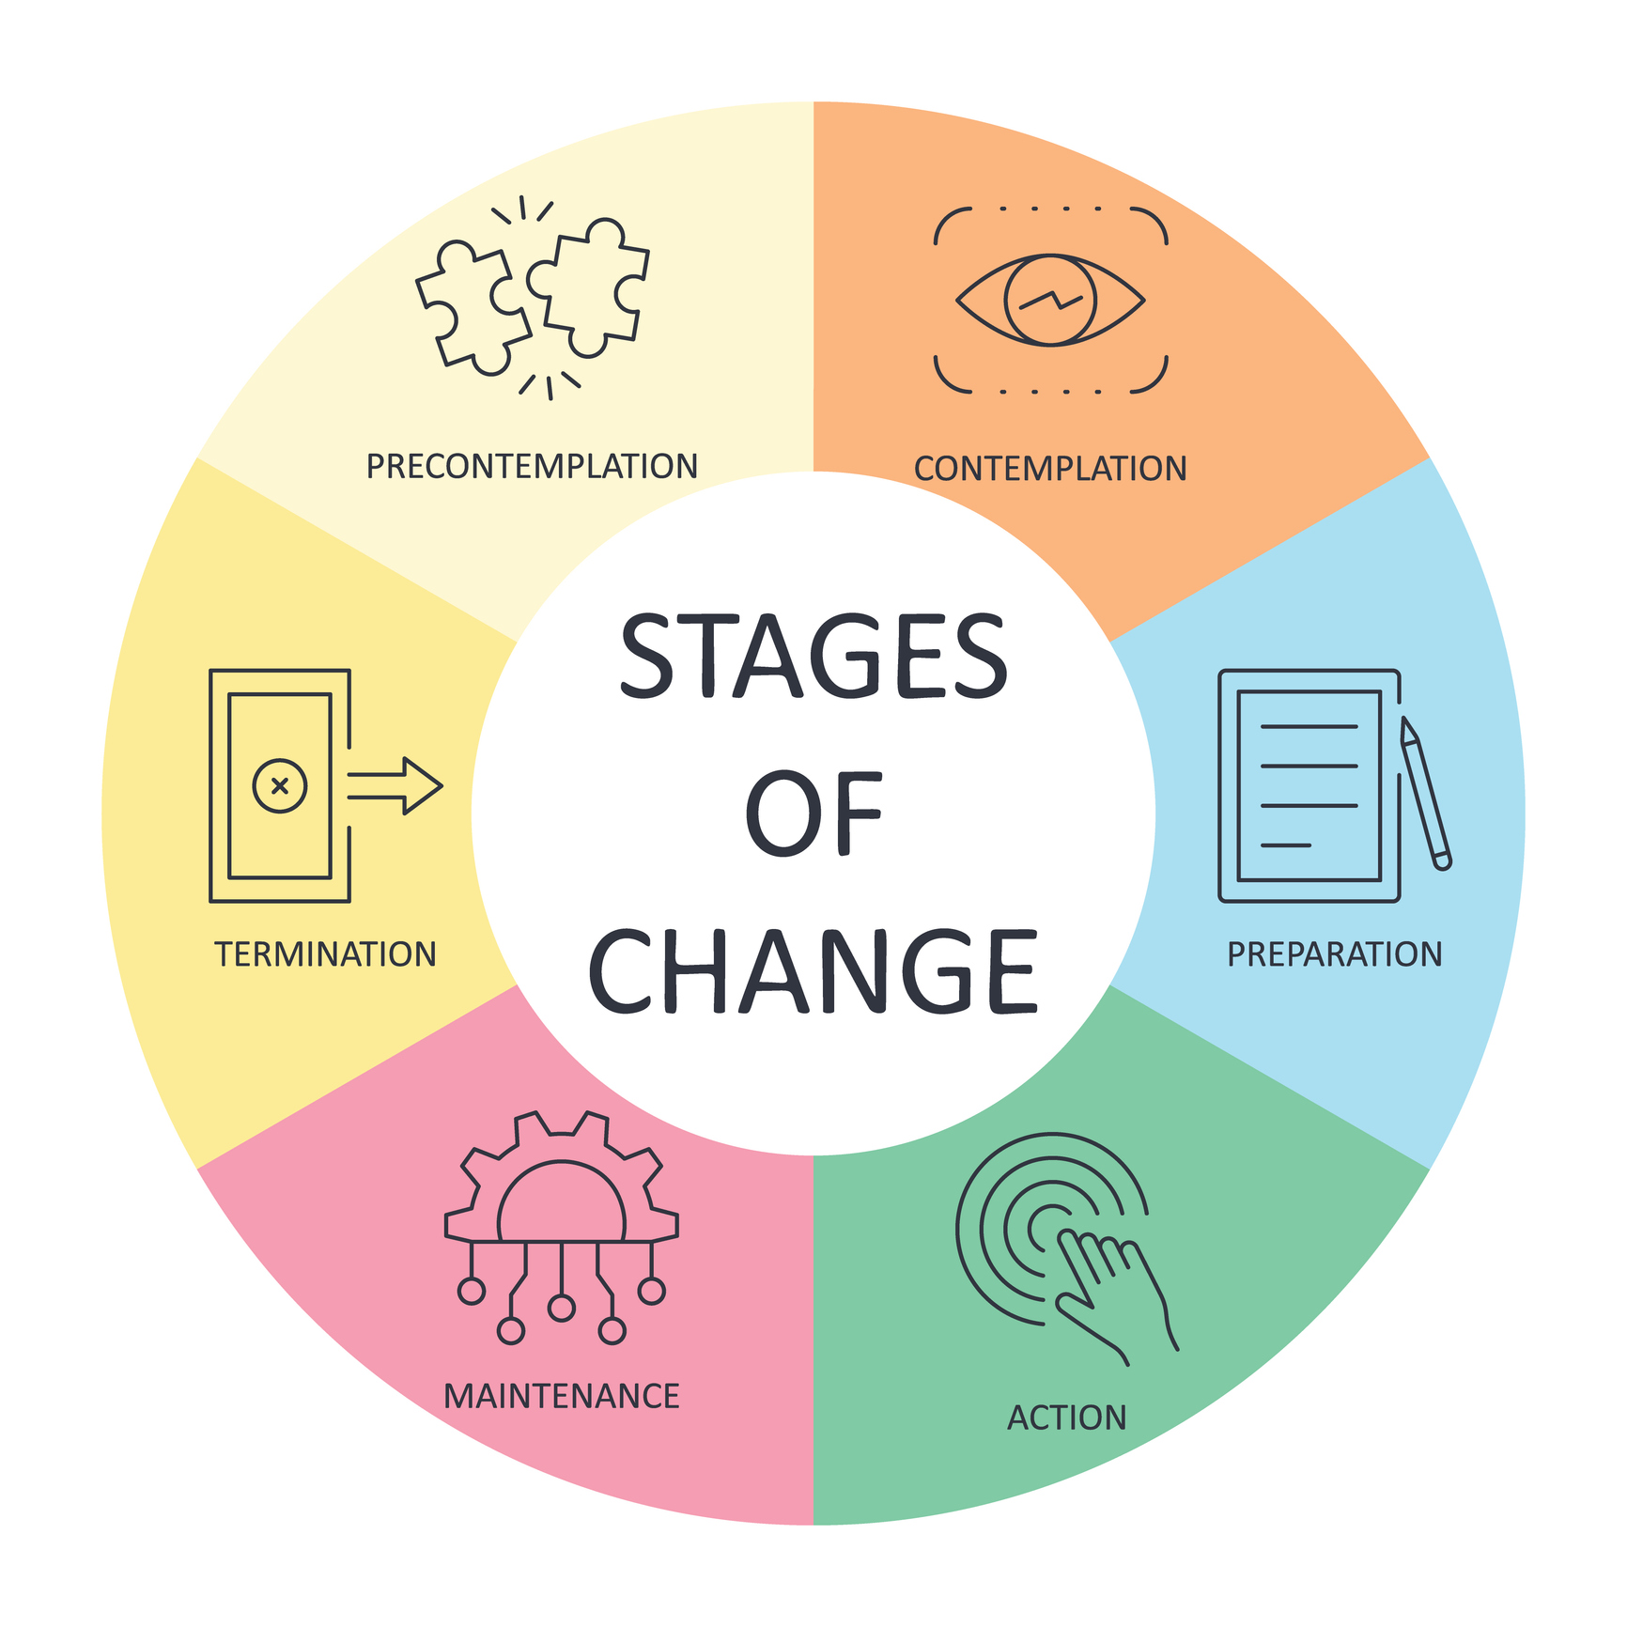
Stages of Change
Transtheoretical Model (TTM) is a framework for understanding how people change their behavior.

Slide 41
Precontemplation
At this stage, individuals are not yet considering change. They may be unaware of the need for change or resistant to it.
“There is no way I’m quitting smoking. I’ve smoked for 30 years, and I seem to be doing just fine.”

Slide 42
Contemplation
Individuals start to recognize the need for change and begin to think about it. They weigh the pros and cons but haven’t committed to taking action.
“I do feel short of breath a lot. Maybe I should cut down.”

Slide 43
Preparation
Individuals are planning to take action soon. They may start making small changes and develop a plan.
“I’m going to talk to my doctor about trying Chantix to help me quit smoking.”

Slide 44
Action
Individuals actively implement their plan and make significant changes to their behavior.
“I started the Chantix last week, and I haven’t smoked for 5 days!”

Slide 45
Maintenance
After achieving their initial goals, individuals work to sustain the changes and prevent relapse.
“I haven’t smoked in 3 months. My breathing is so much better. I’m glad I quit.”

Slide 46
Termination
The new behavior becomes a permanent part of the individual’s lifestyle.
“I’m doing so well. I can’t imagine ever smoking again.”

Slide 47
ASAM: Harm Reduction Principles
American Society of Addiction Medicine (ASAM) recommends, “harm reduction strategies across its clinical guidelines and criteria to minimize the negative health, social, and legal consequences associated with substance use.”
Six Core Principles of Harm Reduction
Humanism: Treating people who use substances with dignity, respect, and compassion, recognizing their inherent human value without moral judgment
Pragmatism: Accepting that drug use is a reality of our world and focusing on practical strategies to minimize harm rather than demanding total abstinence.
Individualism: Recognizing that every person's situation is unique, tailoring support to individual needs rather than applying a single rule for everyone.
Autonomy: Empowering individuals to be the primary agents in reducing their own risks and supporting them in making their own informed health choices.
Incrementalism: Acknowledging that positive behavior change happens in small, manageable steps rather than all at once.
Accountability without termination: Maintaining support and care for a person even if they experience a return to use or do not meet specific goals
https://www.asam.org/advocacy/public-policy-statements

Slide 48

Example Motivational Interviewing (MI) Approach
“What do you think about your marijuana use? Are there any pros/cons you’re seeing?”
MI is a person-centered approach to enhance intrinsic motivation to change and explore and resolve ambivalence
OARS of MI:
  Open ended questions
  Affirming
  Reflecting
  Summarizing
“So you’re saying you feel marijauna helps you sleep. When you don’t sleep well, you feel more anxious and irritable the next day. Do I have that right?”
“It must be hard when your mom grounds you from seeing your friends when you use marijuana.”
“So it’s important to you that we work on ways to help you get a better night’s sleep, is that right?”

Slide 49

Integrated Behavioral Health is a Powerful Tool for Helping Patients with Mental Health and Substance Use Disorders

Slide 50
References
https://aims.uw.edu/
https://crafft.org/
https://oasas.ny.gov/system/files/documents/2019/11/drugabusescreeningtest-10_4-24-18.pdf
https://ctnlibrary.org/instrument/nida-clinical-trials-network-audit-c-questionnaire/
https://www.asam.org/publications-resources/textbooks
https://pmc.ncbi.nlm.nih.gov/articles/PMC3767415/
https://www.psychologytoday.com/us/blog/understanding-addiction/202107/what-exactly-is-the-biopsychosocial-model-addiction
https://www.recoveryanswers.org/recovery-101/brain-in-recovery
https://pmc.ncbi.nlm.nih.gov/articles/PMC3767415/
www.dea.gov/sites/default/files/2022-12/DEA-OPCK_FactSheet_December_2022.pdfDEA Fact Sheet
https://www.dea.gov/sites/default/files/2022-12/DEA-OPCK_FactSheet_December_2022.pdf
https://www.samhsa.gov/mental-health/what-is-mental-health/conditions/co-occurring-disorders
https://mtrcinc.com/stages-of-change/
https://harmreduction.org/about-us/principles-of-harm-reduction/
https://www.asam.org/advocacy/public-policy-statements

Slide 51
Thank You!!

